Slide 2

Resume Ready
Essential Skills and AI Tools for Crafting Your Perfect Resume

Slide 3

“Super” Word Play
HELP! There is a fire at Vast, the restaurant on the 50th floor of the Devon Tower, in downtown Oklahoma City! Emergency crews cannot reach the people inside, the elevator isn’t working and the stairs are blocked by the debris.
Super(b)man has been notified and is on his way to help.
  What skills will he need to be successful in saving the 78 people that are trapped?
Use the Word Play handout to list the skills he needs.
Notes:
Engage
K20 Center. (n.d.). Word Play. Strategies. https://learn.k20center.ou.edu/strategy/4652
5 minute timer: https://www.youtube.com/watch?v=EVS_yYQoLJg

Slide 4
Essential Question
How can I create effective resumes to showcase my skills to future employers?
Notes:
Engage

Slide 5
Lesson Objectives
Understand parts of a resume including best practices.
Create a more focused resume with a target audience.
Experiment with how A.I. can help resume writing.
Notes:
Engage

Slide 6
Current Trends
A single corporate job listing gets an average of 250 applications (Glassdoor).
Over 80% of resumes don’t make it past the first screening round and only 1 in 10 get to a hiring manager (Workopolis).
Applicant Tracking Systems (ATS) usually eliminate 75% of resumes based on formatting, content, or lack of keywords (Gitnux).
Don’t lose hope! Research shows that 68% of candidates that use professional help (like workshops) get a job within 90 days of sending out their resume.
Andrei Kurtuy. (2024). LinkedIn. https://www.novoresume.com/career-blog/resume-statistics
Notes:
Explore

Slide 7

“Super” Word Play
Good news! Super(b)man recently saved 78 people from a fire! A local journalist, Clark Can, was assigned to cover the story.
  What skills will Clark need to successfully publish in the newspaper?
Discuss the skills needed with your Elbow Partner and then use the second section of the Word Play handout to list the skills needed to succeed.
Notes:
Explore
K20 Center. (n.d.). Elbow partners. Strategies. https://learn.k20center.ou.edu/strategy/116
K20 Center. (n.d.). Word Play. Strategies. https://learn.k20center.ou.edu/strategy/4652

Slide 8
Parts of a Resume
Education
Courses taken (including Concurrent Enrollment)
Clubs/Organizations
Awards/Scholarships
Don’t have to put your GPA
Full/Part-Time Student
Notes:
Explain

Slide 9
Parts of a Resume
Work History
Title (or Team Member)
Dates (Month/Year - Month/Year or Present)
Responsibilities (when hired)
Added Responsibilities (learned to help out)
Raises
Mentored/Trained Others

Slide 10
Parts of a Resume
Other Experiences
Volunteer Experience (who was helped, how often)
Leadership Experience (Fundraiser, how much raised/role played)
Skills/Certifications
Highlights
Other relevant information

Slide 11
Do’s and Don’ts
Don’t…
Use paragraphs (we’ll elaborate later).
Submit a resume longer that 2 pages long.
Use multiple fonts.
Use the same resume for everything.
(IMO) Include a headshot.
Add your address with contact information.
Include high school information (after 5 years).

Slide 12
Do’s and Don’ts
Do…
Use Bullet Points.
“Show Them” by using #’s (even averages help).
Include relevant experience.
Have a “Master” Resume (AKA a “CV”).
Take running notes.
Pull up the website/job listing to match keywords and verbiage.
Use a professional Email.

Slide 13
Best Practices
Which sounds better?
Waited tables
Maintained a section of 4 tables
Attention to detail
Providing quality service
Taking customer payment
Accurately counting change

Slide 14
Best Practices
Which sounds better?
Did project for Eagle Scout Badge.
Designed and created a 8’ wooden gazebo at local park.
Made sure it meets city code.
Completed as the first female Eagle Scout in town history.

Slide 15

What is Content Hierarchy?
Notes:
Clifford, C. (2024, December 16). What is content hierarchy? everything you need to know. Locallogy. https://www.locallogy.com/what-is-content-hierarchy

Slide 16
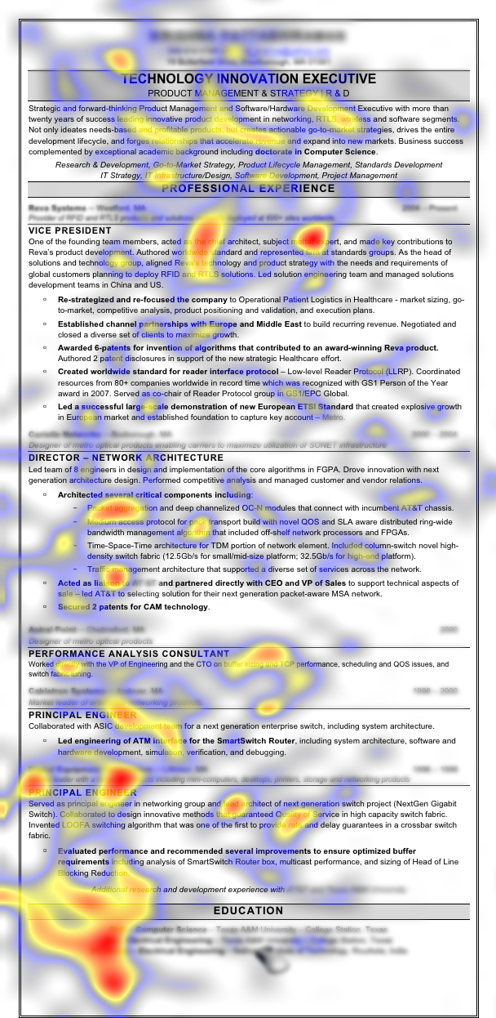
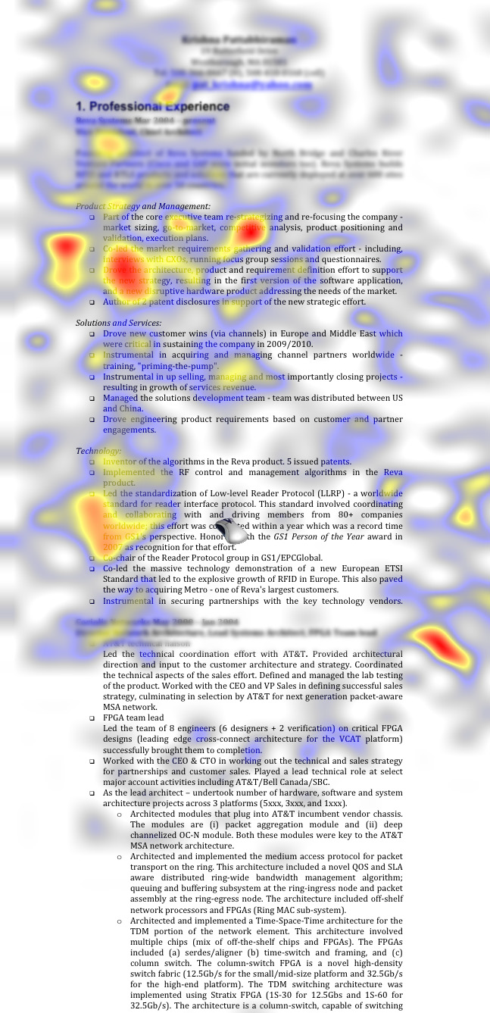
Resume Heatmap
Recruiters on average spend only 6 seconds initially scanning a resume to decide if a candidate is worth further consideration
Notes:
Your resume has 6 seconds to impress a recruiter. Snelling. (2016, June 15). https://www.snelling.com/job_seekers-employment-opportunities/job-seeker-resources/resumes/6-seconds-to-impress-a-recruiter/

Slide 17
Resume Heatmap
The study used “gaze tracking” technology to find that recruiters spent 80% of their time looking at 6 key points.
Name
Current title and company
Previous title and company
Education
Current employment start/end dates
Previous position and start/end dates

Slide 18
Word Play
Now that you have done the “Super” Word Play activity twice, it is time to do it once more, but about YOU!
Think about the parts of a resume: Education, Skills/Certifications, Experience, etc.
How could you use this structure to talk positively about yourself?
Complete the third section of your Word Play handout.
Notes:
Extend
K20 Center. (n.d.). Word Play. Strategies. https://learn.k20center.ou.edu/strategy/4652
10 minute timer: https://www.youtube.com/watch?v=9gy-1Z2Sa-c

Slide 19

Resumes and AI Chatbots
Using AI chatbots can be a powerful tool.
You can use chatbots to help transform resume items into more actionable responses, while still cutting the fluff.
Notes:
Evaluate

Slide 20
Resumes and AI Chatbots
Pitfalls to Avoid
Using personal identifying information
  E.g. addresses and contact information
Not self-reviewing responses
Original creative work
  Creative-based resumes should never upload original content
Health-related information

Slide 21
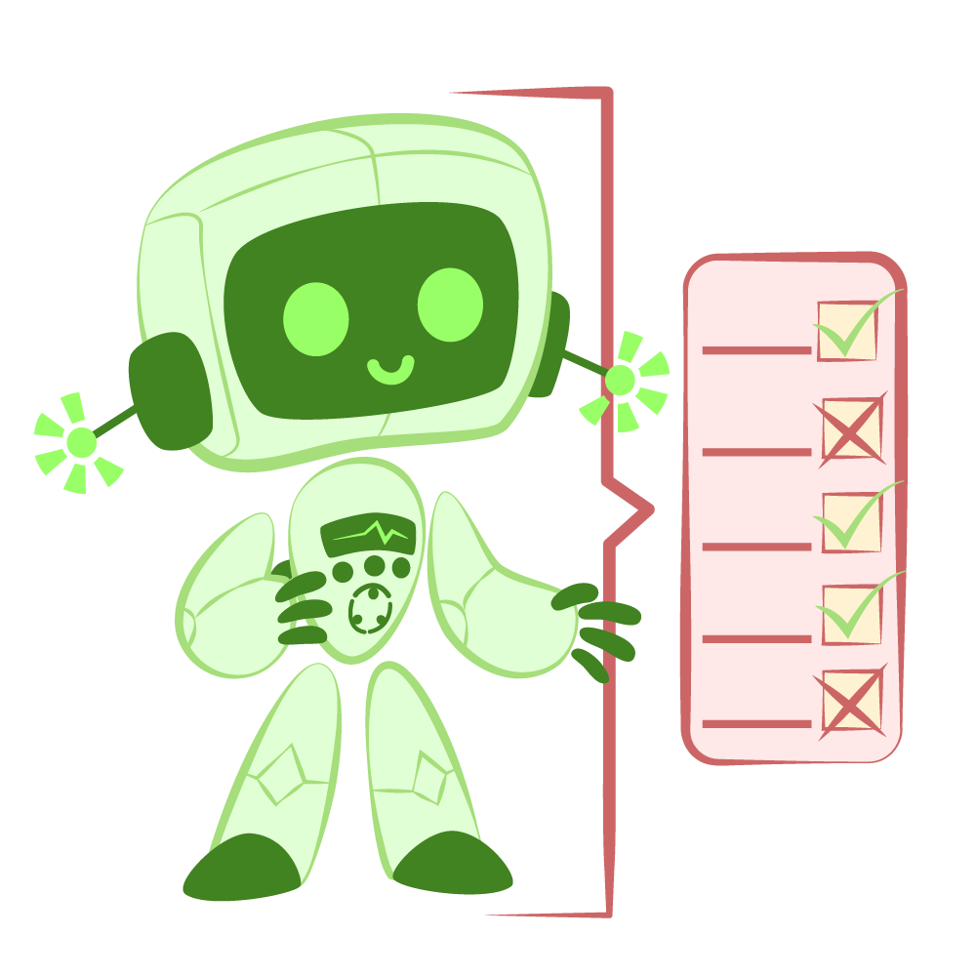
Critique the Bot
Use a chatbot of your choice to compare AI’s list of responsibilities, experiences, and skills required versus your list.
Critique the bot to see how AI examines job descriptions compared to how you do.
Notes:
K20 Center. (n.d.). Critique the Bot. Strategies. https://learn.k20center.ou.edu/strategy/3491

Slide 22
Critique the Bot | Sample Prompts
Skills - “Can you give me a bulleted list of [action verb] a typical [noun] would have at [proper noun/place]?”
  Ex: “Can you give me a bulleted list of of responsibilities for a server at Ted's Cafe Escondido in Norman, OK?”
Experience - “Could you help me come up with a bullet list of responsibilities of [insert role] as if it was self-employment?”
  Ex: “Could you help me come up with a bullet list of responsibilities of babysitting as if it was self-employment?”
Notes:
K20 Center. (n.d.). Critique the Bot. Strategies. https://learn.k20center.ou.edu/strategy/3491

Slide 23

Any Questions?

