Slide 2
Nursing
First Aid Skills and Medical Devices

Slide 3
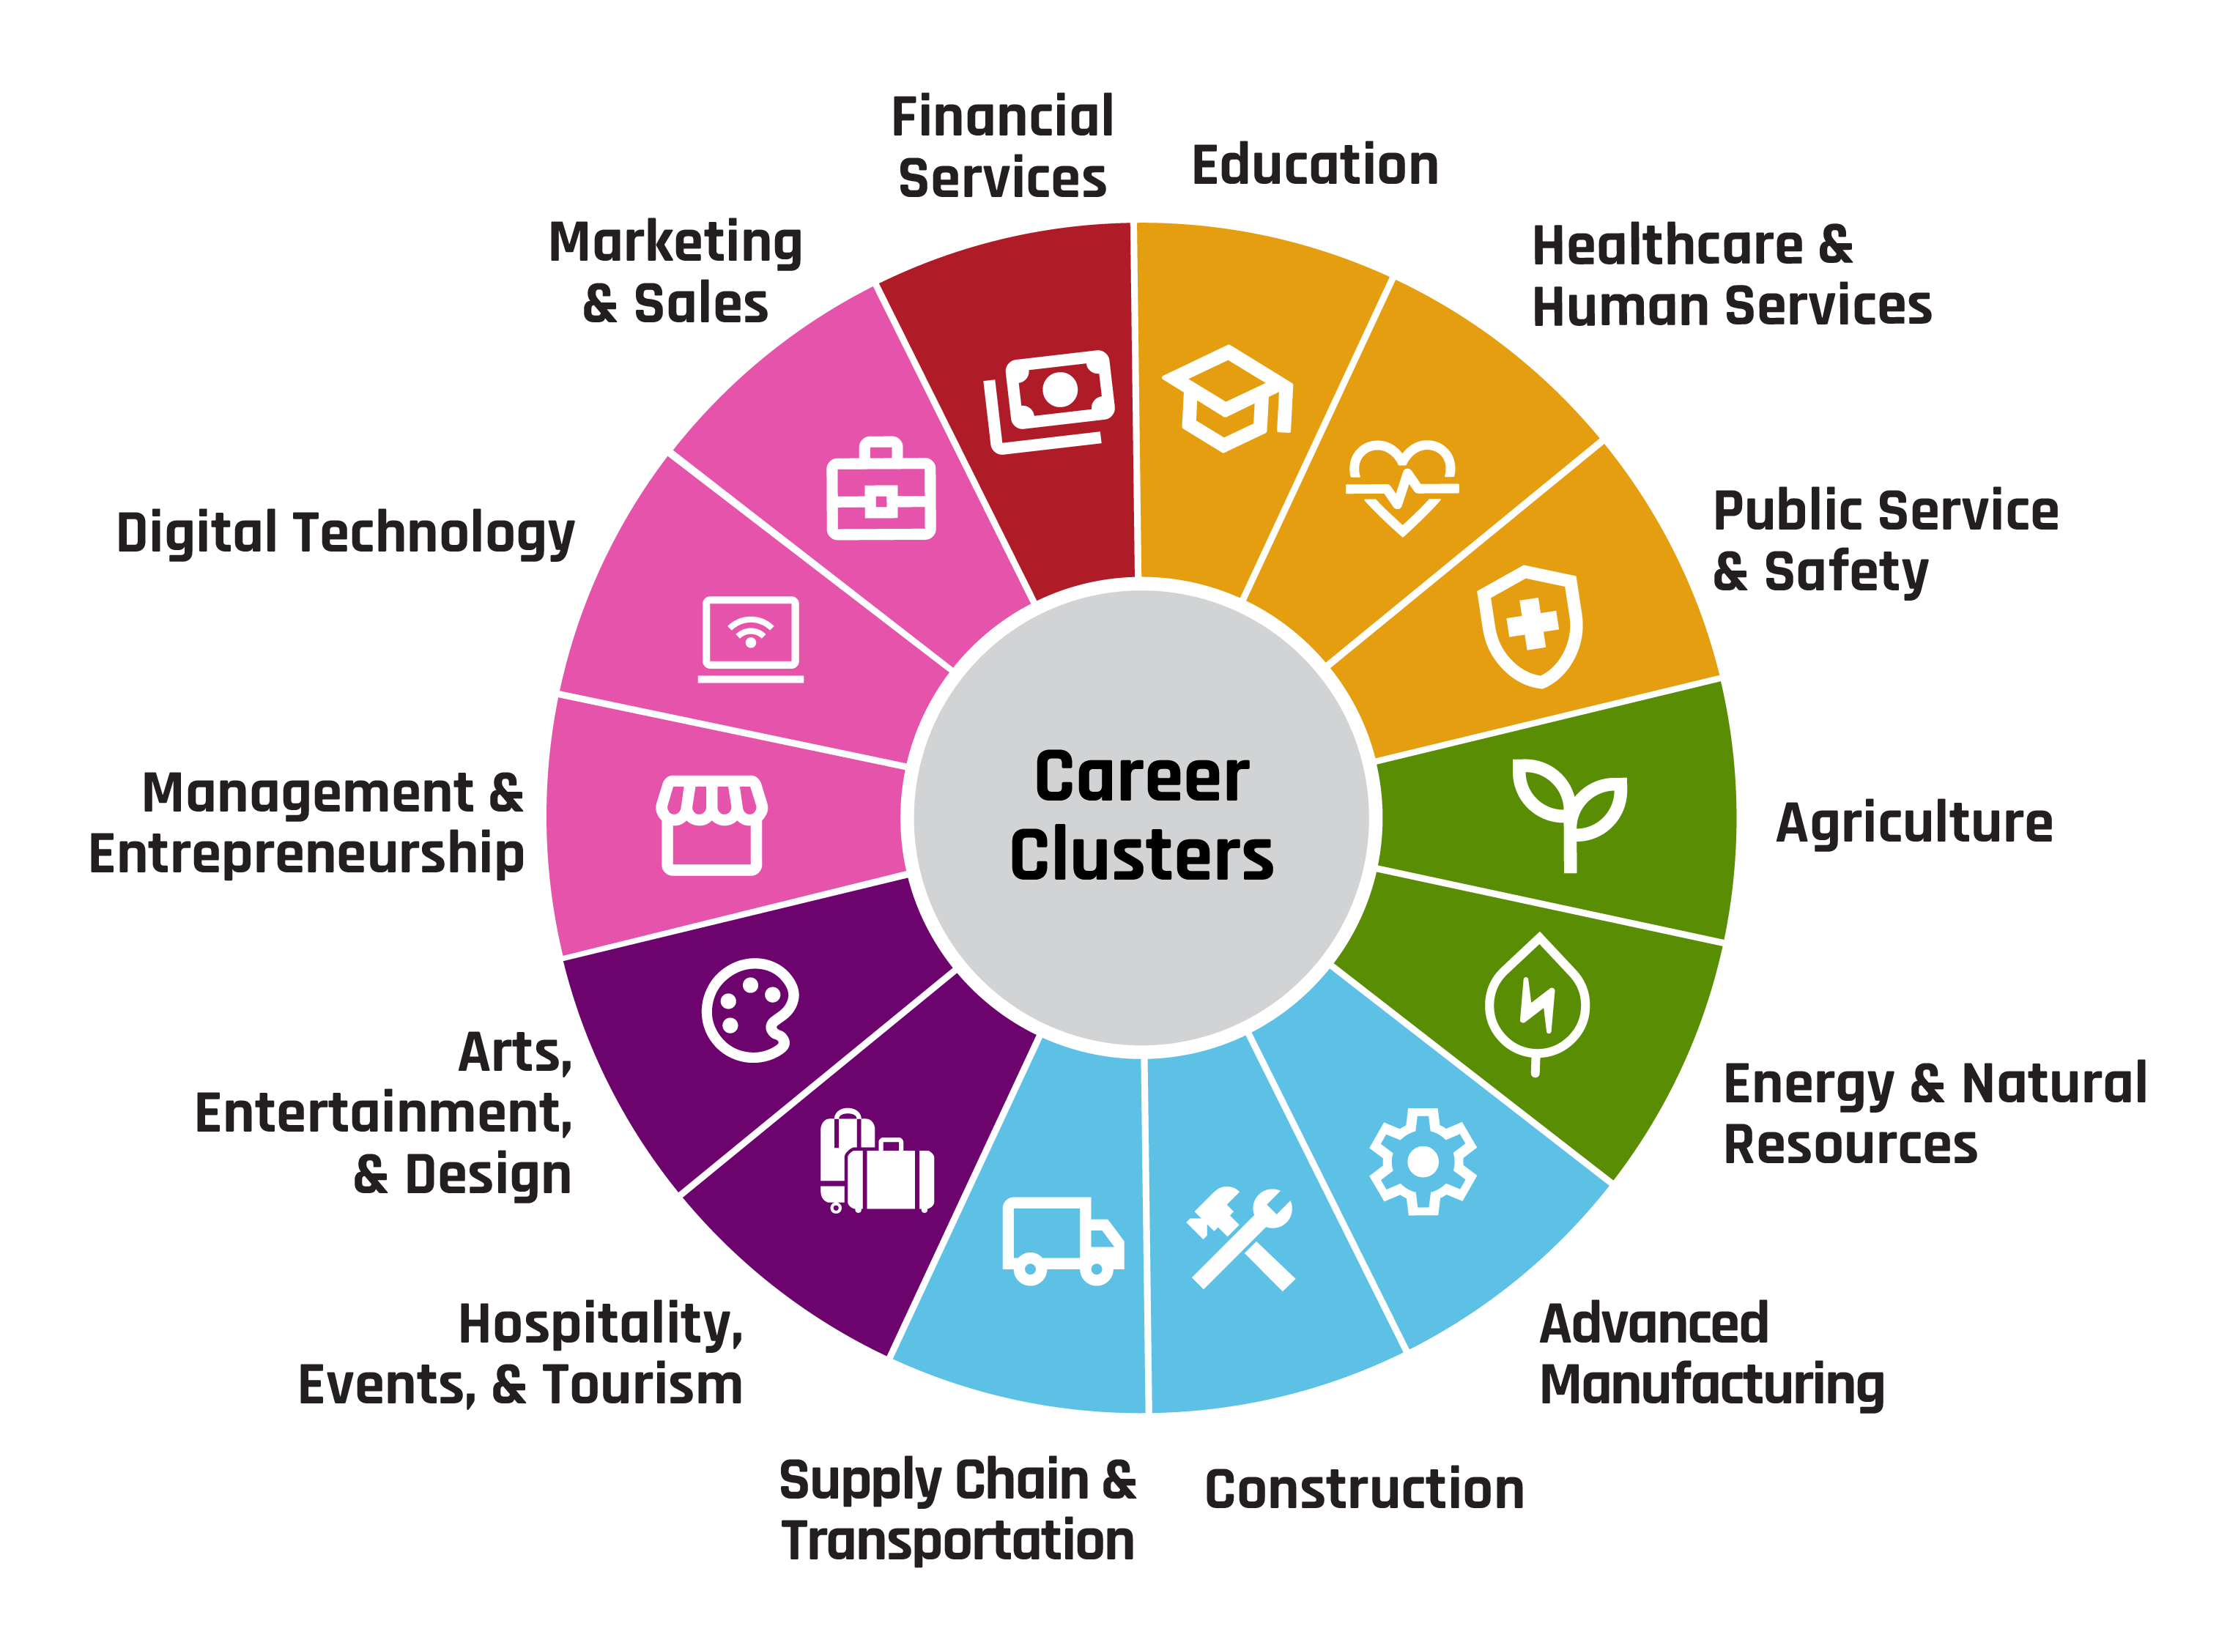
Career Clusters

Slide 4
Overview
Do you enjoy working with your hands, thinking creatively, and solving problems? Then a career in health science might be just right for you!
Professionals in the health science cluster work in hospitals, clinics, and other medical settings where they use their skills to care for patients and improve lives.
One of the many rewarding careers that falls into this cluster is nursing.

Slide 5
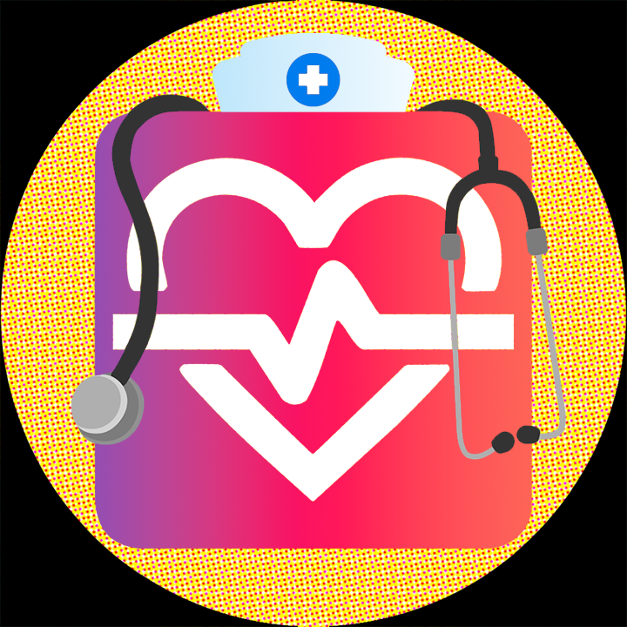
Nursing
Nurses assess and monitor patients, administer medications, collaborate with doctors, and provide emotional support to both patients and their families.
Despite the physical and emotional challenges, many nurses find deep fulfillment in making a tangible difference in people’s lives, offering comfort, healing, and compassionate care every day.

Slide 6
Nursing: Education
There are various levels of education you can pursue to work in this field.
For example, you will need a short training program and to pass a competency exam to become a Certified Nursing Assistant (CNA).
A Registered Nurse (RN) requires at least an Associate’s or Bachelor’s degree in Nursing as well as passing the NCLEX-RN.

Slide 7
Five Corners
Each corner of the room has a topic related to a skill required for nursing:
  Clinical and Technical Skills (job related skills needed to take care of patients)
  Communication and Interpersonal(interaction with others) Skills
  Critical Thinking and Problem Solving
  Emotional and Physical Stamina
  Leadership and Organization Skills
Go to your assigned corner and with your group and come up with 3 reasons why a nurse would need that skill.
Choose a spokesperson and be prepared to share out.

Slide 8
Skills Needed to be a Nurse
Clinical and Technical Skills. Nurses need to understand human anatomy, how to administer medication, how to perform CPR and First Aid, as well as operate medical devices, electronic health records, and diagnostic tools.
Communication and Interpersonal Skills. Nurses need to be able to clearly communicate with patients, work well in teams with other health professionals, and understand and respect diverse backgrounds and beliefs from patients.
Critical Thinking and Problem Solving. Nurses need to be able to act fast in emergencies and high-pressure situations. Nurses also need to pay close attention to detail and adapt quickly to new events.

Slide 9
Skills Needed to be a Nurse
Emotional and Physical Stamina. Nurses need to be able to handle long hours, emotional situations, and high workloads. Nurses also need to be able to stand for long periods of time and lift and move patients.
Leadership and Organization Skills. Nurses need to be able to delegate or assign tasks to assistants and support staff, as well as prioritize tasks and manage multiple patients effectively.

Slide 10
What Can I Do to Prepare?
Focus on key subjects, such as science, mathematics, and English; especially chemistry and biology.
Look for opportunities to volunteer at clinics, hospitals, or nursing homes.
Learn first aid, cardiopulmonary resuscitation (CPR), and how to use various medical devices.

Slide 11
Cardiopulmonary Resuscitation Activity
(CPR)

Slide 12
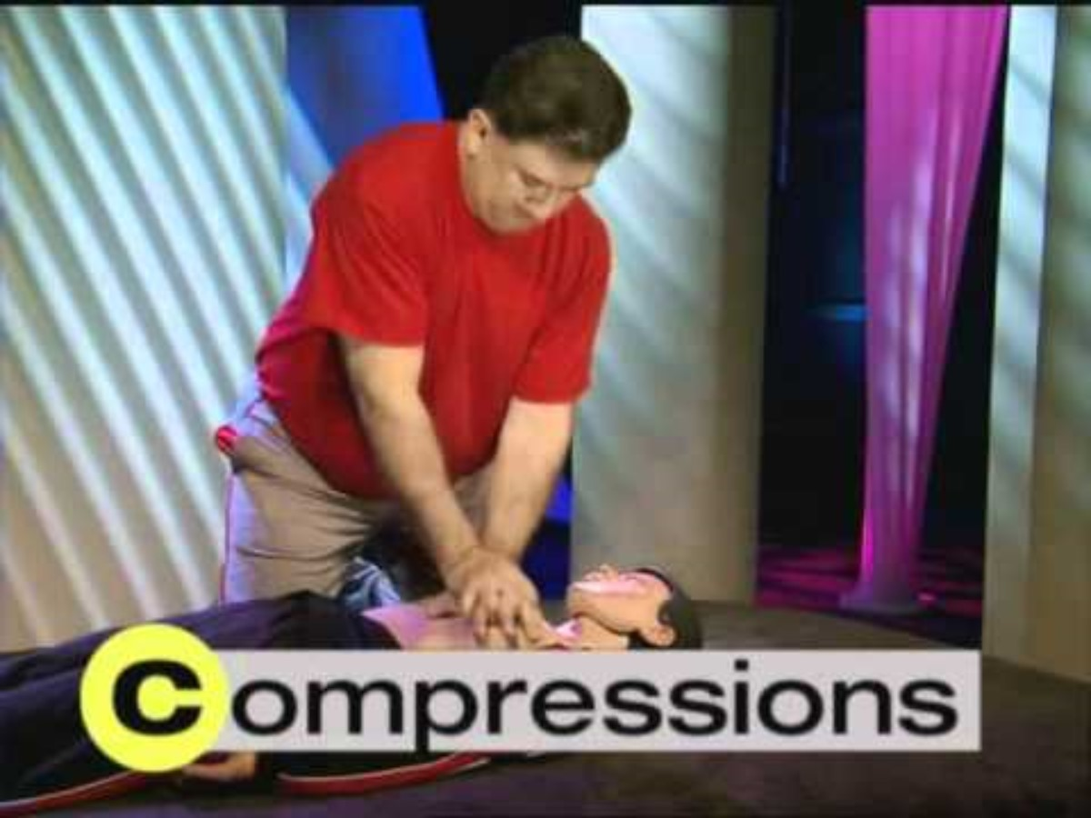
CPR for Adults
Notes:
American Heart Association. (2010, October 17). 2010 Guidelines for CPR [Video]. YouTube. https://www.youtube.com/watch?v=O9T25SMyz3A

Slide 13
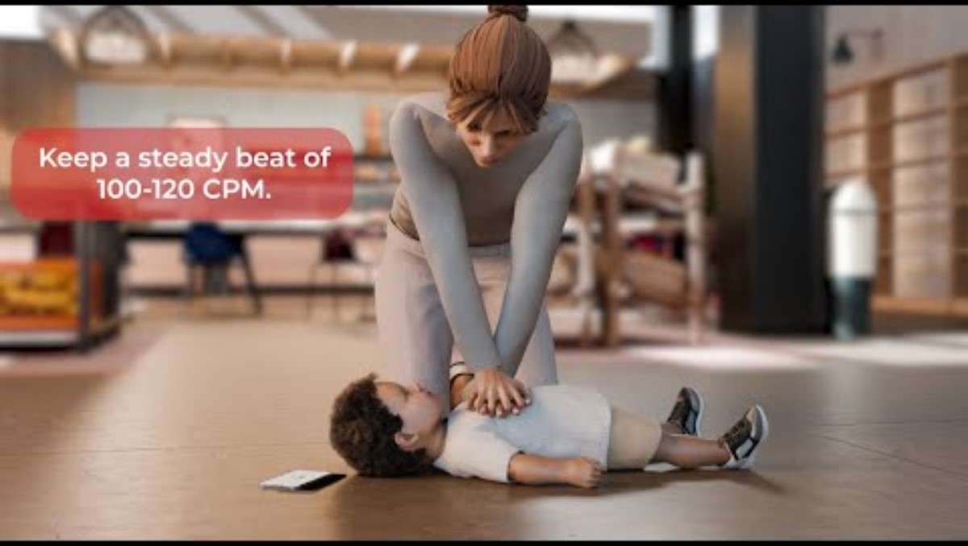
CPR for Children
Notes:
American Heart Association. (2025, January 28). How to give CPR to a child [Video]. YouTube. https://www.youtube.com/watch?v=lXK7IjyhbL0

Slide 14
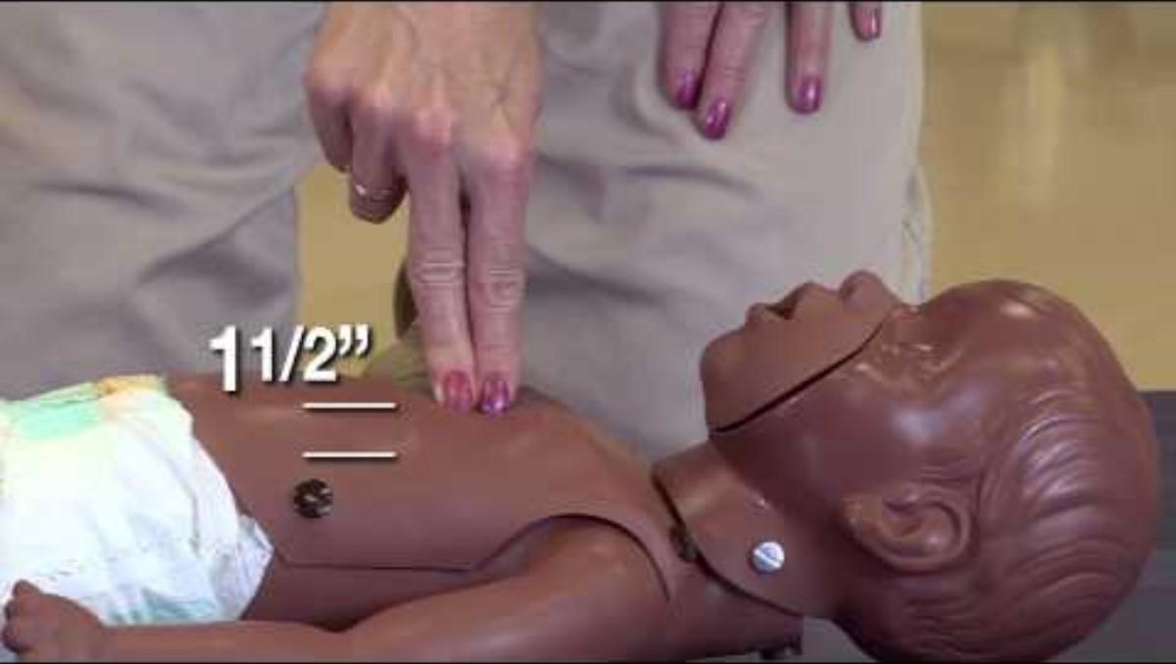
CPR for Infants
Notes:
Cincinnati Children’s. (2013, July 30). CPR for infants (Newborn to 1 year) [Video]. YouTube. https://www.youtube.com/watch?v=n65HW1iJUuY

Slide 15
C.A.B. Method
Compressions: Start with 30 chest compressions, pushing hard and fast in the center of the chest at a rate of 100-120 per minute.
Airway: Tilt the head back slightly to open the airway.
Breathing: Give 2 rescue breaths, ensuring the chest rises.

Slide 16
CPR Scenarios
Based on the provided scenario, follow the appropriate CPR protocol:
Determine is this a CPR procedure for an adult or a child?
Call out each step before you complete it.
Challenge yourself to do it by memory, but feel free to use the step-by-step cards to assist you.

Slide 17
Physical Check-Up Activity
Using various medical devices

Slide 18
Vital Signs
Temperature: Your body temperature.
Pulse: The number of times your heart beats in one minute.
Blood pressure: The force of blood against the walls of the arteries.
Blood oxygen: The amount of oxygen in your blood.

Slide 19
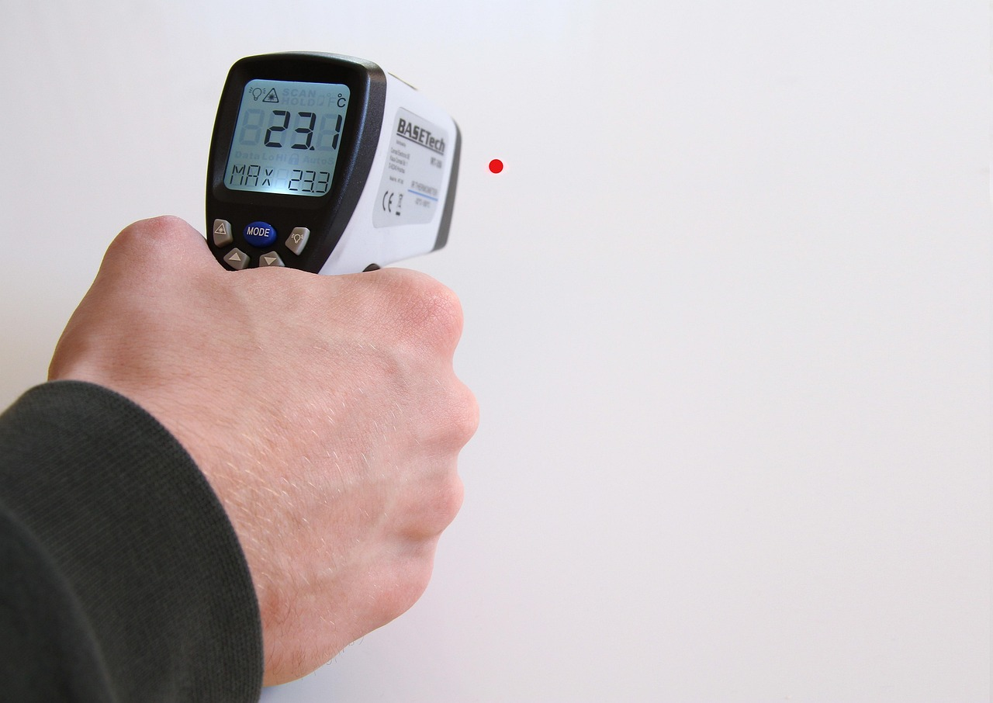
Temperature
Temperature is collected using a thermometer.
Your temperature is obtained since a high temperature can mean your body is fighting an infection. Autoimmune diseases can also cause fever without infection.

Slide 20
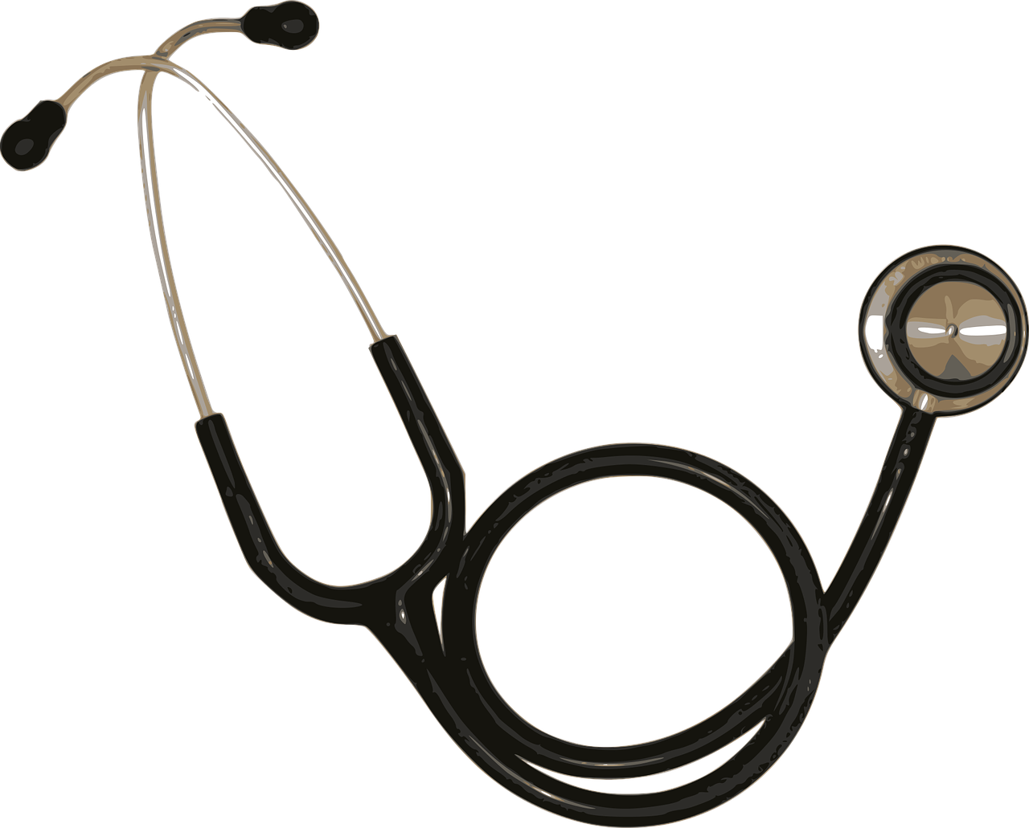
Pulse
Your pulse is collected using a stethoscope or digital monitor.
To use the stethoscope, hold the flat metal part to your heart and count the beats in 15 seconds and multiply by 4, you can also count for a full 60 seconds.

Slide 21
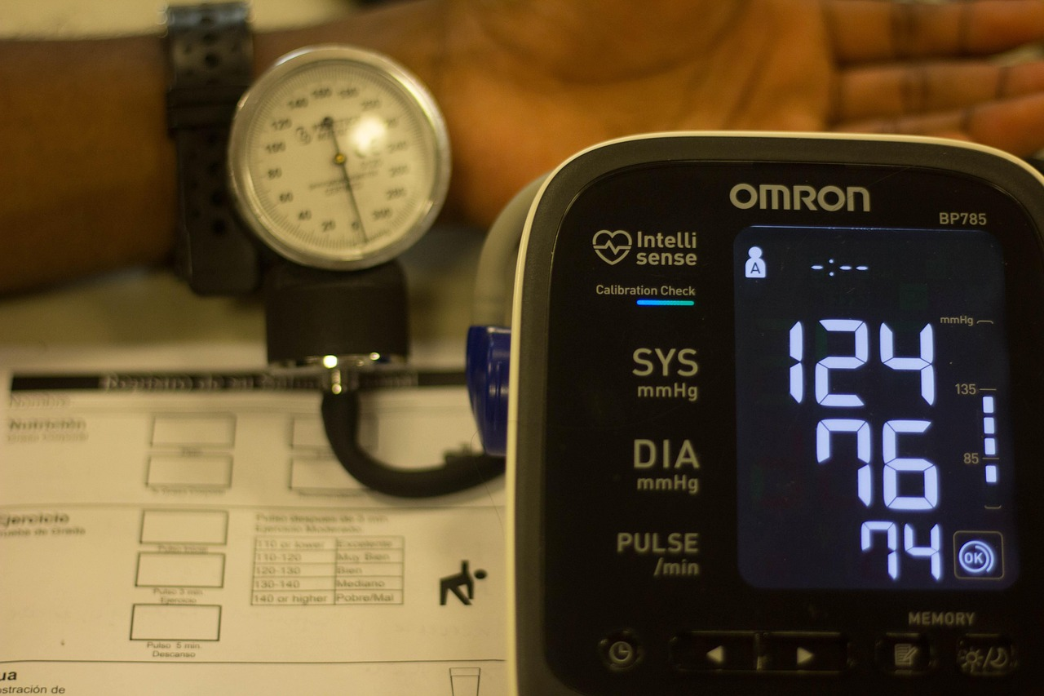
Blood Pressure
Your blood pressure is collected with a sphygmomanometer or blood pressure cuff and monitor.
This device tightens around your arm until it can perceive the pressure inside your blood vessels.

Slide 22
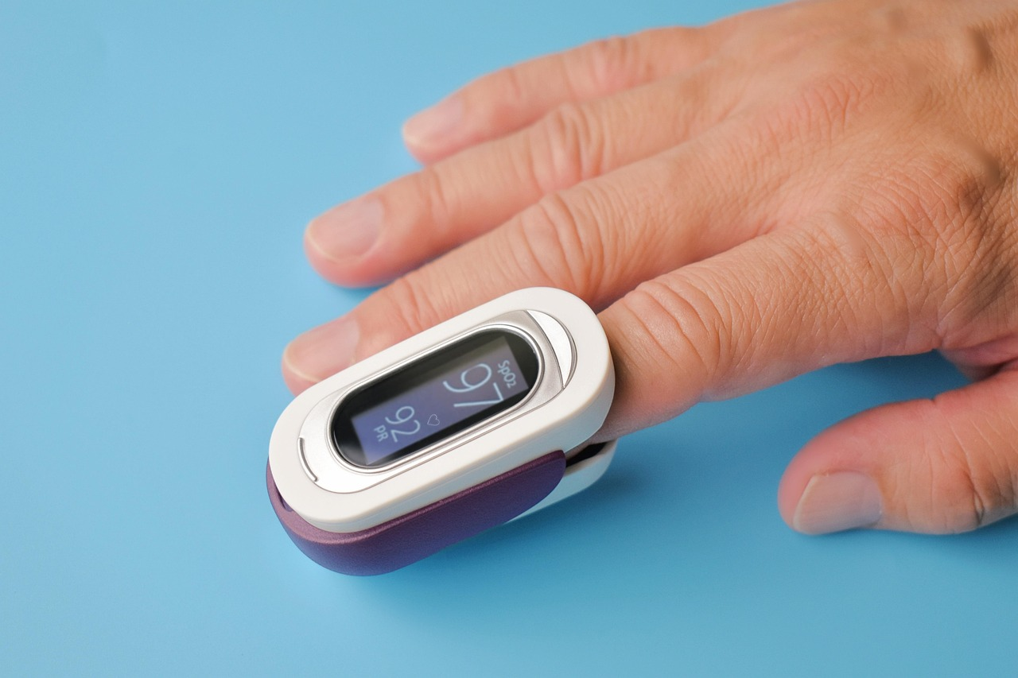
Blood Oxygen
Your blood oxygen is a measure of the amount of oxygen circulating in your blood. It indicates how well oxygen is being delivered to your body’s organs and tissues.
A device known as a pulse oximeter collects this data.

Slide 23
What’s in a Vital Sign?
Comparing vital signs at rest and after exertion.

Slide 24
Steps
Listen to the sound of your lungs and number of breaths you take with the stethoscope for 30 seconds.
Take your blood pressure to determine how fast your blood is moving.
Use the pulse oximeter to check your oxygen levels.
Take your temperature.
Vital Sign | Ranges
Temperature | 97.8 F to 99.1 F (36.5 C to 37.3 C)
Blood Pressure | 90/60 mm HG to 120/80 mm HG
Pulse | 60 to 100 beats per minute
Respiratory Rate | 12 to 18 breaths a minute

Slide 25
Stations Instruction
Station 1: Stay at rest for one minute. Take vital readings.
Station 2: Walk for one minute. Take vital readings.
Station 3: Jog/Run in place for one minute. Take vital readings.
Station 4: Answer reflection questions with your partner.

Slide 26

Zoom Into Your Career - Nusing

Slide 27

Careers in the Nursing Field
With your group, sort your cards into categories.
Use the QR codes for each career to gather information as you sort.
Each career should have:
  Career Title
  Required Education Level
  Years of education needed
  Salary range
Notes:
K20 Center. (n.d.). Card Sort. Strategies. https://learn.k20center.ou.edu/strategy/147

Slide 28
Career Card Sort Solutions
Career | Degree/Certification | Time Required | Salary
Nurse Anesthetist | Doctorate Degree | 8+ years | $139,980 - $239,200+
Nurse Practitioner | Master’s Degree | 6 years | $94,530 - $168,030
Registered Nurse | Bachelor’s Degree | 4 years | $63,720 - $132,680
Licensed Practical Nurse | Technical/Vocational School | 1-2 years | $45,670 - $77,870
Certified Nurses Assistant | Technical/Vocational School | 1 year | $30,020 - $48,780

