Slide 2
Interests to Opportunities
Find the Path That’s Right for You

Slide 3
Essential Question
How can my interests influence my postsecondary path?

Slide 4
Learning Objective
Connect my interests to postsecondary education opportunities.

Slide 5
What Are Your Interests?
Go to bit.ly/MyInterestBoard to create your Interest Board.
Click the “Use template for new design” button.
Log in to Canva.
Notes:
K20 Center. (n.d.). Canva. Tech Tools. https://learn.k20center.ou.edu/tech-tool/612

Slide 6
What Are Your Interests?
Think about your interests in and outside of school, your personality traits, what you like, etc.
On your Interest Board, include at least:
1 character or personality trait
Your favorite school subject(s)
1 interest outside of school
Use a picture or text to represent each item.
Notes:
K20 Center. (n.d.). Canva. Tech Tools. https://learn.k20center.ou.edu/tech-tool/612

Slide 7
Person A
Person B
Person C
I enjoy reading mystery novels, watching crime documentaries, and observing human behavior. My friends often describe me as curious, analytical, and detail-oriented. What I'm studying involves using scientific techniques to investigate crimes and analyze evidence, which perfectly aligns with my passion for solving complex cases.
I love watching films, storytelling, and experimenting with different camera techniques. My friends often describe me as creative, detail-oriented, and enthusiastic. What I'm studying focuses on creating and producing films using advanced digital technology, which allows me to bring my artistic visions to life.
I love figuring out how things work and putting them together—especially when I get to use tools or my hands. My friends often describe me as creative, hardworking, and detail-oriented. What I'm studying focuses on designing, planning, and building things. I get to see how math is used in real ways, which allows me to turn my ideas into reality.
Notes:
K20 Center. (n.d.). Magnetic statements. Strategies. https://learn.k20center.ou.edu/strategy/166

Slide 8
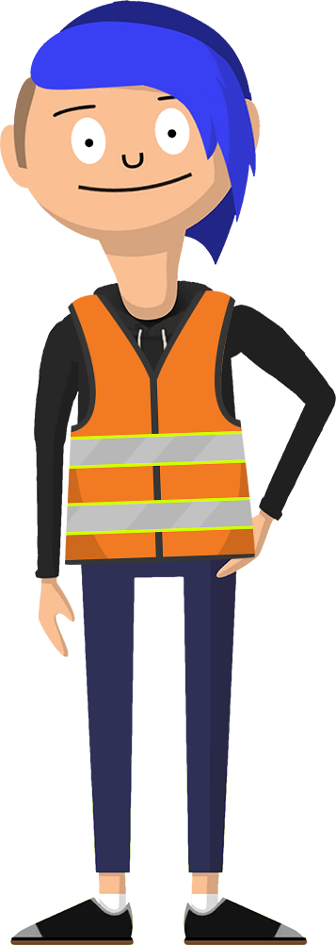
Person A
Person B
Person C
Hi! I’m Amie, and I study Forensic Science at the local university.
Hi! I’m Brittany, and I study Digital Cinema Production at the local community college.
Hey there! I’m Camryn, and I study Construction Technology at the local career tech.
Notes:
K20 Center. (n.d.). Magnetic statements. Strategies. https://learn.k20center.ou.edu/strategy/166

Slide 9
Person A
Person B
Person C
I love experimenting with flavors and creating delicious dishes. My friends describe me as creative, detail-oriented, and always eager to learn new things. What I’m studying focuses on perfecting various techniques in the kitchen. When I'm not cooking, I love exploring new restaurants and trying out different cuisines.
I'm fascinated by the workings of governments. My friends often say I'm analytical, articulate, and passionate about social justice. What I’m studying focuses on the details of political systems and the impact of legislation on society. When I'm not buried in books, I enjoy debating current events and volunteering for community projects.
I’ve always been curious about how the human body works and how we can use technology to help people feel better. My friends often say I'm caring and a problem-solver. What I’m studying focuses on technology used to provide critical insights into patient health. When I'm not studying, I enjoy yoga and capturing details through photography.
Notes:
K20 Center. (n.d.). Magnetic statements. Strategies. https://learn.k20center.ou.edu/strategy/166

Slide 10
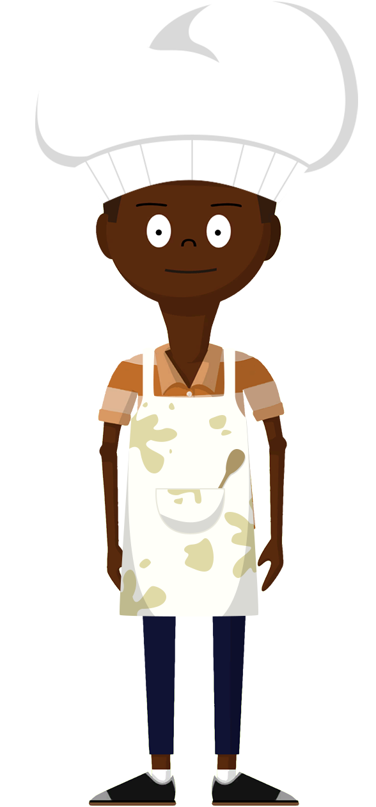
Person A
Person B
Person C
Hi! I’m Asher, and I study
Culinary Arts at the local community college.
Hi! I’m Brock, and I study Political Science at the local university.
Hey there! I’m Carter, and I study Diagnostic Medical Sonography at the local career tech.
Notes:
K20 Center. (n.d.). Magnetic statements. Strategies. https://learn.k20center.ou.edu/strategy/166

Slide 11
Person A
Person B
Person C
I’m interested in medical operations running smoothly and efficiently. My friends describe me as detail-oriented, reliable, and always calm under pressure. What I’m studying focuses on how to prepare surgical instruments and support the surgical team during procedures. When I'm not studying, I enjoy reading medical thrillers.
I'm interested in the legal system and working toward a fair and just society. My friends often say I'm analytical, empathetic, and dedicated to making a difference. What I’m studying focuses on law, court procedures, and rehabilitation programs. When I'm not studying, I enjoy volunteering at local community centers.
I'm interested in farming and the business side of producing food and other agricultural products. My friends describe me as hardworking, with a brain for numbers and a heart for helping people. What I’m studying focuses on how prices change and sustainable farm practices. When I'm not studying, I enjoy spending time in wide-open spaces.
Notes:
K20 Center. (n.d.). Magnetic statements. Strategies. https://learn.k20center.ou.edu/strategy/166

Slide 12
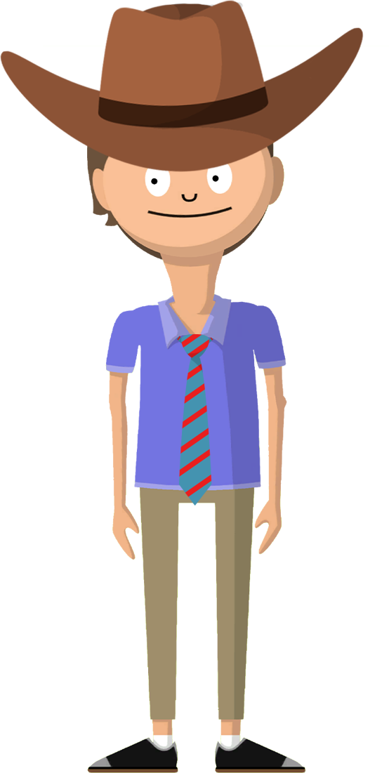
Person A
Person B
Person C
Hi! I’m Alex, and I study Surgical Technology at the local career tech.
Hi! I’m Brooke, and I study Criminal Justice at the local community college.
Hey there! I’m Chris, and I study Agriculture Business at the local university.
Notes:
K20 Center. (n.d.). Magnetic statements. Strategies. https://learn.k20center.ou.edu/strategy/166

Slide 13
What Do You Want to Study?
Once you decide what you love doing—and what you want to be the focus of your studies—you can pick a major at a university or community college, or you can pick a program at a career tech to turn your interest into a future career.
You could major in computer science, apparel design, mass communication, etc.
You could complete a program such as aviation maintenance, graphic design, surgical technology, etc.

Slide 14
Reflection
What?
What major or program of study do you think is most closely related to your interests?
So What?
Why do you think it is important to study something that is related to your interests?
Now What?
What question could you ask on a future campus visit?
Notes:
K20 Center. (n.d.). What? So what? Now what? Strategies. https://learn.k20center.ou.edu/strategy/95

