Slide 2
A Picture is Worth a Thousand Words
Photojournalism

Slide 3
Essential Question
How do photojournalists capture stories?

Slide 4
Learning Goals
Discover how photographs tell a story.
Describe the components of cameras.
Create stories with photographs.

Slide 6
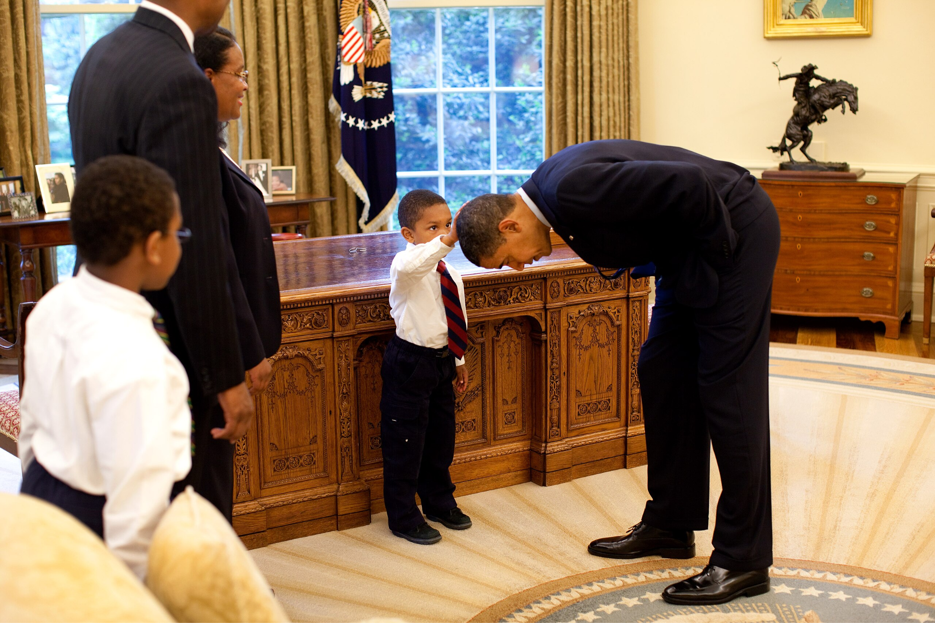
What do you notice about the photo?
What do you wonder about the photo?

Slide 7
Photojournalism
Photojournalism is the use of pictures to tell a story.
Photos are a moment captured in time.
It is the job of photojournalists to capture those moments.

Slide 8
Storytelling Photos
With a partner, examine each photo.
Record the following on your Photo Analysis handout:
Your observations about each photo
The story you think the photographer is trying to tell in each photo

Slide 9
Photojournalism
What stories are being told in the photos?

Slide 10
Photojournalism Essentials
Composition: How subjects and objects are arranged within a frame to create a balanced, engaging image
Exposure: Amount of light hitting the camera sensor
Aperture: Controls the amount of light going through the lens
Shutter speed: Controls the length of time the camera’s shutter remains open to expose the sensor to light
ISO: Measures the sensitivity of the camera sensor to light

Slide 11
How Digital Cameras Work
Notes:
Nat Geo Kids. (2018, November 19). How digital cameras work | How things work with Kamri Noel [Video]. YouTube. https://www.youtube.com/watch?v=Ey6S3rKH_o4

Slide 12
CameraSim
Navigate to k20.ou.edu/camsim
Use the CameraSim Task Cards to explore the simulated camera and experiment with camera settings.

Slide 13
Photo Project
Think about places, events, or activities in your community at which you could take photos.
Visit one of these places or attend one of these events and take three photos, each of which should tell a story.
Prepare to present your photos at a future session.

Slide 14
Photo Presentations
Examine each photo presented.
Offer feedback on each photo using the Photo Feedback handout.

