Slide 1



Slide 2



Pathfinder Quest
I’m New

Slide 3
Essential Question:
How can understanding my interests and strengths help me choose a career path that fits me?

Slide 4
Learning Objectives:
Students will review feelings about transitioning to post-secondary life.
Students will identify personal interests and strengths and connect them to potential career paths.
Students will explore and critique postsecondary degree options that align with their career interests.

Slide 5

Results are In!
Let’s talk about the Student Survey responses.
Who else had similar concerns?
What else do you need help with?

Slide 6

Magnetic Statements
Circle the room and review the magnetic statements.
After reading each statement, stand by the statement that best represents you.
Notes:
Holland, J.L. (1997). Making vocational choices: A theory of vocational personalities and work environments (3rd Ed.). Odessa, FL: Psychological Assessment Resources
K20 Center. (n.d.) Magnetic statements. Strategies. https://learn.k20center.ou.edu/strategy/166

Slide 7
Magnetic Statements
Talk with your group about your chosen statement:
What aspects of the statement do you connect with the most?
Which traits or skills associated with that statement do you find appealing?
How would those traits show up in real-world careers or activities you enjoy?
Notes:
Holland, J.L. (1997). Making vocational choices: A theory of vocational personalities and work environments (3rd Ed.). Odessa, FL: Psychological Assessment Resources
K20 Center. (n.d.) Magnetic statements. Strategies. https://learn.k20center.ou.edu/strategy/166

Slide 8

Career Brainstorm
Now that you have spent time with your statement, use the markers at your poster to brainstorm careers you think could match the statement.
K20 2-minute timer
Notes:
Students should:
Read the existing career ideas already listed.
Add new career suggestions that haven’t been mentioned yet.
Consider how the traits in that statement might connect to different industries or roles.
K20 Center. (2021, September 21). 2 Minute Timer. YouTube. https://www.youtube.com/watch?v=HcEEAnwOt2c

Slide 9
Career Brainstorm
After two minutes, rotate clockwise to the next poster.
Read the existing career ideas already listed.
Add new career suggestions that haven’t been mentioned yet.
Consider how the traits in that statement might connect to different industries or roles.
K20 2-minute timer
Notes:
Students should:
Read the existing career ideas already listed.
Add new career suggestions that haven’t been mentioned yet.
Consider how the traits in that statement might connect to different industries or roles.
K20 Center. (2021, September 21). 2 Minute Timer. YouTube. https://www.youtube.com/watch?v=HcEEAnwOt2c

Slide 10
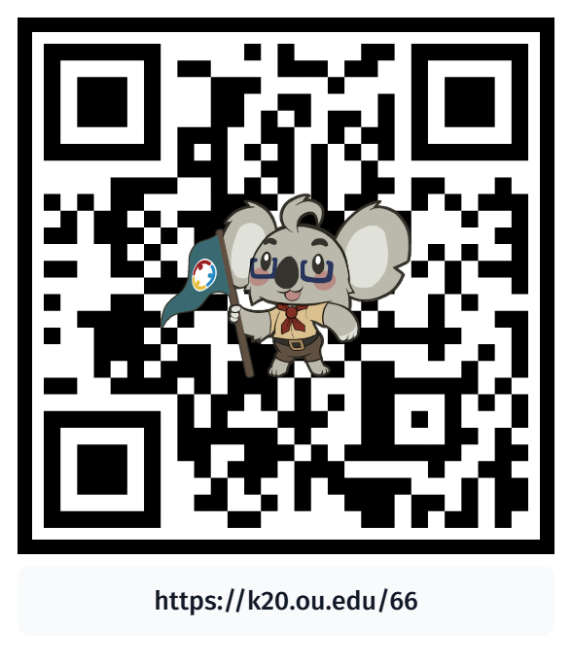
Degree Sheets
Navigate to your PSI’s degree sheet and complete the following:
  Type in URL.
  Scan QR code.
Review program details, such as:
  Required and elective courses;
  Advising contact information.
Write down two majors and an academic advisor for these majors on your handout.

Slide 11
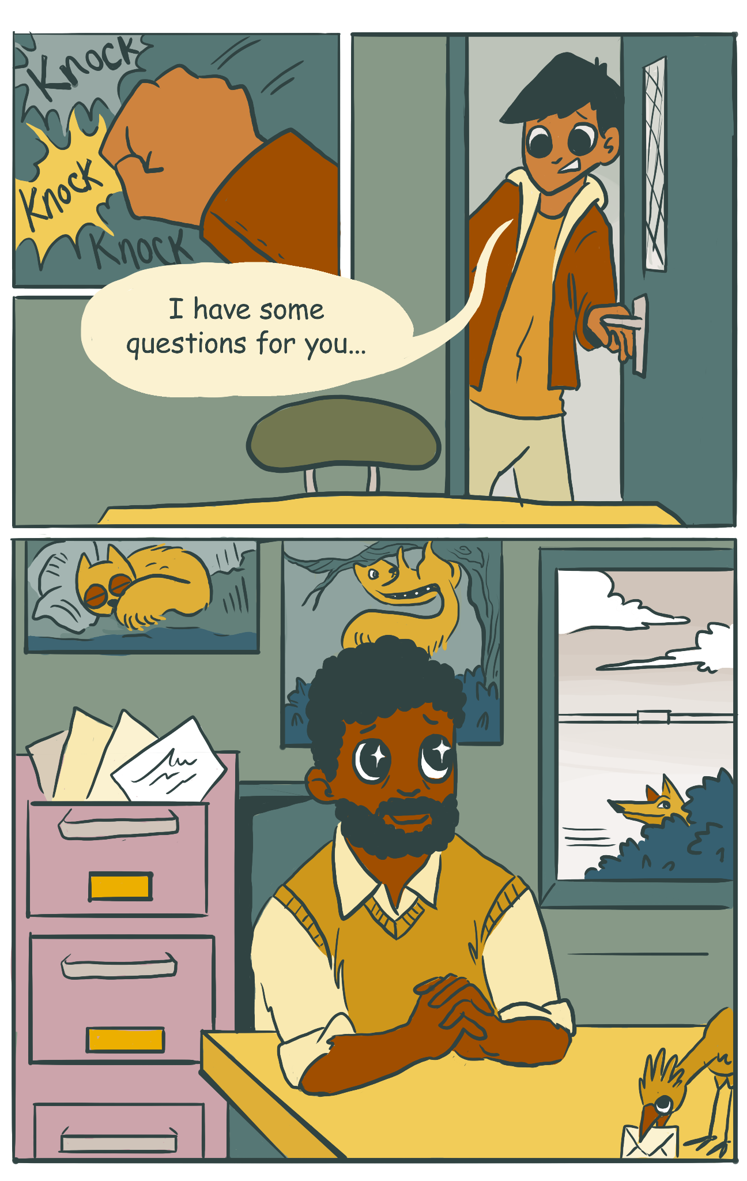
Degree Sheets
Get into small groups.
Brainstorm open-ended questions for advisors.

Slide 12
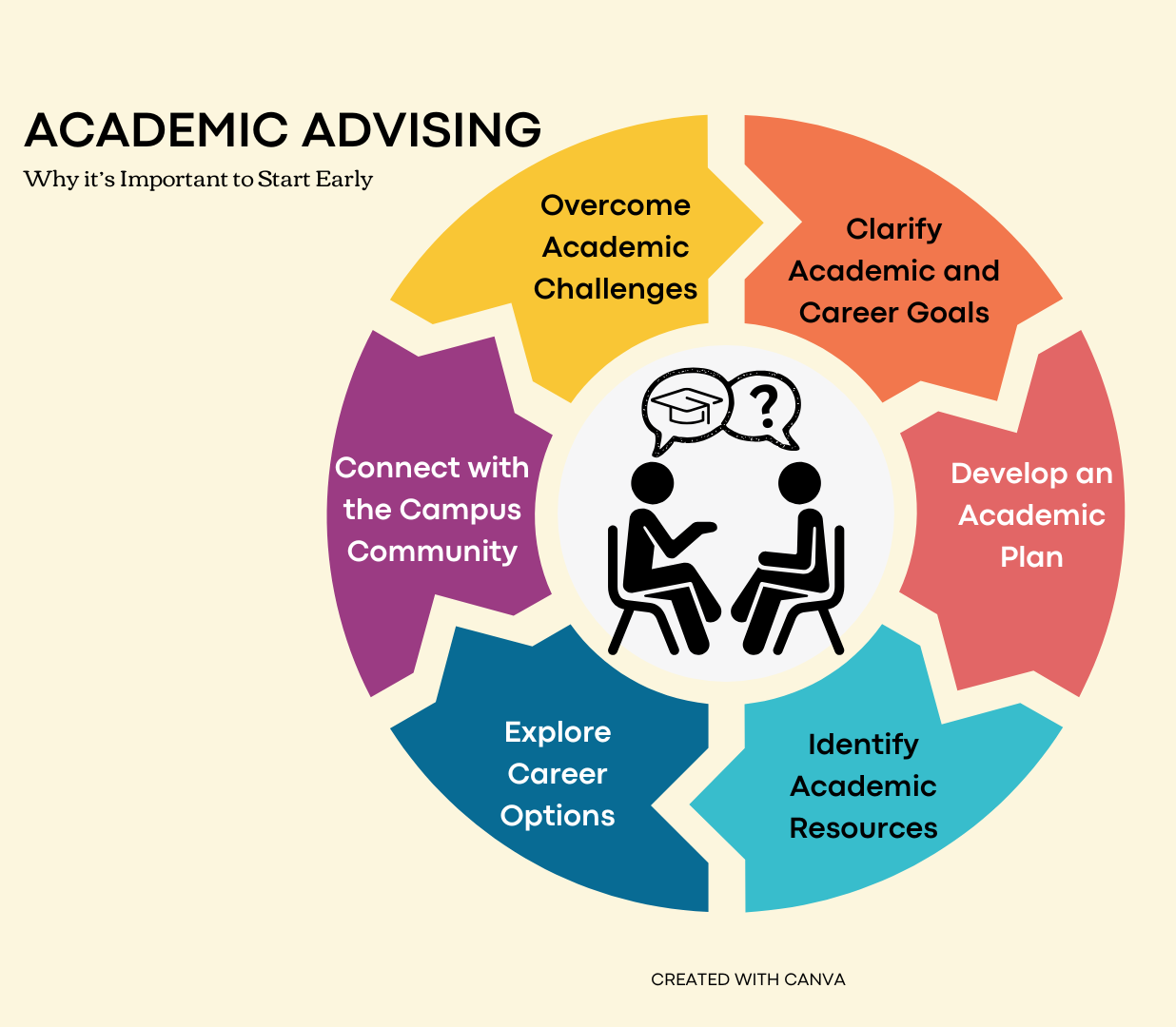

Slide 13

Final Reflection
Using your handout, create a list of 3 careers or degree paths you could see yourself pursuing after today’s discussions.
Add notes about any/all of the following:
  Why does it resonate with you?
  Does it match any of your skills?
  Is it a long-standing interest?
  Or is it something completely new sparked from today’s exploration?
Notes:
K20 Center. (n.d.). Bell ringers and exit tickets. Strategies. https://learn.k20center.ou.edu/strategy/125

Slide 14
Next Session!
Pathways to Possibilities
Meeting date and time:
  ADD INFORMATION
Notes:
Students should:
Read the existing career ideas already listed.
Add new career suggestions that haven’t been mentioned yet.
Consider how the traits in that statement might connect to different industries or roles.
K20 Center. (2021, September 21). 2 Minute Timer. YouTube. https://www.youtube.com/watch?v=HcEEAnwOt2c

