Slide 1



Slide 2

Pathfinder Quest
Welcome to the Trail

Slide 3


Learning Objectives
Students will connect with their peers in a Bingo activity
Students will reflect on their feelings about transitioning to post-secondary life

Slide 4
Essential Question:
How can understanding my interests and strengths help me choose a career path that fits me?

Slide 5
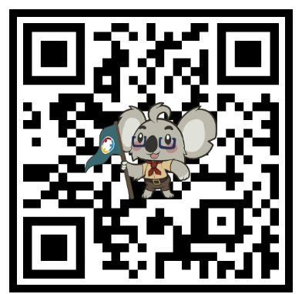
First Semester Check-In
Scan the QR Code
Or
Type: https://k20.ou.edu/6h

Slide 6
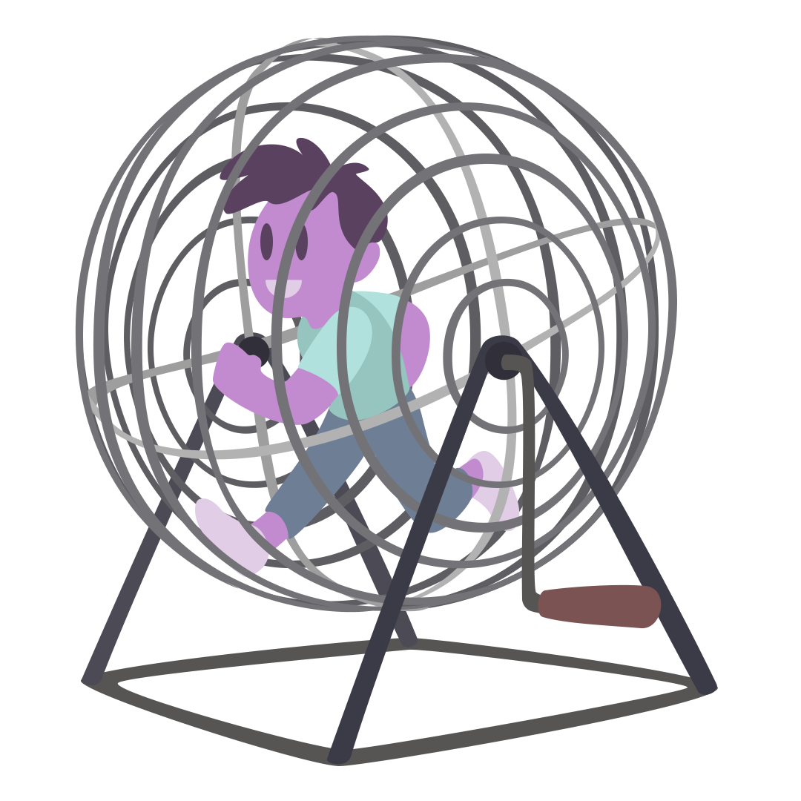



Peer Bingo!
Talk with your peers and see if one of the phrases on your card applies to them.
If yes, have them sign their name in the box.
The same person can fill more than one bingo space
Yell “Bingo” once you have 3 in a row!
K20 3-minute timer
Notes:
Students should:
Read the existing career ideas already listed.
Add new career suggestions that haven’t been mentioned yet.
Consider how the traits in that statement might connect to different industries or roles.
K20 Center. (2021, September 21). 2 Minute Timer. YouTube. https://www.youtube.com/watch?v=HcEEAnwOt2c
K20 Center. (n.d.). Human Bingo. Strategies. https://learn.k20center.ou.edu/strategy/3888

Slide 7
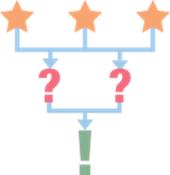

Ice Breaker
Spend 2 minutes completing the 3-2-1 handout:
3 things you’re excited about in college
2 things you’re nervous or unsure about in college
1 fun fact about yourselves
K20 2-minute timer
Notes:
K20 Center. (n.d.). 3-2-1. Strategies. https://learn.k20center.ou.edu/strategy/117
K20 Center. (2021, September 21). 2 Minute Timer. YouTube. https://www.youtube.com/watch?v=HcEEAnwOt2c

Slide 8
Ice Breaker
Find a partner at another table.
Each of you will get 2 minutes to share your responses.
K20 2-minute timer
Notes:
K20 Center. (n.d.). 3-2-1. Strategies. https://learn.k20center.ou.edu/strategy/117
K20 Center. (2021, September 21). 2 Minute Timer. YouTube. https://www.youtube.com/watch?v=HcEEAnwOt2c

Slide 9
Other Resources
Campus resources
  Writing center
  Career services center
Teachers or mentors
Peers or older students
Department website

Slide 10
Next Session!
I’m New
Meeting date and time:
  ADD INFORMATION
Notes:
Students should:
Read the existing career ideas already listed.
Add new career suggestions that haven’t been mentioned yet.
Consider how the traits in that statement might connect to different industries or roles.
K20 Center. (2021, September 21). 2 Minute Timer. YouTube. https://www.youtube.com/watch?v=HcEEAnwOt2c

