Slide 1



Slide 2


Pathfinder Quest
Pathways to Possibilities

Slide 3
Essential Question:
How can understanding my interests and strengths help me choose a career path that fits me?

Slide 4
Lesson Objectives:
Students will be able to identify how different college majors can lead to a variety of career paths.
Students will use online career exploration tools to research potential jobs, employers, and salaries related to a chosen major.
Students will reflect on how their perceptions of careers and majors have changed.

Slide 5

Fiction in the Facts - Tech Careers
Some software engineers never write code and focus entirely on system architecture or project management.
The first computer programmer was a woman named Ada Lovelace.
All cybersecurity professionals must have a degree in computer science.
Notes:
K20 Center. (n.d.). Fiction in the Facts. Strategies. https://learn.k20center.ou.edu/strategy/60

Slide 6


Fiction in the Facts - Tech Careers
Some software engineers never write code and focus entirely on system architecture or project management.
The first computer programmer was a woman named Ada Lovelace.
All cybersecurity professionals must have a degree in computer science.
Notes:
K20 Center. (n.d.). Fiction in the Facts. Strategies. https://learn.k20center.ou.edu/strategy/60

Slide 7
Fiction in the Facts - Unusual Jobs
There are professional line-standers who get paid to wait in lines for others.
Ice cream tasters are required to have a degree in dairy science.
Pet food testers sometimes taste the food themselves (for texture and flavor balance—not for nutrition!).
Notes:
K20 Center. (n.d.). Fiction in the Facts. Strategies. https://learn.k20center.ou.edu/strategy/60

Slide 8
Fiction in the Facts - Unusual Jobs
There are professional line-standers who get paid to wait in lines for others.
Ice cream tasters are required to have a degree in dairy science.
Pet food testers sometimes taste the food themselves (for texture and flavor balance—not for nutrition!).
Notes:
K20 Center. (n.d.). Fiction in the Facts. Strategies. https://learn.k20center.ou.edu/strategy/60

Slide 9
Fiction in the Facts - Medical Field
Surgeons often listen to music while performing operations—it can help with focus and reduce stress.
All doctors must complete at least 10 years of schooling before practicing.
Doctors spend more time on paperwork than with patients.
Notes:
K20 Center. (n.d.). Fiction in the Facts. Strategies. https://learn.k20center.ou.edu/strategy/60

Slide 10
Fiction in the Facts - Medical Field
Surgeons often listen to music while performing operations—it can help with focus and reduce stress.
All doctors must complete at least 10 years of schooling before practicing.
Doctors spend more time on paperwork than with patients.
Notes:
K20 Center. (n.d.). Fiction in the Facts. Strategies. https://learn.k20center.ou.edu/strategy/60

Slide 11

O*NET Interest Profiler
Scan the QR code or type in
www.mynextmove.org/explore/ip
Follow the instructions on your handout.

Slide 12
Did you know that 60% of college students in the United States change their major during their first year of college (Coplin, 2012).
How many of you feel pressure to pick the “perfect” major for your dream job?
Notes:
Coplin, B. (2012). 10 Things Employers Want You to Learn in College: The Skills You Need to Succeed. New
York, Ten Speed Press.

Slide 13


Fact or Fiction?
Fiction!
Many careers are open to a wide range of majors. What matters just as much are your skills, experiences, and interests.
Your major determines your career.
Fact
Unsure
Fiction

Slide 14
Fact or Fiction?
Fact!
Communication, problem-solving, teamwork, and critical thinking are valuable in almost any field.
You can gain transferable skills in any major.
Fact
Unsure
Fiction

Slide 15
Fact or Fiction?
Fact!
Real-world experiences and connections often open more doors than grades alone.
Internships, networking, and campus involvement are more important than GPA in some industries.
Fact
Unsure
Fiction

Slide 16
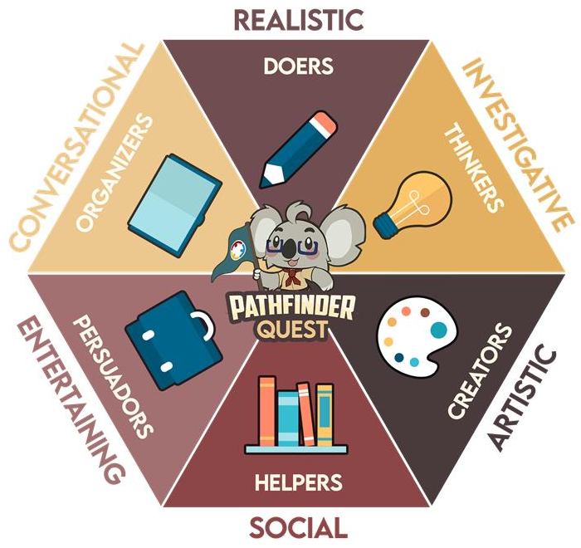
The Holland Code
The Holland Code emphasizes the relationship between career success and a person’s personality type
Notes:
Zainudin, Z. N., Rong, L. W., Nor, A. M., Yusop, Y. M., & Othman, W. N. W. (2020). The relationship of Holland theory in career decision making: A systematic review of literature. Journal of critical reviews, 7(9), 884-892.

Slide 17
The Holland Code
Realistic: "I enjoy building, fixing, or working with tools and machinery."
Investigative: "I love solving complex problems and discovering how things work."
Artistic: "I'm drawn to creative expression and bringing new ideas to life."
Social: "I feel energized when I'm helping others reach their potential."
Enterprising: "I thrive on leading projects and persuading others to take action."
Conventional: "I find satisfaction in organizing information and creating efficient systems."

Slide 18

States and Careers
Follow the instructions on your handout for “Occupation Search”.
Be sure to search for 2-3 different occupations.

Slide 19
I Used To Think… But Now I Know
Use the space provided on your Note Catcher to reflect on the following:
What did you use to think about majors, careers, and college planning?
Now what do you know?

Slide 20


Next Session!
Resume Ready
Meeting date and time:
  ADD INFORMATION
Notes:
Students should:
Read the existing career ideas already listed.
Add new career suggestions that haven’t been mentioned yet.
Consider how the traits in that statement might connect to different industries or roles.
K20 Center. (2021, September 21). 2 Minute Timer. YouTube. https://www.youtube.com/watch?v=HcEEAnwOt2c

