Slide 2
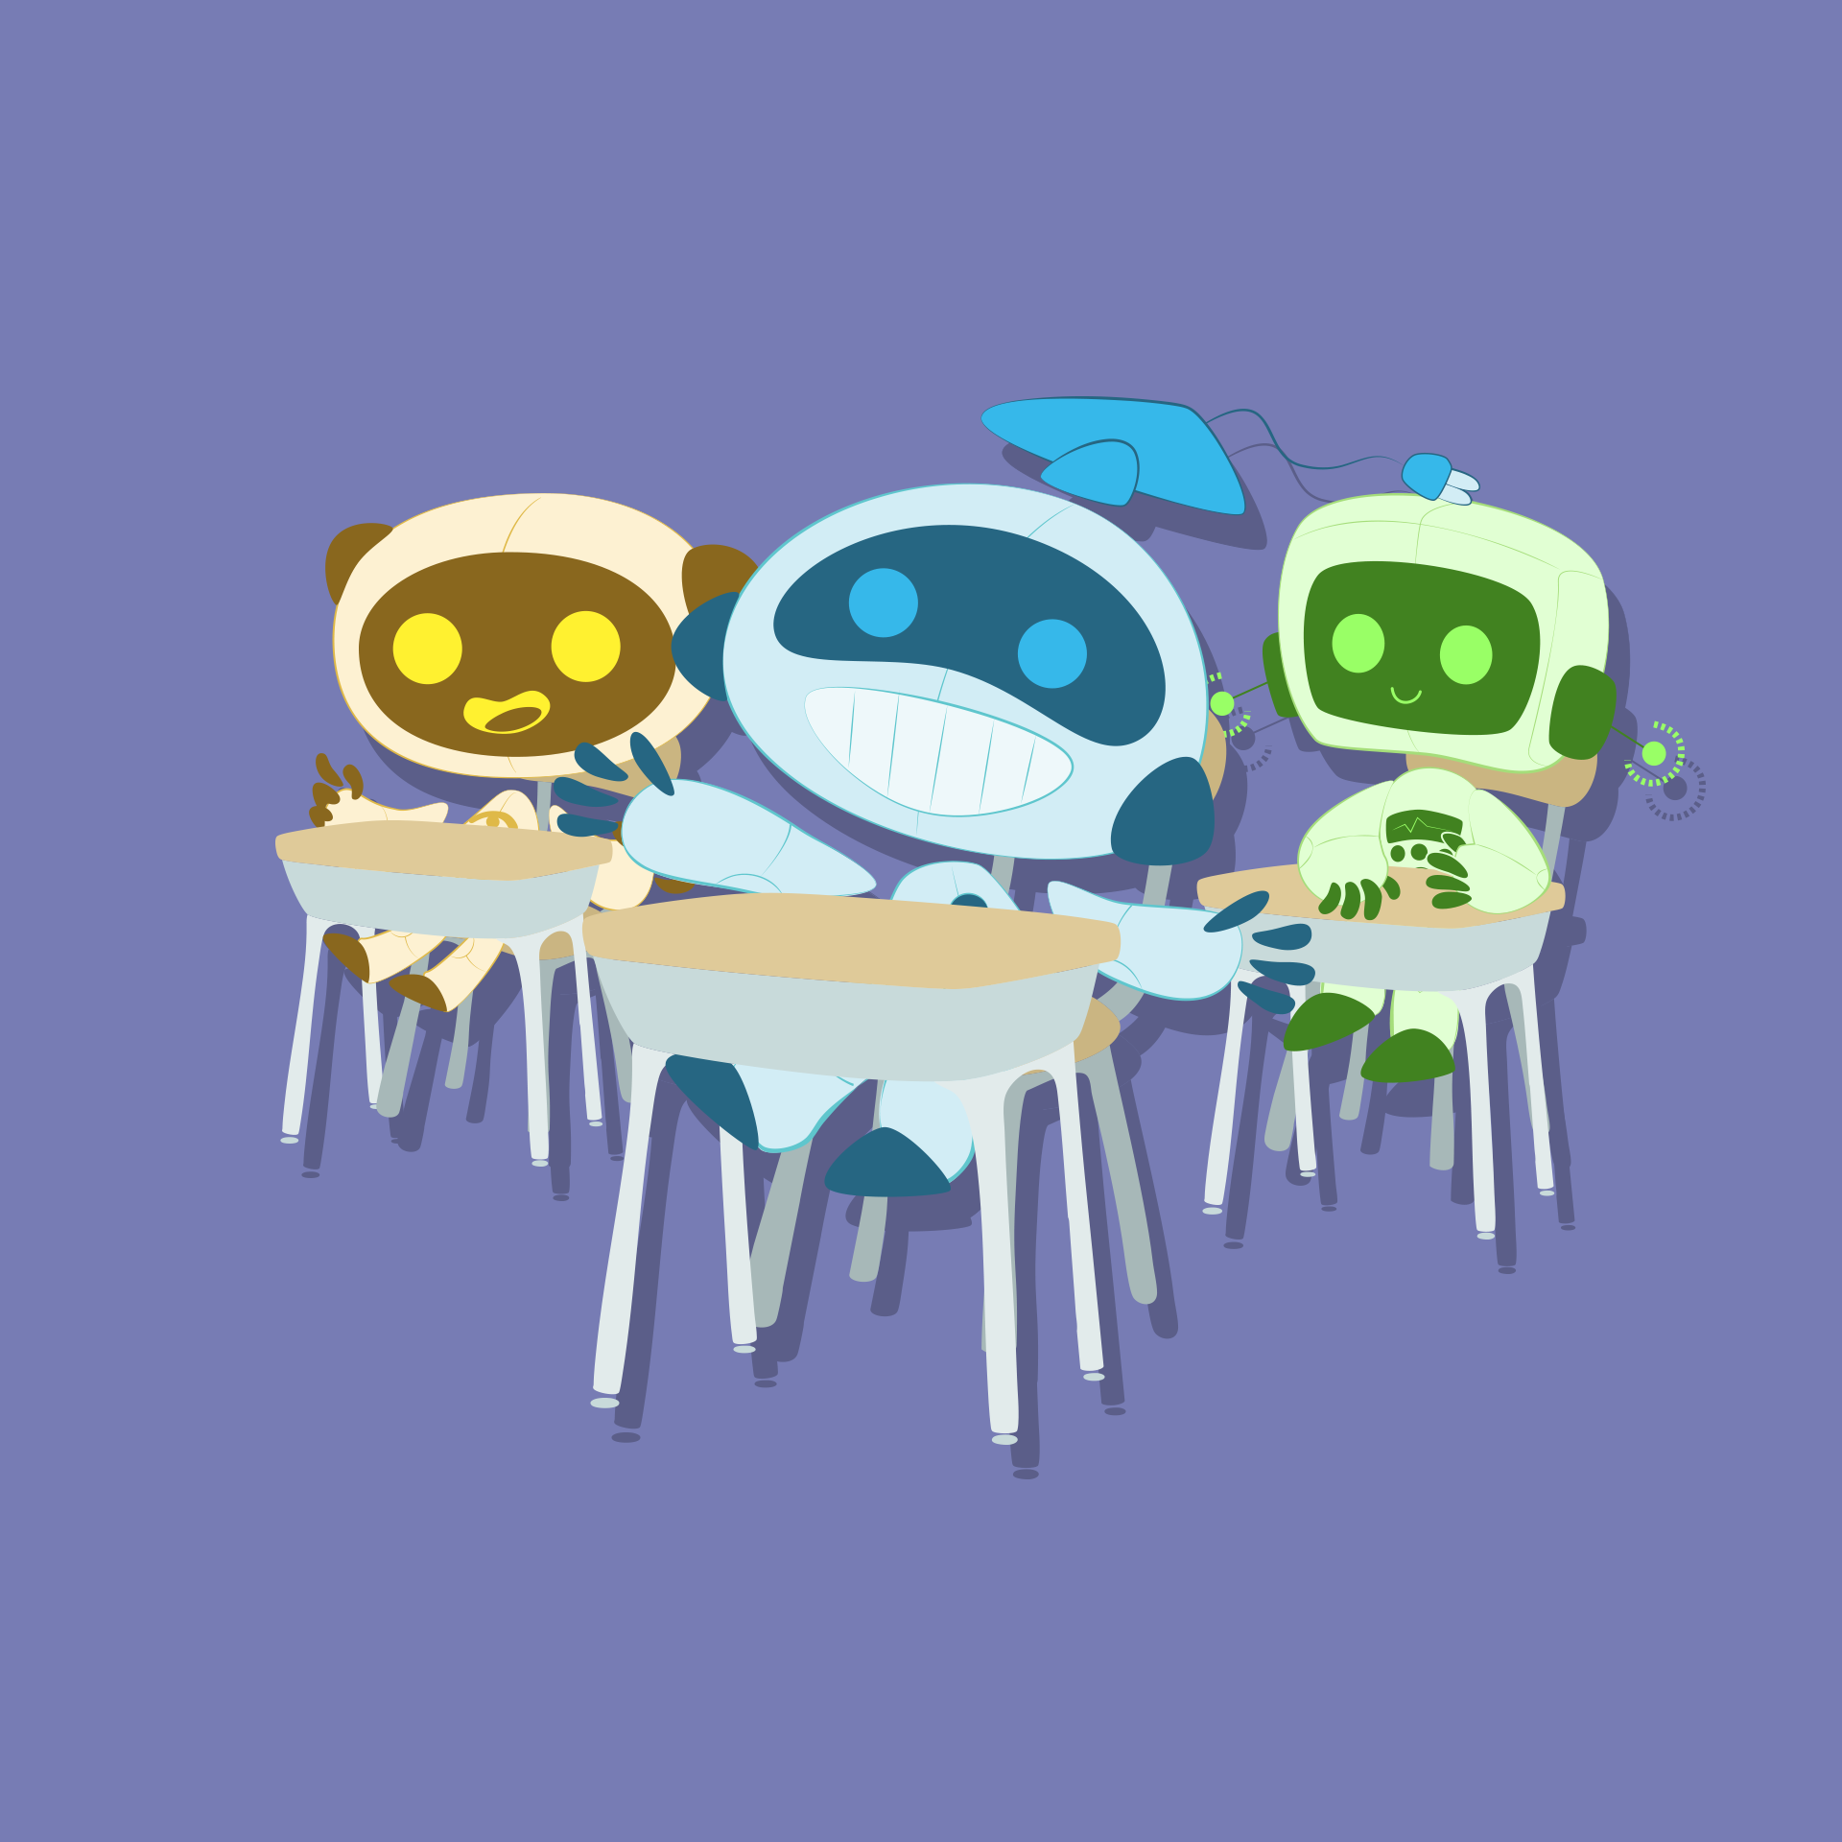
Bots in the Classroom
The Ethics of Artificial Intelligence in the Classroom

Slide 3
Essential Question
How can I use AI responsibly to support my learning?

Slide 4
Learning Objective
Discuss the importance of using AI responsibly in academic settings, including issues related to plagiarism, data privacy, and digital citizenship.

Slide 5


ABC Graffiti
In your small group, brainstorm as many words or phrases that connect to the following question in 30 seconds:
What comes to mind when you think about AI?
Notes:
K20 Center. (n.d.). ABC graffiti. Strategies. https://learn.k20center.ou.edu/strategy/96
https://youtu.be/o9ViOMe_Wnk

Slide 6
ABC Graffiti
Rotate to the next group.
Read through their list.
Add words and phrases to the letters that have not already been used.
Be prepared to move after time is called.
Notes:
K20 Center. (n.d.). ABC graffiti. Strategies. https://learn.k20center.ou.edu/strategy/96
https://youtu.be/o9ViOMe_Wnk

Slide 7
ABC Graffiti
After rotations, read through the added responses.
As a group, choose three responses you found surprising, important, or helpful.
Notes:
K20 Center. (n.d.). ABC graffiti. Strategies. https://learn.k20center.ou.edu/strategy/96

Slide 8

Collaborative Word Cloud
What does it mean to be ethical?
Go to Menti.com
Enter code: XXXX XXXX
Insert QR code here
Notes:
K20 Center. (n.d.). Collaborative word clouds. Strategies. https://learn.k20center.ou.edu/strategy/103

Slide 9

Magnetic Statements: AI Scenarios
For each scenario provided, select a side based on whether you believe it is ethical or unethical.
Discuss your reasons with the others in your group.
Choose a spokesperson and be prepared to share out.
Notes:
K20 Center. (n.d.). Magnetic statements. Strategies. https://learn.k20center.ou.edu/strategy/166

Slide 10
A student writes a rough draft of their personal narrative and uses AI to revise it for better grammar, vocabulary, and sentence flow. The final version is significantly more polished than their usual writing, but they reviewed all the changes and agreed with them. They do not tell the teacher they used AI.

Slide 11
A student uses AI to explain how to solve a math problem. They read the AI explanation, try the next problem on their own, and check their understanding by asking AI follow-up questions.

Slide 12
A student asks AI to suggest ideas for a science project. They choose one suggestion, research it further, and design their own experiment based on the idea.

Slide 13
One group member uses AI to answer all the research questions for a social studies group project and refuses to explain how they got the answers or involve the other team members.

Slide 14
A student is preparing for a social studies debate. They use AI to generate arguments and counterarguments on both sides of the topic to help them practice. During the debate, they use some of the phrasing and examples from the AI-generated content.

Slide 15
During class, a student uses an AI chatbot on their phone to answer a quiz without telling the teacher or trying to solve it themselves first.

Slide 16
In a science class, a student uses AI to generate the answers for an assignment, then turns it in without understanding how it works or making any changes.

Slide 17

Why Do I Want to Use AI?
Review the flow chart.
On a sticky note:
  Write two things you notice
  Write two things you wonder
    I Notice - [color]
    I Wonder - [color]
Notes:
K20 Center. (n.d.). I notice, I wonder. Strategies. https://learn.k20center.ou.edu/strategy/180

Slide 18
Why Do I Want to Use AI?
Turn to your elbow partner and share your notices and wonders.
Feel free to make edits based on the discussion.
Choose one notice and one wonder.
Place each sticky note in the assigned area on the board.
Notes:
K20 Center. (n.d.). I notice, I wonder. Strategies. https://learn.k20center.ou.edu/strategy/180
K20 Center. (n.d.). Elbow partners. Strategies. https://learn.k20center.ou.edu/strategy/116

