Slide 2

First Impressions First
Essential Communication Skills

Slide 3
Essential Question
How do our communication choices shape the first impressions others form of us?

Slide 4
Objectives
Analyze actions that impact first impressions.
Demonstrate clear communication skills.

Slide 5

Nice to Meet You
When you meet someone for the
first time, what do you notice about them?
What do you think people first notice about you?
Think about these answers then
find a partner to discuss.
Notes:
K20 Center. (n.d.) Think-pair-share. Strategies. https://learn.k20center.ou.edu/strategy/139

Slide 6

What You Perceive
Adults often perceive music from their early years as “better” than current music.
What do you think perceive means?

Slide 7
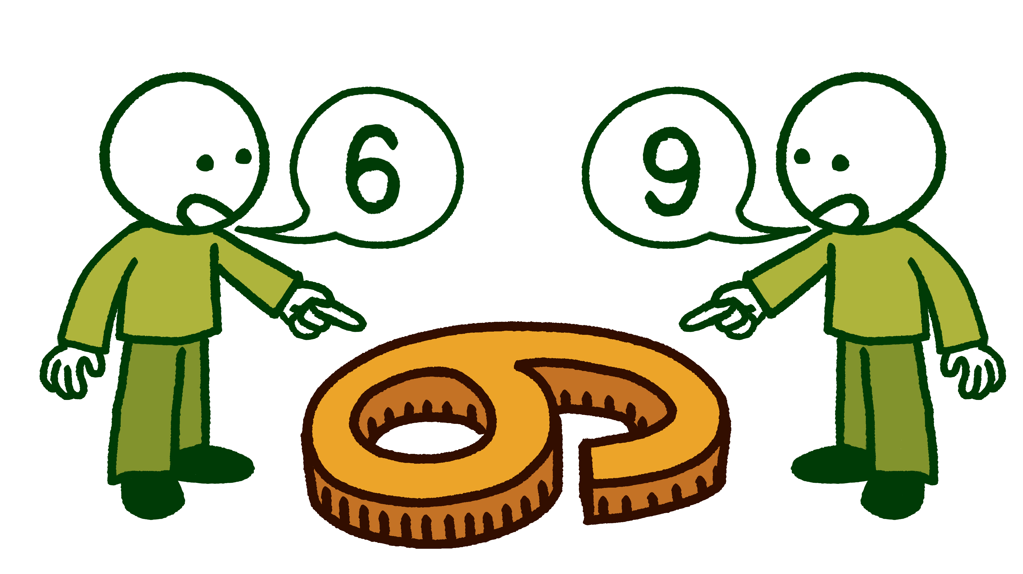
Perception = Reality?
Perception is the interpretation of sensory information from the environment.
Your perception impacts
your daily opinions,
understandings,
and beliefs.

Slide 8
Your Perception
He’s so ugly!

Slide 9
Your Perception
He’s so ugly!
How does this make you feel?
What do you think this is about?

Slide 10
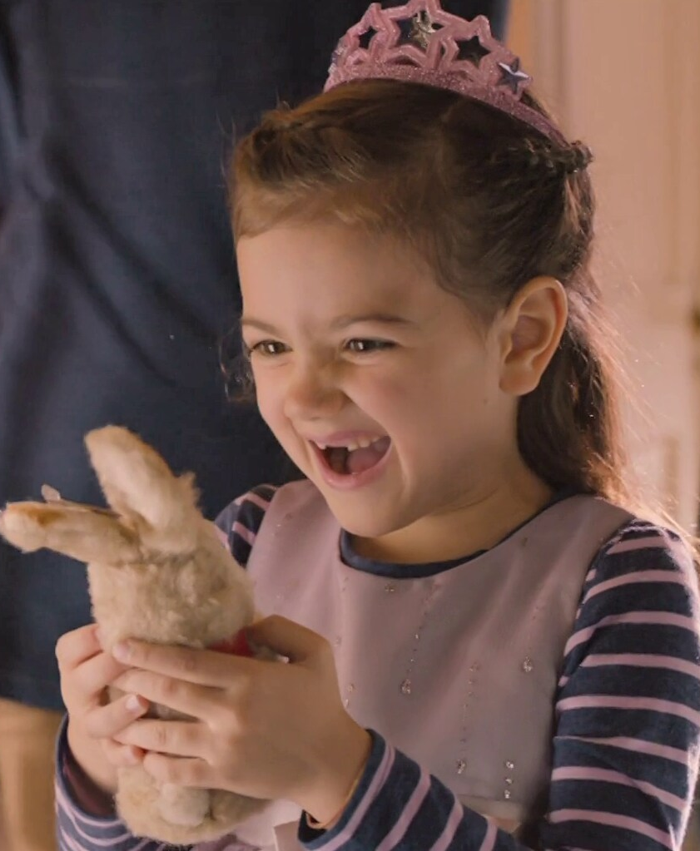
Your Perception
He’s so ugly!

Slide 11
Your Perception
He’s so ugly!
How does this make you feel?
What do you think this is about?

Slide 12

Your Perception
He’s So Ugly
Notes:
Deo. (2016, May 13). ANT MAN Movie - So ugly, I loved [Video]. YouTube. https://www.youtube.com/watch?v=nStEvyBDNgo

Slide 13
Your Perception
As more information was revealed, how did your answer to the following questions change?
How does this make you feel?
What do you think this is about?

Slide 14
Perceptions
Did everyone have the same perception?
If your perception changed, when did it shift?
What might influence someone’s perception?
Why should we consider how
our actions are being perceived?

Slide 15
First Impressions
A first impression is the early opinion that someone makes during an initial interaction.
  It is a quickly formed perception.
  It is often difficult to change.
  What is an example of a first impression?

Slide 16
Express Yourself
Communication affects the first impression you make.
There are different types of communication to help you convey your message:
  Nonverbal
  Verbal
  Written

Slide 17
Nonverbal Communication
Nonverbal communication is the use of
body language to convey a message.
  Examples: facial expressions, outfit, posture, eye contact, etc.
What are you communicating
without using words?

Slide 18
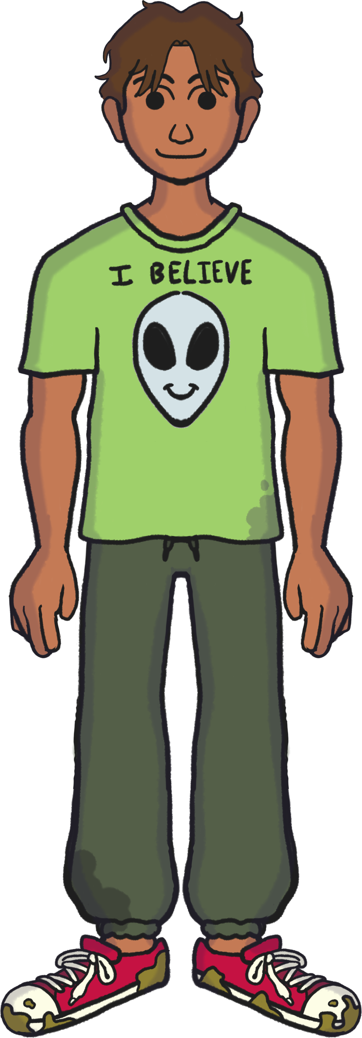

Casual to Smart Casual
Casual or Everyday Wear is comfortable, informal clothing. This may include:
Athletic wear
Shirts with fun graphics
or phrases
shorts

Slide 19

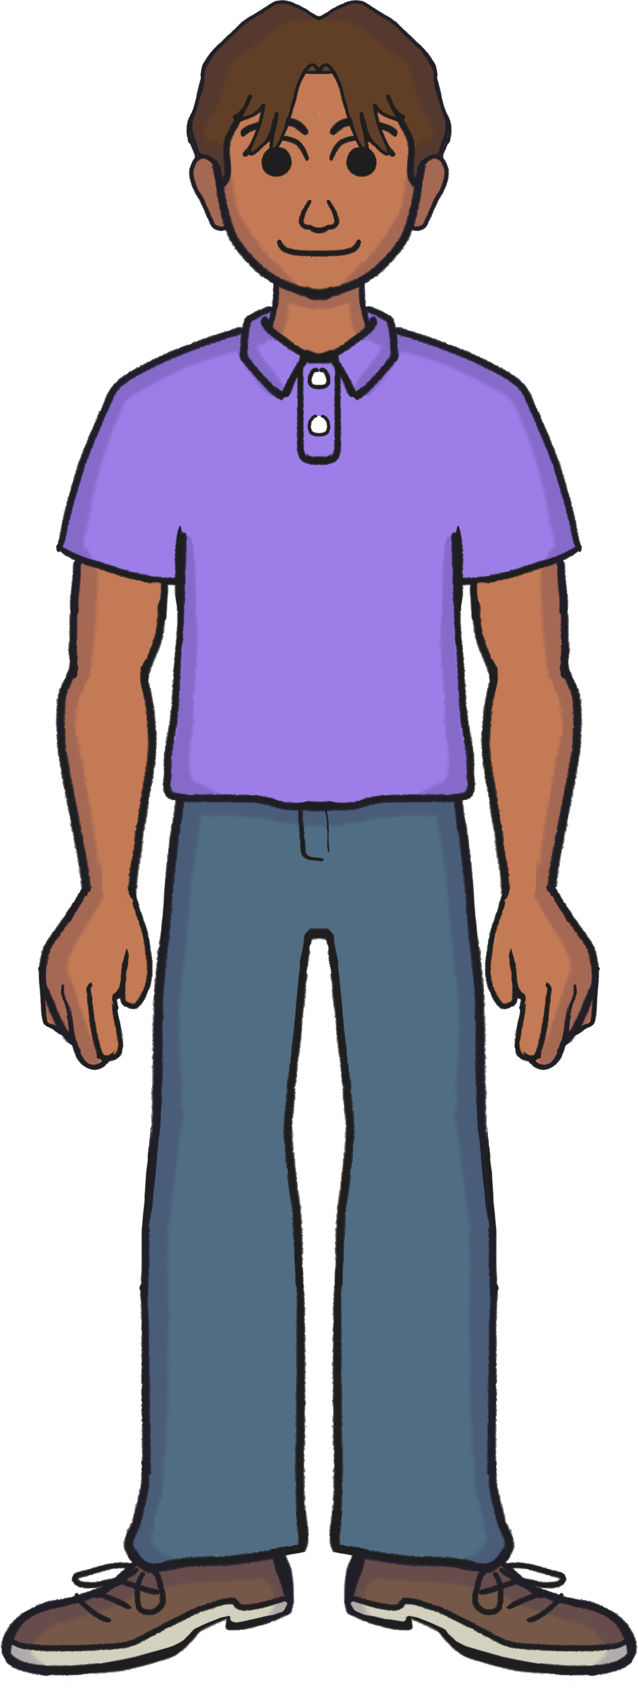
Casual to Smart Casual
Smart Casual means dressing up your casual clothes. To change from casual to smart casual, you can…
Trade loud patterns or graphic shirts for subtle patterns and shirts in a solid color.
Choose clothes that fit well and
aren’t too tight or too baggy.
Have fresh and tidy hair and accessories.

Slide 20
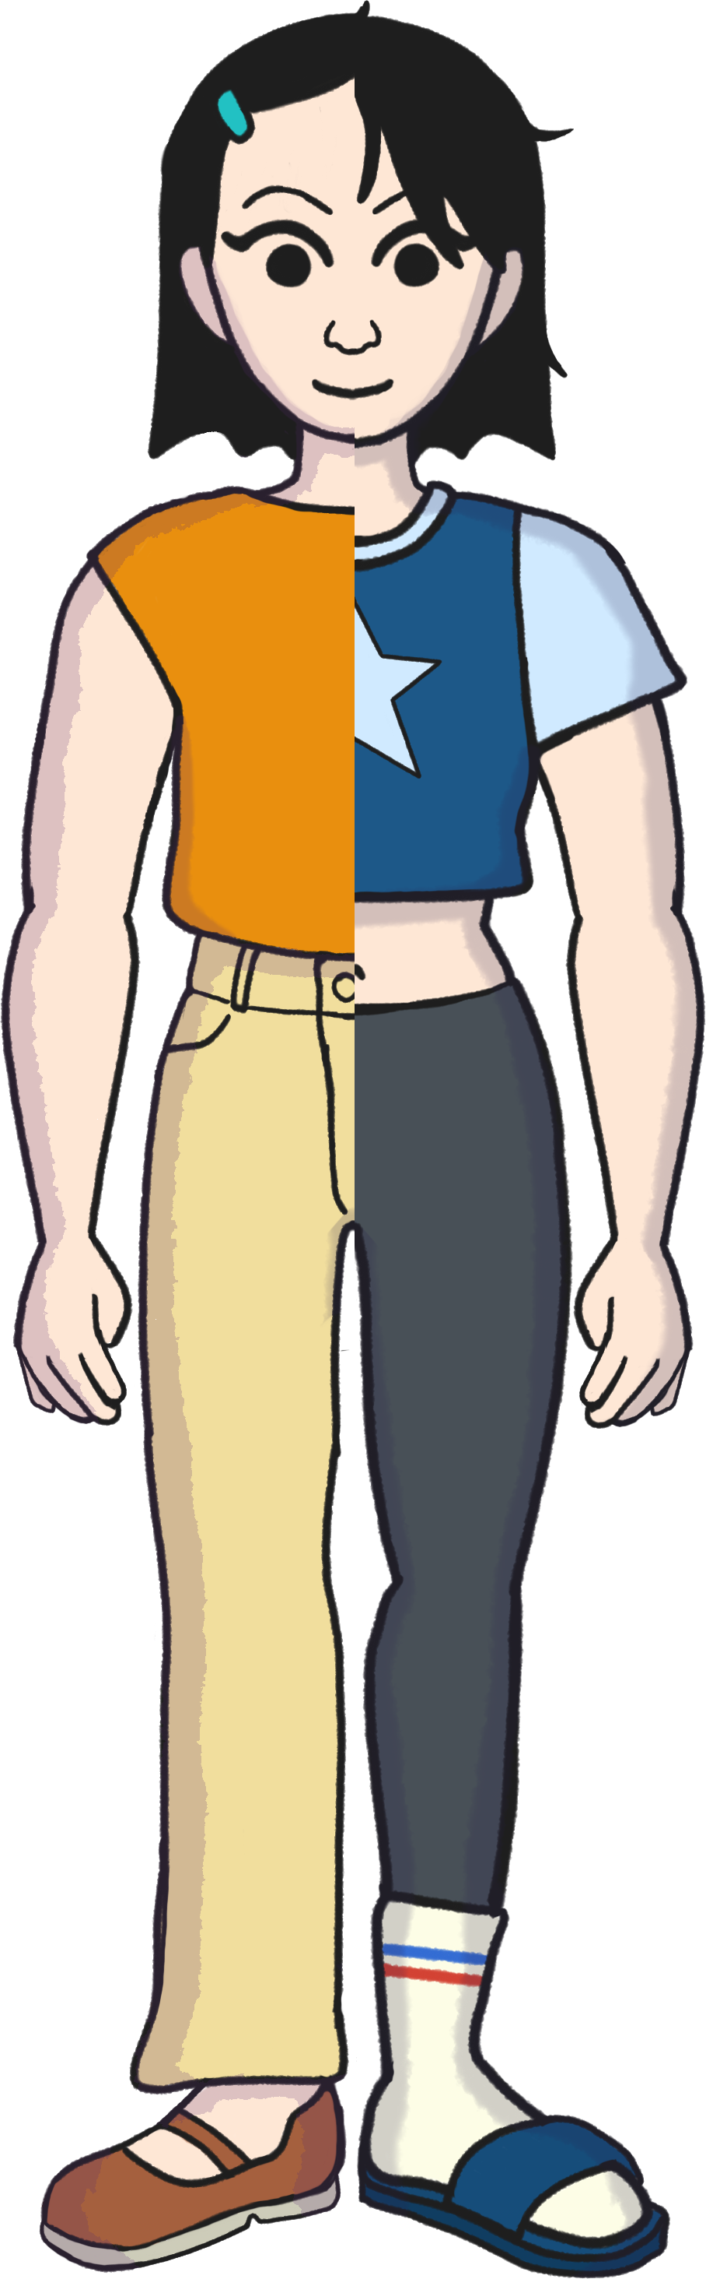
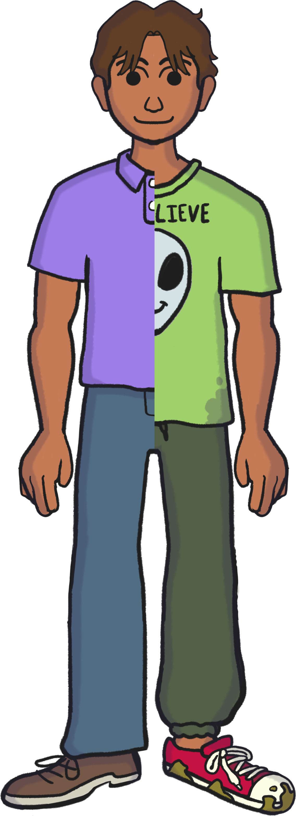
Consider What You’re Communicating
Polished does not have to mean plain.
Present yourself so that you are the focus of the interaction, not your appearance.
Communicate that you are there with intention and that you take yourself seriously.

Slide 21
Your Words Matter
Verbal: the use of spoken words to help you convey your message
  Examples: phone calls, in-person conversations, etc.
Written: the use of text to help you convey your message
  Examples: emails, social media posts, etc.
What do your words imply?

Slide 22
Email Basics
To: | jones@school.edu
Subject: | Geometry Question
Hi Mr. Jones! I’m in your 5th hour math class. Could you please remind me when our volume project is due? Thanks! Mia K.
Understanding the parts of an email can help you write a better email.

Slide 23
To: | jones@school.edu
Subject: | Geometry Question
Hi Mr. Jones! I’m in your 5th hour math class. Could you please remind me when our volume project is due? Thanks! Mia K.
the email address
of the person you are contacting
the topic of the email
Advice: Write your subject like a title. Keep it short, specific, and clear.

Slide 24
To: | jones@school.edu
Subject: | Geometry Question
Hi Mr. Jones! I’m in your 5th hour math class. Could you please remind me when our volume project is due? Thanks! Mia K.
the greeting
Advice: Think about to whom you are writing. Be very respectful and avoid using slang.

Slide 25
To: | jones@school.edu
Subject: | Geometry Question
Hi Mr. Jones! I’m in your 5th hour math class. Could you please remind me when our volume project is due? Thanks! Mia K.
The body of the email includes both the introduction and call to action.
the introduction
the call to action

Slide 26
To: | jones@school.edu
Subject: | Geometry Question
Hi Mr. Jones! I’m in your 5th hour math class. Could you please remind me when our volume project is due? Thanks! Mia K.
Advice: The closing is a great place to express gratitude or appreciation for their help.
the closing
your email signature

Slide 27
To Whom
Sometimes you may email someone you know, and sometimes you must email someone you have never met.
How should this influence your writing?

Slide 28
To Whom
Use the options from the Answer Bank to complete each email on your handout.
Choose the best option for each blank.
You will not use all the available options.

Slide 29
To Whom: Subject
To: | teacher@school.org | To: | professional@company.com
Subject: | _______________ | Subject: | _______________
_____________ |  | _____________
__________________ I’m applying |  | __________________ My name is Johan,
for a summer leadership camp, and I need a letter |  | and I am from Lincoln HS. I’m in a class where we are learning

Slide 30
To Whom: Greeting and Introduction
_____________ | _____________
__________________ I’m applying | __________________ My name is Johan,
for a summer leadership camp, and I need a letter of recommendation. I was wondering if you could write one for me. I really liked your class, and I think you know me well. | and I am from Lincoln HS. I’m in a class where we are learning about careers, and it would be really cool to hear from someone who does your job.

Slide 31
To Whom: Call to Action
The letter is due in 2 weeks. Would you have time to write one for me? | We are hoping to have someone speak next month. Is there anyone from your business who would be willing and available to speak to our class?
_______________ I can send you more | _________________ I can send you
information, including how and where to submit the letter. | what time our class starts. I look forward to hearing from you!

Slide 32
To Whom: Closing
_______________ I can send you more information, including how and where to submit the letter. | _________________ I can send you what time our class starts. I look forward to hearing from you!
____________________ | ____________________
Anna Jones | Johan R.

Slide 33
Practice Makes Confident
Developing your communication skills will take time.
By practicing written, verbal, and nonverbal communication, you can increase your confidence and become an effective communicator.
Effective communication means:
  the message was clearly communicated,
  individuals reached a mutual understanding,
  and you acquired the desired response.

Slide 34
Depends on the Situation
Use one situation to practice your nonverbal and verbal communication skills.
Use another situation to practice your written communication skills.
How does the situation impact
your communication?

Slide 35
Situation 1 | Situation 2 | Situation 3
You recently received a grade lower than you expected on your last major assignment. You are not sure why you didn’t earn more points and want to ask your teacher how you can improve your grade. | You heard a professional share what they do for a living and think you may want to do what they do after high school. What the professional said sounded interesting, but you want to know what their job is like daily. You want to reach out to a local professional to ask about job shadowing opportunities. | You learned that you may be able to take classes at a local career tech or college before you graduate high school. You are interested, but unsure which classes would be best for you. You contact a representative from a local career tech or college to express interest, ask about which classes they would recommend, and inquire about the steps you must take to enroll.

Slide 36
Depends on the Situation
Which situation did you use to practice nonverbal and verbal communication? Which did you use for written communication?
Situation 1: Contacting a teacher about your grade
Situation 2: Contacting a professional about job shadowing
Situation 3: Contacting a career tech or college representative about taking classes
Which did you find most challenging? Why?

Slide 37

Lasting Impressions
Mirror: What do I currently do to
make a good first impression?
Microscope: What skill can I practice
to improve others’ first impressions of me?
Binoculars: How can I apply what I learned to future situations?
Notes:
K20 Center. (n.d.). Mirror, microscope, binoculars. Strategies. https://learn.k20center.ou.edu/strategy/3020

