Slide 2

Broadcasting
Creating a Successful Newscast

Slide 3
Essential Question
What makes a news broadcast effective?
How can we create a compelling student newscast?

Slide 4
Learning Objectives
Students will identify key features of a high-quality news broadcast and understand what makes a story newsworthy.
Students will collaborate in production roles to plan, film, and edit a short news segment.
Students will evaluate their own and others’ newscasts using constructive feedback to improve their final products.

Slide 5

Student Broadcasting
With your partner select a video to watch.
As you watch the video answer the questions on your handout.
Be prepared to share your answers with the class.
Notes:
Broadcast excellence. STN. (2025). https://www.studenttelevision.com/broadcast-excellence-winners-2025

Slide 6
What is NEWS?
What makes a story “newsworthy”?
What things are happening in our school that we could make into stories?

Slide 7
Pop-Up Challenge!
Create a 1–2-minute news segment about something that is happening in the school.
You have 50 minutes to complete the challenge!

Slide 8

Pop-Up Challenge!
What did you need to be successful?
What role did you play in the filming of your pop-up challenge video?
What was challenging?
Notes:
K20 Center. (n.d.). Collective brain dump. Strategies. https://learn.k20center.ou.edu/strategy/111

Slide 9
Production Reflection
What worked well—in your production and the broadcasts you watched?
What types of stories that stood out?
What made those stories effective or engaging?
What would you like to incorporate into your own production?

Slide 10

Story Pitch Session
On a piece of paper write down three ideas you have for a news story.
Everyone will stand up.
Each person will read out one of their ideas.
If someone says an idea on your paper, mark it off.
You will only sit if you have shared all your ideas or your list is marked off.
Notes:
K20 Center. (n.d.). Stand up, sit down. Strategies. https://learn.k20center.ou.edu/strategy/1771

Slide 11

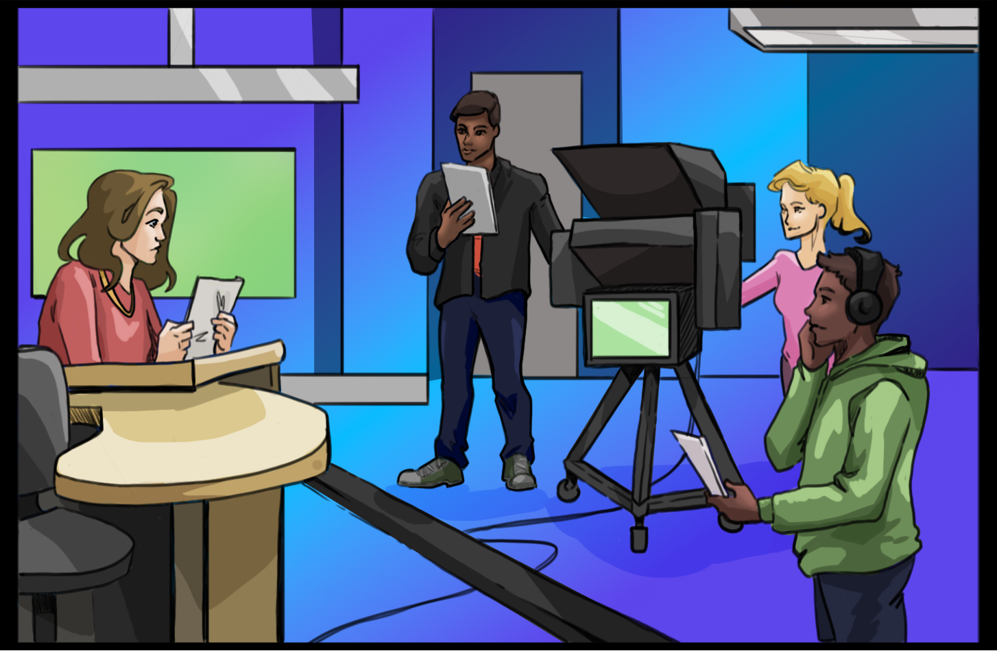
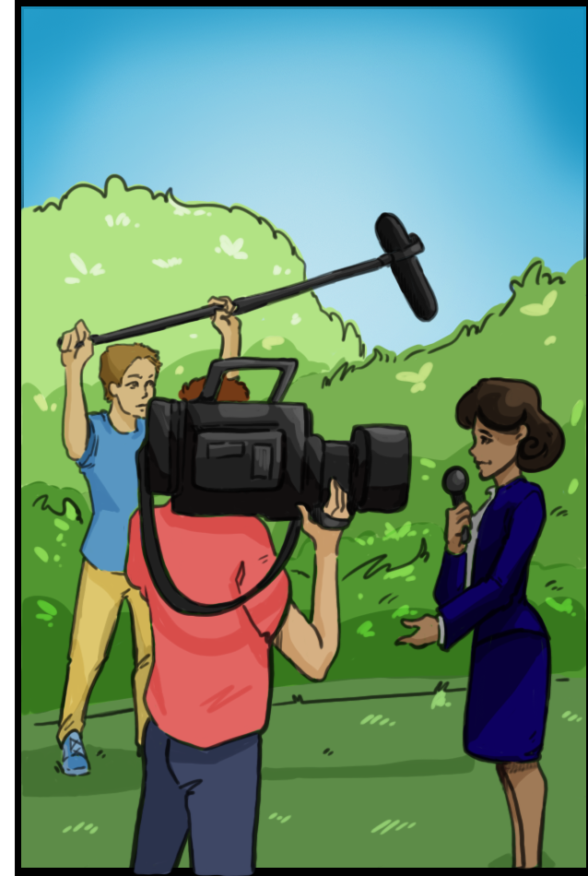
Floor Manager
Camera Operator
Audio
Anchor
Editor
Director
Reporter

Slide 12
Role Selection
Determine your top three roles you would like to try out.
Be advised you may not get your first choice!!
You will have the opportunity to experience all the roles involved in producing a newscast throughout the semester.

Slide 13
Story Development
In your group, use the Newcast Story Planning Sheet to determine the needs for your story.
  What will the story be called?
  How long will the story be?
  What type of story is it (field or studio)?
  What will you need (equipment, types of shots, graphics)?

Slide 14
Script Writing
With your group develop a script for your story.
As you write your script include the following:
  The names of each person talking on camera
  The types of shots you will need
  Places where you transition
  Voice overs, music, intros, and outros

Slide 15
Filming Timeline
What order do we need to film the stories?
What things are needed for the stories? (Voice-overs, graphics, etc.)
Who is going to be responsible for each of these?
What are the deadlines?
Who will keep us on track?

Slide 16
Planning and Preparation
Once you have your plan for your newscast, you may start filming the segments according to your schedule.
Be sure to obtain the proper permission for filming!

Slide 17
Video Editing
With your group, use the Video Editing Guide to help you import media, cut and arrange footage, and add graphics and music for your segment.
Once you have completed your segment, export the file so it can be merged with the other segments into one broadcast.

Slide 18
Bringing It All Together
The main editors will put the segments together using the outline you developed.
For those who are not working on editing, create promotional material for your newscast (posters, flyers, trailers, social media posts).

Slide 19

Screening Time
We will watch our broadcast together.
As we watch it write down two stars you have (things done well) and one wish (something that can be improved for next time).
Notes:
K20 Center. (n.d.). Two stars and a wish. Strategies. https://learn.k20center.ou.edu/strategy/83

Slide 20
Reflection
Thinking about the process of making a broadcast, answer these two questions on your paper:
  What was the most challenging part of making the broadcast?
  What steps did you take to help make the broadcast a success?
  How did you and your group work together as a team?

