Slide 2
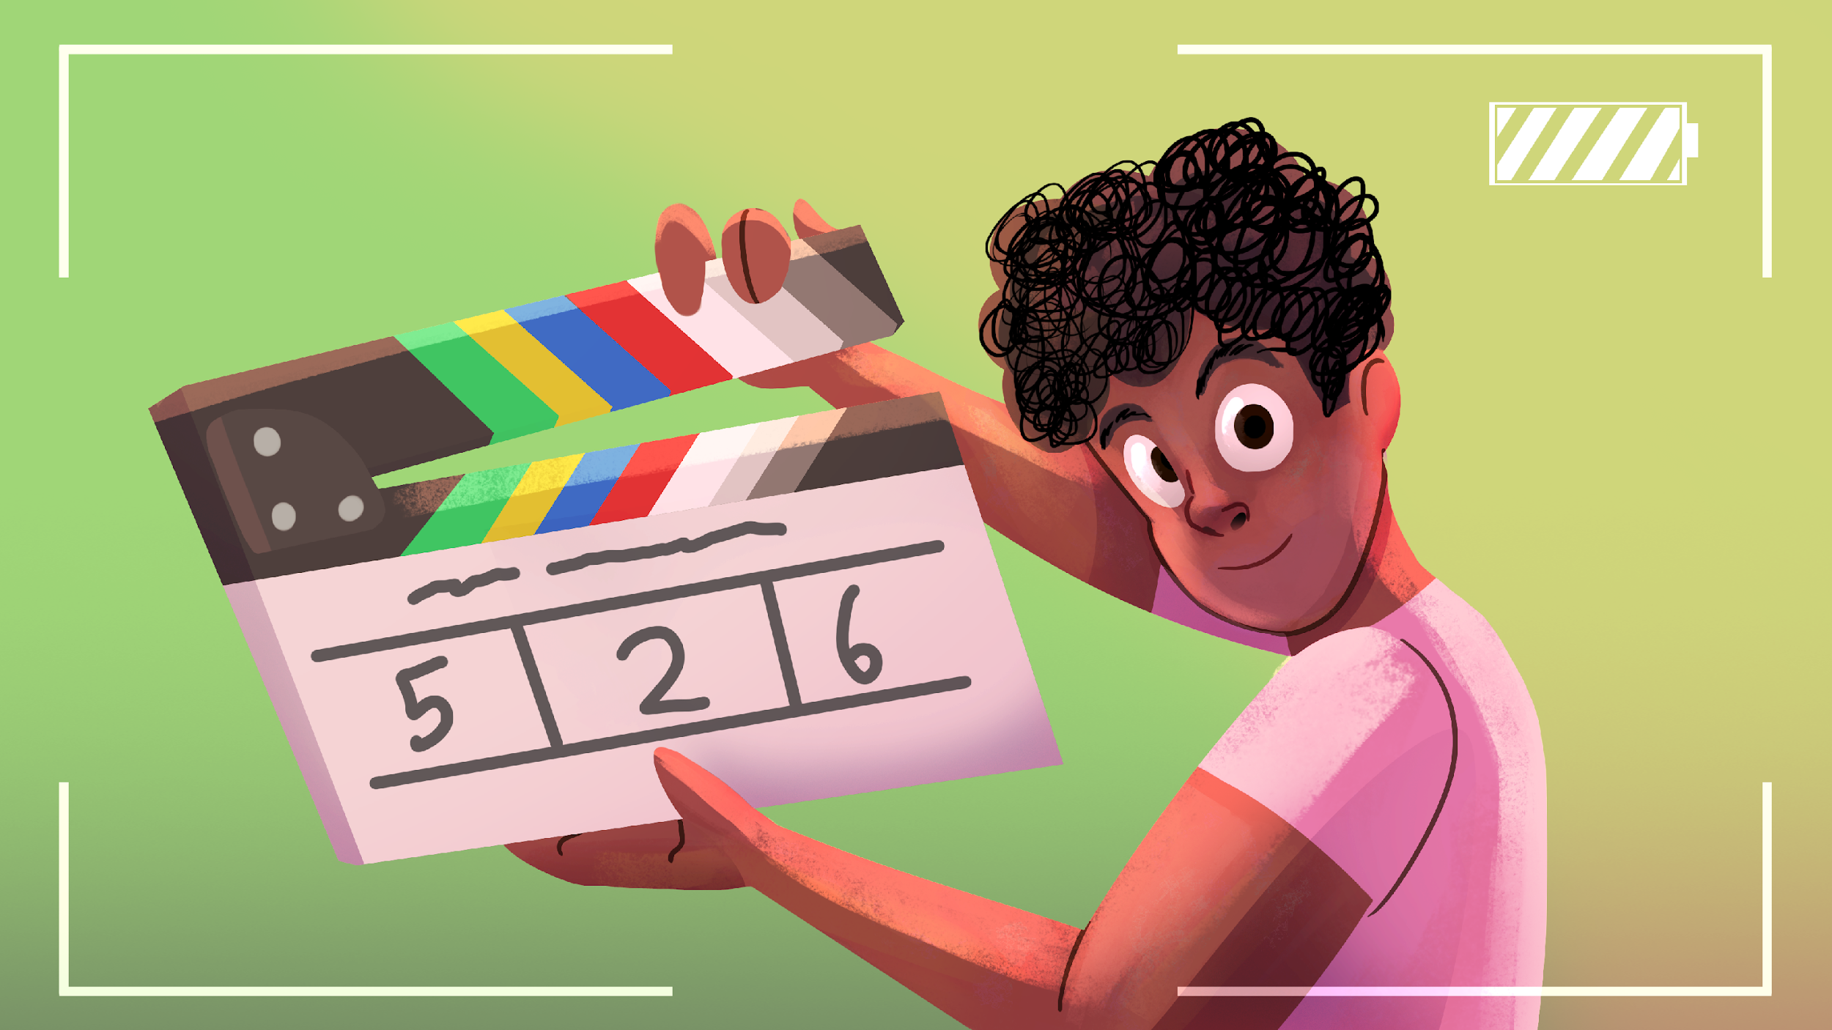
Videography
Telling Stories One Shot at a Time

Slide 3
Essential Question
How can you use camera shots and editing to tell a story visually?

Slide 4
Objectives
Identify different types of camera shots.
Demonstrate basic camera operation and setup.
Edit footage using basic editing techniques.
Produce a finalized short video product.

Slide 5
Making a Shot List
You are going to be composing a shot list from a short clip from a movie or TV show.
  Choose a short clip about 1-3 minutes long.
  It must be school appropriate.
  Watch the clip twice. The first time all the way through, and the second, pausing to fill in your handout.

Slide 6

I Notice, I Wonder
What was a particular shot that you found interesting or particularly compelling?
What did you notice about how it was used?
What do you still wonder?

Slide 7
What is a Shot List?
A shot list is the structure or skeleton of your video, it’s a map of your scene.
You want to create a comprehensive list of every shot including details like the shot number, shot type, the camera movement, and a short description, as well as other information.
Shot List Example from Wonder Woman

Slide 8
Basic Camera Functionality
Take some time to familiarize yourself with the basic features of the camera. You should be able to:
  Power the camera on and off.
  Start and stop recording.
  Zoom in and out.

Slide 9
Basic Camera Functionality – Cont.
  Watch something on playback
  Connect a mic
  Connect headphones
  Mount on tripod

Slide 10

Shot Scavenger Hunt
You are going to go on a scavenger hunt for various shots around the school.
Using your Scavenger Hunt handout on the back of the Shot Types, collect at least one of each type of shot.

Slide 11
Scavenger Hunt Review
Upload your clips to the place provided for you.
As you watch some of the clips, think about if it fits the shot type requested.
What went well in the clip? What did not?

Slide 12
Shot Sequence
A shot sequence is a group of camera shots that are edited together to show a complete action or tell part of a story.
Each shot shows something different, like what is happening, where, and to whom.

Slide 13

Example Shot Sequence

Slide 14

Shot Types – Establishing
Shows the setting or location.
Helps the viewer know where a scene takes place.
Example: A wide shot of a building or hallway.

Slide 15
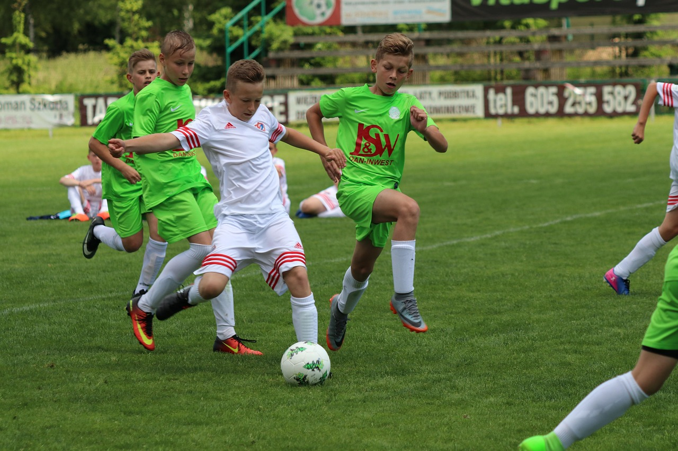
Shot Types – Wide
This shot shows the entire subject and their relation to what is around them.
Example: Showing two characters head to toe.

Slide 16

Shot Types – Medium Shot
Shows the subject from the waist up.
Used for showing actions or interactions.
Example: A student walks into a room.

Slide 17

Shot Types – Close-Up
Focuses on a face or object.
Used to show emotion or detail.
Example: A close shot of a surprised face.

Slide 18

Shot Types – POV
A shot taken from the perspective or “view” of a character or subject.
Example: A shot of what someone see on their phone.

Slide 19
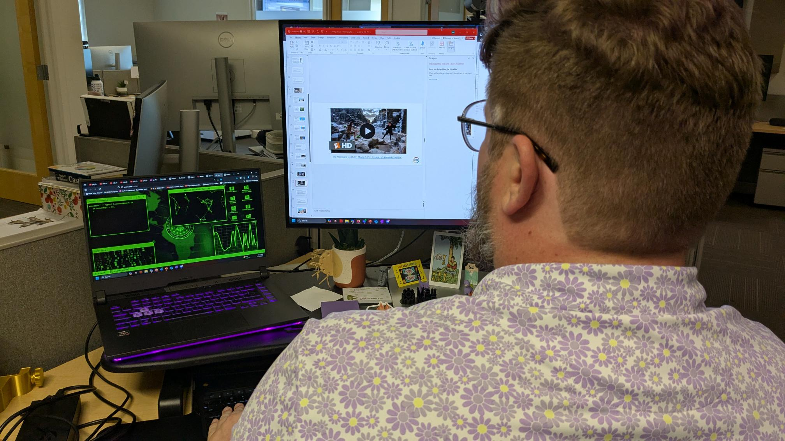
Shot Types – Over the Shoulder (OTS)
A camera angle where the camera is placed behind the back above the shoulder of a subject.
Commonly used to show a back and forth between characters.
Example: A heated conversation.

Slide 20
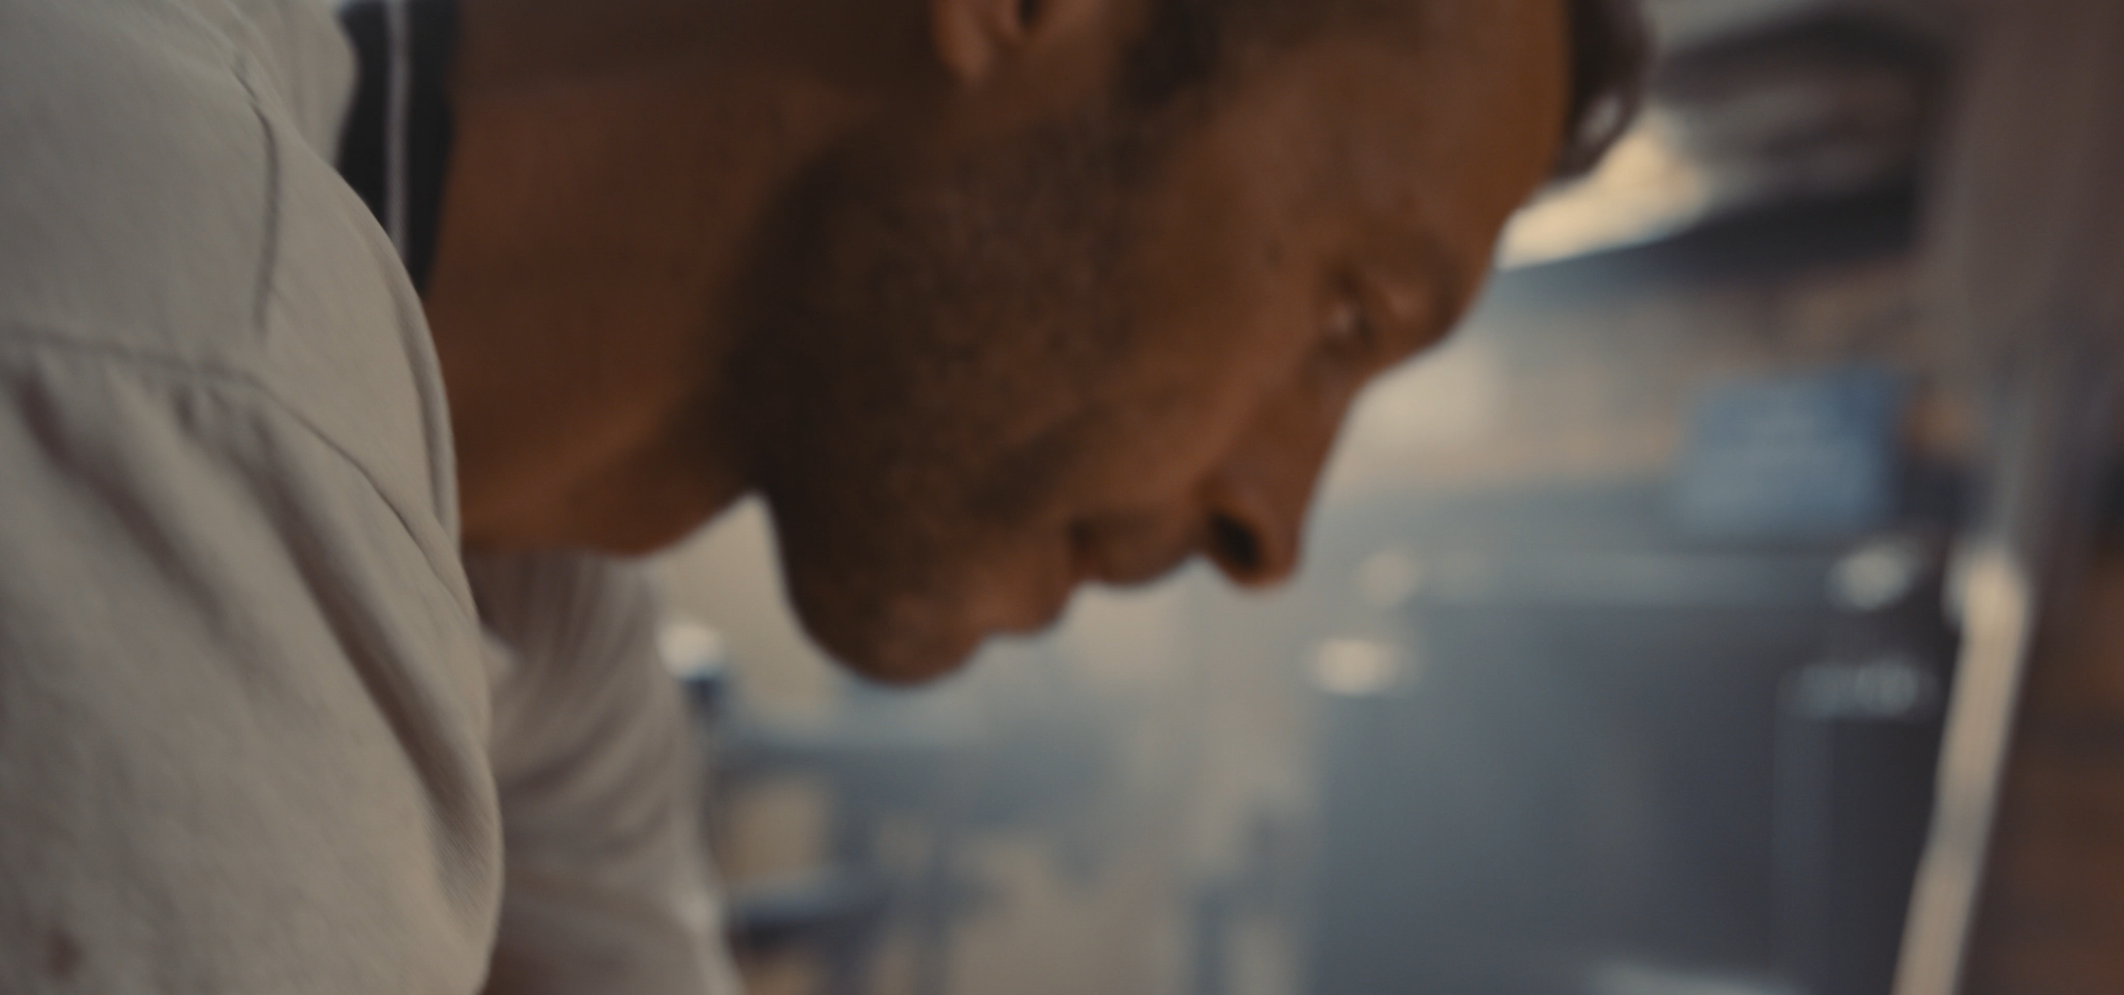
Shot Types – Cut-In
Zooms on a specific part of the subject.
Adds detail or emphasis.
Example: A close shot of someone tapping on a desk.

Slide 21
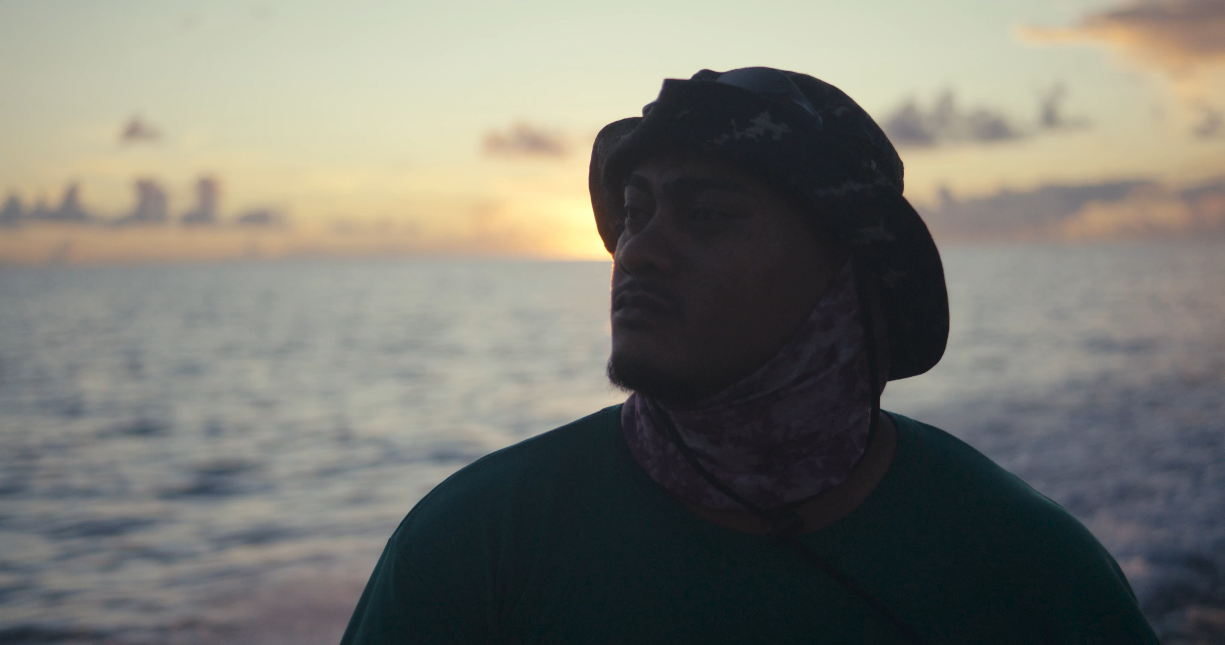
Shot Types – Cutaway
Shows something outside the main action.
Adds context or reaction.
Example: The characters discuss someone in another room, who is then shown.

Slide 22
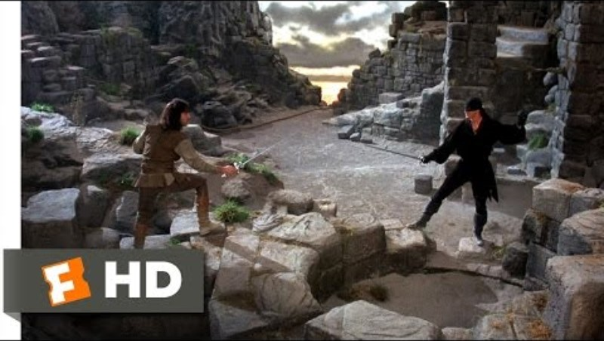
The Princess Bride (3/12) Movie CLIP - I Am Not Left-Handed (1987) HD

Slide 23
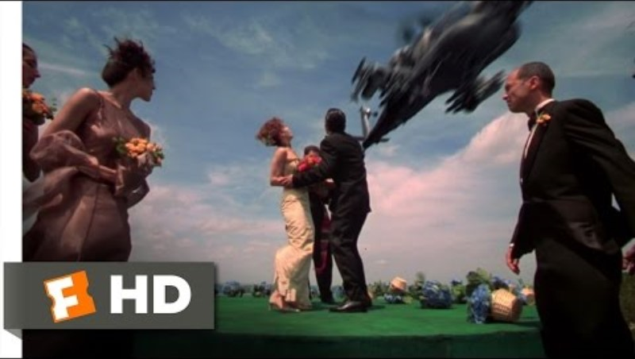
Spy Kids (1/10) Movie CLIP - Marriage is a Mission (2001) HD

Slide 24
Framing & Composition
Framing refers to what the image shows or does not show. For example, a character who is “out of frame” is present but not shown in the scene.
Composition is the arrangement of elements in the scene itself, often done in a way to create a specific effect or

Slide 25
Rule of Thirds
This is a composition guideline which encourages dividing a frame into nine parts using two vertical and two horizontal lines.
Subjects should then be placed at the intersections of these lines. (See the example on the next slide).

Slide 26
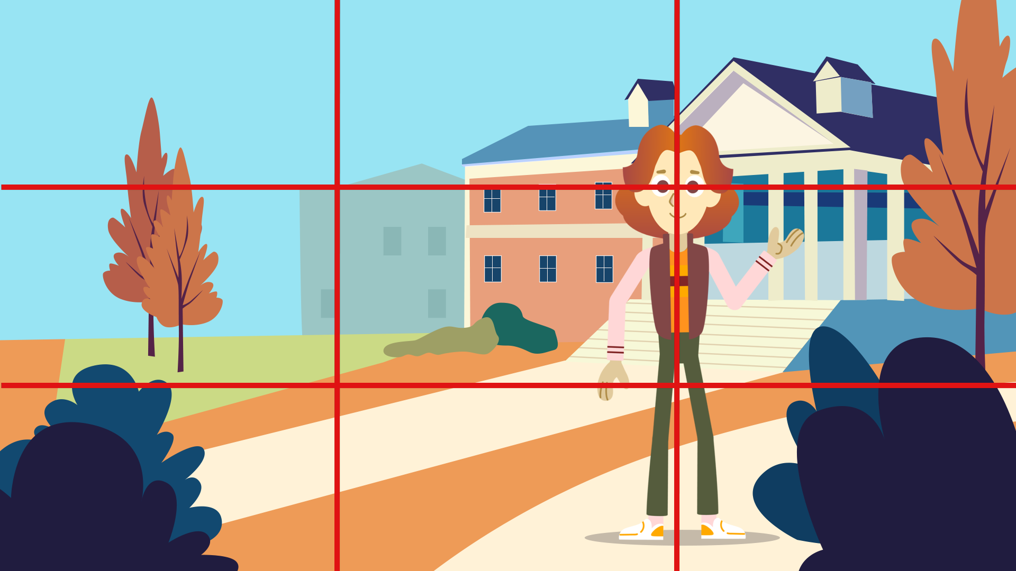
Rule of Thirds - Example

Slide 27
Headroom
Refers to the space between the top of the subjects head and the top of the frame.
Relates to the Rule of Thirds, proper head room creates visual balance and impacts how viewers “see” a subject.

Slide 28


Headroom - Examples
Correct
Incorrect

Slide 29
Lead Room (Nose Room)
This is the space in front, and in the direction of, moving or still subjects.
Shots with good framing leave a bit of room in front of an object, which corresponds to what the human eye expects.
Example: A race car moving down the track, with room in front.

Slide 30


Lead Room (Nose Room) - Example
Correct
Incorrect

Slide 31
Balance
Balance in a shot refers to all the elements in the frame feeling evenly placed and visually comfortable.
For example, a person on one side of the frame and something interesting on the other side.

Slide 32
Symmetry
Symmetry is when both sides of a shot look very similar or the same. Often used to show calm, order, and tranquility.
For example, a person standing in the center of the hallway with equal space on both sides.

Slide 33

Symmetry or Balance?

Slide 34
Tell A Story
Using the scenarios you will see in just a bit, you are going to tell your own story through film.
Each shot needs to have a purpose.
The story must be told chronologically.
Must use a mix of ten shots, with one each of: Establishing, Wide, Medium, Close Up, Cut-in, and Cut Away.

Slide 35
Tell A Story: Scenarios
Trashketball Showdown
  Two fierce competitors face off to score a goal in a game of trashketball.
The Great Hallway Race
  A dramatic photo finish between classmates in a hallway race.

Slide 36
Tell A Story: Scenarios (cont.)
Rock, Paper, Chaos
  A tense game of rock, paper, scissors, with unexpected twists and turns.
The Tale of the Lost Pencil
  A student has lost their lucky pencil and finds it in the unlikeliest of places.

Slide 37
Chop it Up!
Using the provided guide, edit your video into a coherent, chronological story.
It must be at least 90 seconds long, but not over three minutes.
Use one of each: Establishing, Wide, Medium, Close Up, Cut Away, Cut-in.

Slide 38

3-2-1 Feedback
Using the provided handout, answer the questions to give feedback as you watch each video.

Slide 39
That’s a Wrap
What could have made this project easier or more successful?
What part of the video making process did you find most challenging?
How did your editing choices affect the way the story was told?

