Slide 2
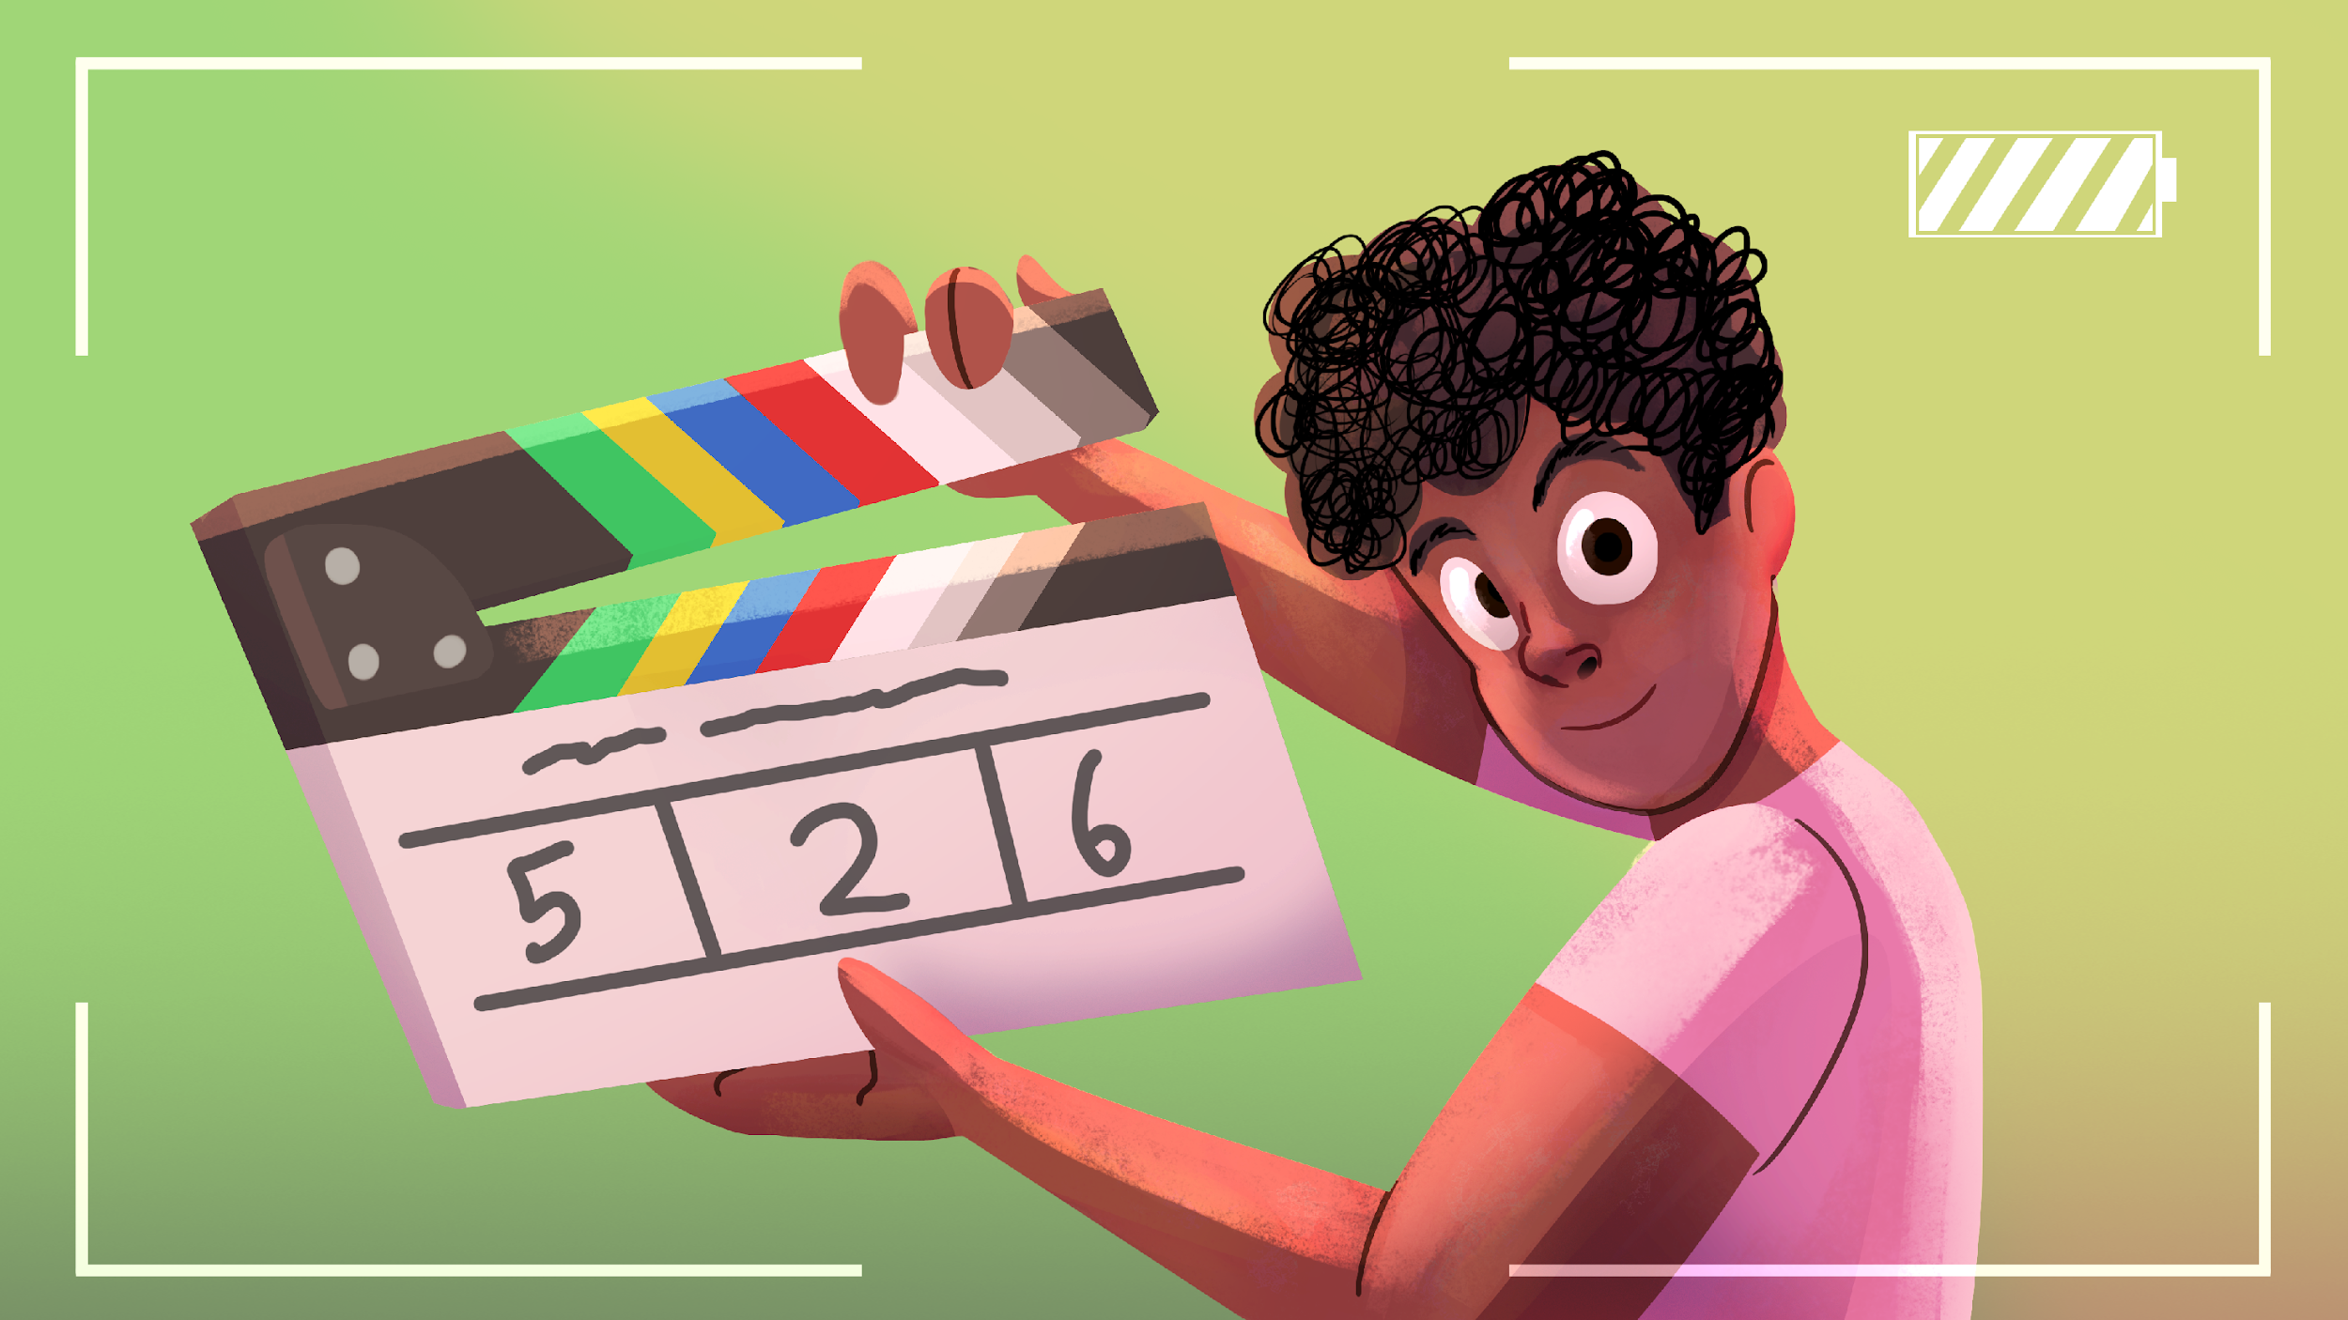
Videography
Telling Stories One Shot at a Time

Slide 3
Essential Question
How can you use camera shots and editing to tell a story visually?

Slide 4
Learning Objectives
Identify different types of camera shots.
Demonstrate basic camera operation and setup.
Edit footage using basic editing techniques.
Produce a finalized short video product.

Slide 5
Making a Shot List
Compose a shot list using a short clip from a movie or TV show.
  Choose a short clip that is about 1–3 minutes long.
    The clip must be school appropriate.
  Watch the clip twice. Watch it one time all the way through then watch it a second time, pausing to complete your handout.

Slide 6

I Notice, I Wonder
Which shot did you find particularly interesting or compelling?
What did you notice about how the shot was used?
What do you still wonder?
Notes:
K20 Center. (n.d.). I notice, I wonder. Strategies. https://learn.k20center.ou.edu/strategy/180

Slide 7
What is a Shot List?
A shot list is the structure or skeleton of your video. Think of it as a map of your scene.
Shot lists should be a comprehensive list of every shot with details including the shot numbers, shot types, camera movement, and short descriptions of each shot.
Identify these details in the shot list for Wonder Woman.
Notes:
Shot list for Wonder Woman. (2025). Studio Binder. https://app.studiobinder.com/company/580e85847e7982164664e844/collab/66ee07a4cb549cdd5a4c7abd/projects/66ee06ce7e498ff44f63133b/shots/66ee06db9358adfb649e8245?utm_source=blog&utm_medium=sb-app&utm_campaign=shot-list&utm_content=wonder-woman-shot-list&utm_term=shot-list-template

Slide 8
Basic Camera Functionality
Explore the basic features of your camera.
Each person should be able to:
  Power the camera on and off
  Start and stop recording
  Zoom in and out

Slide 9
Basic Camera Functionality Cont.
Each person should be able to:
  Watch something on playback
  Connect a mic
  Connect headphones
  Mount the camera on a tripod

Slide 10

Shot Scavenger Hunt
Go on a scavenger hunt to take various shots around the school.
Use your Scavenger Hunt handout to review the different shot types you must collect.
Check shots off your list as you complete them.

Slide 11
Scavenger Hunt Review
Upload your clips in the space provided.
Watch each clip shown and consider if the clip matches the shot type.
What went well in each clip? What did not?

Slide 12
Shot Sequence
A shot sequence is a group of camera shots that are edited together to show a complete action or tell part of a story.
Each shot shows something different: what is happening, where something is happening, to whom, etc.

Slide 13

Example Shot Sequence
Notes:
Goble, D. (2020, March 2). 5-shot sequence example [Video]. YouTube. https://www.youtube.com/watch?v=Vc1g9NowqV4

Slide 14

Shot Types: Establishing Shot
An establishing shot shows the setting or location.
Helps the viewer understand where a scene takes place.
Example: A wide shot of a building or hallway.

Slide 15
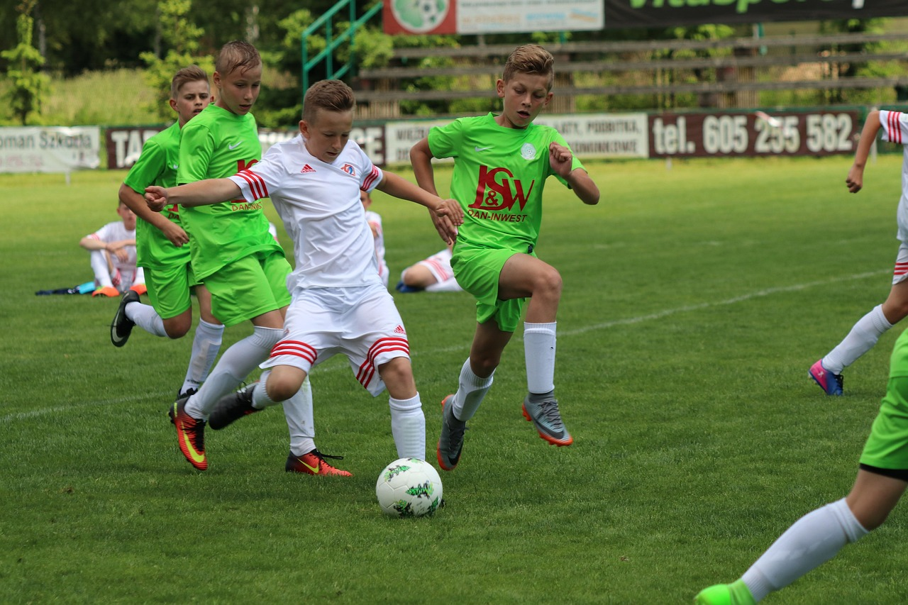
Shot Types: Wide Shot
A wide shot shows the entire subject and their relation to what is around them.
Example: A shot that shows two characters head to toe.
Notes:
amek. (n.d.). Football, youth, shot image [Image]. Pixabay. https://pixabay.com/photos/football-youth-shot-2389444/

Slide 16

Shot Types: Medium Shot
A medium shot shows the subject from the waist up.
This type of shot is used to show actions or interactions.
Example: A shot of a student walking into a room.

Slide 17

Shot Types: Close-Up Shot
A close-up shot focuses on a face or object.
This type of shot is often used to show emotion or detail.
Example: A close-up shot of a surprised face.

Slide 18

Shot Types: POV Shot
A POV shot is taken from the perspective or “view” of a character or subject.
Example: A shot of what someone sees on their phone.
Notes:
a_mv92. (n.d.). Arkansas, winter, adventure image [Photograph]. Pixabay. https://pixabay.com/photos/arkansas-winter-adventure-nature-2028759/

Slide 19
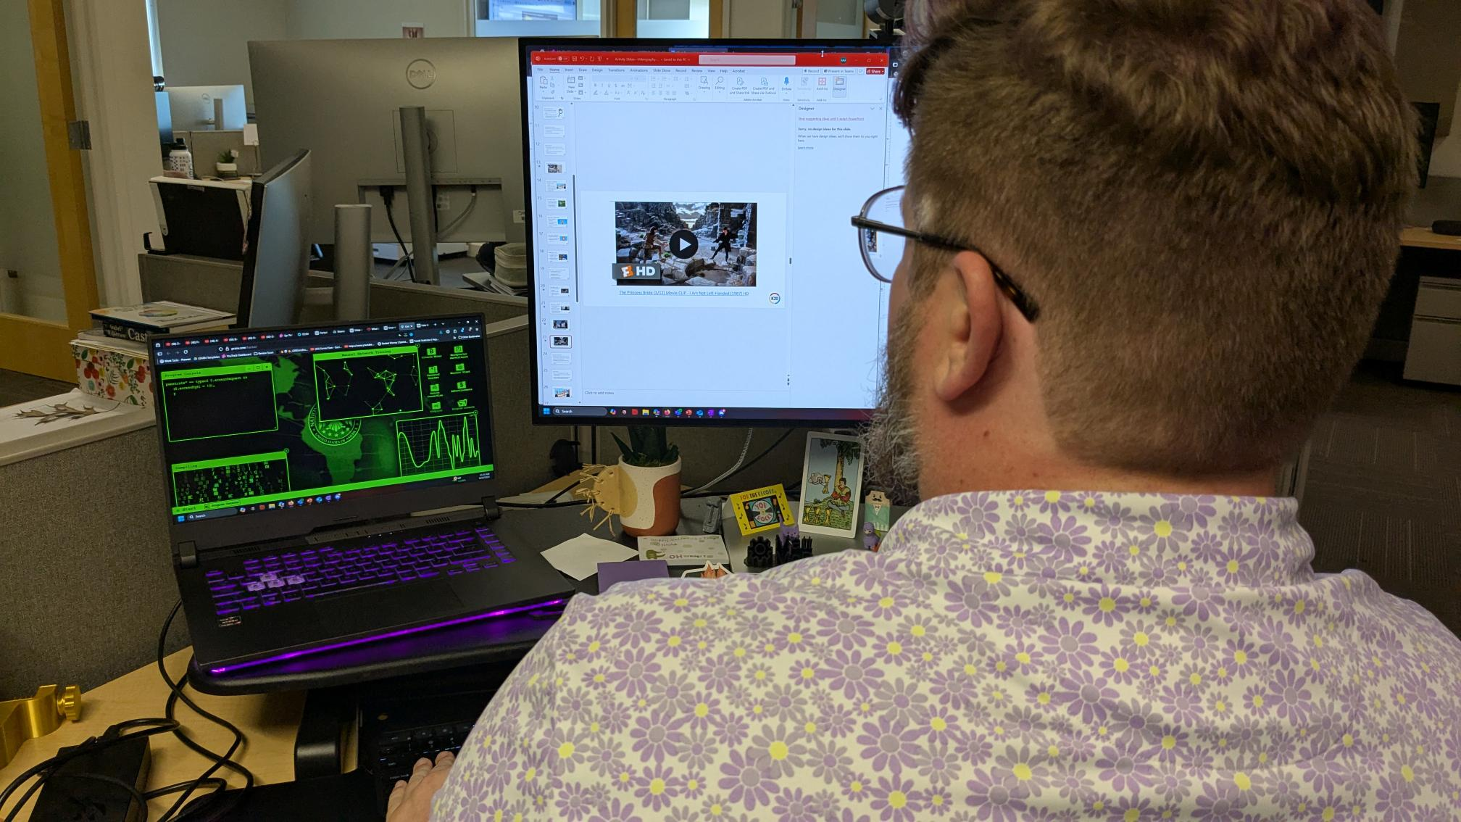
Shot Types: Over-the-Shoulder (OTS) Shot
An over-the-shoulder (OTS) shot is taken from a camera angle where the camera is placed behind a subject and looks over the subject’s shoulder.
This shot is commonly used to show a back-and-forth between two characters.
Example: Over-the-shoulder shots to capture a heated conversation.
Notes:
K20 Center. (n.d.). Over-the-shoulder shot of a person at a computer [Photograph].

Slide 20
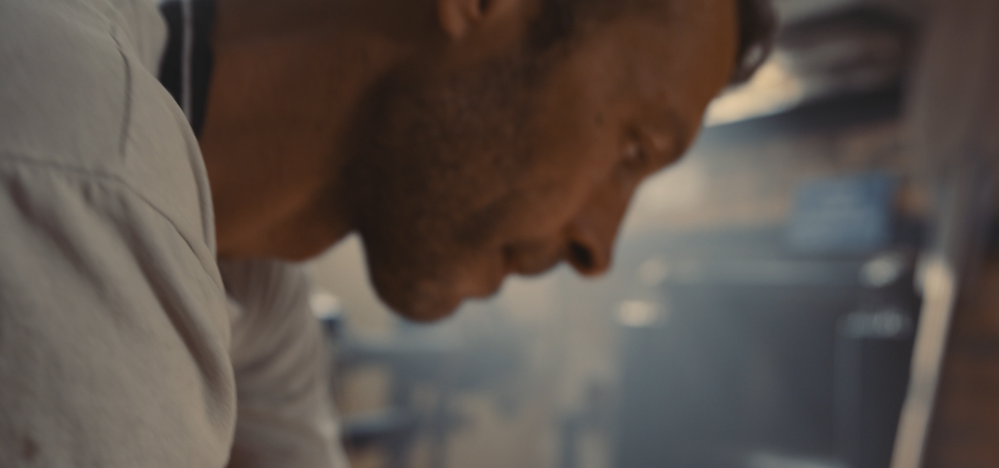
Shot Types: Cut-In Shot
A cut-in shot zooms in on a specific part of the subject.
Adds detail or emphasis.
Example: A close shot of someone tapping on a desk.
Notes:
Ohana, O. (n.d.). Baker, cutting, bread, cut [Video]. Artlist. https://artlist.io/stock-footage/clip/close-up-of-baker-cutting-bread-loaves/32482
Ohana, O. (n.d.). Baker, bread, knife, cutting [Video]. Artlist. https://artlist.io/stock-footage/clip/baker-cutting-bread/32480

Slide 21
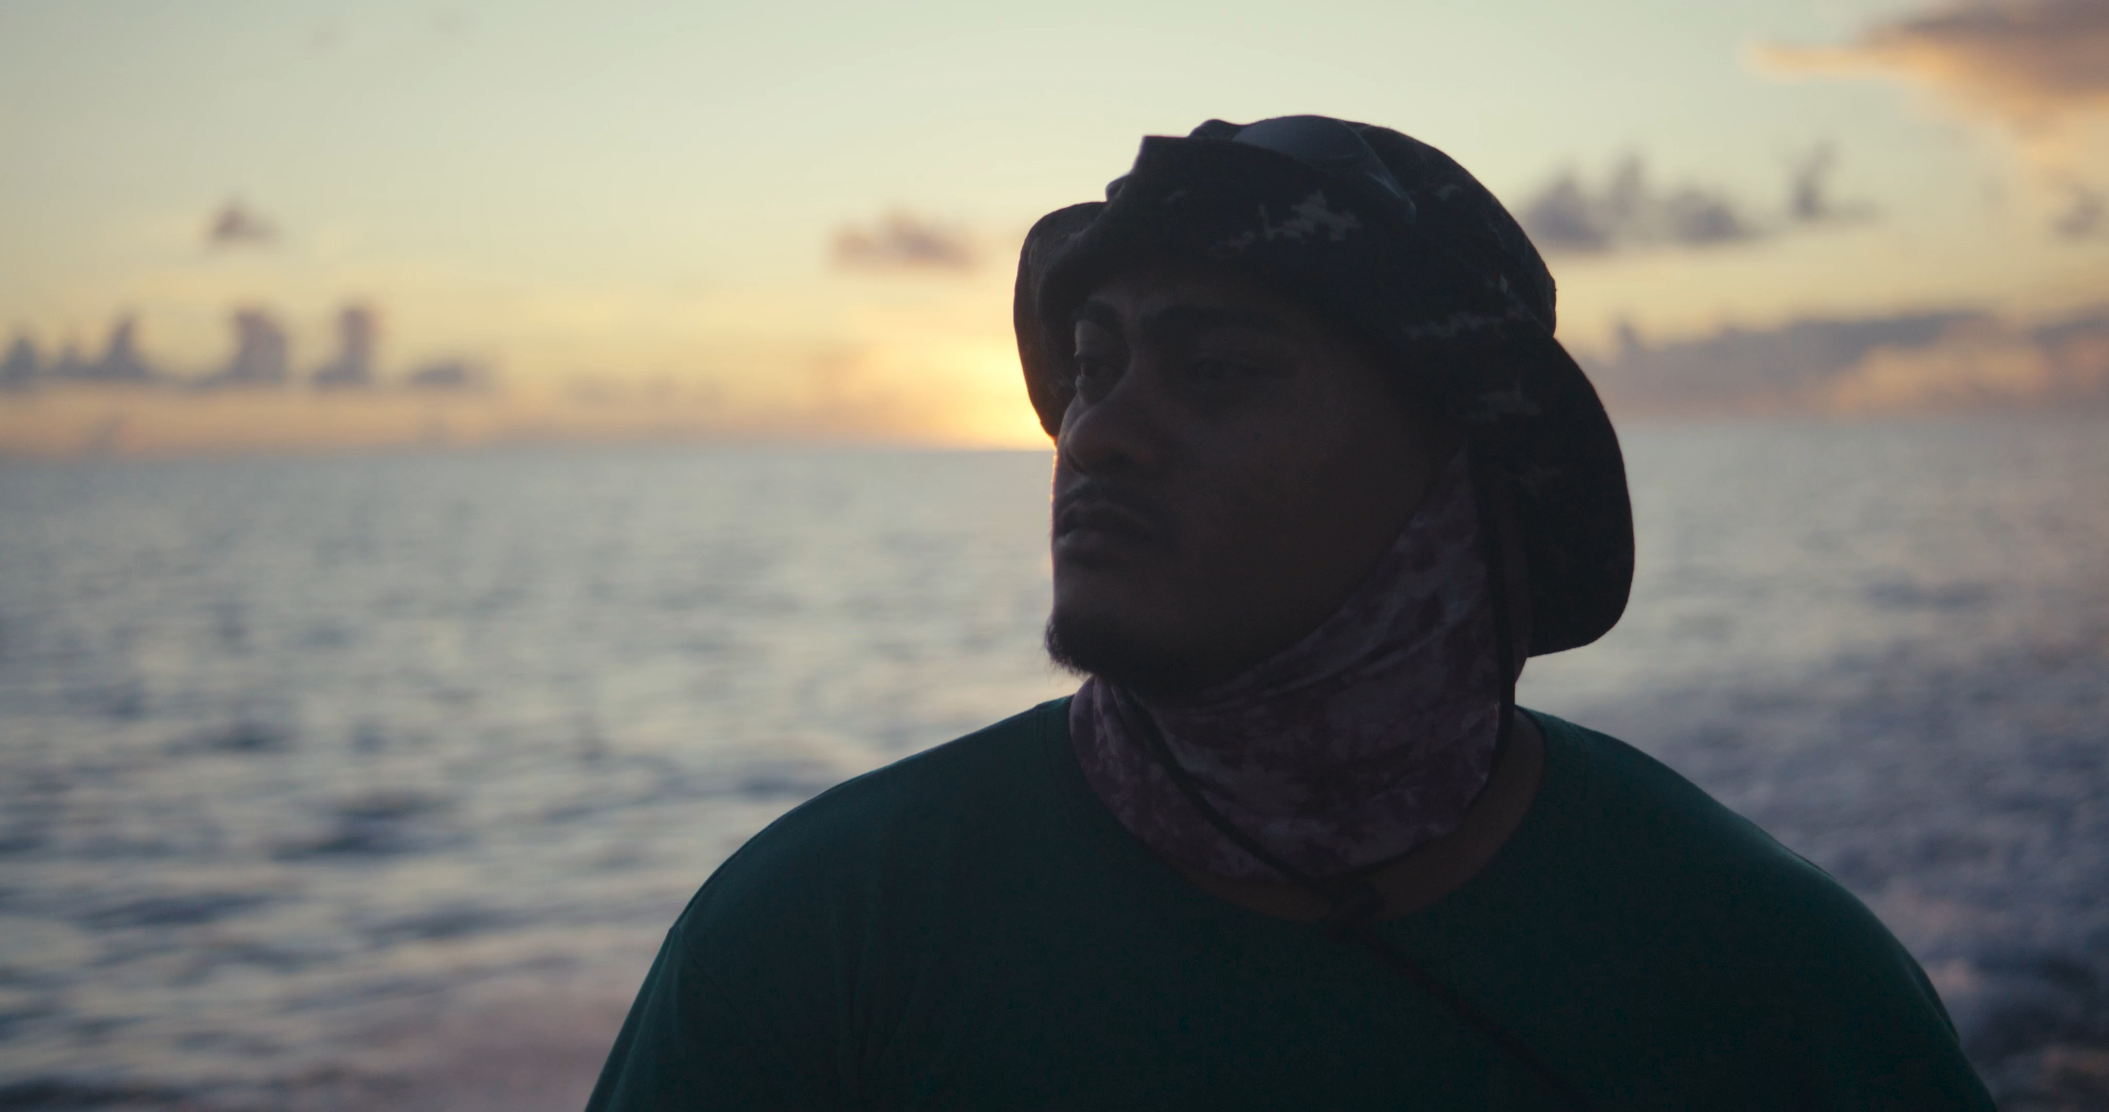
Shot Types: Cutaway Shot
A cutaway shot shows something outside of the main action.
Adds context or a reaction.
Example: Characters discuss someone in another room, who is then shown.
Notes:
Frost, S. (n.d.). Sunset, fisherman, sailing, boat [Video]. Artlist. https://artlist.io/stock-footage/clip/sunset-fisherman-sailing-boat/6496026
Frost, S. (n.d.). Kids, fun, childhood, beach [Video]. Artlist. https://artlist.io/stock-footage/clip/kids-fun-childhood-beach/6496024

Slide 22
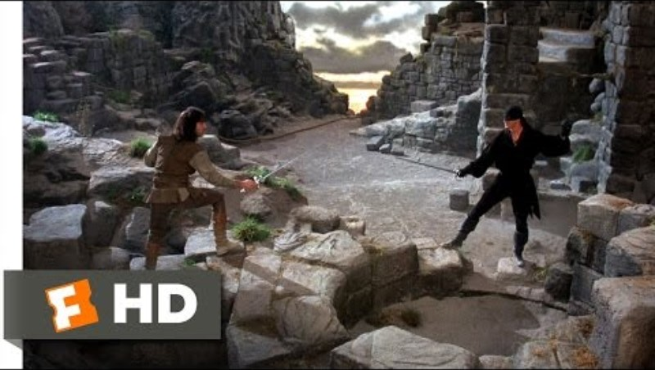
The Princess Bride—I Am not Left-Handed
Notes:
Movieclips. (2015, February 11). The Princess Bride (3/12) movie clip – I am not left-handed [Video]. YouTube. https://www.youtube.com/watch?v=rUczpTPATyU

Slide 23
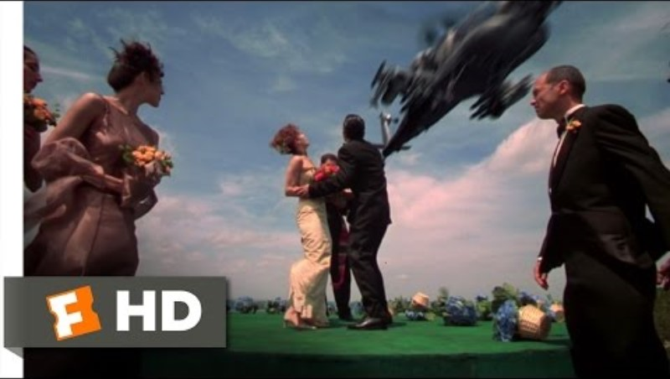
Spy Kids—Marriage is a Mission
Notes:
Movieclips. (2011, September 28). Spy Kids (1/10) movie clip – Marriage is a mission (2001) HD [Video]. YouTube. https://www.youtube.com/watch?v=AHHH770W4Wk

Slide 24
Framing & Composition
Framing refers to what the scene shows or does not show. For example, a character who is “out of frame” is present but not shown in the scene.
Composition is the arrangement of elements in the scene itself. This arrangement is often designed to create a specific effect or emotion.

Slide 25
Rule of Thirds
The rule of thirds is a composition guideline that suggests dividing a frame into nine parts using two vertical lines and two horizontal lines.
The guideline suggests that subjects should be placed at the intersections of the lines.
See an example of this rule on the next slide.

Slide 26
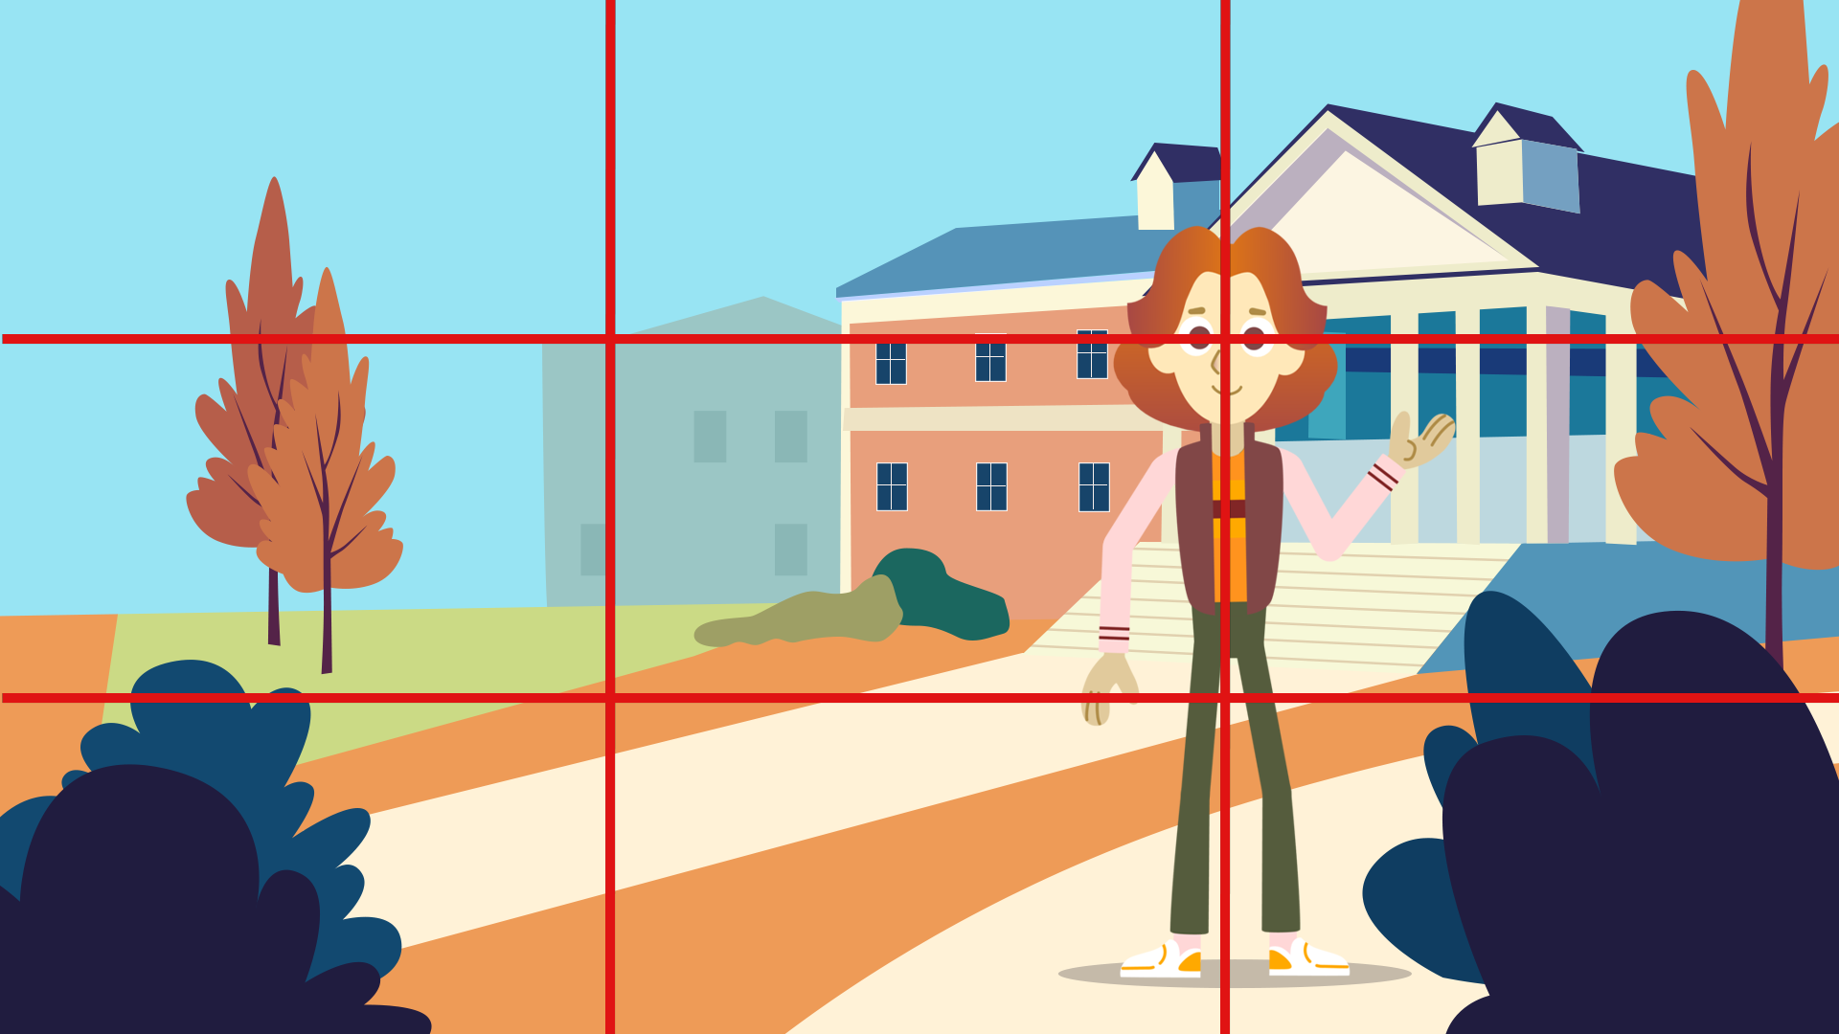
Rule of Thirds Example

Slide 27
Headroom
The term headroom refers to the space between the top of the subject’s head and the top of the frame.
This relates to the rule of thirds, as proper headroom creates a visual balance and impacts how viewers “see” a subject.

Slide 28


Headroom Examples
Correct
Incorrect

Slide 29
Lead Room or Nose Room
Lead room, also called nose room, is the space in front and in the direction of moving or still subjects.
Shots with good framing leave lead room in front of an object, which corresponds to what the human eye expects.
Example: A shot featuring a race car moving down a track leaves room in front of the car.

Slide 30


Lead Room (Nose Room) Example
Correct
Incorrect

Slide 31
Balance
When referring to a shot, balance describes all the elements in a frame being evenly placed visually comfortable.
Example: A person on one side of the frame and something interesting on the other side of the frame.

Slide 32
Symmetry
Symmetry describes both sides of a shot looking very similar or the same.
Symmetry is often used to show calm, order, and tranquility.
Example: A person standing in the center of a hallway with equal space on both sides.

Slide 33

Symmetry or Balance?

Slide 34
Tell a Story
Use the scenarios on the next slides to tell your own story through film.
Each shot must have a purpose.
The story must be told chronologically.
Use a mix of 10 shots including one of each of the following types:
  Establishing shot, wide shot, medium shot, close-up shot, cut-in shot, and cutaway shot.

Slide 35
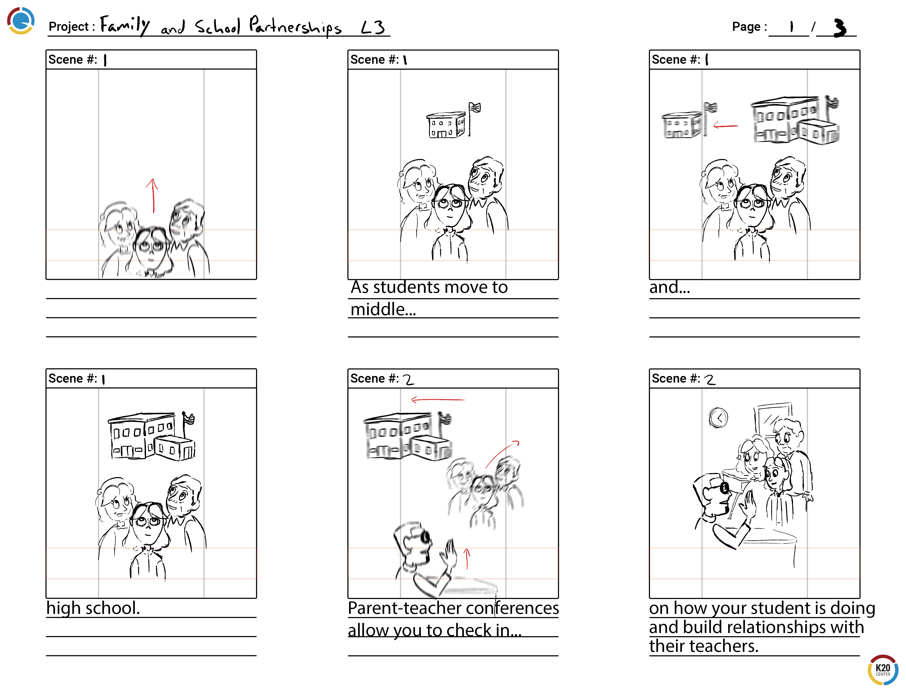
Example Storyboard

Slide 36
Tell a Story: Scenarios
Trashketball Showdown
  Two fierce competitors face off to score a goal in a game of trashketball.
The Great Hallway Race
  A dramatic photo finish of a hallway race between classmates.

Slide 37
Tell a Story: Scenarios
Rock, Paper, Chaos
  A tense game of rock, paper, scissors, with unexpected twists and turns.
The Tale of the Lost Pencil
  A student loses their lucky pencil, then finds it in the unlikeliest of places.

Slide 38
Chop it Up!
Use the provided guide to edit your video into a coherent, chronological story.
Your video must be between 90 seconds and 3 minutes long.
Use one of each of the following shots: establishing, wide, medium, close-up, cutaway, cut-in

Slide 39

3-2-1 Feedback
Watch your classmates’ videos.
Provide feedback on your peers’ videos using the 3–2–1 Feedback handout.
Notes:
K20 Center. (n.d.). 3-2-1. Strategies. https://learn.k20center.ou.edu/strategy/117

Slide 40
That’s a Wrap!
What could have made this project easier or more successful?
Which part of the video-making process did you find to be the most challenging?
How did your editing choices affect the way the story was told?

