Slide 2
Intellectual Property no Jutsu: Copywrongs, Fair Use, and Naruto v. Slater

Slide 3
Essential Question
How can you use someone else’s work ethically and legally within your own to create something new?

Slide 4
Learning Objectives
Understand intellectual property as a creator.
Understand the role of copyright laws and who they protect.

Slide 5

Create Your Personal Logo
A personal logo is an expression of your creative personality.
Your personal logo should be simple, like a symbol or silhouette, and should be unique from other well-known logos. Use no more than two colors.
Sketch several quick ideas. Fine one that represents your personal brand or style!
Notes:
K20 Center. (2021, September 21). K20 Center 5 minute timer. [Video]. YouTube. https://www.youtube.com/watch?v=EVS_yYQoLJg

Slide 6

Elbow Partners
Take turns to show and tell your partner which logo design you chose.
Explain why you chose your design. How does it represent your personal brand of self expression and the creative identity you would like to grow into?

Slide 7
What protects you?
Think about the following scenario:
I took your logo, put it on a sweatshirt, and sold them for 60 dollars each.
Discuss the following questions with your Elbow Partner:
How would you feel if this happened to you?
What can you do about this?
In this scenario, what do you think gives you the right to take action against me? What do you think protects me?

Slide 8
Implications
Good news: your logo is already legally protected under copyright. No need to apply for it. You owned it the second you created it.
Legally, you can take me to court.

Slide 9

Think-Pair-Share
Does information want to be free?
“On the one hand, information wants to be expensive because it’s so valuable. The right information in the right place just changes your life. On the other hand, information wants to be free because the cost of getting it out is getting lower and lower all the time. So you have these two fighting against each other.” –Stuart Brand

Slide 10
Think-Pair-Share
Does information want to be free?
“On the one hand, information wants to be expensive because it’s so valuable. The right information in the right place just changes your life. On the other hand, information wants to be free because the cost of getting it out is getting lower and lower all the time. So you have these two fighting against each other.” –Stuart Brand
Thinking about the quote and what you have learned so far, what do you think “information wants to be free” means in its full context?

Slide 11
Does information want to be free?
Some info is valuable and costs money (like paywalled content).
But tech makes sharing cheap and fast, which makes attempts to control or restrict content (like with a paywall) almost impossible.
This creates a conflict: people want to get paid for their work, but the internet makes copies of things and spreads them around fast.
Pictures, videos, and language go viral (spreading like a a virus) or become memes (from the word “memetic,” passing from person to person through imitation).
Everything spreads whether you want it to or not—that’s the nature of the internet.

Slide 12
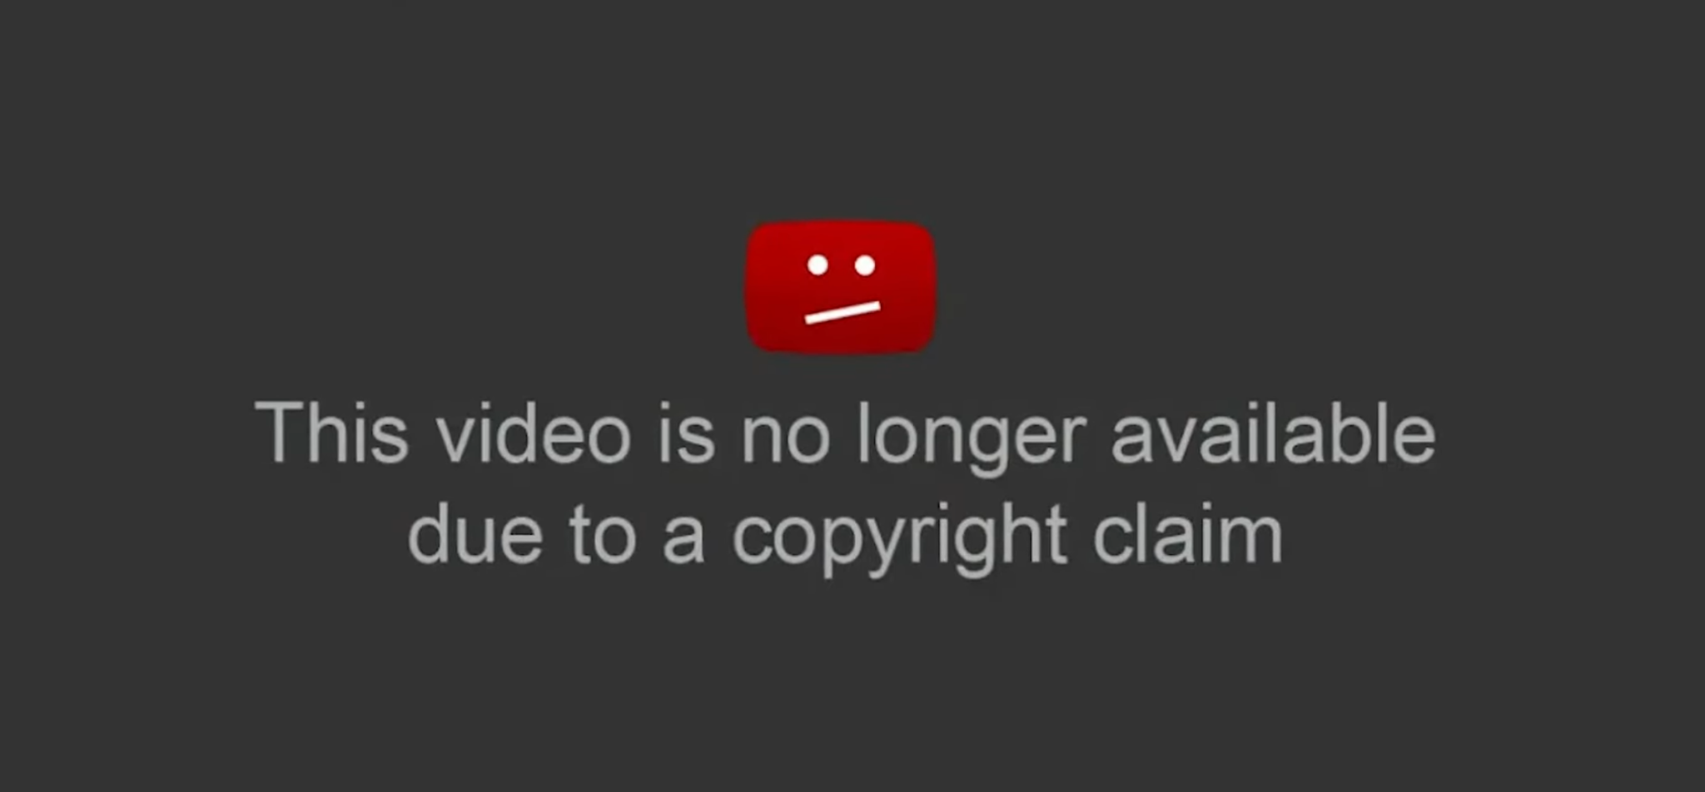
DMCA: Digital Millennium Copyright Act
Have you ever seen this or something like it?
Notes:
[@vidIQ]. (2024, September 26). Everything you NEED to know about NOT getting a copyright claim! [Video]. YouTube. https://www.youtube.com/watch?v=z6sOGNjOmVU

Slide 13
Word Cloud
What counts as intellectual property?

Slide 14
Intellectual Property
Examples of intellectual property:
Tweets
Stickers
Doodles
Logos
Pictures of your cat

Slide 15
Reflect
What have you created recently that might be protected as intellectual property?
Have you used or transformed something originally made by someone else, like a drawing or photo?

Slide 16
Copyright
Literary
Musical
Dramatic
Choreographic
Visual Art
Film
Architecture
Sound

Slide 17
Copyright
Copyright protects all original works equally.
The law doesn’t differentiate protection based on purpose or quality.
Whether it’s high art or a garbage fire, if you created it, it’s yours.
  Including work you’ve done for school.

Slide 18

Sketchnotes
As you watch the video, sketch notes of what you here. You may include lines, shapes, dots, arrows, diagrams, colors, etc. to represent key points and main ideas.
Notes:
CrashCourse. (2015, May 7). Copyright, Exceptions, and Fair Use: Crash Course Intellectual Property #3. YouTube. https://www.youtube.com/watch?v=Q_9O8J9skL0&list=PL8dPuuaLjXtMwV2btpcij8S3YohW9gUGN&index=4&ab_channel=CrashCourse

Slide 19
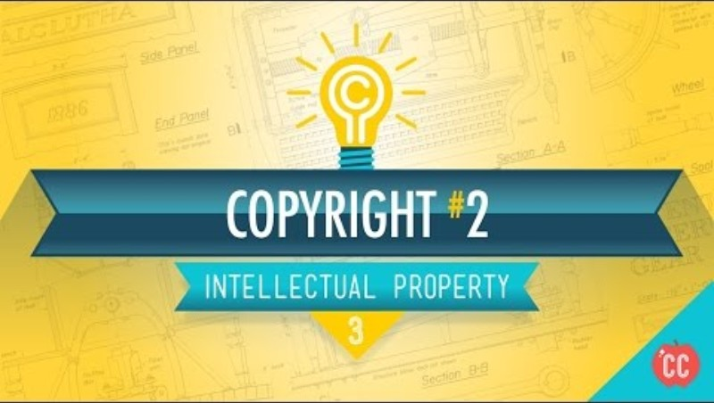
Notes:
CrashCourse. (2015, May 7). Copyright, Exceptions, and Fair Use: Crash Course Intellectual Property #3. YouTube. https://www.youtube.com/watch?v=Q_9O8J9skL0&list=PL8dPuuaLjXtMwV2btpcij8S3YohW9gUGN&index=4&ab_channel=CrashCourse

Slide 20
Takeaways
At the bottom of your notes, respond to the following question:
What piece of knowledge do you think is or will be most useful to you?

Slide 21
Stealing vs. Transforming
What do you think the difference between stealing and transforming is?

Slide 22
Fair Use
Why are you using it?
What kind of thing are you using it for?
How much are you using?
Will it hurt the original creator’s money or audience?
Notes:
Why are you using it?
If you're using it for school, a project, or to teach or comment on something, that’s usually fair. Example: Making a video essay about a movie and using short clips to explain your points.
What kind of thing are you using?
Part of something already published (like a book or song) is fairer to use than something unpublished. Something factual is fairer to use than something from a fictional or creative work. Example: Quoting a news article rather than copying a comic strip.
How much are you using?
A small part is better than a big chunk. Only use what you need. Example: Using 10 seconds of a song in your podcast intro rather than the whole track.
Will it hurt the original creator’s money or audience?
If your version replaces theirs or stops people from buying it, that’s a problem. Example: Remixing a song you like and uploading it to YouTube rather than uploading the original song.

Slide 23
Golden Rules
Golden Rule #1
Do unto others as you’d have them do unto you.
Take not from others unless you’d be okay if they did the same to you. Remember your logo on a $60 sweatshirt!
Fair use can mean remixing, referencing, reviewing, but responsibly.
Not a free pass—it's a legal defense, not a right.
What feels “fair”?
Golden Rule #2
He who has the gold makes the rules.
For example, creators—for example, on YouTube—run into automated copyright claims.
Due to corporate influence, enforcement is often stacked against small creators. Be aware!

Slide 24
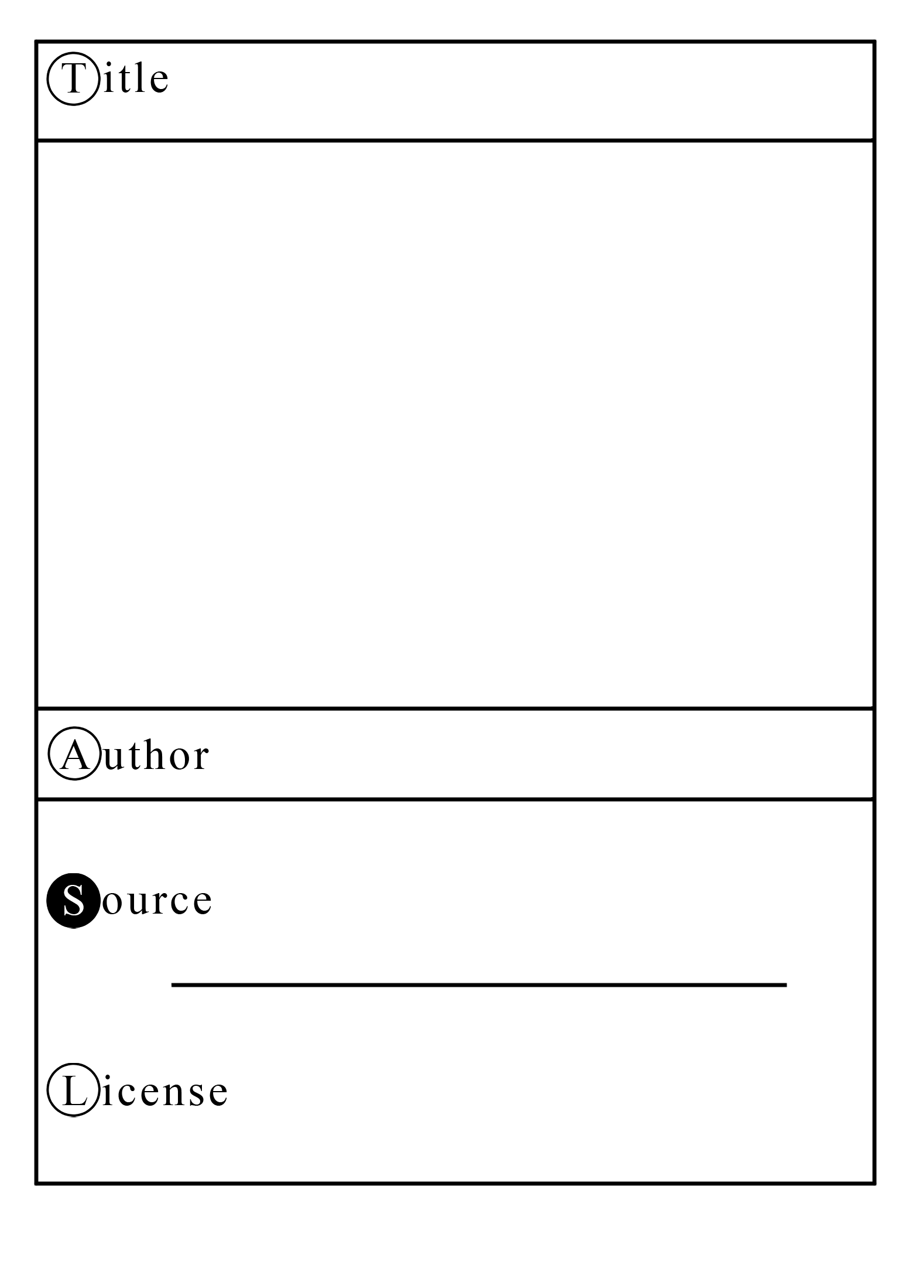
TASL Cards
T: Title
A: Author
S: Source
L: License

Slide 25
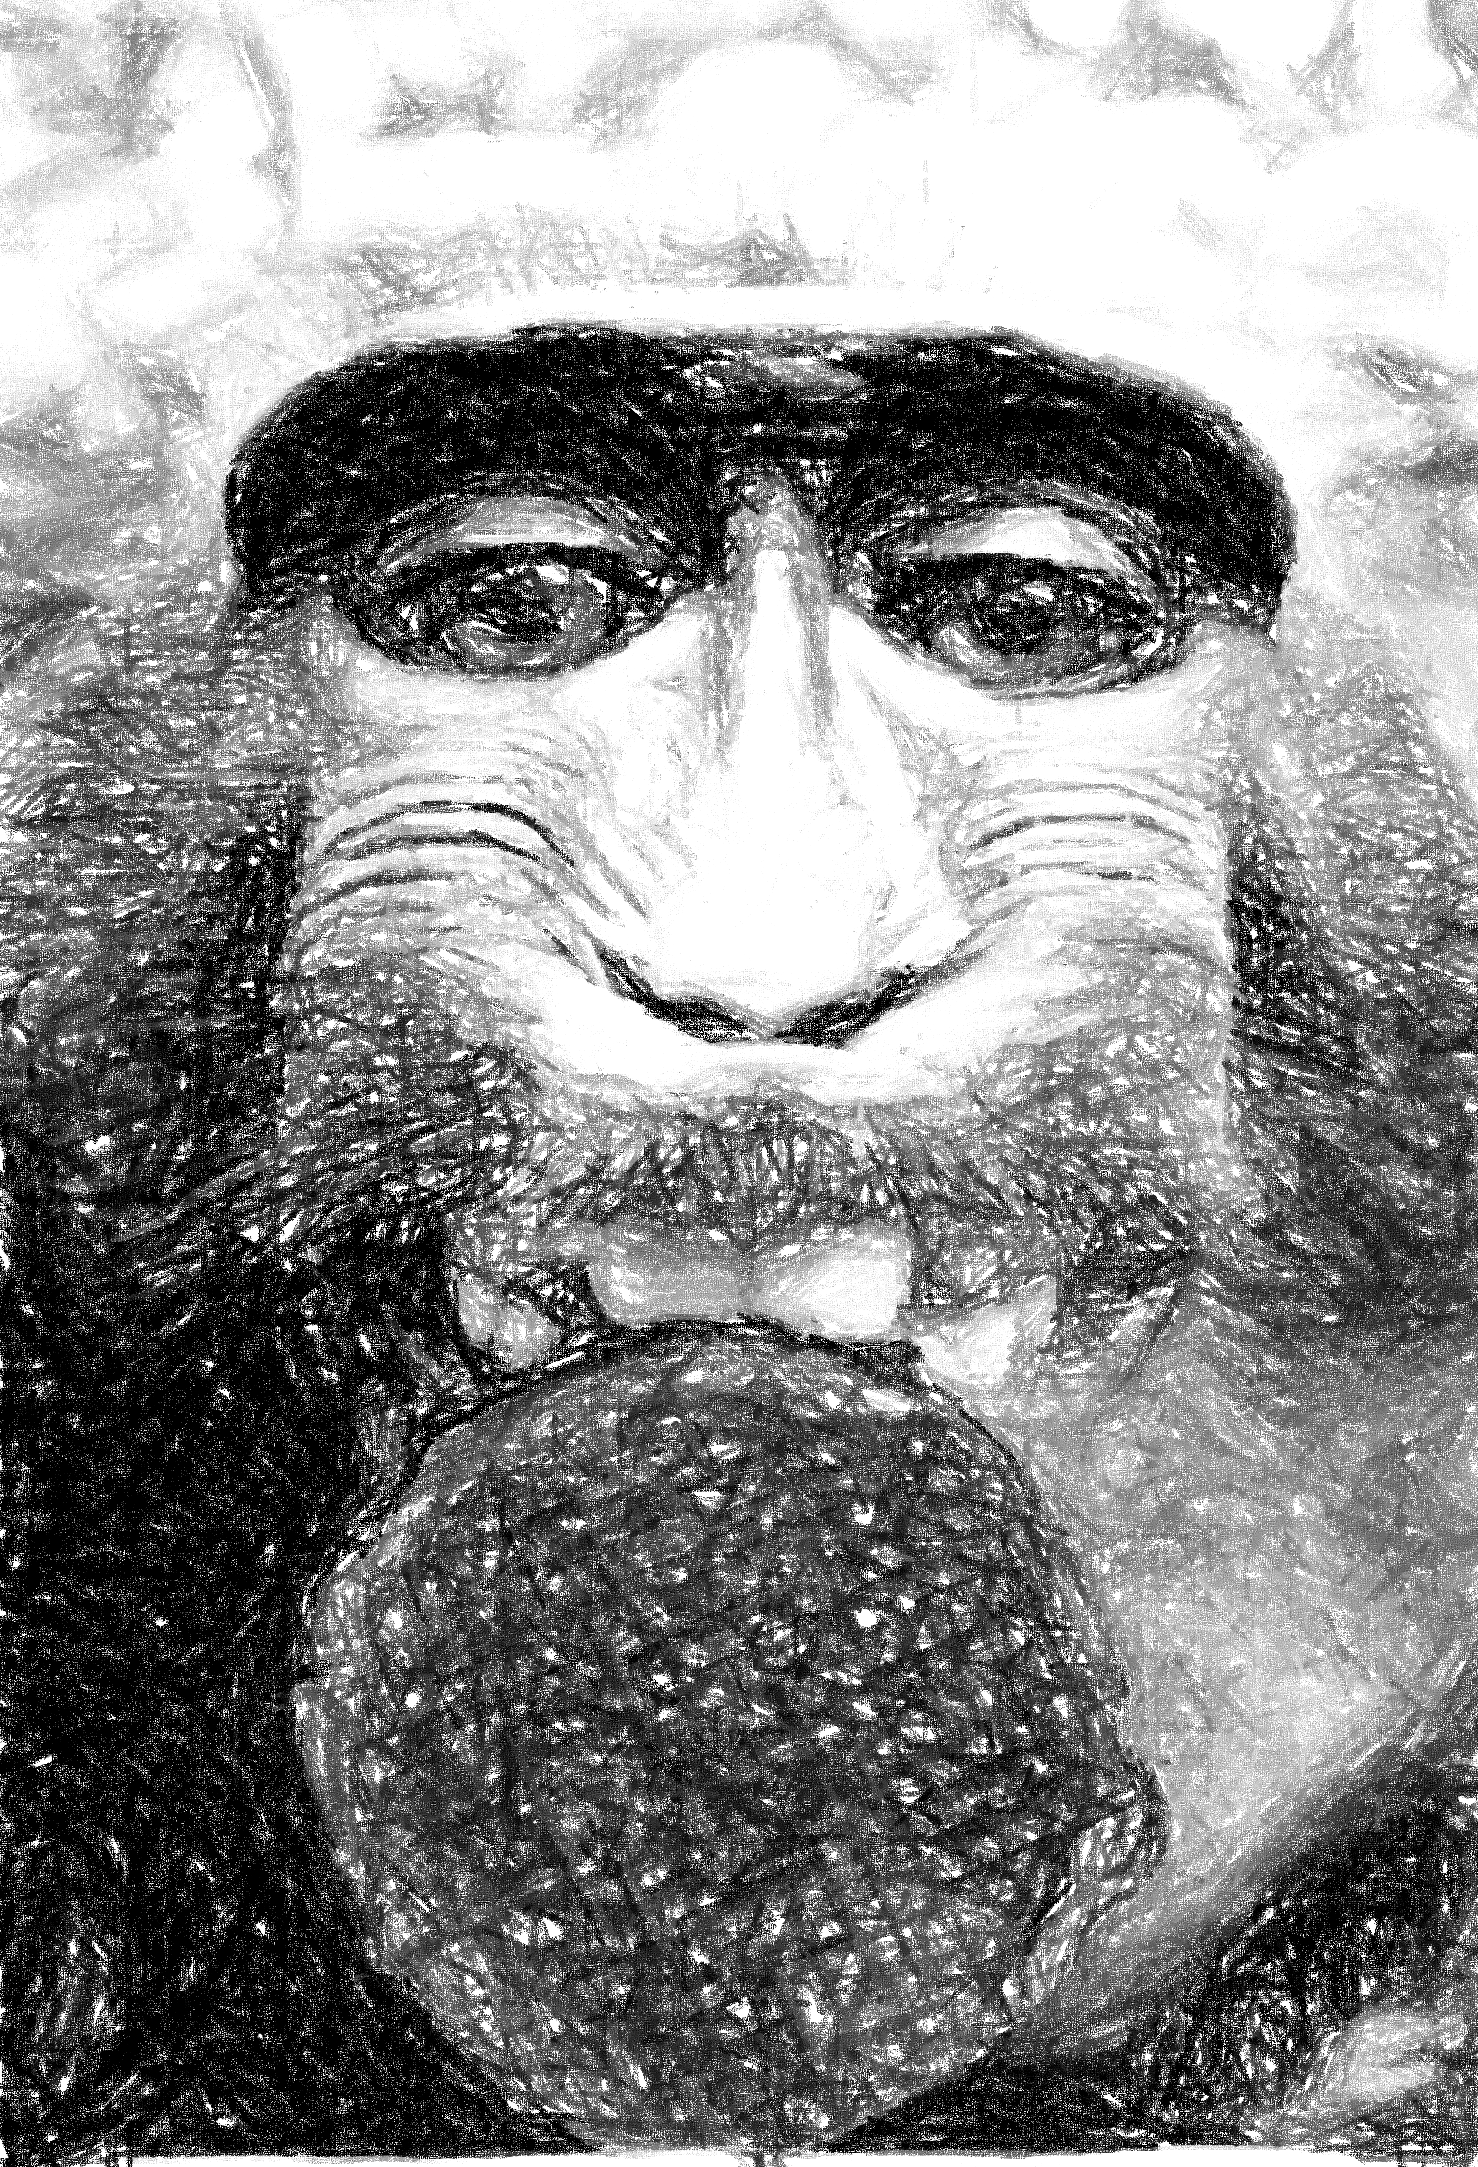
TASL Cards
Monkey selfie with a stroopwafel
T: Title
A: Author
S: Source
L: License
Ash Crow
Wikimedia Commons
Public domain
Notes:
Crow, A. (2014). Monkey selfie with a stroopwafel. Wikimedia Commons. https://commons.wikimedia.org/w/index.php?curid=34605880

Slide 26
Catalog Resources
Review the provided resources.
Gather a variety of resources (pictures, articles, etc.), make sure it is enough to complete three TASL cards.
Begin filling out your TASL card templates.

Slide 27
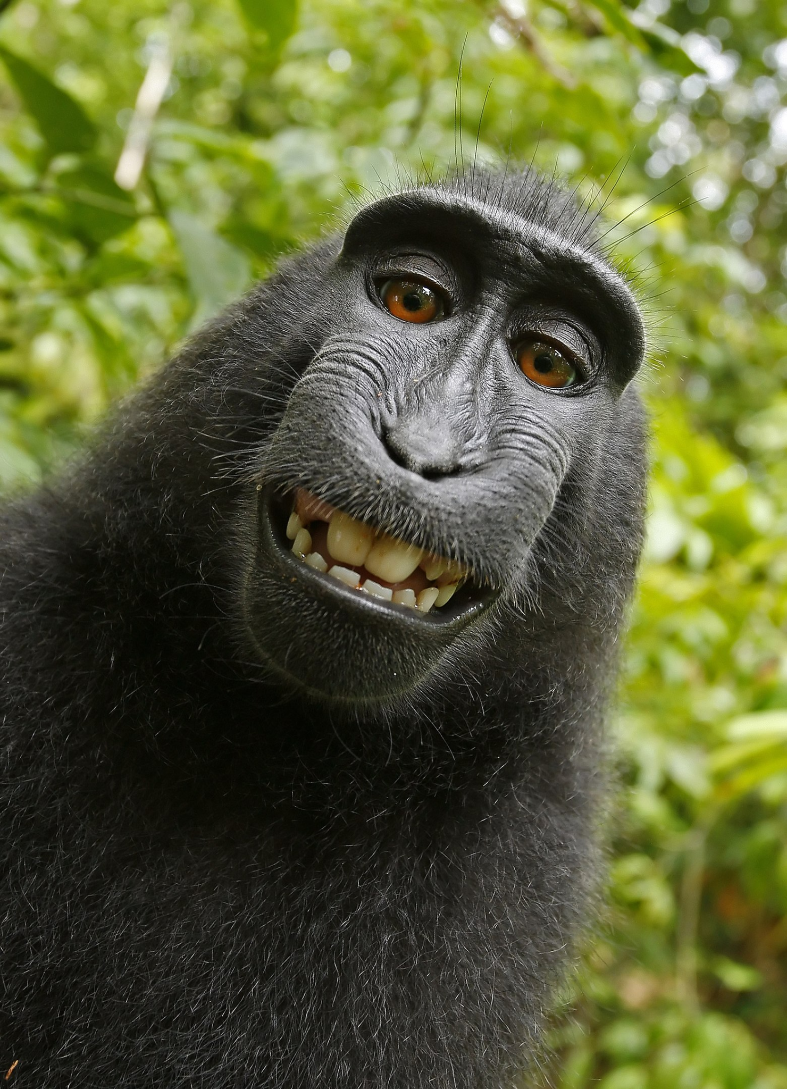
Naturo v. Slater
Notes:
Slater, D. Macaca nigra self-portrait large [Photograph]. Wikimedia Commons. https://commons.wikimedia.org/wiki/File:Macaca_nigra_self-portrait_large.jpg

Slide 28
Naturo v. Slater
Slater published the picture, which became a viral success.
Wikipedia shared the picture on Wikimedia Commons, considering it public domain. They cited the idea that Slater did not own the picture because he didn’t physically take the picture.
And because Naruto, as a monkey, can’t own intellectual property.

Slide 29
What do you think?
Turn to your elbow partner and discuss the following questions:
Are Wikipedia’s claims true? Who owns the photo?
Who do you believe should own it?

Slide 30
Naturo v. Slater Continued
Slater sued Wikipedia. He argued he should own the photo since he set up the conditions for Naruto to take the picture.
In response, PETA sued Slater on Naruto’s behalf, claiming that the monkey itself should be able to own the copyright on the picture it took.
Any proceeds PETA won from the case were planned to go to environmental conservation for Naruto’s forest habitat.

Slide 31
Naturo v. Slater Results
The U.S. Copyright Office ruled that:
Slater does not own the picture since, despite bringing about the conditions for the picture to be taken, he did not take the picture itself.
Only humans can own copyright.
As a result, the photo is considered public domain — free for anyone to use.
Slater ultimately lost a lot of money from the legal mess, and Naturo also did not see any money from it.

Slide 32
Gray Areas: AI
Think about the following questions:
What do you think about art or writing made with AI?
Can you own something made by AI?
Should AI creations be labeled?
Should everything posted online be fair game for AI to reference and remix?
Discuss the questions in your small group.

Slide 33
Reflect
Considering what you have learned about ethics, respect, and creativity so far, how will that knowledge change how you make and use different works?

Slide 34
Setting Up
Navigate to canva.com.
Select create, then websites.
Choose the portfolio website option.
Select a template.

Slide 35
Portfolio
Create a title page with the following information.
Personal logo
Your name
Type of work you do
  I.e. 3D artist, journalist, etc.
Optional: tagline
  Simple and formal: “Wilson High School Journalism Club | Lifestyle Writer”
  Express a creative goal: “Aspiring 3D Artist”
  Showcase your personality: “Making a difference one word at a time.”

Slide 36
Add Your Creations
Add a creative work that you have already made for class.
Include a visual representation of your work.
  If an article, include the front page of it. Something that others can view.
Explain your creative choices when creating your work.
If needed, include an attribution.

