Slide 2
Intellectual Property no Jutsu
Copywrongs, Fair Use, and Naruto v. Slater

Slide 3
Essential Question
How can you use someone else’s work ethically and legally within your own work to create something new?

Slide 4
Learning Objectives
Understand intellectual property from the perspective of a creator.
Understand the role of copyright laws and who they protect.

Slide 5

Create Your Personal Logo
A personal logo is an expression of your creative personality.
Create a personal logo that:
Is simple, like a symbol or silhouette
Is unique compared to other well-known logos.
Uses no more than two colors.
Sketch several ideas. Find one that represents your personal brand or style.
Notes:
K20 Center. (2021, September 21). K20 Center 5 minute timer [Video]. YouTube. https://www.youtube.com/watch?v=EVS_yYQoLJg

Slide 6

Elbow Partners
Take turns sharing with your partner which logo design you chose.
Explain why you chose your design. How does it represent your personal brand of self-expression and the creative identity you would like to grow into?
Notes:
K20 Center. (n.d.). Elbow partners. Strategies. https://learn.k20center.ou.edu/strategy/116

Slide 7
What protects you?
Think about the following scenario:
I took your logo, put it on a sweatshirt, and sold each sweatshirt for 60 dollars each.
Discuss the following questions with your Elbow Partner:
How would you feel if this happened to you?
What can you do about this?
In this scenario, what do you think gives you the right to take action against me? What do you think protects me?

Slide 8
Implications
Your logo is already legally protected under copyright. You don’t have to apply for copyright. You owned your logo from the time you created it.
Legally, you can take me to court.

Slide 9

Think-Pair-Share
Does information want to be free?
“On the one hand, information wants to be expensive because it’s so valuable. The right information in the right place just changes your life. On the other hand, information wants to be free because the cost of getting it out is getting lower and lower all the time. So you have these two fighting against each other.” –Stuart Brand
Notes:
K20 Center. (n.d.). Think-Pair-Share. Strategies. https://learn.k20center.ou.edu/strategy/139

Slide 10
Think-Pair-Share
Does information want to be free?
“On the one hand, information wants to be expensive because it’s so valuable. The right information in the right place just changes your life. On the other hand, information wants to be free because the cost of getting it out is getting lower and lower all the time. So you have these two fighting against each other.” –Stewart Brand
Thinking about the quote and what you have learned so far, what do you think “information wants to be free” means in its full context?
Notes:
Brand, S. (1984). Hackers Conference, Marin County, CA, United States.
K20 Center. (n.d.). Think-Pair-Share. Strategies. https://learn.k20center.ou.edu/strategy/139

Slide 11
Does information want to be free?
Some information is valuable and costs money, like paywalled content.
Technology makes sharing cheap and fast, which makes attempts to control or restrict content, like with a paywall, almost impossible.
This creates a conflict: People want to get paid for their work, but the internet makes copies of things and quickly spreads things around.
Pictures, videos and language go viral (spreading like a virus) or become memes (comes from the word “memetic,” which means passing between people through imitation.
Everything spreads whether you want it to or not—that’s the nature of the internet.

Slide 12

DMCA: Digital Millennium Copyright Act
Have you ever seen this or something like it?
Notes:
vidIQ. (2024, September 26). Everything you NEED to know about NOT getting a copyright claim! [Screenshot]. YouTube. https://www.youtube.com/watch?v=z6sOGNjOmVU

Slide 13
Word Cloud
What counts as intellectual property?
Notes:
Teacher’s Note: If using Mentimeter to create a word cloud, paste the QR code for the word cloud into this slide.

Slide 14
Intellectual Property
Examples of intellectual property:
Tweets
Stickers
Doodles
Logos
Pictures of your cat

Slide 15
Reflect
What have you created recently that might be protected as intellectual property?
Have you ever used or transformed something originally made by someone else, like a drawing or photo?

Slide 16
Copyright
Literary
Musical
Dramatic
Choreographic
Visual art
Film
Architecture
Sound

Slide 17
Copyright
Copyright protects all original works equally.
The law doesn’t differentiate protection based on purpose or quality.
Whether it’s high art or a rough draft, if you created it, it’s yours.
  This includes work you’ve done for school.

Slide 18

Sketchnotes
As you watch the video, sketch notes of what you hear and see.
This may include lines, shapes, dots, arrows, diagrams, colors, etc. to represent key points and main ideas.
Notes:
K20 Center. Sketchnotes. Strategies. https://learn.k20center.ou.edu/strategy/2870

Slide 19
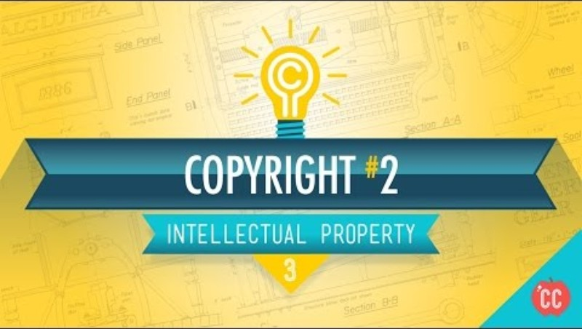
Notes:
CrashCourse. (2015, May 7). Copyright, exceptions, and fair use: Crash course intellectual property #3 [Video]. YouTube. https://www.youtube.com/watch?v=Q_9O8J9skL0&list=PL8dPuuaLjXtMwV2btpcij8S3YohW9gUGN&index=6

Slide 20
Takeaways
At the bottom of your notes, respond to the following question:
What piece of knowledge do you think is or will be most useful to you?

Slide 21
Stealing vs. Transforming
What do you think is the difference between stealing and transforming?

Slide 22
Fair Use
Why are you using it?
What kind of thing are you using it for?
How much are you using?
Will using it take away from the original creator’s money or audience?

Slide 23
Golden Rules
Golden Rule #1:
Do unto others as you’d have them do unto you.
Do not take from others unless you’d be okay if they did the same to you. Remember your logo on a $60 sweatshirt!
Fair use can mean remixing, referencing, and reviewing, but responsibly.
Fair use is not a free pass. It’s a legal defense, not a right.
What feels “fair”?
Golden Rule #2:
He who has the gold makes the rules.
For example, creators—like YouTube creators—encounter automated copyright claims.
Due to corporate influence, enforcement of copyright claims is often stacked against small creators. Be aware!

Slide 24
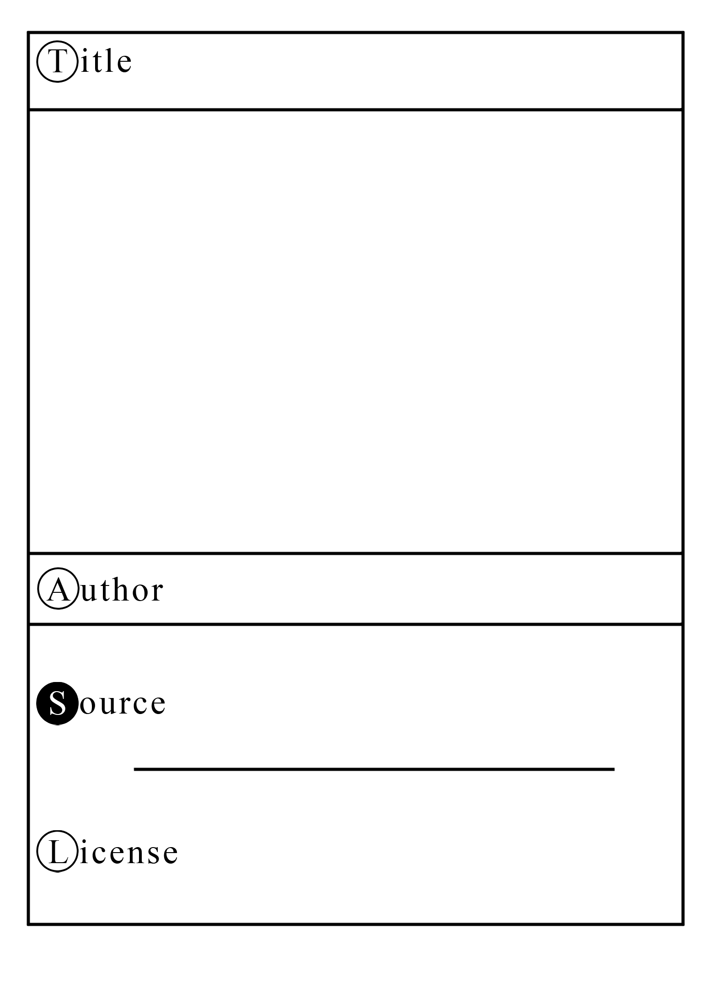
TASL Cards
T: Title
A: Author
S: Source
L: License

Slide 25
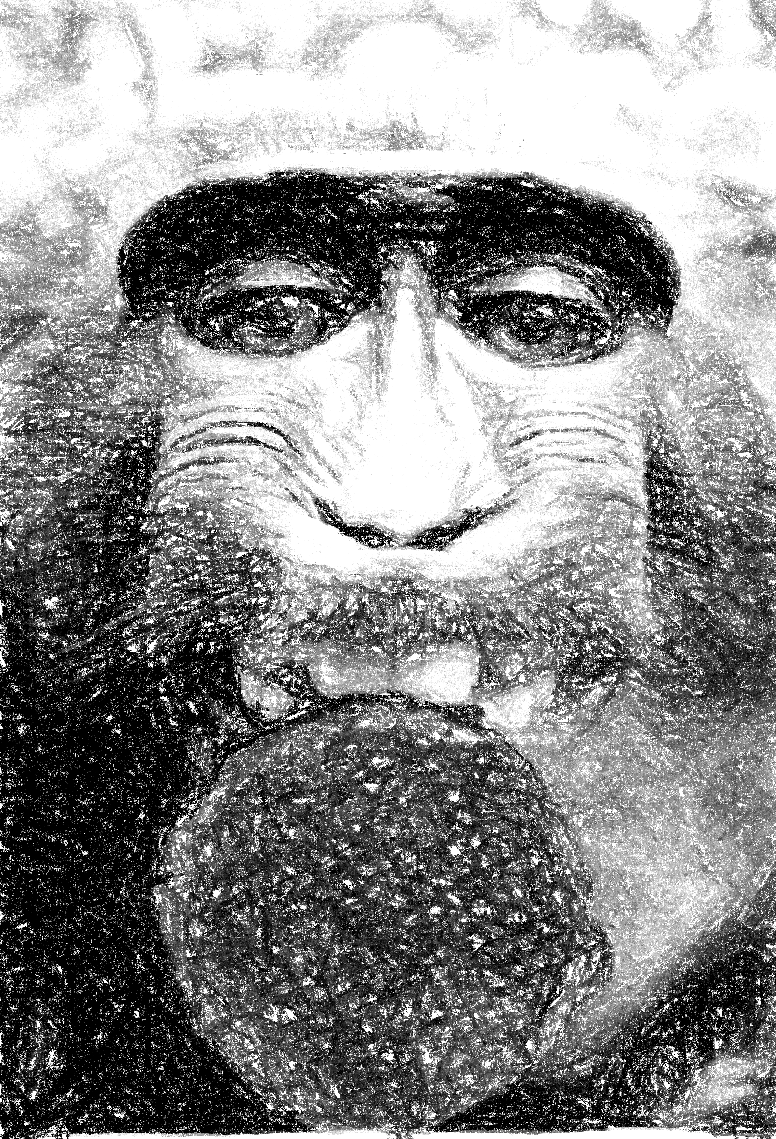
TASL Cards
Monkey selfie with a stroopwafel
T: Title
A: Author
S: Source
L: License
Ash Crow
Wikimedia Commons
Public domain
Notes:
Crow, A. (2014). Monkey selfie with a stroopwafel [Photograph]. Wikimedia Commons. https://commons.wikimedia.org/w/index.php?curid=34605880

Slide 26
Catalog Resources
Review the provided resources.
Gather a variety of additional resources (pictures, articles, etc.).
  Make sure you have enough information to complete three TASL cards.
Fill out your TASL card templates.

Slide 27
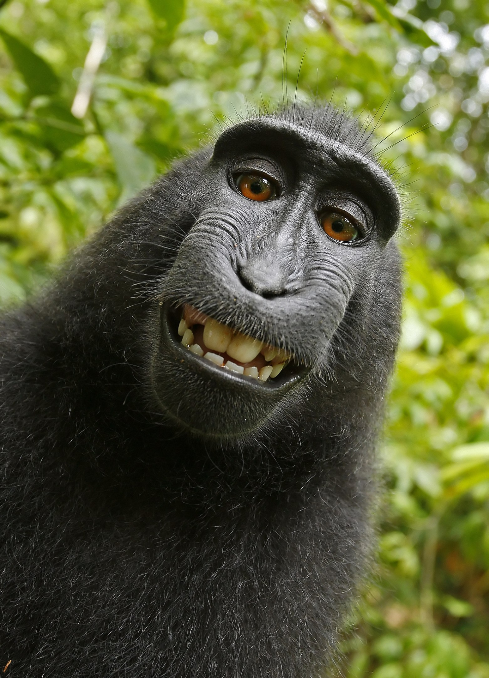
Naturo v. Slater
Notes:
Macaca nigra self-portrait large [Photograph]. (2014, October 29). Wikimedia Commons. https://commons.wikimedia.org/wiki/File:Macaca_nigra_self-portrait_large.jpg

Slide 28
Naruto v. Slater
Slater published the picture, which became a viral success.
Wikipedia shared the picture on Wikimedia Commons, considering the picture public domain. Wikipedia cited the idea that Slater did not own the picture because he did not physically take the picture.
Wikipedia said that Naruto took the picture, but because Naruto, as a monkey, can’t own intellectual property, the image is public domain.

Slide 29
What do you think?
Discuss the following questions with your elbow partner:
Are Wikipedia’s claims true? Who owns the photo?
Who do you believe should own it?

Slide 30
Naruto v. Slater Continued
Slater sued Wikipedia. He argued that he should own the photo since he set up the conditions for Naruto to take the picture.
In response, PETA sued Slater on Naruto’s behalf. PETA claimed that the monkey itself should own the copyright on the picture it took.
Any proceeds PETA won from the case were planned to go to the environmental conservation of Naruto’s forest habitat.

Slide 31
Naruto v. Slater Results
The U.S. Copyright Office ruled that:
  Slater did not own the picture because, despite creating the conditions for the picture to be taken, he did not take the picture itself.
  Only humans can own copyright.
As a result, the photo is considered public domain, which means it is free for anyone to use.
Slater ultimately lost a lot of money from the legal mess, and Naruto did not receive any money either.

Slide 32
Gray Areas: AI
Consider the following questions:
What do you think about art or writing made with AI?
Can you own something made by AI?
Should AI creations be labeled?
Should AI be able to reference and remix everything posted online?
Discuss the questions in your small group.

Slide 33
Reflect
Consider everything you have learned about ethics, respect, and creativity. How will this knowledge change how you make and use different works?

Slide 34
Setting Up
Navigate to canva.com.
Select “create,” then “websites.”
Choose the “portfolio website” option.
Select a template.
Notes:
K20 Center. (n.d.). Canva. Tech Tools. https://learn.k20center.ou.edu/tech-tool/612

Slide 35
Portfolio
Create a title page with the following information.
Personal logo
Your name
Type of work you do
  i.e., 3D artist, journalist, etc.
Optional: tagline
  Make it simple and formal: “Wilson High School Journalism Club | Lifestyle Writer”
  Express a creative goal: “Aspiring 3D Artist”
  Showcase your personality: “Making a difference one word at a time.”

Slide 36
Add Your Creations
Add a creative work that you have previously made for class to your portfolio.
Include a visual representation of your work.
  If your work is an article, include the front page of it, which gives others something to view.
Explain the creative choices you made when creating your work.
If needed, include an attribution.

