Slide 2
Prompting Professionalism: AI for Resume Writing

Slide 3
Essential Question
How can AI help turn work experiences into powerful resume statements that showcase skills?

Slide 4
Learning Objectives
Identify how AI can be used to enhance resume language by transforming basic job descriptions into professional statements.
Demonstrate how to write effective AI prompts to generate improved resume content based on their own experiences.
Evaluate the quality and appropriateness of AI-generated resume content, making revisions to ensure clarity, professionalism, and accuracy.

Slide 5
“No matter how good AI gets, humans still want role models, and we want to be inspired by human greatness. This is why we cheer for Olympic swimmers, even though speed boats go faster.”
-Kevin Roose
Notes:
Roose, Kevin. (2022). Futureproof: 9 rules for surviving in the age of AI. Random House. 73.

Slide 6


Quick Write
Write as much as you can about the following topic:
  Describe your work/volunteer experiences for a resume.
Don’t worry about grammar, just keep writing until the time runs out.
Even if it doesn’t seem to make sense, write it.
3 Minute K20 Timer
Notes:
K20 Center. (n.d.). Quick write. Strategies. https://learn.k20center.ou.edu/strategy/1127
K20 Center. (2021, September 21). 3 Minute Timer. YouTube. https://www.youtubeeducation.com/watch?v=iISP02KPau0

Slide 7
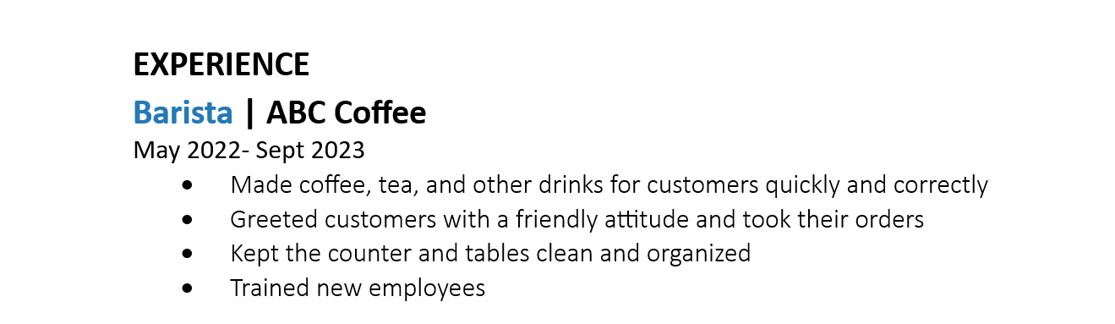
What do you like about this example?

Slide 8
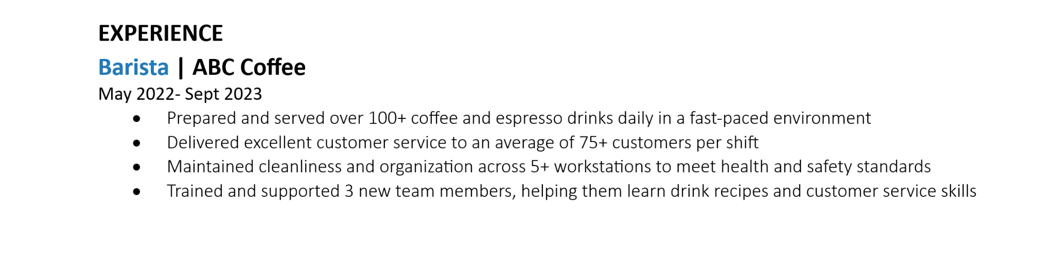
What do you like about this example?

Slide 9

Let’s Practice Using AI
Use the Experience to Expertise handout to practice using AI.
Choose an AI chat bot.
Select an example experience from the list of “Sample Student Work Experiences.”
Task: Ask the AI Chatbot to make your chosen experience more actionable.
Afterwards, reflect on your experience by completing an “I Notice, I Wonder” on the back of the handout.
Notes:
K20 Center. (n.d.). I notice, I wonder. Strategies. https://learn.k20center.ou.edu/strategy/180

Slide 10

AI Literacy and Why-Lighting
Read the Getting Started with AI handout.
Highlight parts you think are important or something you didn’t know.
Write in the margins why you highlighted that part.
Notes:
K20 Center. (n.d.). Why-lighting. Strategies. https://learn.k20center.ou.edu/strategy/128

Slide 11
Revisit Quick Write
Reread what you wrote earlier.
Select 1 experience. It could be work related or not, but it should be a real-life experience.
Prompt AI to turn your experience into a professional bullet-pointed resume.
  Use the “Write with CONTEXT” graphic to help!
Notes:
K20 Center. (n.d.). Quick write. Strategies. https://learn.k20center.ou.edu/strategy/1127

Slide 12
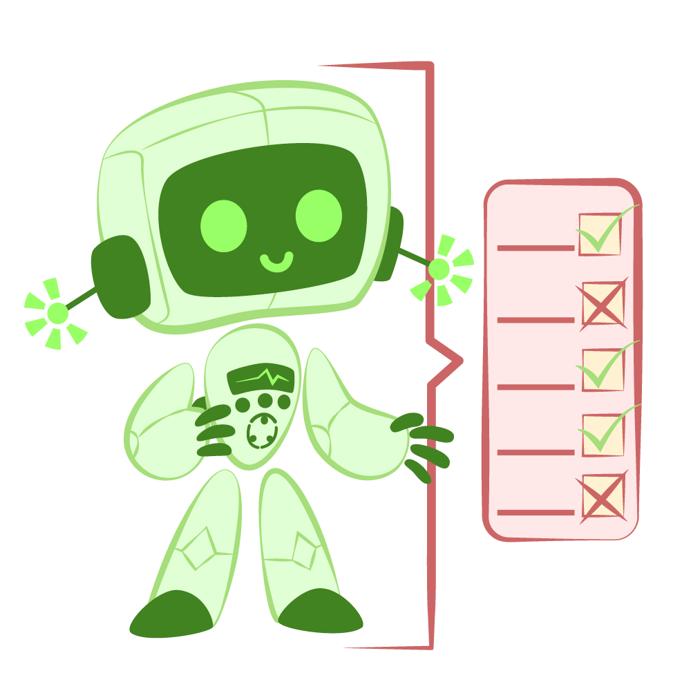
Critique The Bot
Based on what you know about how a resume should be formatted, how did the bot do?
What did the Bot miss?
Did it make each bullet action-oriented?
What details do you need to still add?
Did the bot give too much or too little information?
Notes:
K20 Center. (n.d.). Critique the Bot. Strategies. https://learn.k20center.ou.edu/strategy/3491

Slide 13
Pitfalls to Avoid
Avoid using personal identifying information
  E.g. addresses and contact information
    You should fill in personal information after you have been interviewed.
Avoid self-reviewing responses.
Avoid submitting original creative work.
  Creative-based resumes should never upload original content.
Avoid sharing health-related information.
Chatbots are meant to be a tool not the toolbox.

Slide 14
What other ways can AI help improve resumes?

