Slide 2
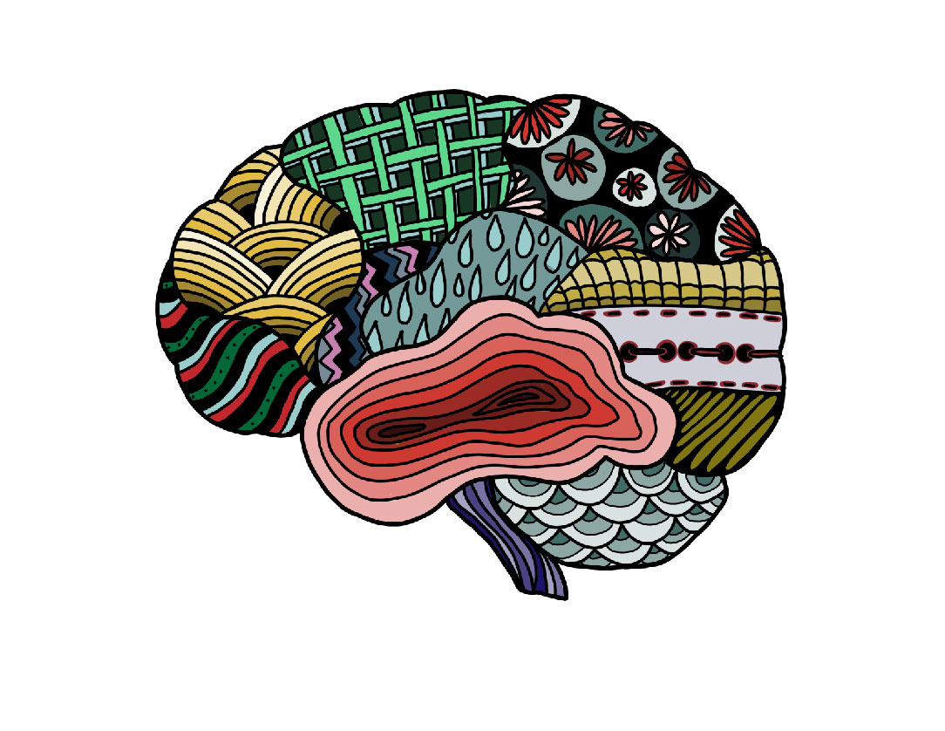
What’s Mindset Got to Do With It?
Identifying and Shifting a Fixed Mindset to a Growth Mindset

Slide 3

Think, Write, Pair Share
Think of a time in your life when you worked hard at something (maybe it was something challenging or difficult).
Why did you spend so much time or put so much effort into it?
How did you "grow" from that experience? What did you learn?

Slide 4
Based on Our Discussion
Can you “grow” when dealing with situations that are challenging or you don’t like or enjoy?
What would happen if you approached all situations that you do not like or find challenging with the same "mindset” or attitude?

Slide 5
Essential Question
How can our thoughts and beliefs about failure affect our success in school and life?

Slide 6
Lesson Objectives
Students will reflect on their own mindset and current beliefs that affect a growth mindset.
Students will develop a plan to foster a growth mindset.

Slide 7

Card Sort Activity
Place each statement under the correct category they represent, Growth Mindset or Fixed Mindset.
Growth Mindset
Fixed Mindset
Statement #1
Statement #2
Statement #3
Statement #4

Slide 8

What is Mindset?
Watch the assigned videos and take notes using your copy of the Frayer Model handout.
Respond to the prompt on the back of your handout:
  What is one takeaway from the videos that you found impactful and insightful?

Slide 9
Discuss
Discuss the videos and notes with your group.
Identify additional important information and add it to your notes.

Slide 10
Card Sort Activity
With your new understanding of Growth and Fixed Mindset, review the sorted cards and do the following:
Move statement cards as needed based on new understanding.
Discuss justification for placement.
Growth Mindset
Fixed Mindset
Statement #1
Statement #2
Statement #3
Statement #4

Slide 11
Choose One!
Choose one sorted statement. It could have been the easiest or toughest to sort.
Record the statement and justification on the bottom of your Frayer Model.
Share out your selection.

Slide 12
Stories that Inspire Us
Select and watch one of the videos.
Identify and record on your Frayer Model:
  Examples and situations that displayed either a growth or fixed mindset.
  How the actions and words of others impacted the speaker’s mindset.

Slide 13
What Does Growth Mindset Mean to You?
How has your thinking about struggle and failure changed in light of this new information?
How does knowing about a growth mindset change the way you treat yourself when you struggle and fail?
How does believing in a growth mindset change the way you approach a new challenge or something difficult?

Slide 14
Setting Goals
THINK of a situation or experience that you approach with a fixed mindset.
WHY does that situation or experience keep you from success or how does it challenge you?
WHAT can you do to approach the situation or experience with a growth mindset?
WHO might help you succeed?
WHAT other strategies could you apply to accomplish this growth mindset?
CREATE a growth mindset goal statement.

