Slide 2

Engineering Explorers
Introduction to the Engineering Design Process

Slide 3

Build a Tower
You and your team have 5 minutes to build a tower using the materials provided!
5 Minute K20 Timer
Notes:
K20 Center. (2021, September 21). 5 Minute Timer. YouTube. https://www.youtube.com/watch?v=EVS_yYQoLJg&list=PL-aUhEQeaZXLMF3fItNDxiuSkEr0pq0c2&index=7

Slide 4
Build a Tower
What were some challenges?
What information would you have found helpful in completing the task?
How do you think having a clear design process might have helped your team?

Slide 5
Essential Question
How can we use the engineering design process to solve real world problems?

Slide 6
Learning Objective
Describe the key stages of the engineering design process and explain their purpose.
Collaboratively apply the engineering design process to solve open-ended challenges.
Reflect on their problem-solving process to identify strengths and areas for improvement.

Slide 7
Question | Scenario
Today’s challenge is all about building upward! Imagine you are engineers tasked with designing a structure that can reach impressive heights while remaining strong and stable. Around the world, engineers face similar challenges when designing skyscrapers, communication towers, and wind turbines—they must balance height with strength and stability.
Can your team reach new heights with a design that’s both tall and sturdy?

Slide 8
Question | Criteria
Your job is to design and construct the tallest free-standing tower possible using the provided materials and within 5 more minutes. Your tower must be able to stand on its own for at least 10 seconds without tipping over. Think carefully about the shape of your base, the balance of weight, and how each part supports the structure.
5 Minute K20 Timer
Notes:
K20 Center. (2021, September 21). 5 Minute Timer. YouTube. https://www.youtube.com/watch?v=EVS_yYQoLJg&list=PL-aUhEQeaZXLMF3fItNDxiuSkEr0pq0c2&index=7

Slide 9

What is the Engineering Design Process?
Taco Party
Notes:
KQED Quest. (2017, April 12). The Engineering Design Process: A Taco Party. YouTube. https://www.youtube.com/watch?v=MAhpfFt_mWM

Slide 10
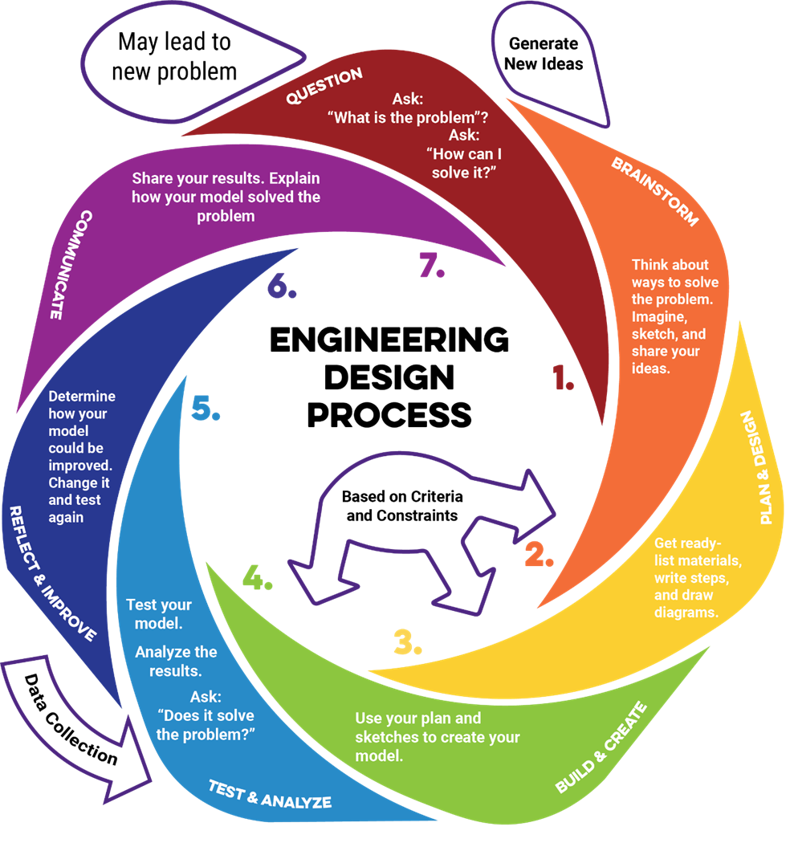
Question
Actions:
Identify the problem or need you’re trying to solve.
Define the goals, criteria (what it must do), and constraints (limitations like time or materials).
Purpose: Defining the problem helps engineers stay focused on finding an effective, realistic solution that meets specific goals and limitations.

Slide 11
Brainstorm
Actions:
Research how others have solved similar problems.
Sketch or describe multiple possible solutions before choosing one to develop further.
Purpose: This step encourages innovation and prevents teams from settling on the first idea too quickly.

Slide 12
Plan & Design
Actions:
Create detailed drawings or blueprints, including labels, dimensions, and materials.
Plan the building steps and assign team roles.
Purpose: Engineers use this phase to visualize, calculate, and organize how the solution will be built and tested.

Slide 13
Build & Create
Actions:
Follow your plan to construct a prototype (model) of your design.
Document your process — photos, notes, and any changes you make.
Purpose: Building a prototype allows engineers to test concepts, evaluate materials, and uncover design challenges in a tangible way.

Slide 14
Test & Analyze
Actions:
Test your design against the original problem or goal.
Collect measurable data (e.g., height, strength, speed, accuracy).
Purpose: Testing provides data and evidence that show how well the solution meets the established criteria and constraints.

Slide 15
Reflect & Improve
Actions:
Use test results to refine your design — tweak, rebuild, or start over.
Compare your new results to the original version.
Purpose: Engineers rarely get it perfect the first time - they refine their designs through testing and redesign.

Slide 16
Communicate
Actions:
Share your final results, explaining your process and improvements.
Use visuals, data, and clear reasoning to show how your design works.
Purpose: Engineers communicate to demonstrate their reasoning, justify design choices, and inspire further innovation or collaboration.

Slide 17

Cognitive Comics
Create a comic strip illustrating how you would solve your own STEM Challenge.
Start by writing your own scenario and question.
Then, imagine what actions you and your group would take to solve the problem.
Use each phase of the engineering design process as a guide.
Notes:
K20 Center. (n.d.). Cognitive comics. Strategies. https://learn.k20center.ou.edu/strategy/198

Slide 18
Cognitive Comics
Things to consider:
Add challenges you may encounter in either working with a group or designing the product.
Show what could go wrong.
How could you work through challenges or problems (this may mean revisiting phases).
Notes:
K20 Center. (n.d.). Cognitive comics. Strategies. https://learn.k20center.ou.edu/strategy/198

Slide 19

Glow & Grow
How have you done well with the engineering design process?
How can you improve your understanding of the engineering design process?
Notes:
K20 Center. (n.d.). Glow and Grow. Strategies. https://learn.k20center.ou.edu/strategy/4962

