Slide 2

STEM Challenge: STEM in Action
Creating a Compelling STEM Commercial Video

Slide 3
Essential Question
How can we use the engineering design process to solve real-world problems?

Slide 4
Learning Objective
Students will use the engineering design process to solve a real-world problem.

Slide 5
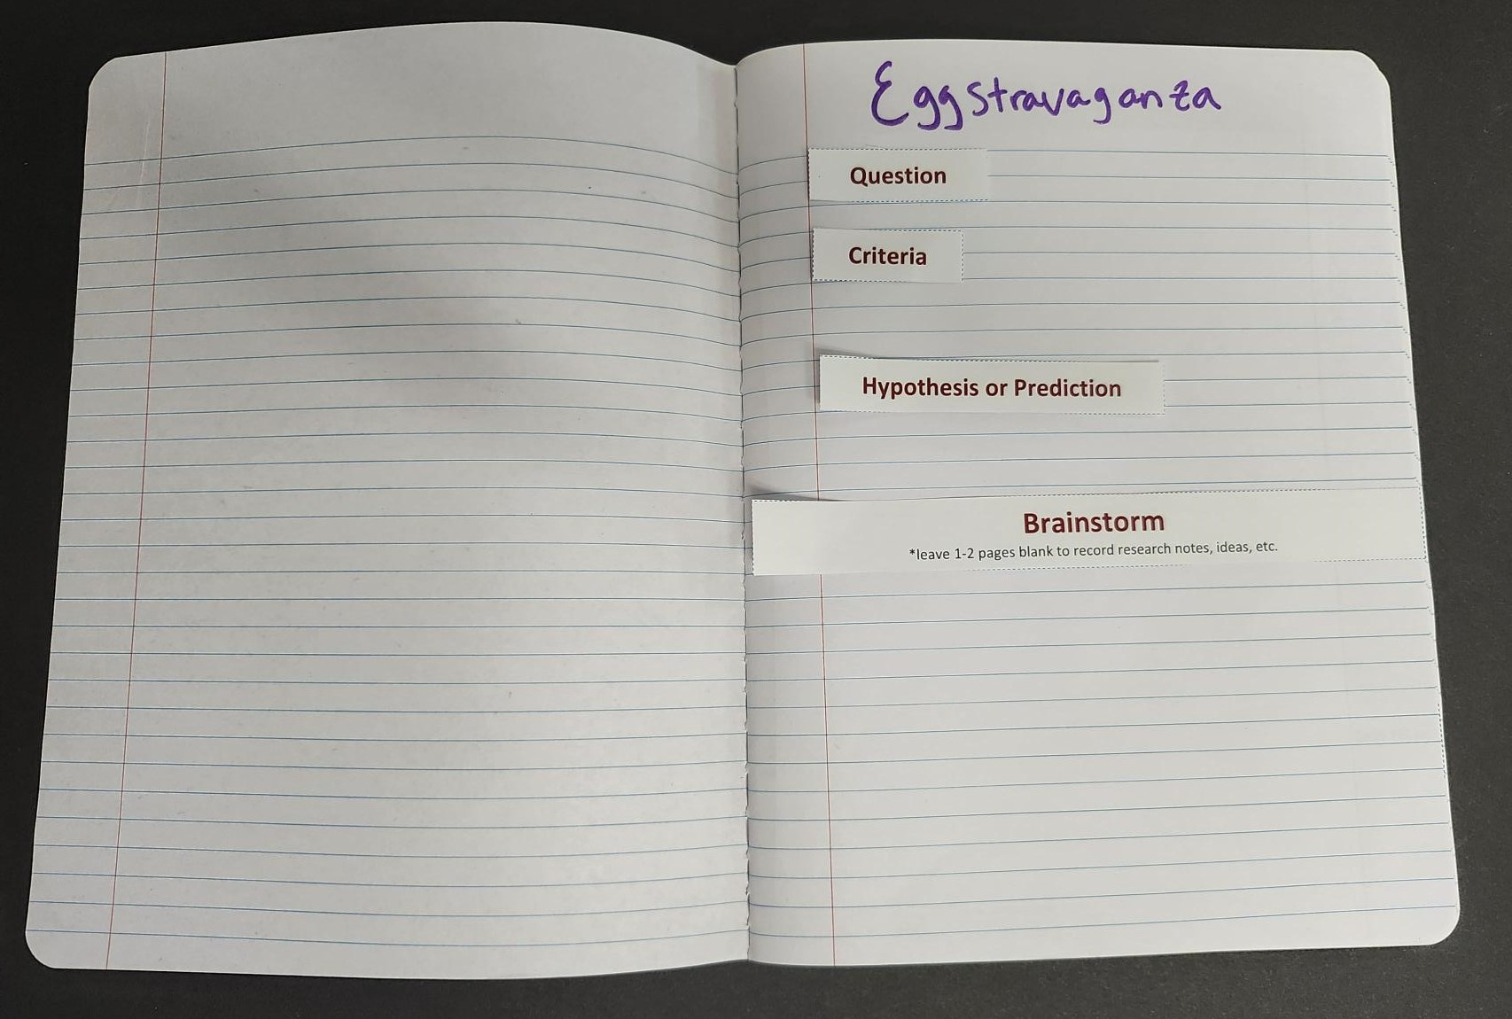
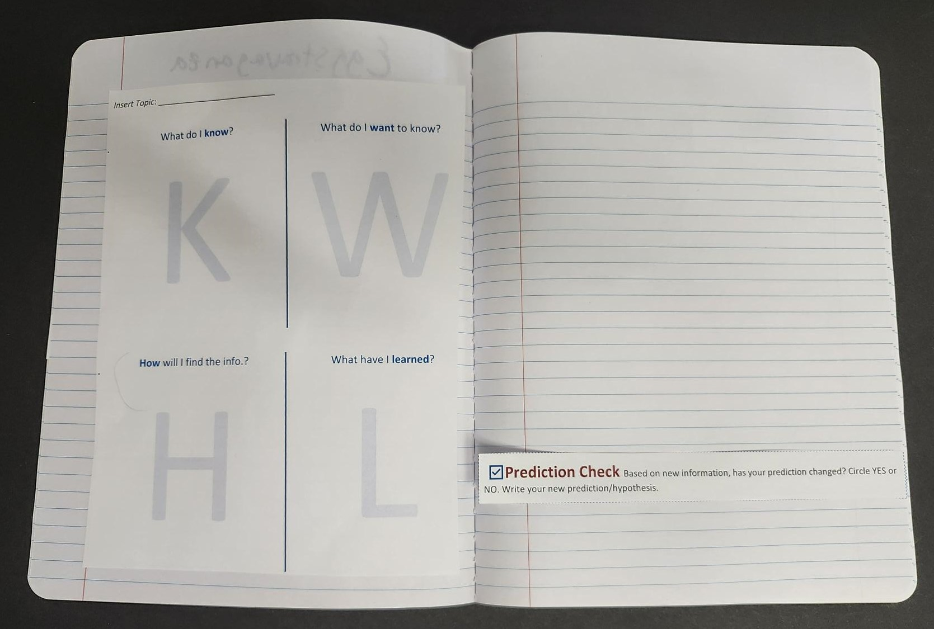
Question |
Notebook Setup
Title of STEM Challenge
Question
Criteria
Brainstorm (leave space for work)
KWHL chart (see later slide)

Slide 6
Question | Scenario
Problem: Engineers and scientists don’t just create products—they also need to communicate their ideas effectively to the public.
Your Task: Create a short commercial or advertisement for a STEM-related invention, discovery, or product. Your goal is to convince your audience why your STEM idea is useful, exciting, or important, using both creativity and accurate scientific information.

Slide 7
Question | Criteria
Your commercial must clearly explain the purpose and function of your STEM invention or idea.
You may work individually or in small groups.
You may use materials provided (poster boards, markers, props, or digital video tools).
Your commercial should be 1–2 minutes long.
Bonus challenge: Include a demonstration or visual representation of how your invention works.

Slide 8

Question | KWHL
Know: What do I know about the task?
Wonder: What do I not know (and want to know) about the task?
Notes:
K20 Center. (n.d.). KWHL Graphic Organizer. Strategies. https://learn.k20center.ou.edu/strategy/127

Slide 9
Brainstorm | KWHL
Know: What do I know about the task?
Wonder: What do I not know (and want to know) about the task?
How: How will I find the information I need to complete the task?
Notes:
K20 Center. (n.d.). KWHL graphic organizer. Strategies. https://learn.k20center.ou.edu/strategy/127

Slide 10
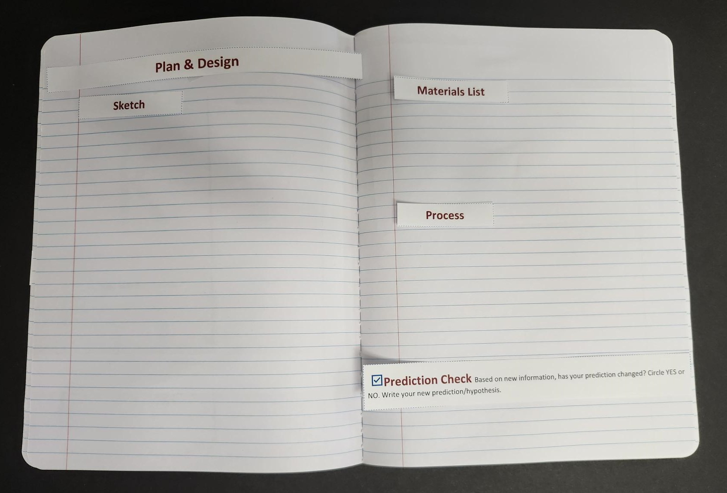
Plan and Design | Notebook Setup
Plan & Design
Pitch Idea (see additional handout)
Materials List
Process
  Write down every step you took.

Slide 11

Pitch Your Idea
Use the Pitch Organizer to brainstorm the context surrounding your experiment and gather ideas about how you want to talk about it in your commercial.
After filling out the organizer, write your pitch or idea for your commercial.
Get teacher approval before moving forward with your idea.
Notes:
K20 Center. (n.d.). 5w cube. Strategies. https://learn.k20center.ou.edu/strategy/81

Slide 12
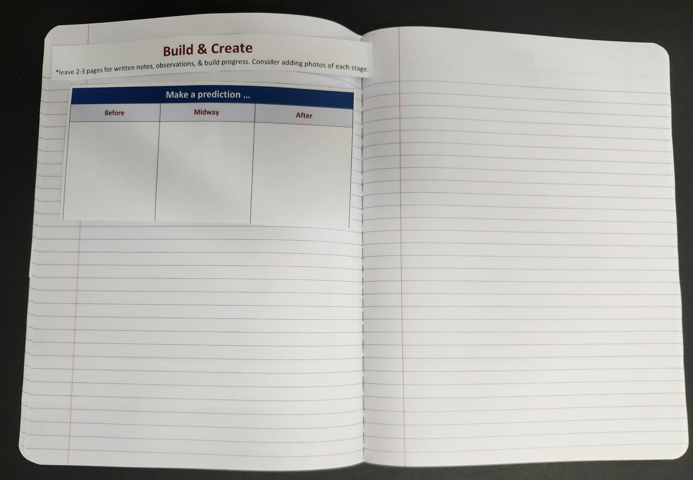
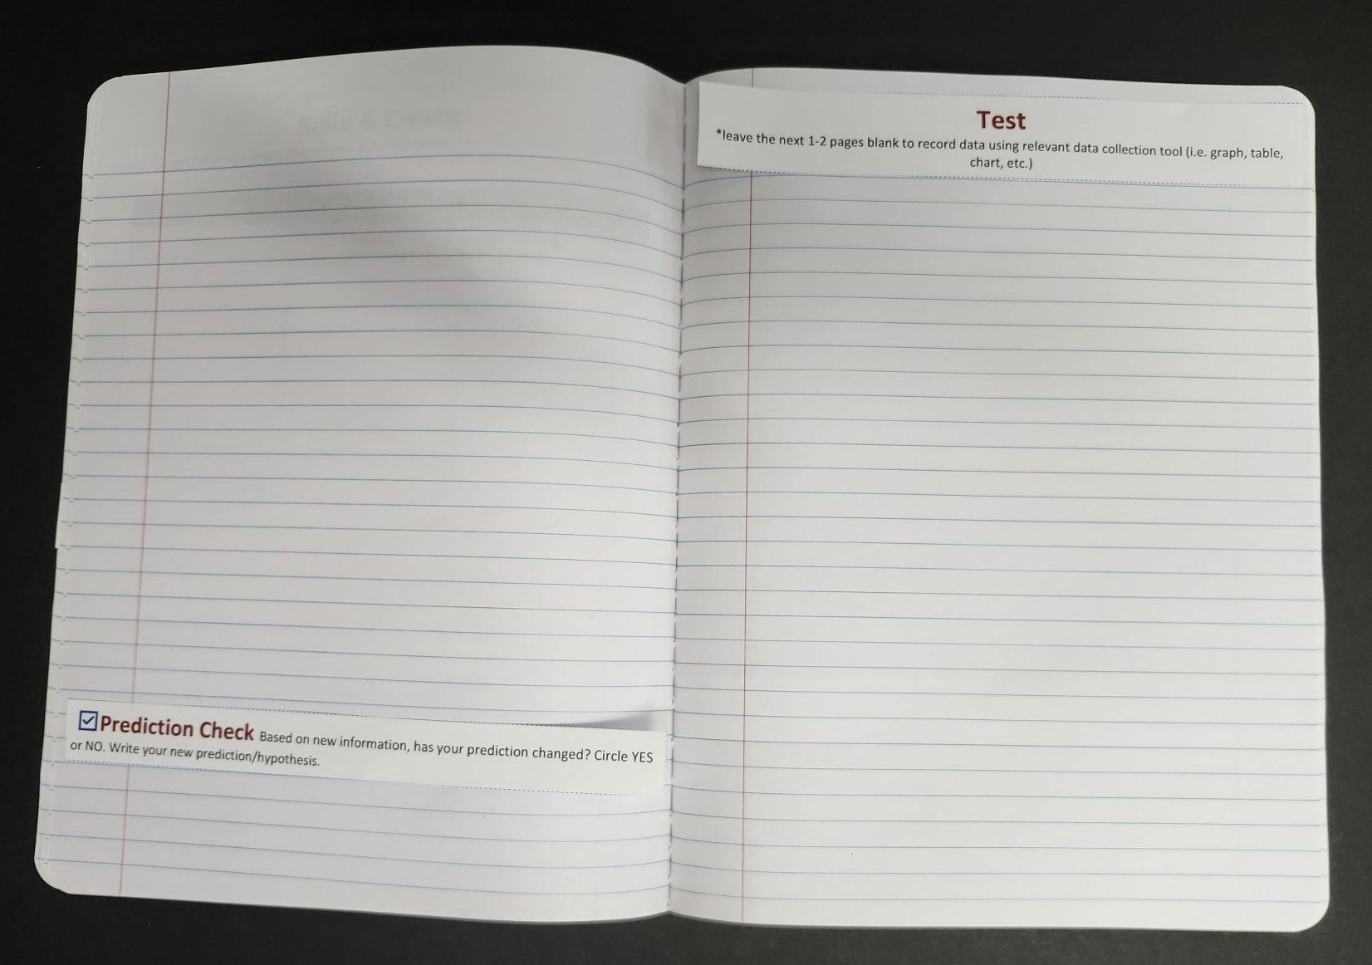
Create | Notebook Setup
Create.
  Leave space for notes, photos, & observations.
Storyboard (see additional handouts)

Slide 13
Create | Storyboard
Draft a Storyboard and Shots List.
List materials/props needed for commercial creation.
Provide a replicable step-by-step process for how to create your prototype.
Engineering Tip: Your designs and storyboard are the blueprint for everything that comes next. The more care and detail you put in now, the easier it will be to create, test, and improve later.

Slide 14
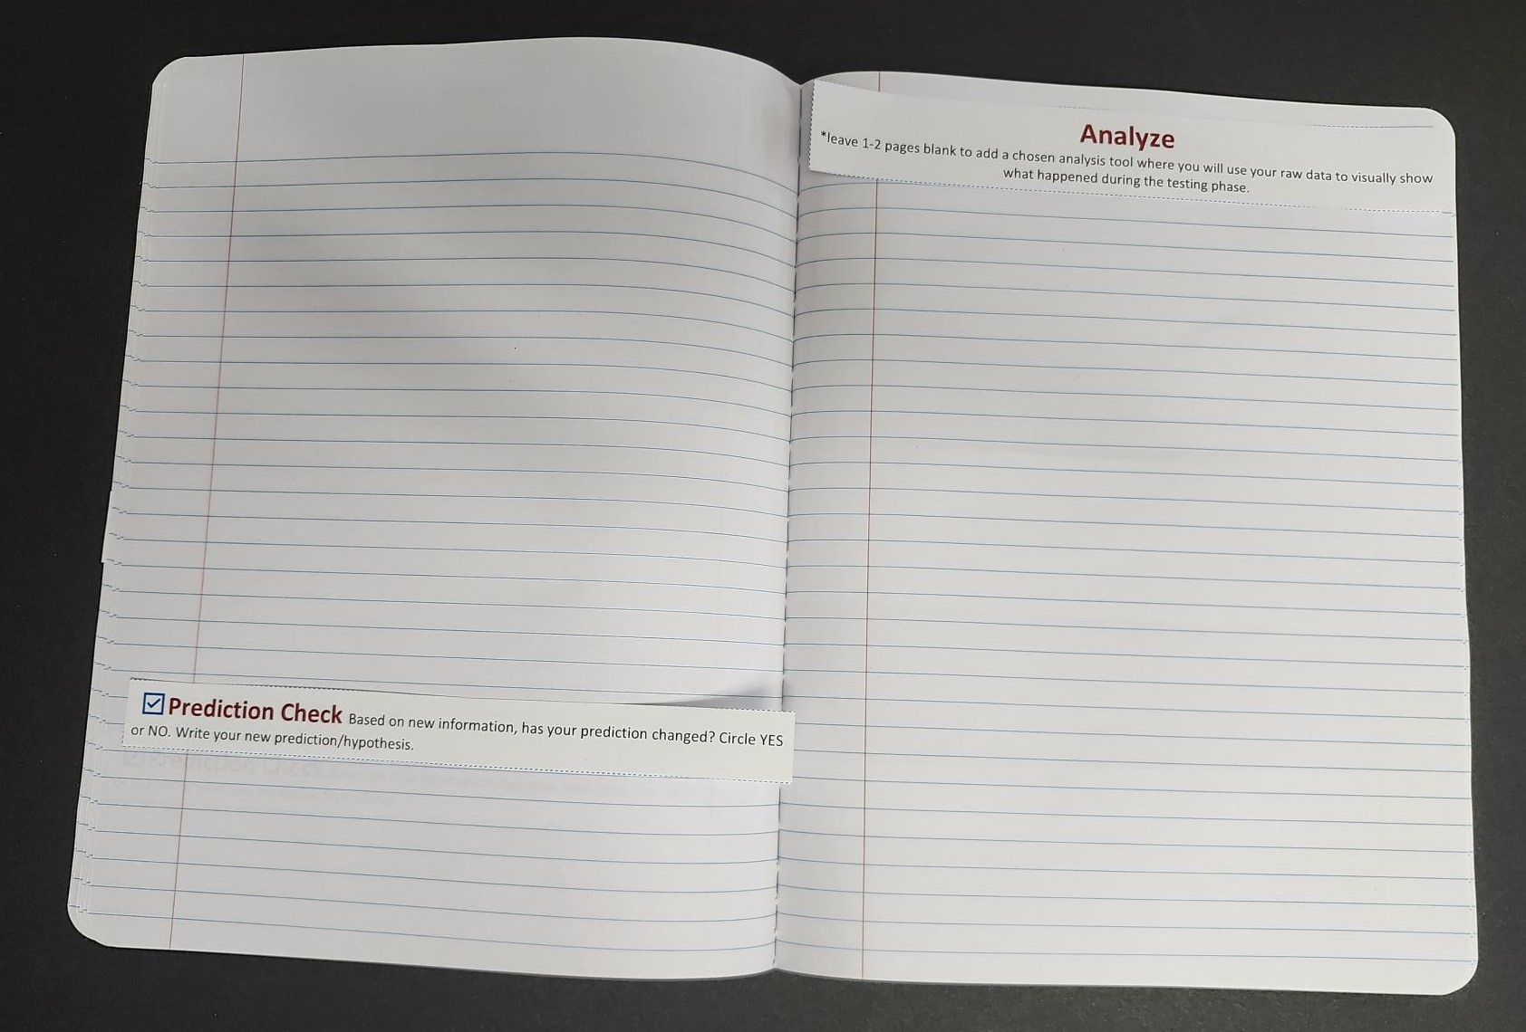
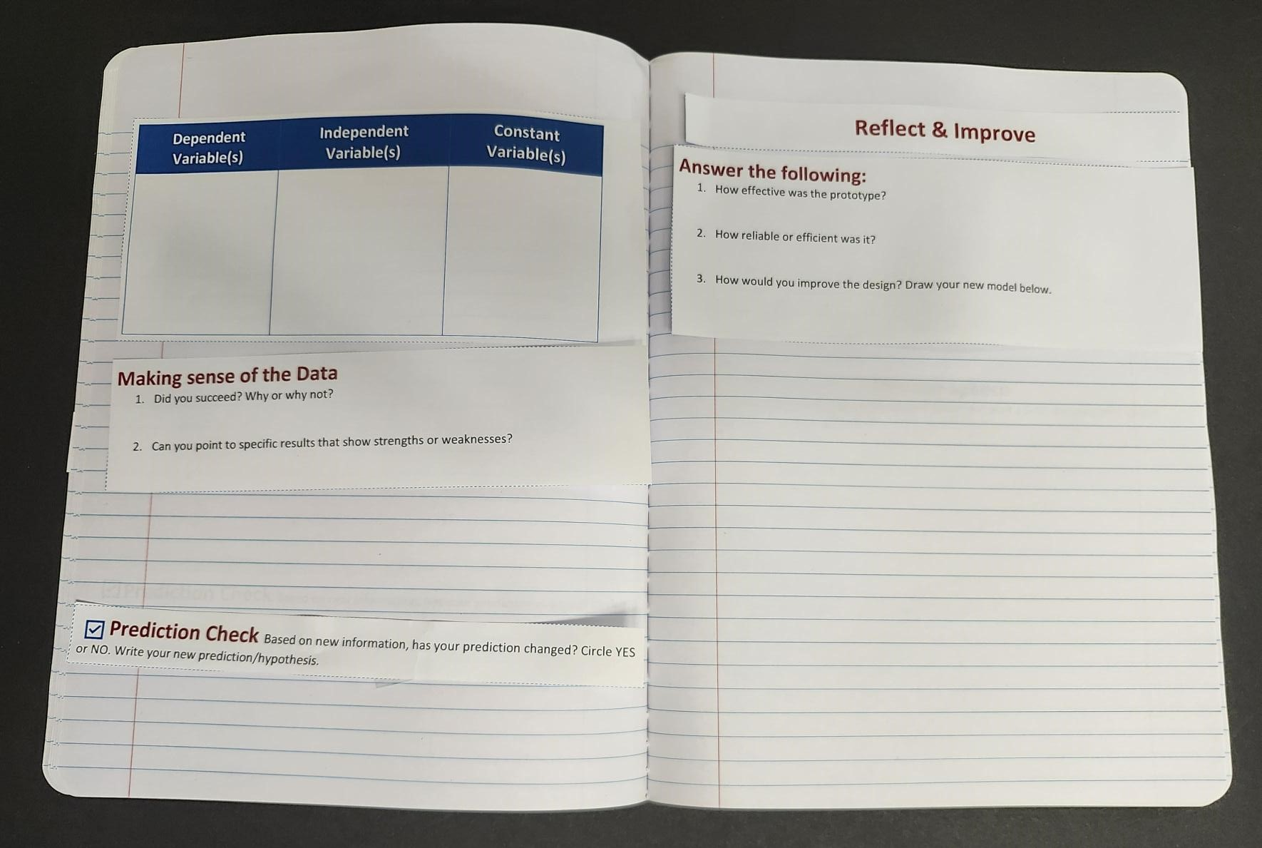
Test and Analyze | Notebook Setup
Test (leave space for data collection)
Analyze (leave space for analysis tool)

Slide 15
Test and Analyze | Test Prototype
As a group, brainstorm and determine what makes a commercial successful.
Use criteria and constraints from the Question phase.
Follow a consistent process so that results are reliable.
Gather observations and feedback.
How would you gather feedback from your peers?

Slide 16
Test and Analyze | Analyze Prototype
What form of peer feedback data was most helpful?
  How will you display the data?
  How will you analyze the data?
After reviewing the feedback as a group, what changes will you make from the peer feedback data?

Slide 17
Reflect and Improve | Notebook Setup
Reflect & Improve.
Answer the following:
  How effective was the commercial prototype?
  How reliable or efficient was it?
  Draft a new storyboard below.
Create your commercial!

Slide 18
Reflect and Improve | Review and Create
Review your peer feedback results.
  Identify strengths to keep and weaknesses to address.
  Revise and iterate your storyboards.
Using your storyboards and shotlist, begin filming shots for your commercial.
Finally, use video editing software to splice your individual shots together for a rough or final cut of your commercial.

Slide 19
KWHL
Know: What do I know about the task?
Wonder: What do I not know (and want to know) about the task?
How: How will I find the information I need to complete the task?
Learn: What have I learned about the task?
Notes:
K20 Center. (n.d.). KWHL graphic organizer. Strategies. https://learn.k20center.ou.edu/strategy/127

Slide 20

Debrief| 3-2-1
What are three things you learned?
What are two challenges you overcame?
What is one improvement you would make if you had more time?
Notes:
K20 Center. (n.d.). 3-2-1. Strategies. https://learn.k20center.ou.edu/strategy/117

