Slide 2

STEM Challenge: Secret Codes
Decoding Cryptology and Egyptian Number Systems

Slide 3
Essential Question
How can we use the engineering design process to solve real-world problems?

Slide 4
Learning Objective
Students will use the engineering design process to solve a real-world problem related to STEM.

Slide 5
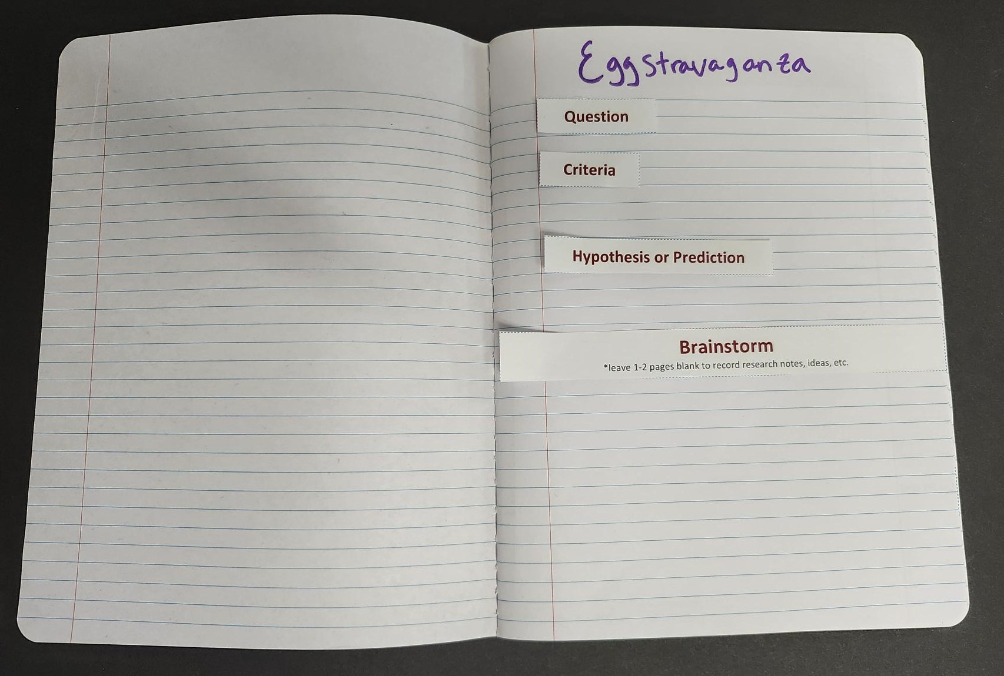
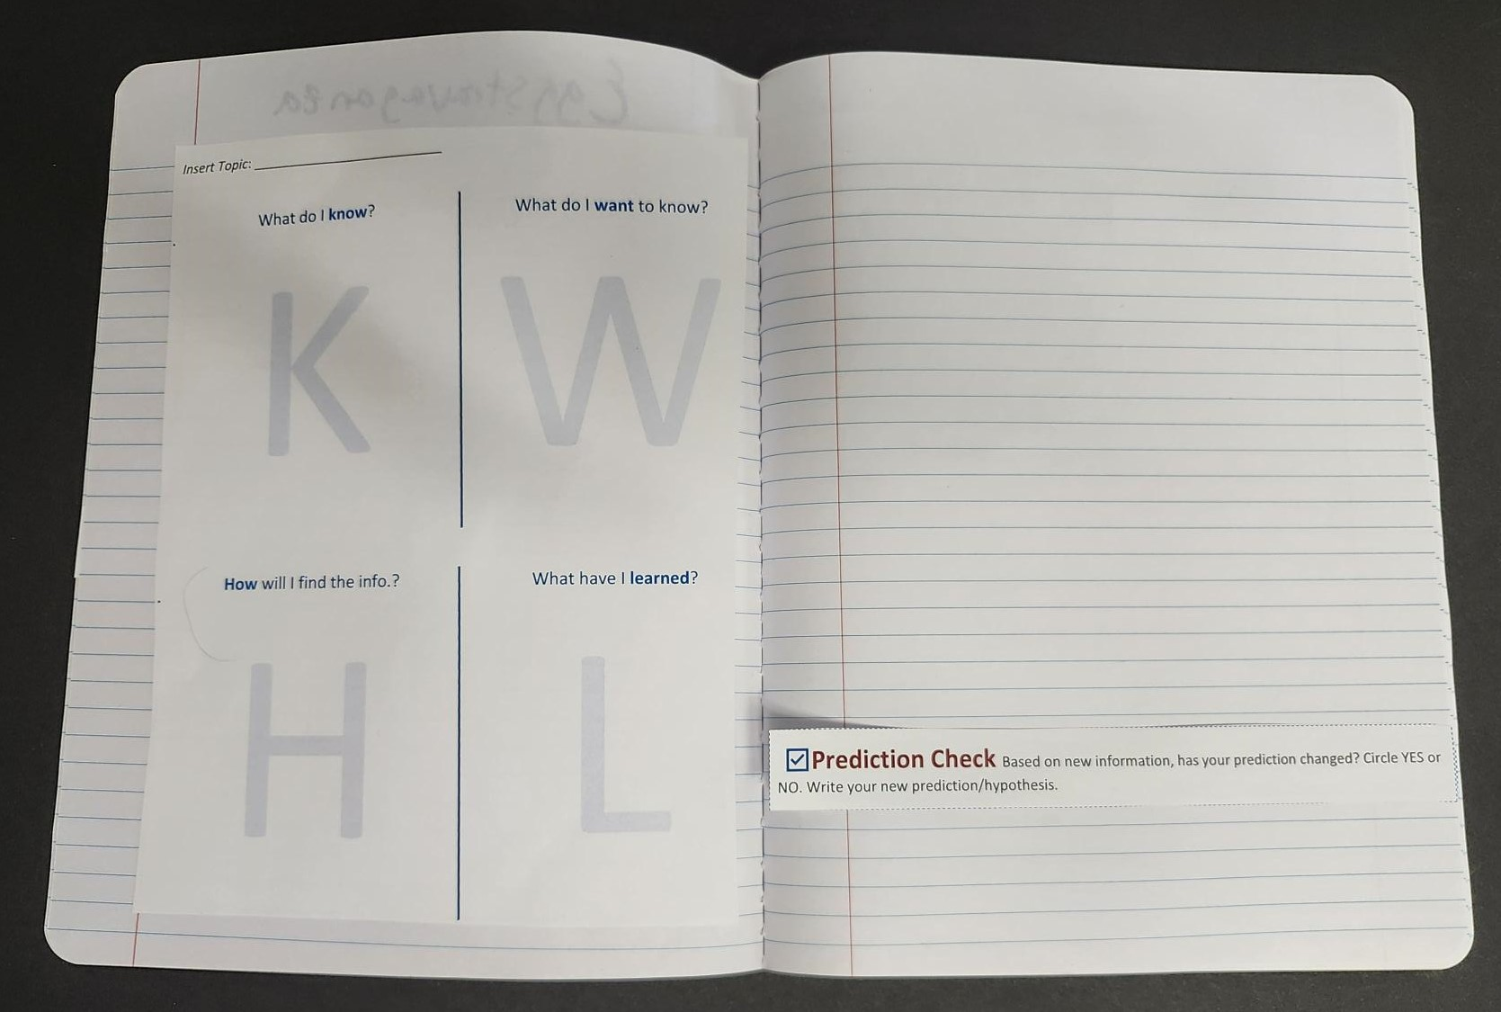
Question |
Notebook Setup
Title of STEM Challenge
Question
Criteria
Hypothesis or Prediction
Brainstorm (leave space for work)
KWHL chart (see later slide)
Prediction Check (see later slide)

Slide 6
Question | Scenario
Problem: Extra-terrestrials have invaded! They have successfully infiltrated all of the world’s communication systems. Whatever we say or type, they can understand and act on.
Your Task: To help the Resistance save human lives by developing a secret code for relaying vital messages.

Slide 7
Question | Criteria
Your system must allow a message to be encoded and decoded accurately.
You may only use the materials provided (e.g., papers, markers, or stamps).
Your design should include a clear key or legend for interpreting messages.
Your method must be understandable to someone else following your instructions.
Your system must be usable by another group without additional explanation.

Slide 8
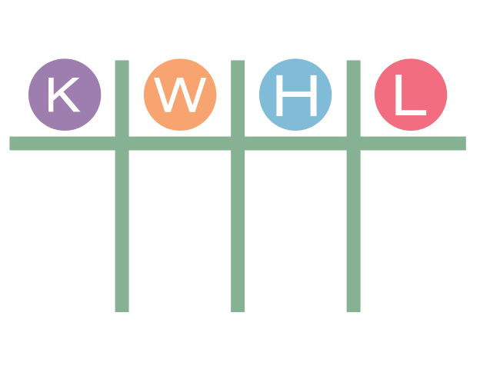
Question | KWHL
Know: What do I know about the task?
Wonder: What do I not know (and want to know) about the task?
Notes:
K20 Center. (n.d.). KWHL Graphic Organizer. Strategies. https://learn.k20center.ou.edu/strategy/127

Slide 9
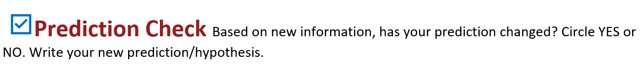

Slide 10
Brainstorm | KWHL
Know: What do I know about the task?
Wonder: What do I not know (and want to know) about the task?
How: How will I find the information I need to complete the task?
Notes:
K20 Center. (n.d.). KWHL graphic organizer. Strategies. https://learn.k20center.ou.edu/strategy/127

Slide 11

Secret Codes Padlet
https://tinyurl.com/K20SECRETCODES

Slide 13
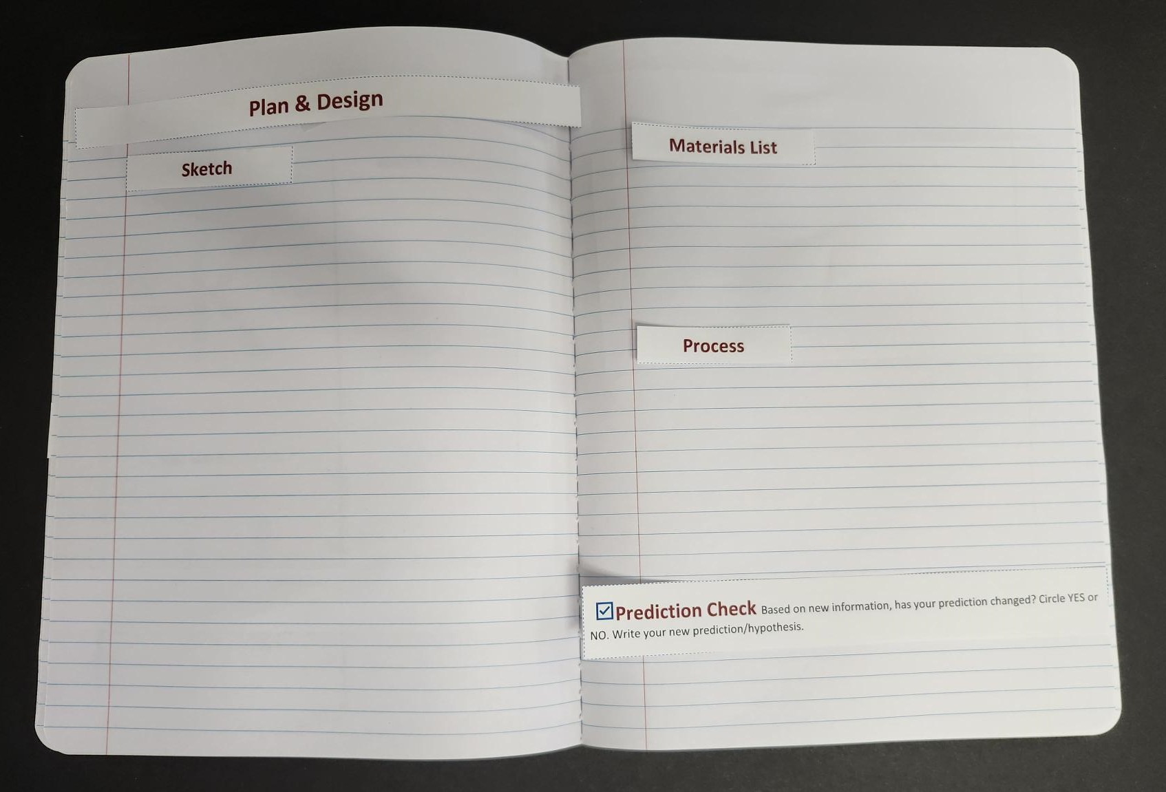
Plan and Design | Notebook Setup
Plan & Design
Sketch
Materials List
Process
  Write down every step you took.
Prediction Check

Slide 14
Plan and Design | Sketch and Model
Select an idea.
Sketch the alphabet, the symbol, or whatever letters, symbols, or visual units you are using.
  Make sure to label letter and punctuation mark, if punctuation marks are used.
List materials.
Provide a replicable step-by-step process for how to create and use your encryption prototype.
Engineering Tip: Your designs and sketches are the blueprint for everything that comes next. The more care and detail you put in now, the easier it will be to recreate later.

Slide 16
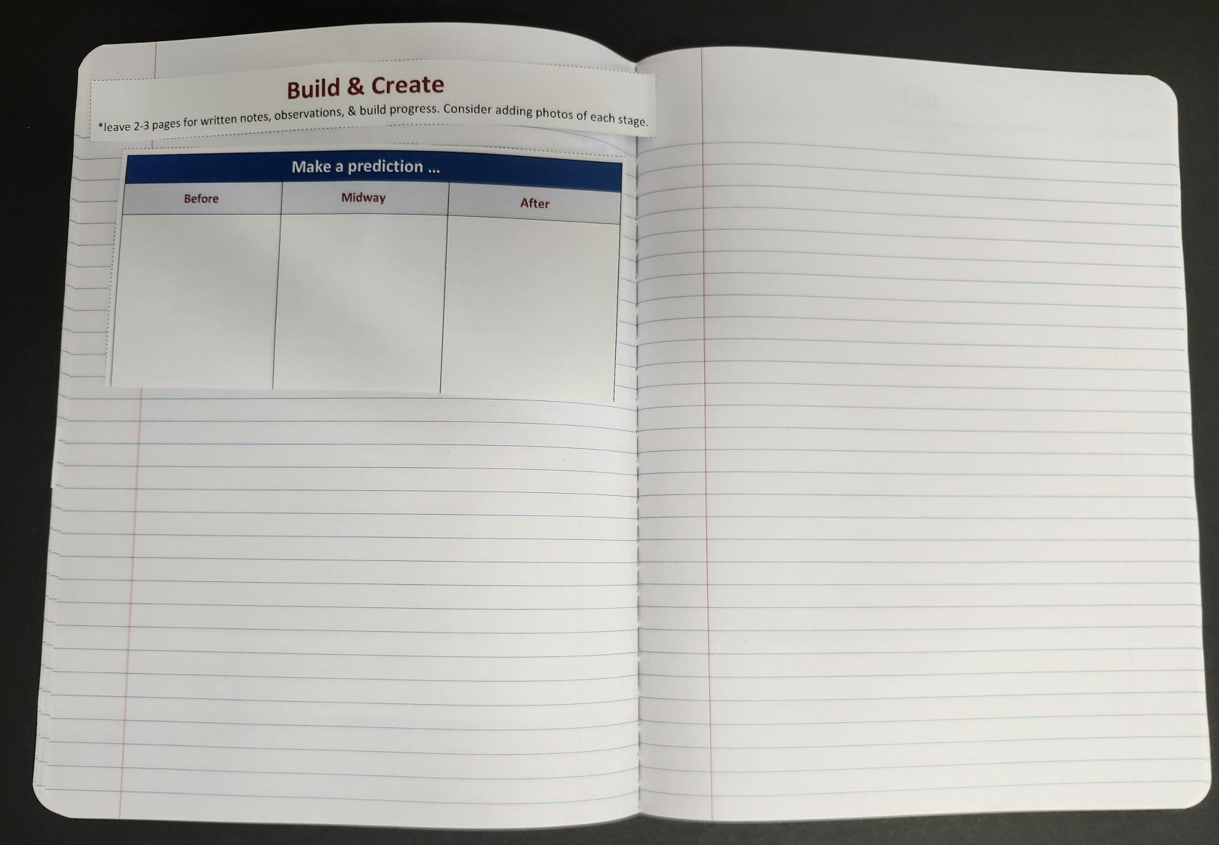
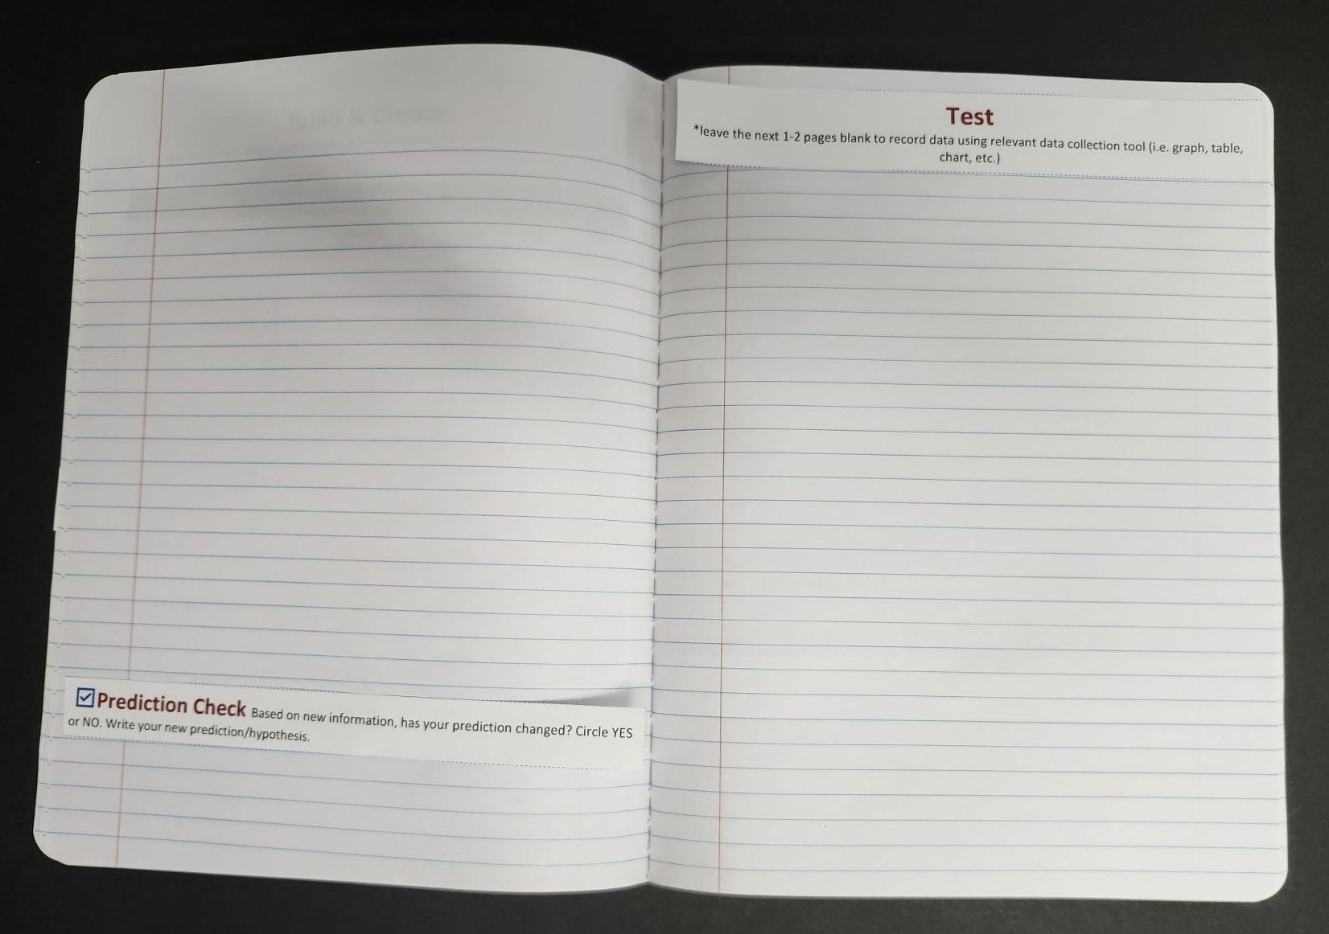
Create | Notebook Setup
Create.
  Leave space for notes, photos, & observations.
Make a Prediction table.
  Here is where you can record what you think will happen if you do not take into consideration the importance of communication.
Prediction Check.

Slide 17
Create | Prototyping
Begin creating your prototype!
Follow your drawings, models, and instructions carefully.
  Use tools responsibly and safely.
Document your progress as you craft your secret code through the following:
  Photos
  Observational Notes
    Note whether adjustments were needed.
  Sketches

Slide 19
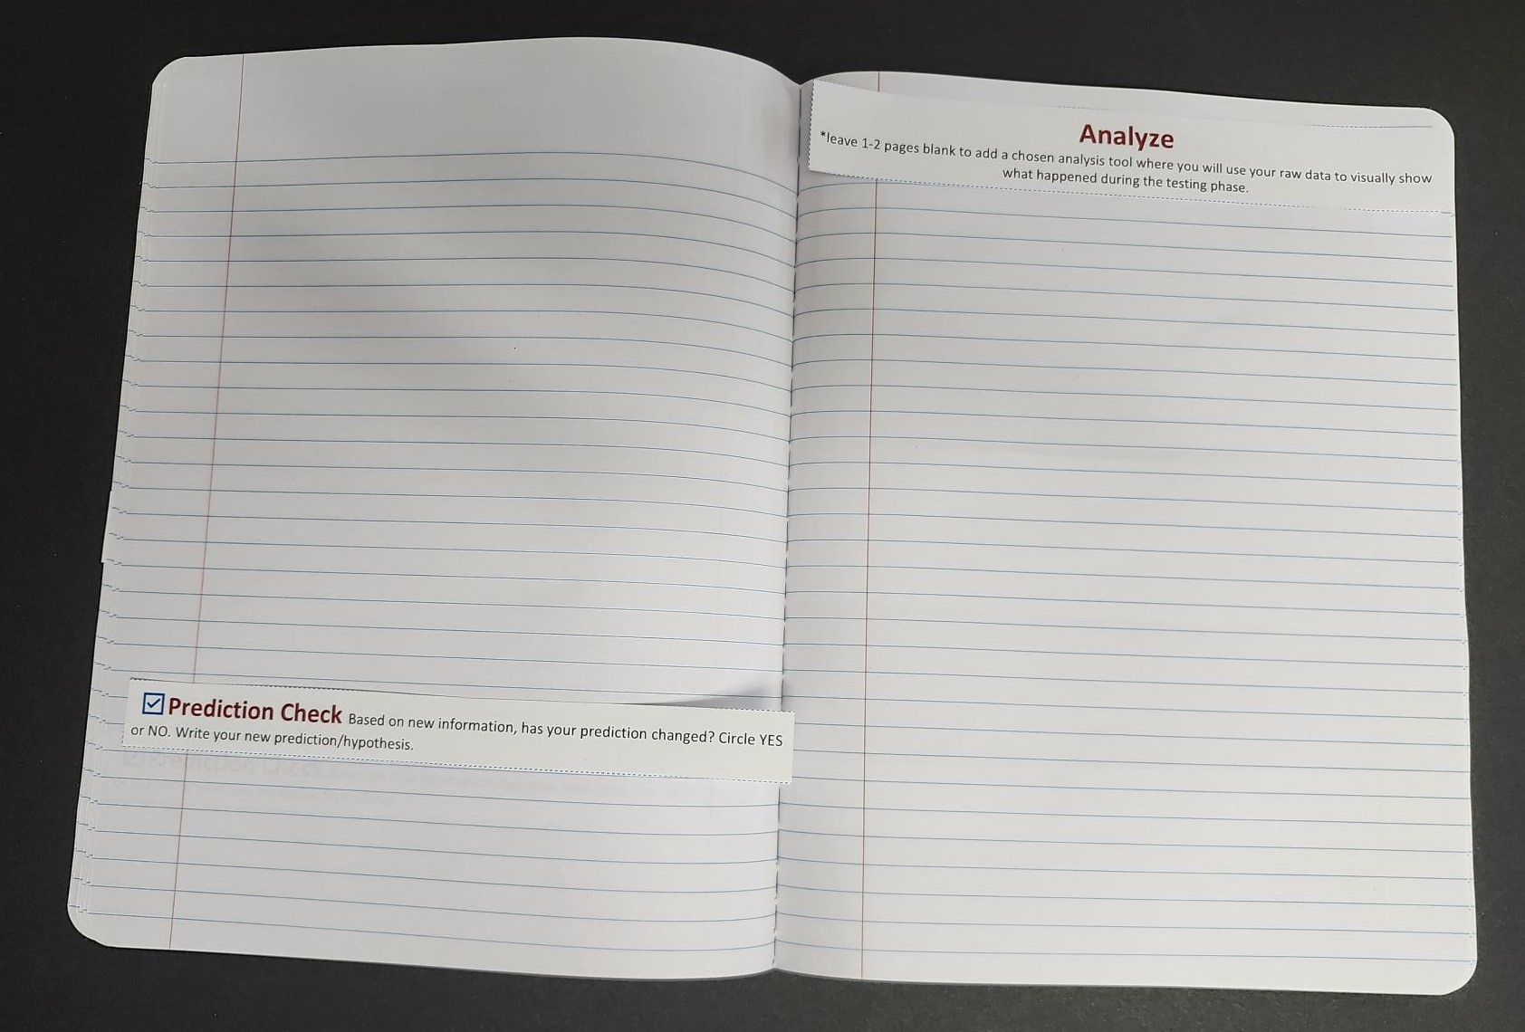
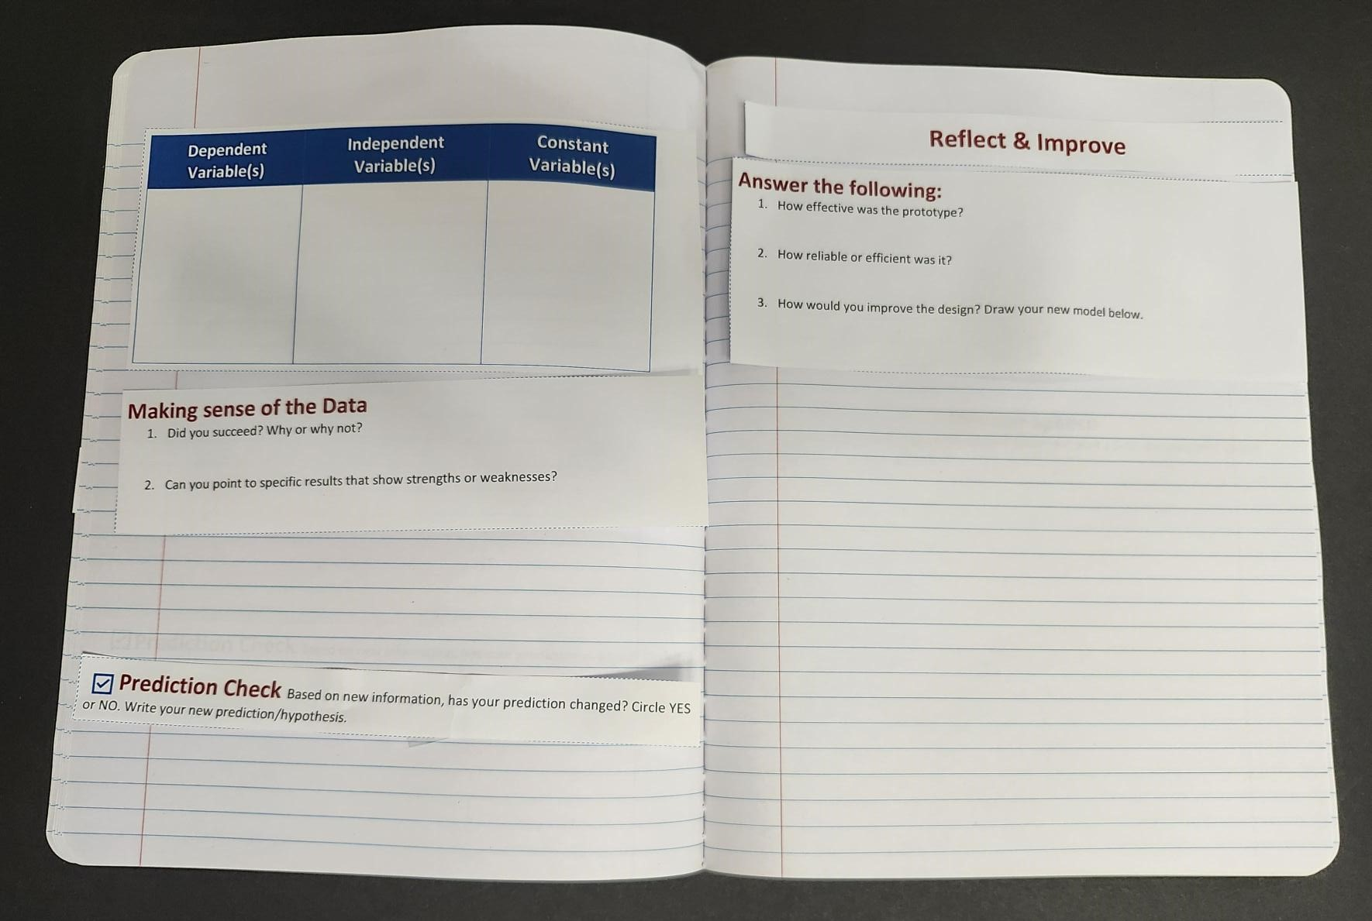
Test and Analyze | Notebook Setup
Test (leave space for qualitative observations)
Prediction Check
Analyze (leave space for analysis tool)
Variables Table
Making sense of the Observations (see slide)
Prediction Check

Slide 20
Test and Analyze | Test Prototype
Test Protocol
Exchange your encoded message and key with another group
Decode another group’s message using only their instructions
Do not ask for help during decoding
Observe how the system performs
Collect Data
Was the message decoded correctly?
How long did it take?
Were there any errors?
What caused confusion?

Slide 21
Test and Analyze | Analyze Prototype
Analyze Results
Did your system successfully communicate the message?
What patterns do you notice in your data?
What worked well?
What needs improvement?
Use Evidence
Accuracy of decoded message
Time required
Errors or misunderstandings
Feedback from other groups

Slide 23
Reflect and Improve | Notebook Setup
Reflect & Improve.
Answer the following:
  How effective was the prototype?
  How reliable or efficient was it?
  How would you improve the design? Draw your new model below.

Slide 24
Reflect and Improve | Review Test Results
Review your test results.
Identify strengths to keep and weaknesses to address.
Propose targeted changes to improve the design.
  Consider materials, measurements, features, or creation methods.
Engineering Tip: Your goal in this section is to make the design more effective, efficient, and reliable before retesting or final presentation.

Slide 25
KWHL
Know: What do I know about the task?
Wonder: What do I not know (and want to know) about the task?
How: How will I find the information I need to complete the task?
Learn: What have I learned about the task?
Notes:
K20 Center. (n.d.). KWHL graphic organizer. Strategies. https://learn.k20center.ou.edu/strategy/127

Slide 26
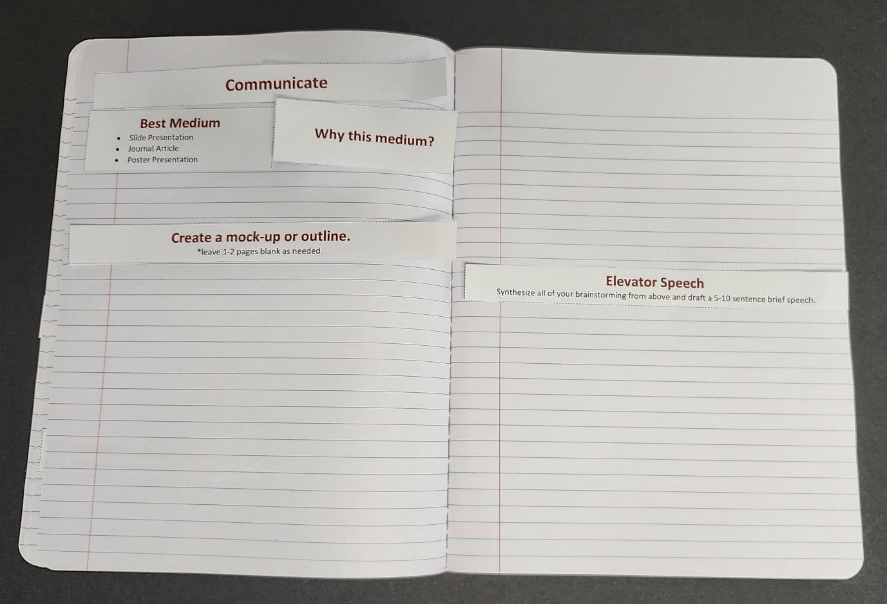
Communicate | Notebook Setup
Communicate.
Best Medium and why?
  Slide Presentation
  Journal Article
  Poster Presentation
Create a mock-up or outline.
Elevator Speech (see slide).

Slide 27
Communicate | Real-World Connections
Congratulations! Your group has been chosen to present at the annual Spark Expo, hosted by billionaire superhero Toni Spark.
Decide on the best medium to present your prototype and experience.
Create a mock-up or outline of what you would actually present.

Slide 28
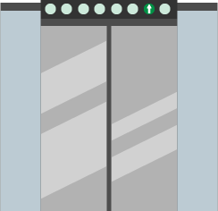
Debrief| Elevator Speech
Take your mock-up or outline and create a 3-5 minute speech.
  Be sure to add transitions between ideas.
Practice!
Notes:
K20 Center. (n.d.). Elevator speech. Strategies. https://learn.k20center.ou.edu/strategy/57

Slide 29

Debrief| 3-2-1
What are three things you learned?
What are two challenges you overcame?
What is one improvement you would make if you had more time?
Notes:
K20 Center. (n.d.). 3-2-1. Strategies. https://learn.k20center.ou.edu/strategy/117

