Slide 2
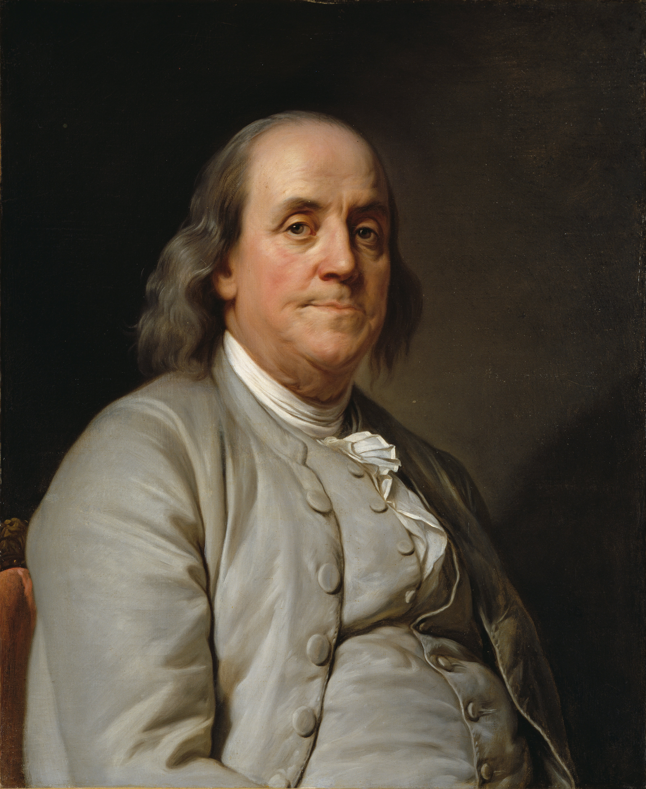
Benjamin Franklin
President of Pennsylvania
U.S. Government
Notes:
Guest Speaker’s Note: Please insert a current professional photo of yourself or a project.
---
Duplessis, J.S. (1785). Benjamin Franklin [Painting]. Wikimedia Commons. https://commons.wikimedia.org/wiki/File:Joseph_Siffrein_Duplessis_-_Benjamin_Franklin_-_Google_Art_Project.jpg

Slide 3
About My Job: President of Pennsylvania
Enforce & Govern State Laws
Appoint Officials
Exercises Legislative Powers
  Sign or Veto Bills
Represent the State
Call on National Guard (as needed)

Slide 4
My Career Path
Founder and Publisher – The Pennsylvania Gazette
Author – Poor Richard’s Almanac
Postmaster of Philadelphia
Member – Pennsylvania Provincial Assembly
United States Minister to Sweden & France
President of Pennsylvania

Slide 5
What Keeps Me Going
I love learning new things, and in this job, I am always learning new things.
I appreciate knowing that I have earned the respect and trust of others, enough to be in such influential leadership positions.

Slide 6
Career Challenges
I lived in London while representing the colonies.
  Waiting on letters and other news to arrive caused delays.
  Travel (by boat) between London and home took several weeks.
I worked with people from England, France, and what is now known as the U.S.
  Everyone had different opinions, values, and wants.

Slide 7
Finding Your Path
Study: political science, civics, government, or public policy.
Get Involved: volunteer, join a campaign, and look for local opportunities.
Develop Skills: social intelligence, interpersonal influence, networking, and thinking before speaking.

Slide 8
Questions?

