Slide 2

I Graduated High School.
Now What?

Slide 3
Essential Questions
What’s standing between me and my next step?
What do I need to do to move forward?

Slide 4
Learning Objectives
Identify available GEAR UP services and how they support the transition to higher education and career pathways.
Understand the continued opportunities to enroll in higher education after high school graduation.
Demonstrate an understanding of the steps needed to begin the enrollment process for a college or university.

Slide 5
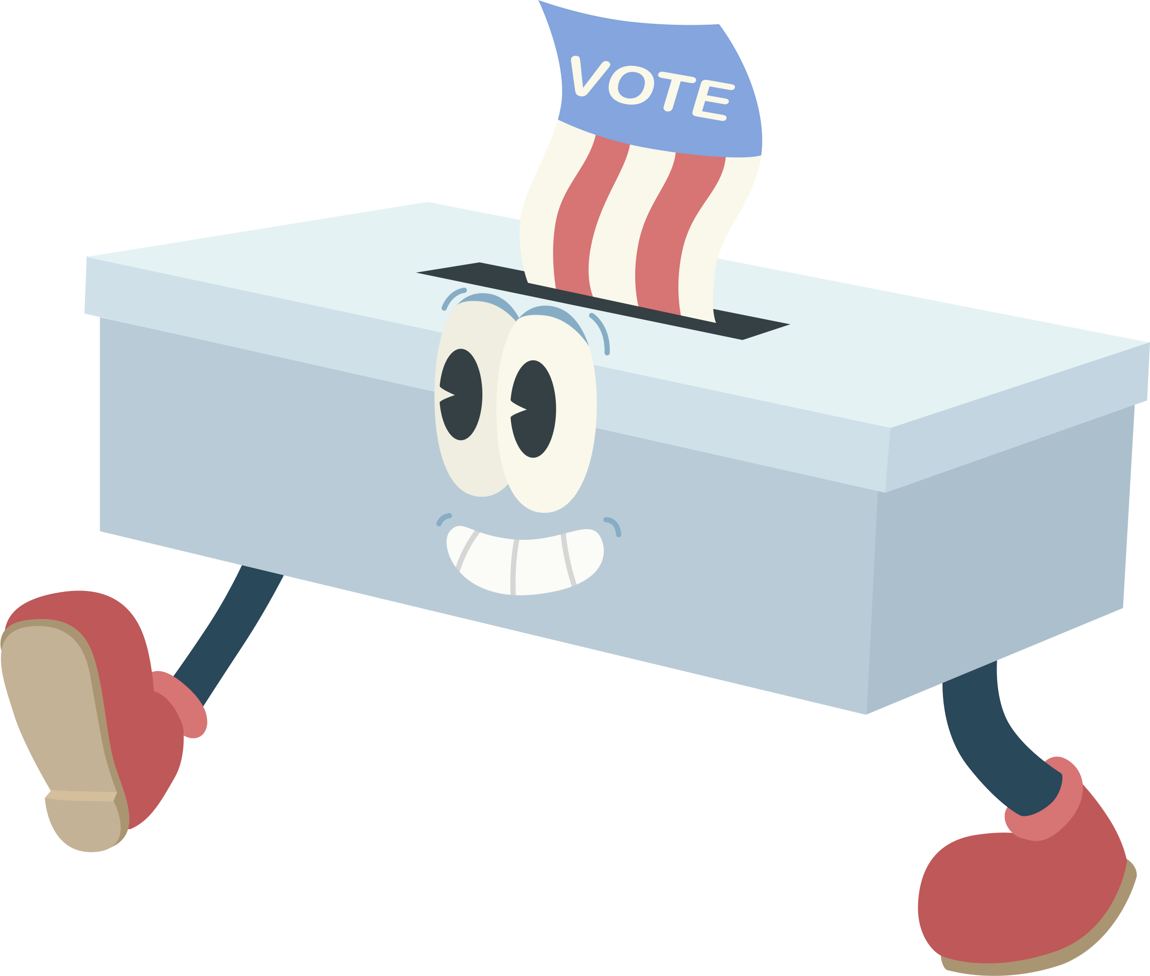
Walking Vote
Listen to the prompts and move to the side that matches your choice.
Notes:
Prompts:
A $100,000 a year job that you absolutely hate or a $65,000 a year job that you love?
Have a flexible, predictable workday or a flexible, changing schedule?
Be your own boss and manage everything or work for someone else and focus only on your job?
Take out student loans to attend your dream school or attend a less expensive school and avoid debt?
Earn a degree in a “safe” field like business or major in a passion subject like art/music?
Earn enough money to live comfortably now or invest heavily for early retirement?
Have a large savings account but live thrifty or have no savings but live luxuriously?
K20 Center. (n.d.). Walking Vote. Strategies. https://learn.k20center.ou.edu/strategy/4126

Slide 6
Would you rather…
<
have a $100,000-a-year job that you absolutely hate
>
have a $65,000-a-year job that you love

Slide 7
Would you rather…
<
have a flexible, predictable workday
>
have a flexible, changing schedule

Slide 8
Would you rather…
<
be your own boss and manage everything
>
work for someone else and focus only on your job

Slide 9
Would you rather…
<
take out student loans to attend your dream school
>
attend a less expensive school and avoid debt

Slide 10
Would you rather…
<
earn a degree in a “safe” field like business
>
major in a passion subject like art/music

Slide 11
Would you rather…
<
earn enough money to live comfortably now
>
invest heavily for early retirement

Slide 12
Would you rather…
<
have a large savings account but live thrifty
>
have no savings but live luxuriously

Slide 13

Beach Ball Talk and Toss
Think about your responses to the prompts in the previous activity.
  What are the things that are most important to you?
Notes:
K20 Center. (n.d.). Beach ball talk and toss. Strategies. https://learn.k20center.ou.edu/strategy/3049

Slide 14
Since graduating from high school…
What are some things you have enjoyed?
What is something you didn’t expect or weren’t prepared for?
Is there something you’d like to change or do differently?
Notes:
Click to reveal each of the three bullet points:
Since graduating high school what are some things you have enjoyed?
What is something you didn’t expect or weren’t prepared for?
Now that you’re here is there something you’d like to change or do differently?

Slide 15


Facts in the Fiction
True or False: Most students clearly understand the exact steps they need to complete their degree.
False. Many students who leave college say they would return if given a clear and simple pathway to completion. Confusing degree requirements often discourage progress.
Notes:
Click to show true or false answer and explanation.
Most students clearly understand the exact steps they need to complete their degree.
False, because many students who leave college say they would return if given a clear and simple pathway to completion. Confusing degree requirements often discourage progress.
K20 Center. (n.d.). Facts in the Fiction. Strategies. https://learn.k20center.ou.edu/strategy/60

Slide 16

Facts in the Fiction
True or False: Knowing the total cost of college and available financial aid helps students stay on track toward graduation.
True. Financial uncertainty is a major barrier to returning. Clear information about tuition, aid, and costs can support persistence.
Notes:
Click to show true or false answer and explanation.
Knowing the total cost of college and available financial aid helps students stay on track toward graduation.
True. The survey found that financial uncertainty is a major barrier to returning. Clear information about tuition, aid, and costs can support persistence.

Slide 17
Facts in the Fiction
True or False: Students often leave college because they are unsure which credits will transfer or count toward their degree.
True. Unclear transfer and credit policies make it harder for students to re-enroll or complete their degrees efficiently.
Notes:
Click to show true or false answer and explanation.
Students often leave college because they are unsure which credits will transfer or count toward their degree.
True. The report highlights that unclear transfer and credit policies make it harder for students to re-enroll or complete their degrees efficiently.

Slide 18
Facts in the Fiction
True or False: Short-term programs and alternative credentials can provide flexible options for students to reach their career goals.
True! Growing interest in shorter, skills-based pathways help students return to education with clear, career-focused goals.
Notes:
Click to show true or false answer and explanation.
Short-term programs and alternative credentials can provide flexible options for students to reach their career goals.
True. The article notes growing interest in shorter, skills-based pathways that help students return to education with clear, career-focused goals.

Slide 19

SMART Goals
Create two SMART goals related to enrolling in a college or university.

Slide 20

Bridge Assessment
insert link
Notes:
Ipholio. (n.d.). Skydance Bridge OKC [Photograph]. Wikimedia Commons. https://commons.wikimedia.org/wiki/File:Skydance_Bridge_OKC.jpg

Slide 21
Find your TREK Rapid Feedback survey!
GUMS
FUTURE
OKC
insert link
insert link
insert link

