Slide 1
Time Management

Slide 2
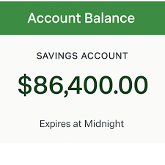
Your Bank Account
Imagine you wake up tomorrow…and find $86,400 in your bank account! But there’s a catch: whatever you don’t spend by midnight disappears forever. You can’t save it, and you can’t carry it over. What would you do with with it?

Slide 6

Scenario: Applying for an Internship
A friend of yours wants to apply for an internship where she can gain real-world experience over the summer. There’s way too much work to do in one sitting. How could she make the process manageable?

Slide 7
Micro-Goals
Micro-goals are small, specific, and actionable steps that make big projects easier to start and complete.

Slide 8

How to break up a research paper or long essay into micro-goals:
Find three sources
Reflect on the sources
Read one article
Write an outline
Draft the introduction
Notes:
Click to reveal each of the 5 micro-goals:
Find three sources
Reflect on the sources
Read one article
Write an outline
Draft the introduction
Person writing on paper. (n.d.). Adobe Stock. https://stock.adobe.com/search?k=write%252Ba%252Bresearch%252Bpaper&asset_id=1688391745

Slide 9

Becoming more active on campus
Attend campus fairs
Explore 4-5 organizations that interest you
Attend at least one event per week
Notes:
Click to reveal each of the 5 micro-goals:
Attend campus fairs
Explore 4-5 organizations that interest you
Attend at least one event per week
Campus activities (n.d.). Adobe Stock [stock photo]. https://stock.adobe.com/search?k=campus%252Bactivities&asset_id=1230072233

Slide 10
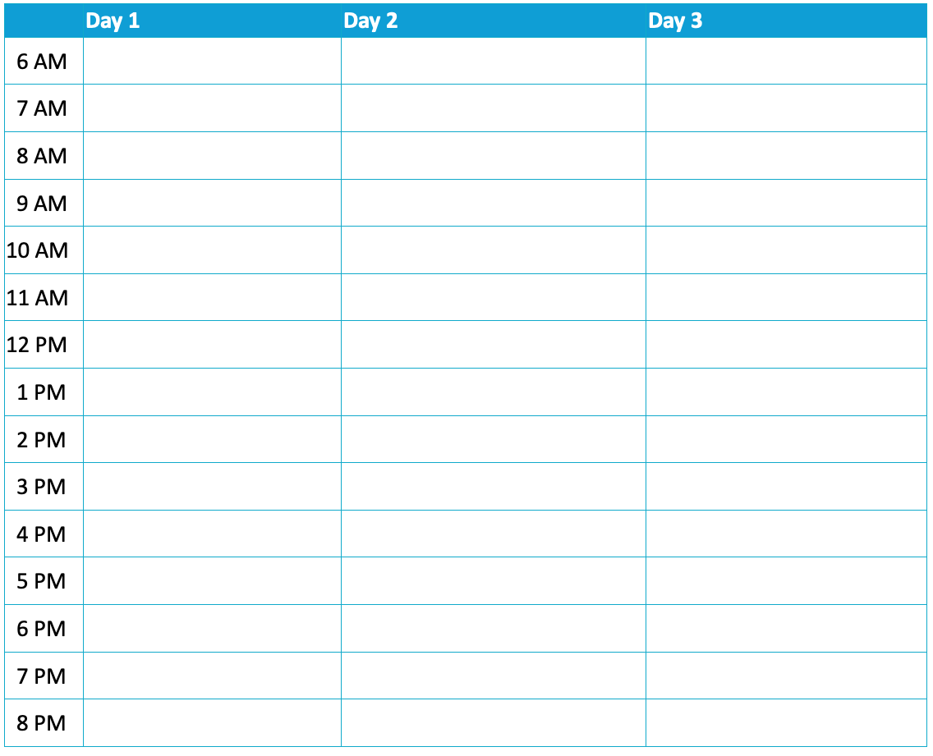
Time-Blocking
Create a schedule using a Time-Blocking Chart.
Include your micro-goals, class time, work, events, and activities.
Remember to include time for meals, sleeping, and socializing!

Slide 11
Peer Review
Ask your partner clarifying questions.
Are micro-goals included?
Does the schedule reflect realistic amounts of time?
Are barriers accounted for with strategies (study spot, reminders, buffer blocks)?
Is there balance (sleep, meals, downtime, classes)?

Slide 12

Evaluate
Divide your sticky note in half.
On one half, draw how you feel about the content you’ve explored today.
On the other half, write a sentence explaining what you understand or think now.
Notes:
K20 Center. (n.d.). How am I feeling? What am I thinking?. Strategies. https://learn.k20center.ou.edu/strategy/187

