Slide 2
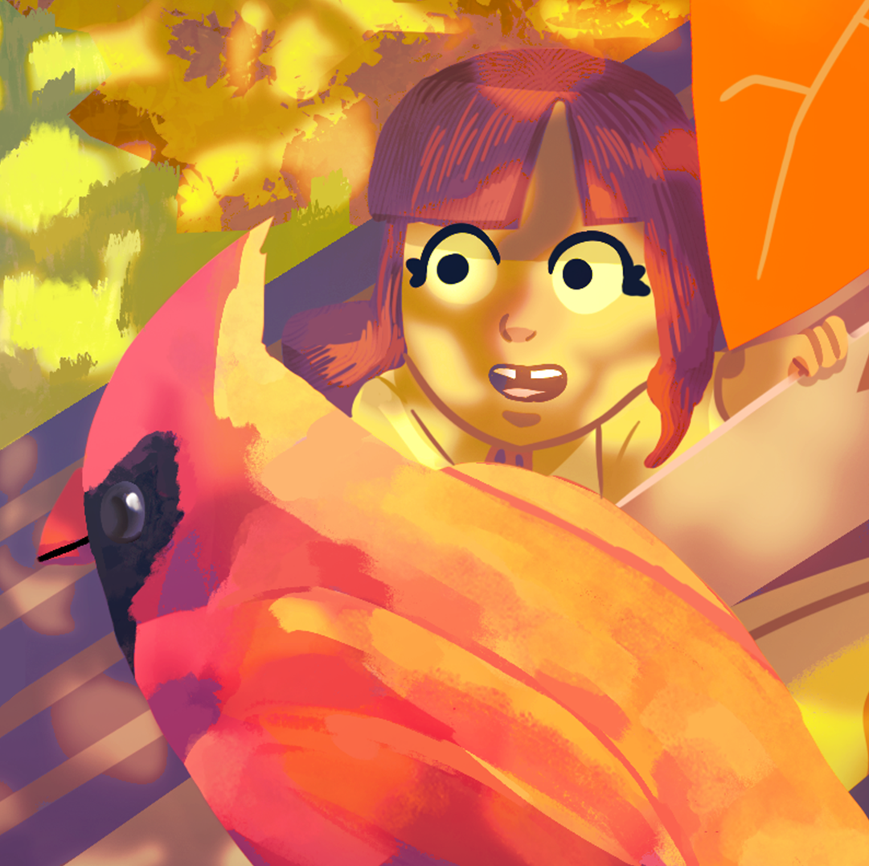
Roots of Curiosity
Nature Journaling

Slide 3
Essential Question
How does nature journaling deepen observation, curiosity, and scientific thinking?

Slide 4
Learning Objectives
Apply nature journaling techniques to record observations with words, sketches, and symbols.
Develop questions from observations to support curiosity and scientific thinking.
Connect the nature journaling activity to classroom learning.

Slide 5
What is Nature Journaling?
Nature journaling is a way to capture observations in the outdoor world using words, images, symbols, and colors. Your illustrations do not need to be perfect but should be understandable.
Nature journaling helps us strengthen our observation and thinking skills. It also builds curiosity.

Slide 6
Prompt for Journaling
Carefully read the prompt for your nature journaling session.
At the top of your journal page, record the date, time, and location of your session.
Gather materials you will need for your journal session.

Slide 7
Zoom In, Zoom Out
Find an object to focus on for this nature journal.
Record observations at three scales: close-up (zoom in), life-sized, far away (zoom out).
Use circles to show magnified views for the zoom-in scale. To describe the zoomed-out view, you can include details such as growth forms, a description of where the object is, or a small map.
Use writing, drawing, and numbers to record your observations.

Slide 8
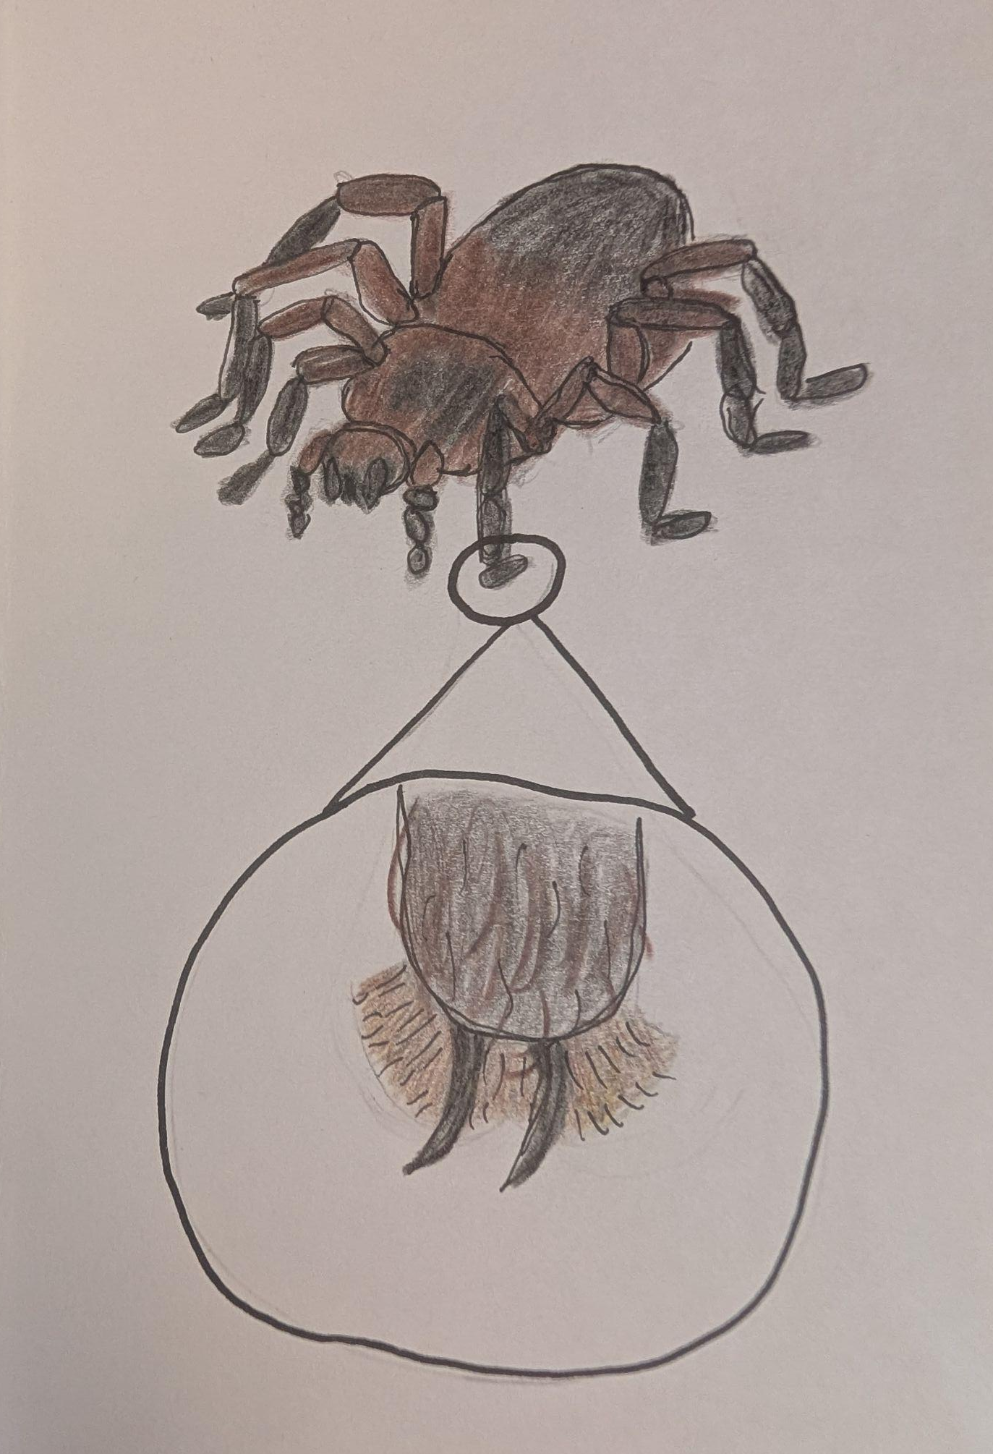
Notes:
Johnson, R. J. (2026). Tarantula [Drawing]. K20 Center.

Slide 9
Mapping
Make a map of the area within the boundaries described.
Use symbols to show where things occur and make a key that illustrates what each symbol means.
Include an arrow pointing north and a scale.
Record 2–3 landmarks to use as reference points.
Add any objects or animals you notice to your map.
Add questions to your map as you work.

Slide 10
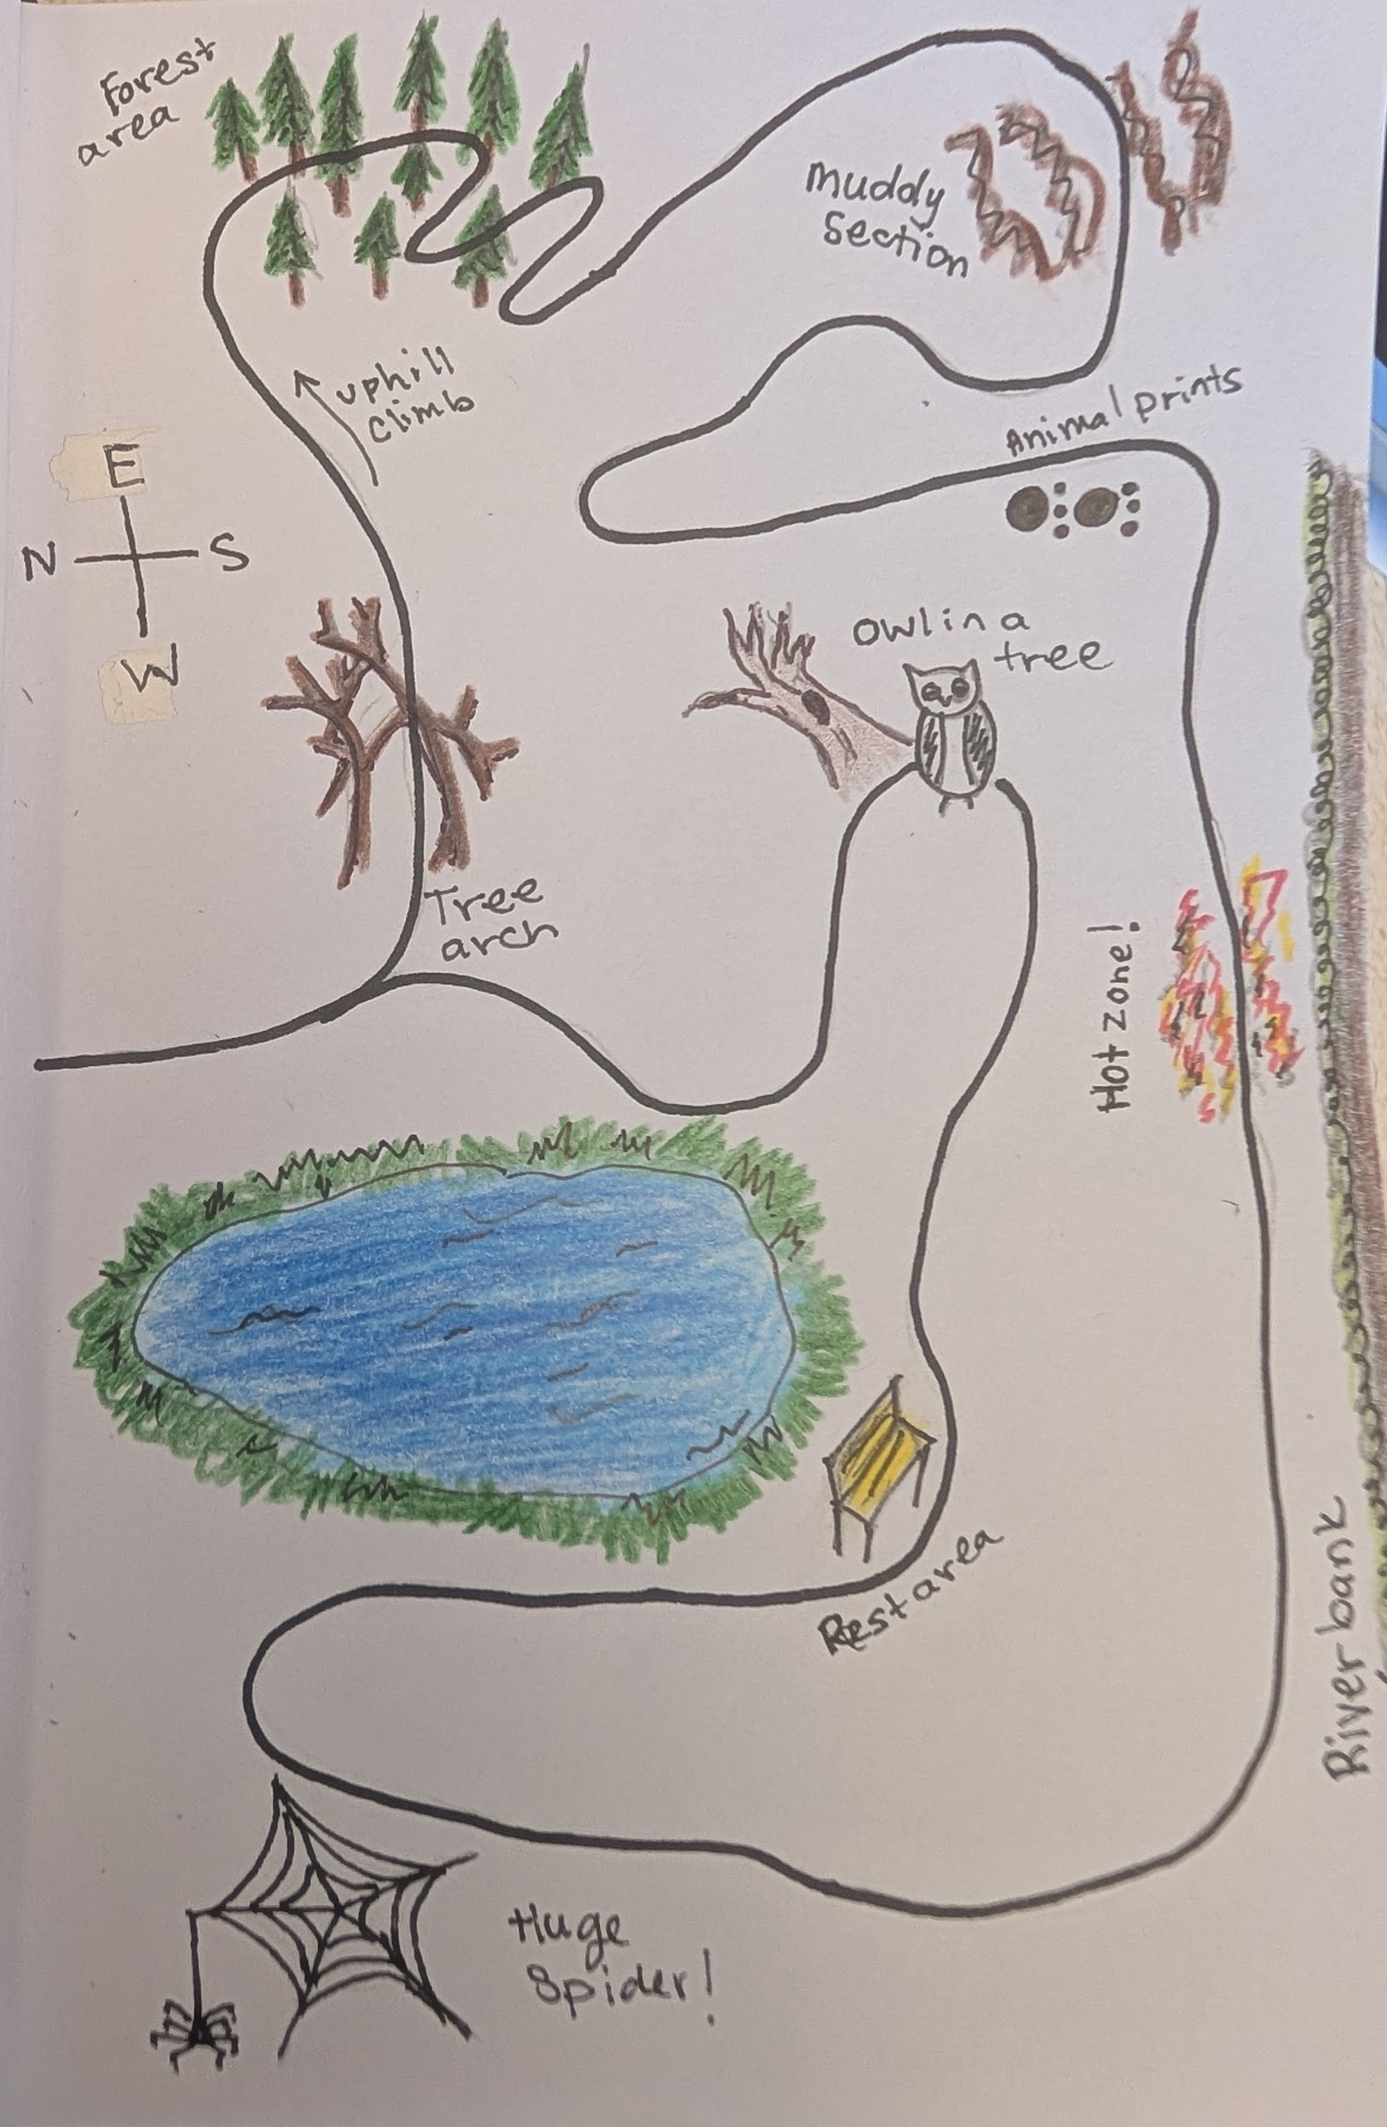
Notes:
Johnson, R. J. (2026). Nature walk [Drawing]. K20 Center.

Slide 11
Soundscape Map
Listen to sounds in the space around you for this nature journal.
Draw yourself in the center of the paper.
Identify the sounds you hear and where they are coming from.
Find creative ways to show sounds using symbols, diagramming, words, and sketches.

Slide 12
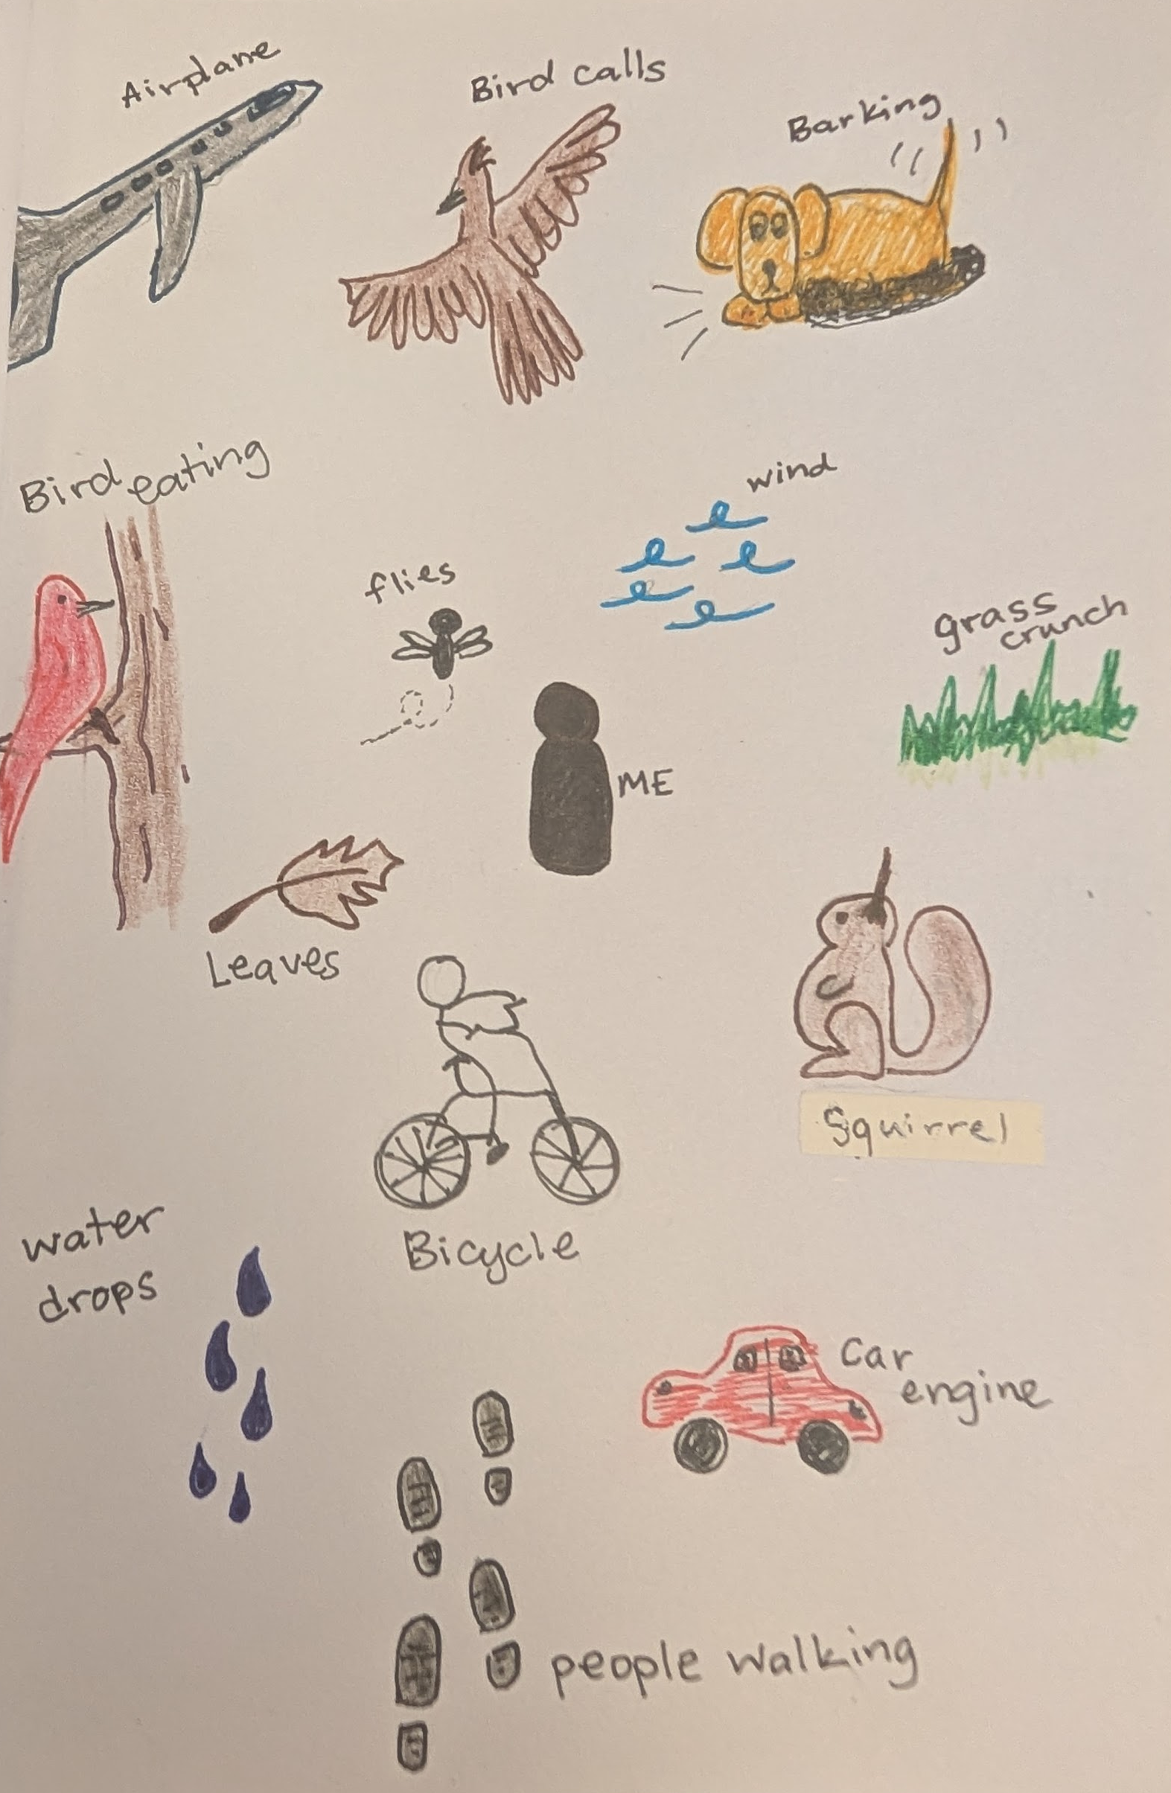
Notes:
Johnson, R. J. (2026). Sounds outside [Drawing]. K20 Center.

Slide 13
Questioning Questions
Find an object or phenomena to focus on for this nature journal.
Use words, pictures, and numbers to record observations, leaving space between the observations.
Then, ask questions about the phenomena or object you observed.
Use words like who, what, when, where, how, and why to ask as many questions as possible. Do not worry about answering them.
If you become curious about something else, you can restart the process focusing on that object or phenomena.

Slide 14
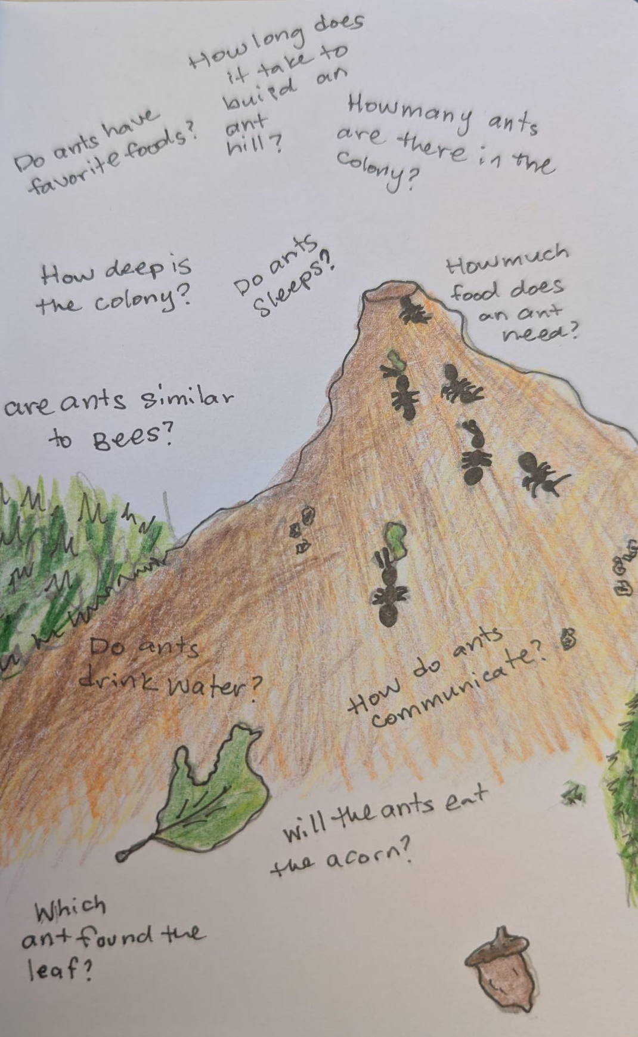
Notes:
Johnson, R. J. (2026). The ants [Drawing]. K20 Center.

Slide 15
Hidden Numbers
Count, measure, time, or estimate things around you. Try to find different ways to quantify your observations.
Be creative in the way you quantify your observations. There are no wrong methods. Numbers are only one way to show observations.
Use your journal to record what you quantify.

Slide 16
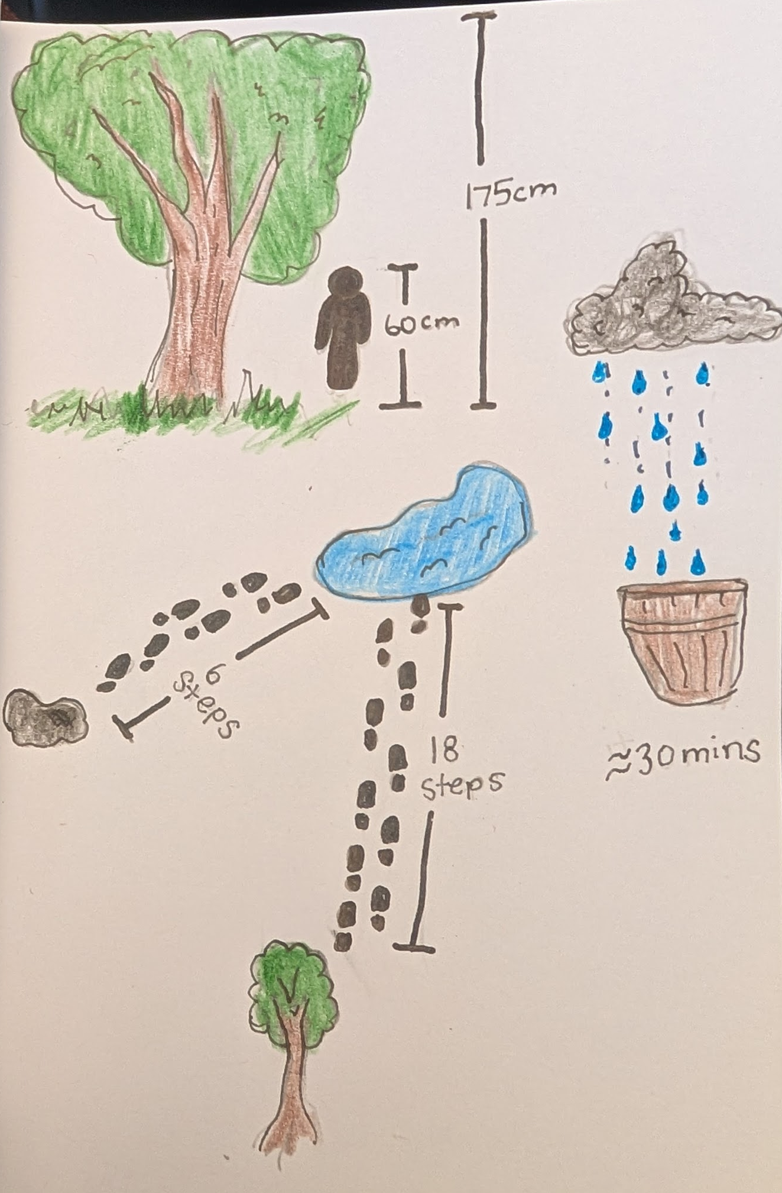
Notes:
Johnson, R. J. (2026). Measurements [Drawing]. K20 Center.

Slide 17
Timeline
Find a flower in the peak of its bloom and describe it in the center of the page using words and pictures.
Find the oldest and youngest versions of this flower and draw one on the left side and one on the right side of the page.
Find as many intermediate stages as you can and draw them, arranging them sequentially on the page.
Write notes as you draw and record any questions you have.

Slide 18
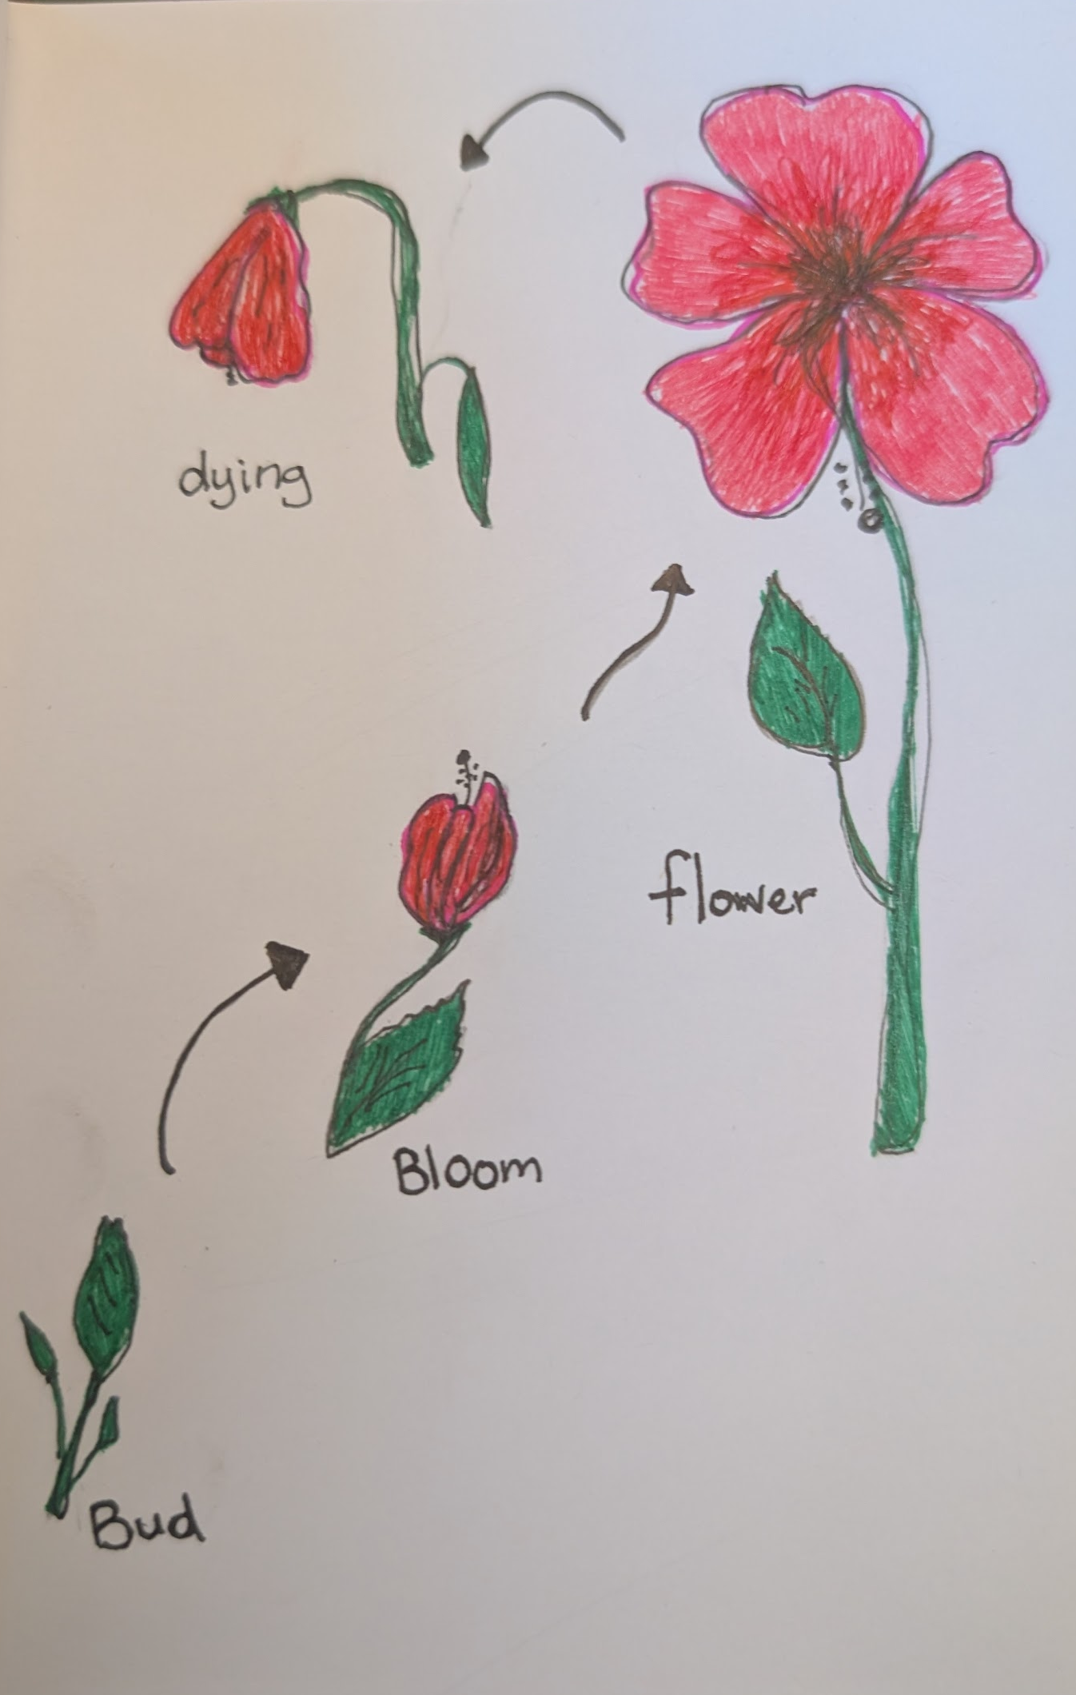
Notes:
Johnson, R. J. (2026). Hibiscus [Drawing]. K20 Center.

Slide 19
Animal Encounters
Find an animal and record observations about it for as long as possible.
Use words, pictures, and numbers to describe the appearance and behavior of the animal. Use words to capture what is difficult to draw quickly.
Because the animal will move, start several drawings and work on one whenever the animal assumes that pose.

Slide 20
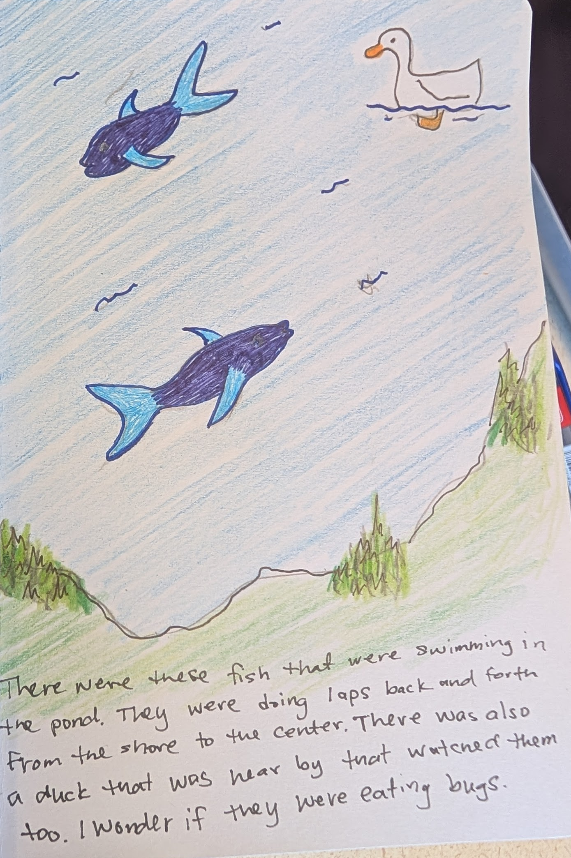
Notes:
Johnson, R. J. (2026). Duck pond [Drawing]. K20 Center.

Slide 21
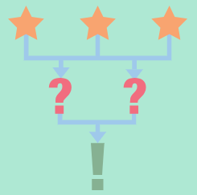
Reflection: 3-2-1 Strategy
Think about today’s nature journaling activities for a few minutes.
Respond to the following prompts on your handout:
  3—Three things you saw that interested you.
  2—Two questions you have.
  1—One connection to content you learned in class.
Notes:
K20 Center. (n.d.). 3-2-1. Strategies. https://learn.k20center.ou.edu/strategy/117

