Slide 2
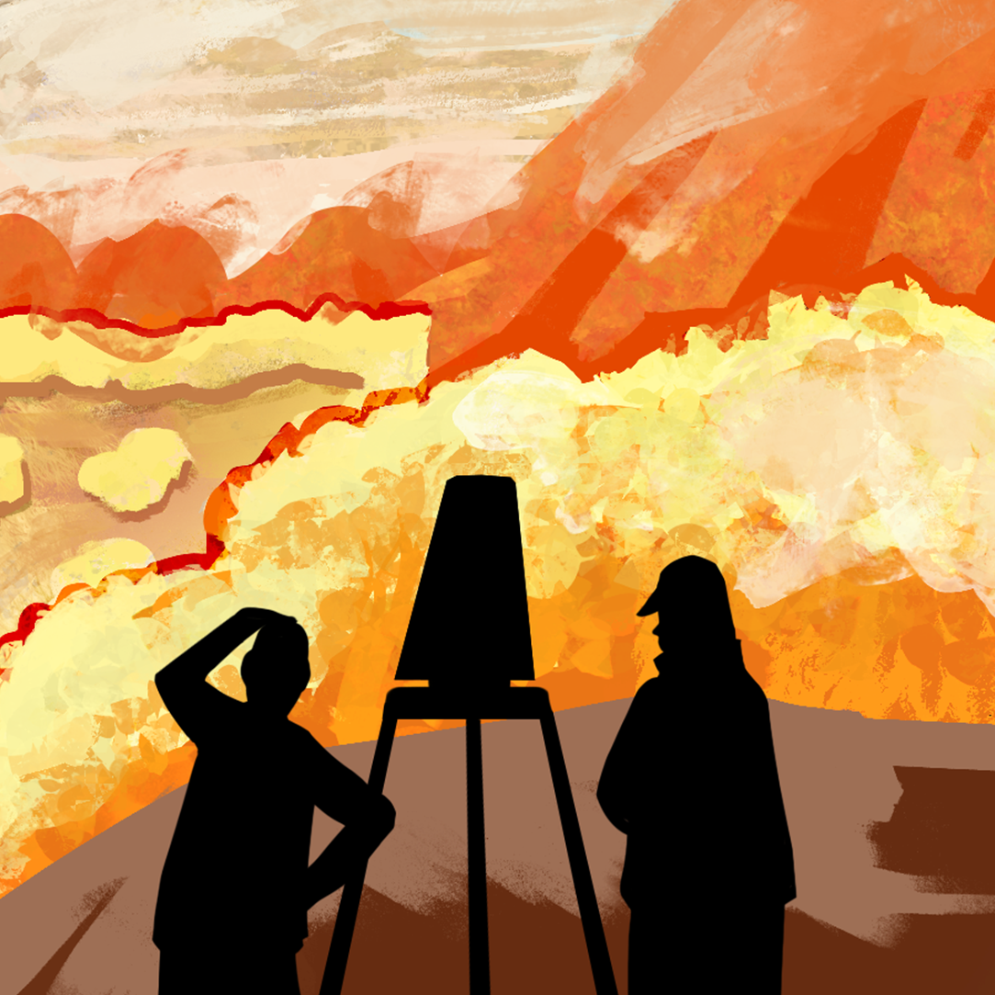
Surveying My Career

Slide 3
Essential Question
How can understanding my skills, personality traits, and interests help me identify career pathways that align with my strengths and future goals?

Slide 4
Learning Objectives
Analyze personal skills, traits, and interests to identify aligned career clusters.
Reflect on identified career clusters to consider future academic and career planning.

Slide 5

Commit and Toss
Answer the following question on your paper:
  How do your interests or skills help you decide what type of career you want?
Crumple your paper with your response and toss it across the room.
Pick up a different paper and share what is written on it with the whole class.
Notes:
K20 Center. (n.d.). Commit and toss. Strategies. https://learn.k20center.ou.edu/strategy/119

Slide 6
Career Motivator Survey
Navigate to k20.ou.edu/i8
Carefully read each statement of the survey.
Rate each statement 0–2 based on how much it sounds like you.
  0 = Not like me
  1 = Sometimes like me
  2 = Very much like me
Add up the scores in each cluster and record each total.
Notes:
Advance CTE. (2023). Career interest survey: Motivator edition. https://careertech.org/resource-center/series/career-interest-surveys/career-interest-survey-motivator-edition/

Slide 7
Career Cluster Survey
Navigate to k20.ou.edu/k8
Carefully read each statement of the survey.
Place a check in the box next to each statement that sounds most like you.
  You can add as many or as few checks as you want.
Add up the scores in each cluster and record each total.

Slide 8
Cluster 1: Advanced Manufacturing | Cluster 2: Agriculture | Cluster 3: Arts, Entertainment, & Design
Cluster 4: Construction | Cluster 5: Digital Technology* | Cluster 6: Education
Cluster 7: Energy & Natural Resources | Cluster 8: Financial Services | Cluster 9: Healthcare & Human Services
Cluster 10: Hospitality, Events, & Tourism | Cluster 11: Management & Entrepreneurship* | Cluster 12: Marketing & Sales*
Cluster 13: Public Service & Safety | Cluster 14: Supply Chain & Transportation | * Also a Cross-Cutting Career Cluster

Slide 9
Career Exploration
Navigate to k20.ou.edu/gq
Read the information about your top three Career Clusters.
Summarize the focus of each Career Cluster.
Notes:
K20 Center. (n.d.). Making CENTS: Career clusters. Infogram. https://infogram.com/making-cents-career-clusters-1h1749w3gygjq2z

Slide 10
Career Question
Determine which Career Cluster is your top choice.
Choose a career in the cluster you selected.
Navigate to mynextmove.org or onetonline.org.
Search the career you selected and answer the career questions on your handout.

Slide 11

Reflection
On your sticky note, complete the following prompts with words or images:
  I am feeling…
  I am thinking about…
Notes:
K20 Center. (n.d.). How am I feeling? What am I thinking?. Strategies. https://learn.k20center.ou.edu/strategy/187

Slide 12
Career Cluster Anchor Chart
Design an anchor chart to represent your selected Career Cluster. Include the following:
  Name of the cluster
  Examples of jobs within the cluster
  Colors, symbols, and images that represent the cluster
Notes:
K20 Center. (n.d.). Anchor charts. Strategies. https://learn.k20center.ou.edu/strategy/58

Slide 13

Roundabout Conversations
Review your notes about your chosen career cluster.
When the music plays, walk in your assigned direction until the music stops.
Partner up with the person across from you.
Share your research about your chosen career cluster and your responses to the career questions on your handout with your partner.
Notes:
K20 Center. (n.d.). Roundabout conversations. Strategies. https://learn.k20center.ou.edu/strategy/196

