Slide 2

Forensic Science CSI
(Classroom Scene Investigations)
Forensic Careers

Slide 3
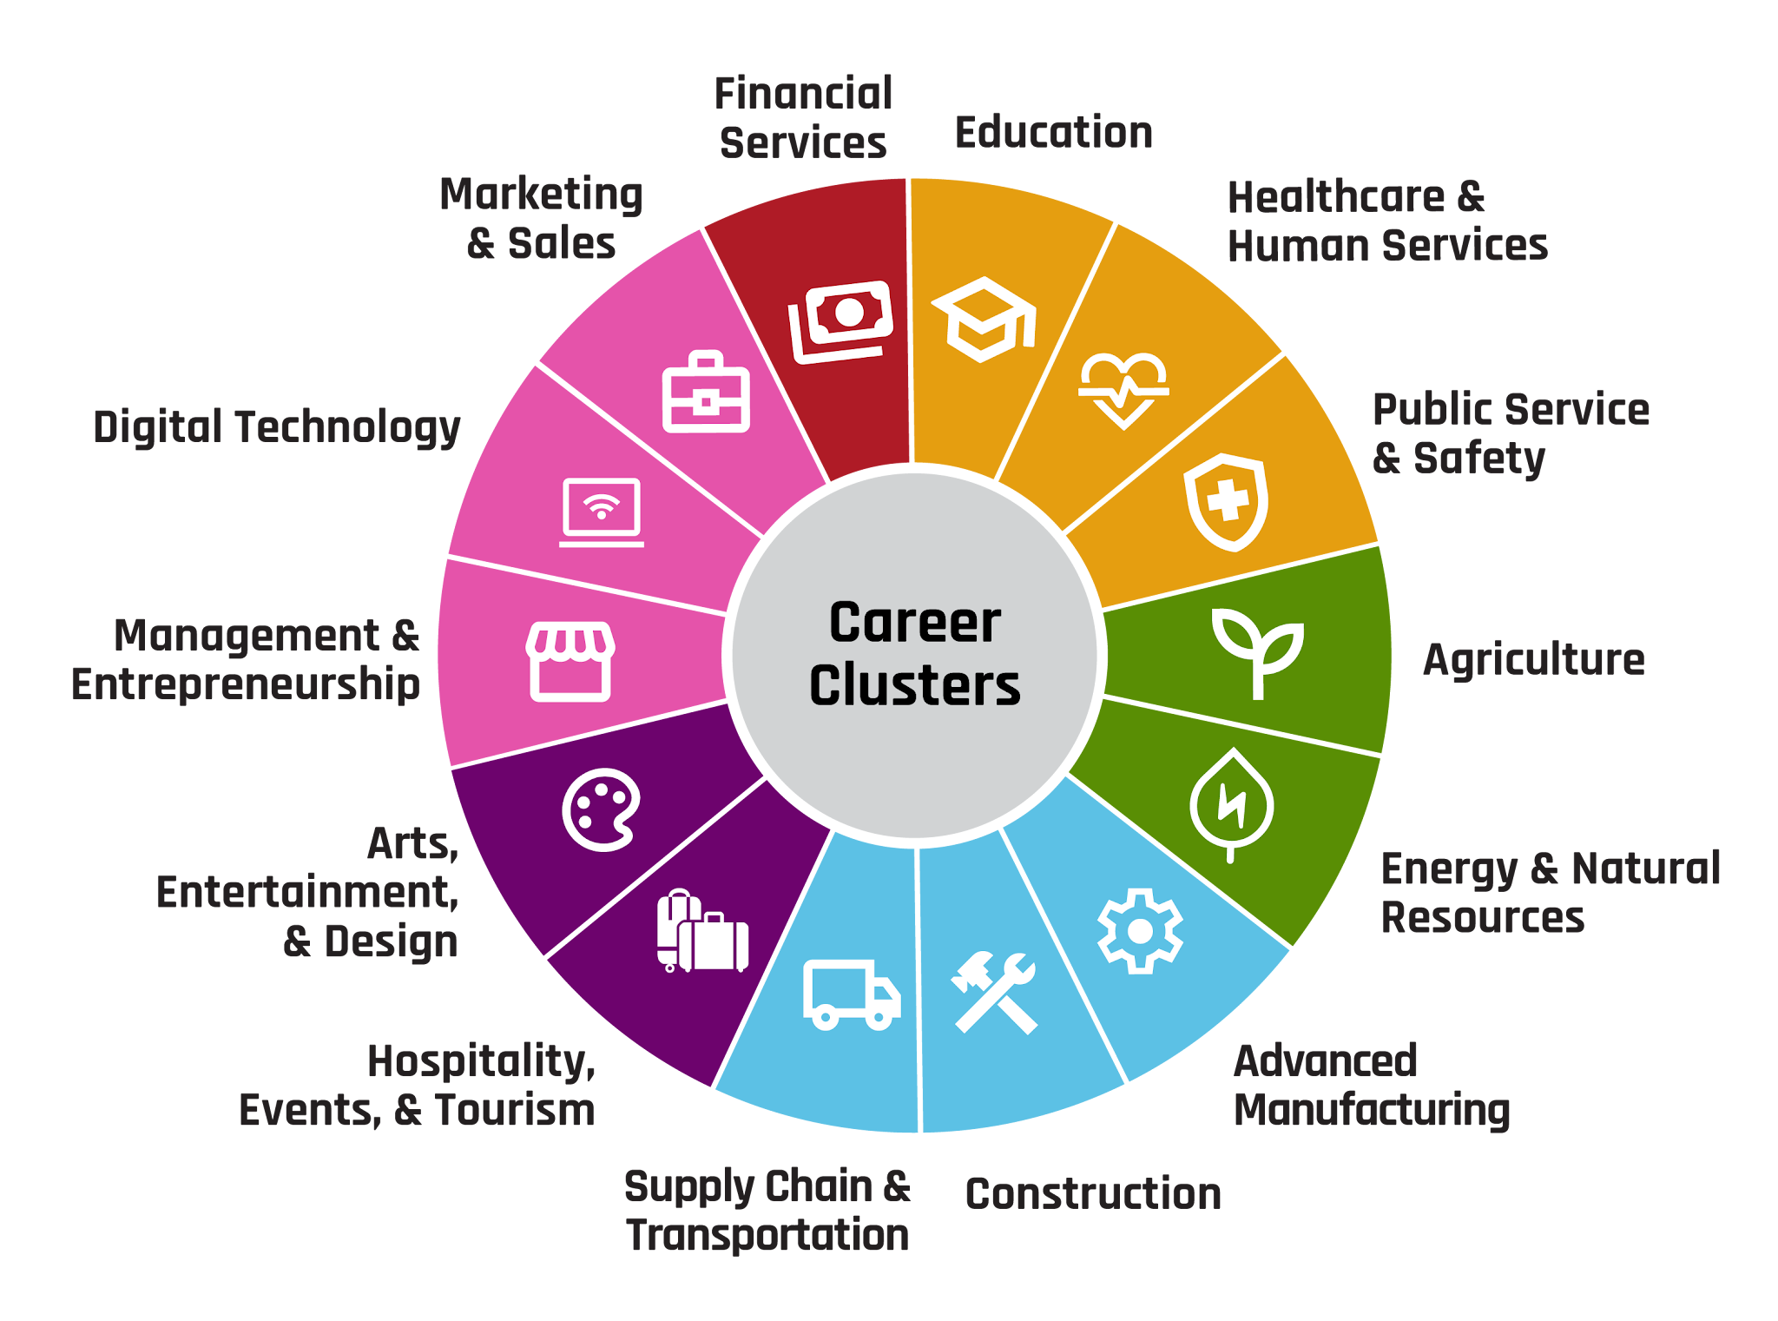
Career Clusters

Slide 4
Forensic Science
A forensic science is any science used for the purpose of the law.
Jobs:
  Crime scene investigator
  DNA analyst or digital analyst
  Evidence technician
  Forensic accountant
  …and so many more!
The average salary of a forensic scientist is $72,060.

Slide 5
Essential Question
What skill opportunities exist within the field of
forensic science?

Slide 6
Learning Objectives
Explore careers in forensic science and discuss how forensic professionals use scientific skills and evidence to investigate cases.
Apply forensic science techniques to isolate DNA, analyze fingerprints, and examine hair samples.
Classify educational pathways and income of forensic careers based on their roles and responsibilities.

Slide 7
Five Skill Corners
Go to your assigned corner of the room.
Read the skill on your poster.
With your group, write three ideas of why the skill on the poster would be important for a forensic scientist.
Choose someone from your group to share out your ideas.
Notes:
K20 Center. (n.d.). Four corners. Strategies. https://learn.k20center.ou.edu/strategy/138

Slide 8
Important Skills
Analytical skills: Carefully evaluate physical, biological, and microscopic evidence to draw logical conclusions about crimes.
Communication skills: Write detailed, accurate lab reports, consult other experts, and clearly explain scientific findings in court.
Attention to detail: Maintain precise records of observations and preserve evidence from contamination or misidentification.
Math and data skills: Correctly use statistical concepts to interpret data and lab results from crime scenes or recreated scenes.
Problem-solving skills: Apply established scientific methods and laboratory tests to solve active investigative questions.

Slide 9
Working Toward Forensic Careers
Focus on math and science courses.
  Chemistry and Biology especially
Look into vocational school and summer program opportunities, such as:
  UCO Forensic Science Summer Camp
  Oklahoma State Bureau of Investigation Forensic Science Center Tours
  UCO Intro to Forensic Science Micro-Credential Course
  Oklahoma City National Memorial STEM Series
Notes:
Oklahoma City National Memorial Museum. (n.d.). National memorial STEM series. https://memorialmuseum.com/events/
Oklahoma State Bureau of Investigation. (2026, September 10). Tour of OSBI’s Forensic Science Center. https://oklahoma.gov/osbi/services/criminalistics-services-division/public-tours-information.html
University of Central Oklahoma. (n.d.). Intro to forensic science. https://www.uco.edu/programs/microcredentials/intro-forensic-science
University of Central Oklahoma. (n.d.). FSI summer camp at UCO. https://www.uco.edu/fsi/community/

Slide 10

S-I-T
As you watch the video, record the following on your handout:
S: One surprising fact or idea
I: One interesting fact or idea
T: One troubling fact or idea
Notes:
K20 Center. (n.d.). S-I-T (Surprising, interesting, troubling). Strategies. https://learn.k20center.ou.edu/strategy/926

Slide 11
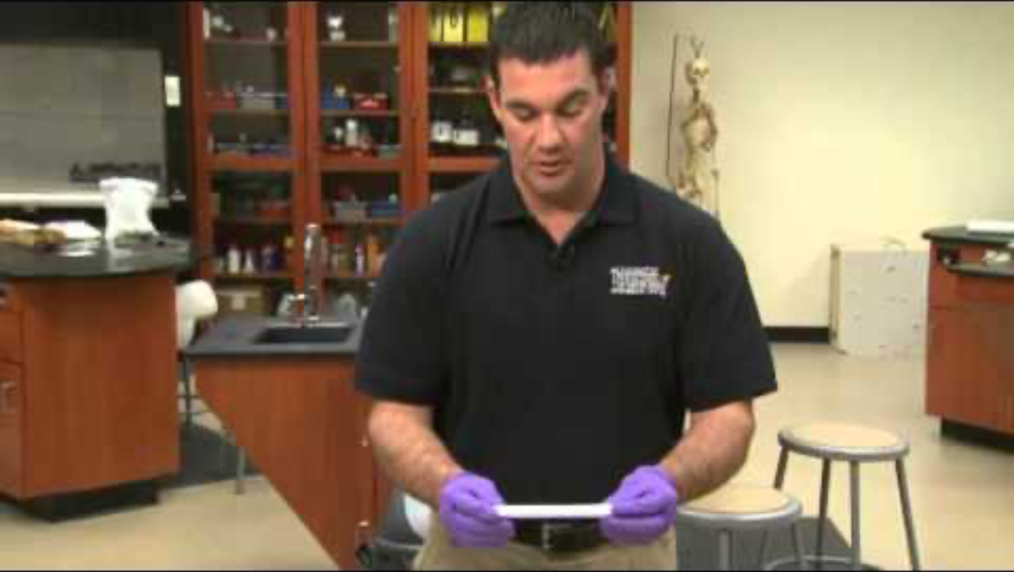
How to Properly Swab DNA Evidence at a Crime Scene
Notes:
National Forensic Academy. (2016, September 13). How to properly swab DNA evidence at a crime scene [Video]. YouTube. https://www.youtube.com/watch?v=2HPeZWGtjD0

Slide 12
DNA Isolation
DNA isolation is a procedure used by many healthcare workers.
  This process extracts DNA from an organism's cells.
  The DNA is then studied, analyzed, or used in experiments for comparison.

Slide 13
DNA Isolation Activity
Follow the instructions on your DNA Isolation handout to extract DNA from a strawberry.
Place your extracted DNA into the plastic bag.
After completing the extraction, respond to the analysis questions on your handout.

Slide 14
DNA Isolation Discussion Questions
How might household chemicals or environmental factors, like dirt or rain, interfere with DNA collection?
What steps must a forensic technician take at a crime scene to ensure that their own DNA does not contaminate the evidence?

Slide 15
DNA Isolation Discussion Questions
How might the difference in number of chromosomes in a human versus a strawberry affect a forensic scientist’s ability to extract visible DNA from a tiny drop of blood?
What steps must a forensic technician take at a crime scene to ensure that their own DNA does not contaminate the evidence?

Slide 16
DNA Isolation
Usually after an collecting a specimen, it goes to a lab for DNA extraction.
Navigate to the University of Utah’s Stark Learning Center using the link: https://k20.ou.edu/wp
Complete the simulation to learn how to complete an extraction of human DNA.
Notes:
Navigate to: https://learn.genetics.utah.edu/content/labs/extraction/ to start the simulation.

Slide 17
S-I-T
While watching the video on the following slide, record:
S: One surprising fact or idea
I: One interesting fact or idea
T: One troubling fact or idea
Notes:
K20 Center. (n.d.). S-I-T (Surprising, interesting, troubling). Strategies. https://learn.k20center.ou.edu/strategy/926

Slide 18
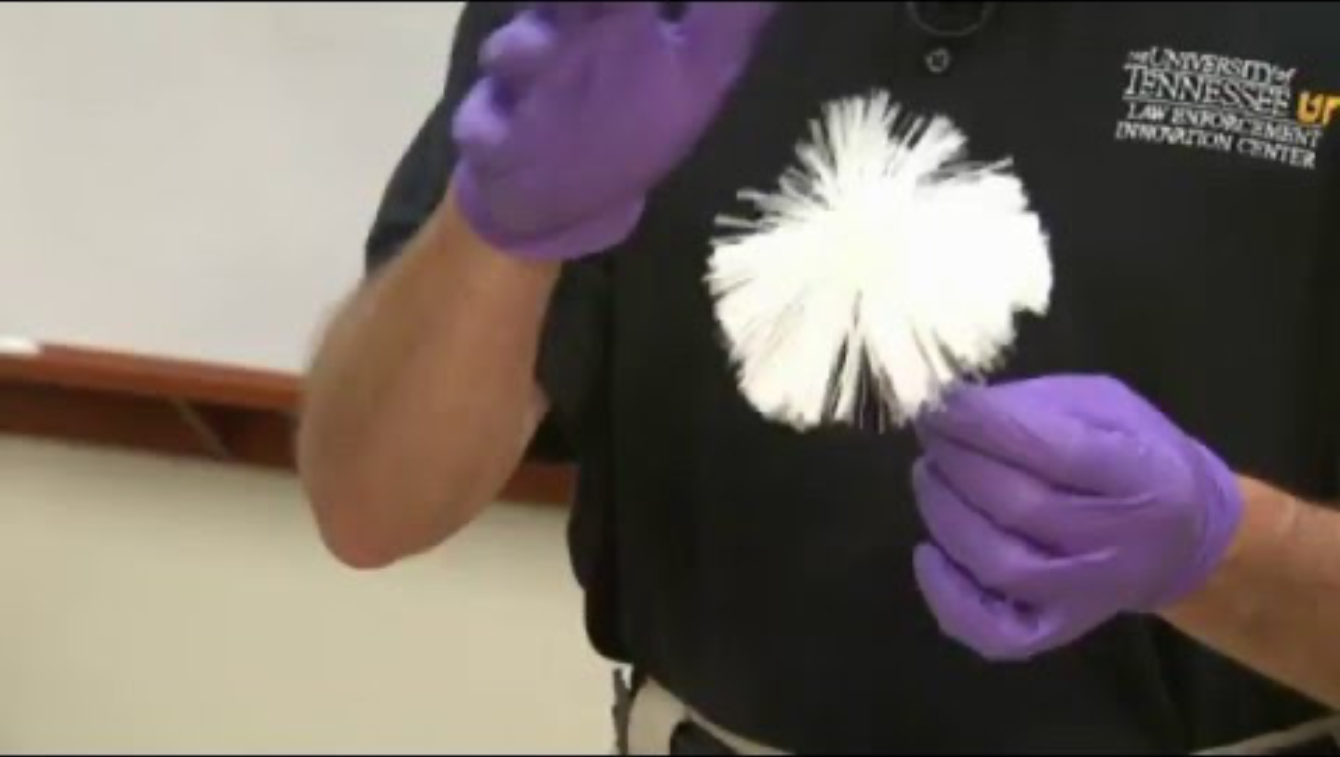
How to Process Latent Fingerprints Using Non-Magnetic Powder
Notes:
National Forensic Academy. (2016, September 13). How to process latent fingerprints using non-magnetic powder [Video]. YouTube. https://www.youtube.com/watch?v=V7G5lp6QigQ

Slide 19
Fingerprinting
Fingerprinting is essential to:
  Identify an individual, as no set of fingerprints is the same from one person to the next
  Do background checks
  Access security systems
  Link suspects to a crime scene
  Track a criminal’s repeated offenses
Notes:
Global Forensic and Justice Center. (2013). A simplified guide to fingerprint analysis. Forensic Science Simplified. https://www.forensicsciencesimplified.org/prints/

Slide 20
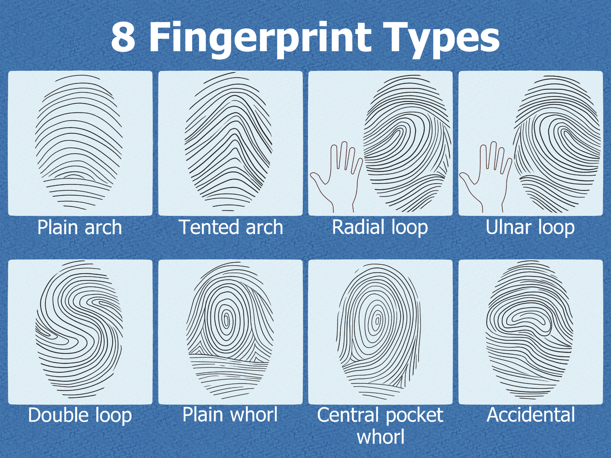
Types of Fingerprints
Notes:
Clatterbuck, C. (2025, December 30). The ultimate guide to fingerprint patterns and how to analyze them. WikiHow. https://www.wikihow.com/Different-Types-of-Fingerprints

Slide 21
Creating Fingerprints
Create an imprint of each of your fingers.
  Cover the entire top portion of your finger in ink.
  Place the outermost part of your finger on the paper.
  Roll your finger from one side to the other then lift.
  Repeat the process with each finger.

Slide 22
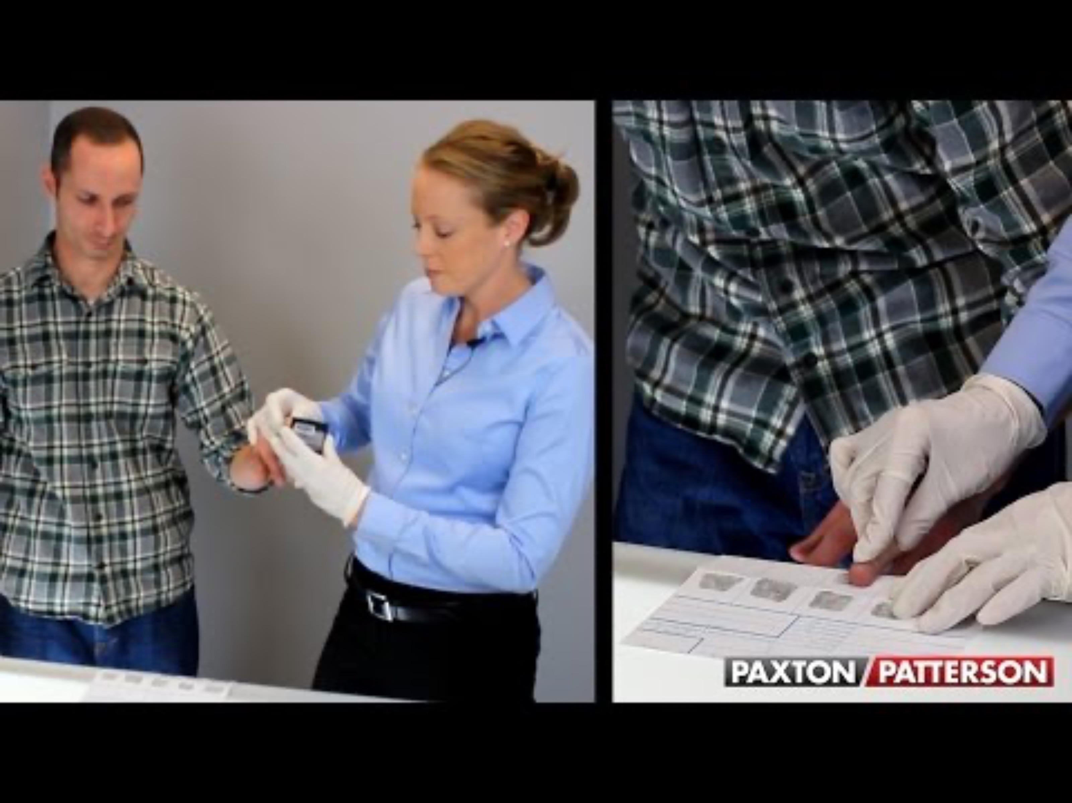
Fingerprinting Technique Using a 10 Print Card
Notes:
College & Career Ready Labs. (2016, June 11). Fingerprinting technique using a 10 print card [Video]. YouTube. https://www.youtube.com/watch?v=47YLGj_yLVA

Slide 23
S-I-T
While watching the video on the following slide, record:
S: One surprising fact or idea
I: One interesting fact or idea
T: One troubling fact or idea
Notes:
K20 Center. (n.d.). S-I-T (Surprising, interesting, troubling). Strategies. https://learn.k20center.ou.edu/strategy/926

Slide 24
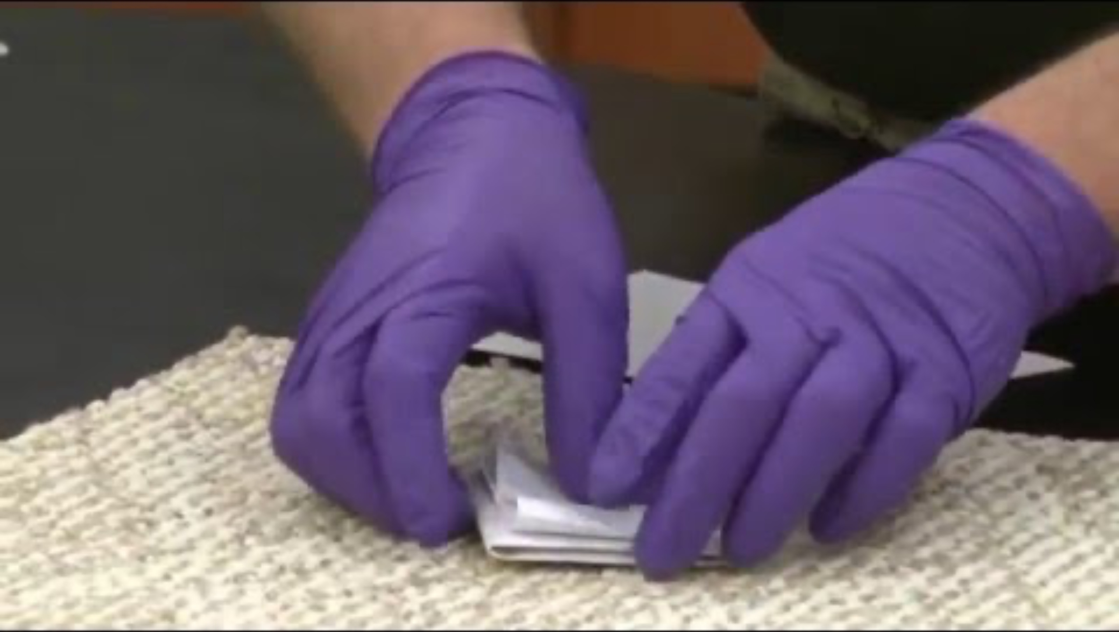
How to Collect Hair & Fiber Evidence at a Crime Scene
Notes:
National Forensic Academy. (2016, March 30). How to collect hair & fiber evidence at a crime scene [Video]. YouTube. https://www.youtube.com/watch?v=cfWsgS0ID-s

Slide 25
Collecting Hair at a Crime Scene
Hair collection can help an investigator determine:
  the species from which the hair originated
  the hair color, age, and race of an individual
  any chemical treatments to an individual's hair
Hair collections should be collected with tweezers to prevent cross-contamination.
Notes:
Global Forensic and Justice Center. (2013). A simplified guide to trace evidence. Forensic Science Simplified. https://www.forensicsciencesimplified.org/trace/how.html

Slide 26
Creating a Wet Mount
Collect the following materials:
slide
cup of water
pipette
coverslip
Follow the directions on your handout.

Slide 27
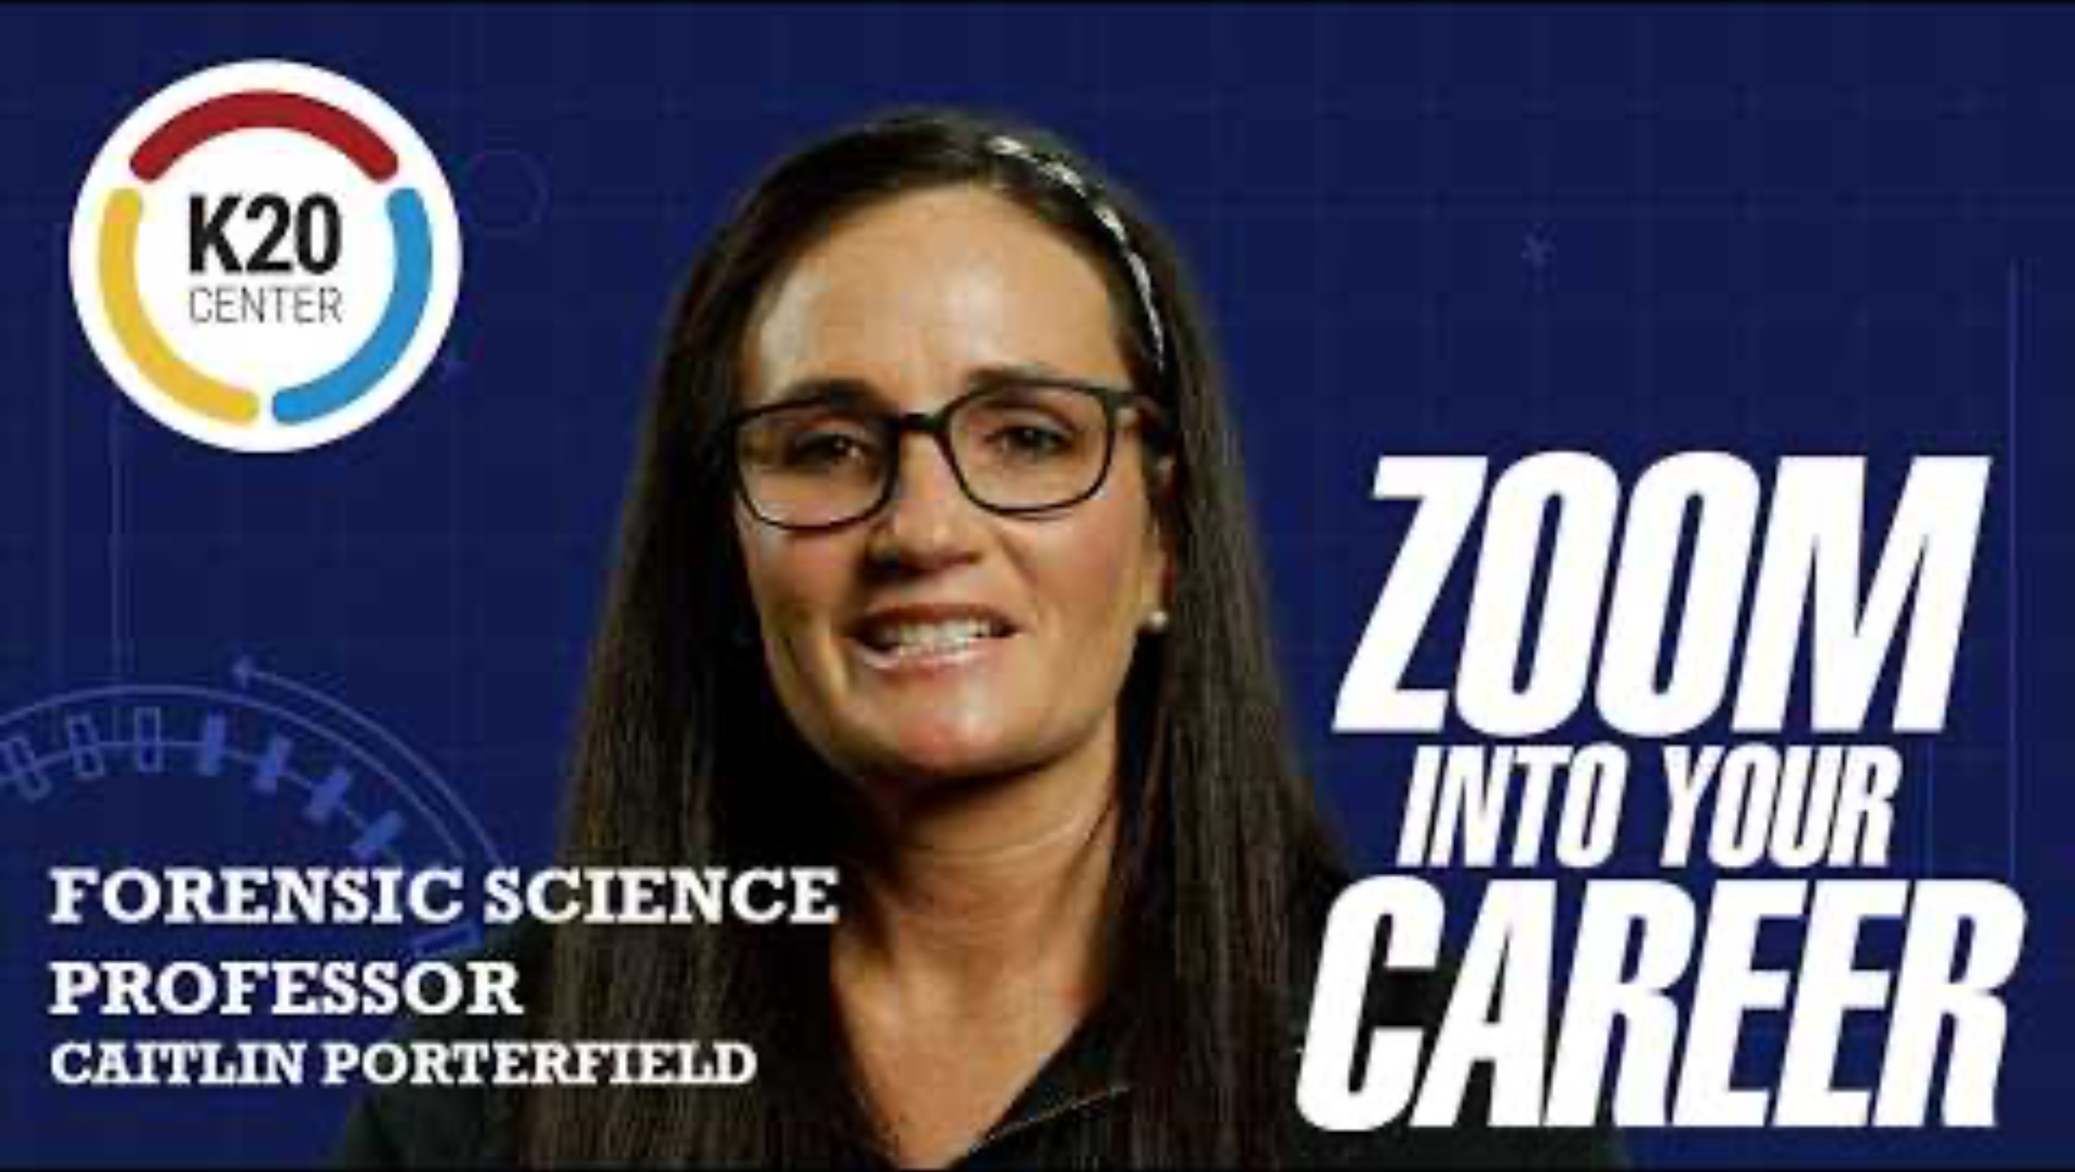
Zoom into Your Career: Caring for Communities With Caitlin Porterfield
Notes:
K20 Center. (2026, April 23). Zoom into your career - Caring for communities with Caitlin Porterfield [Video]. YouTube. https://www.youtube.com/watch?v=hTCCrrQpbb4

Slide 28
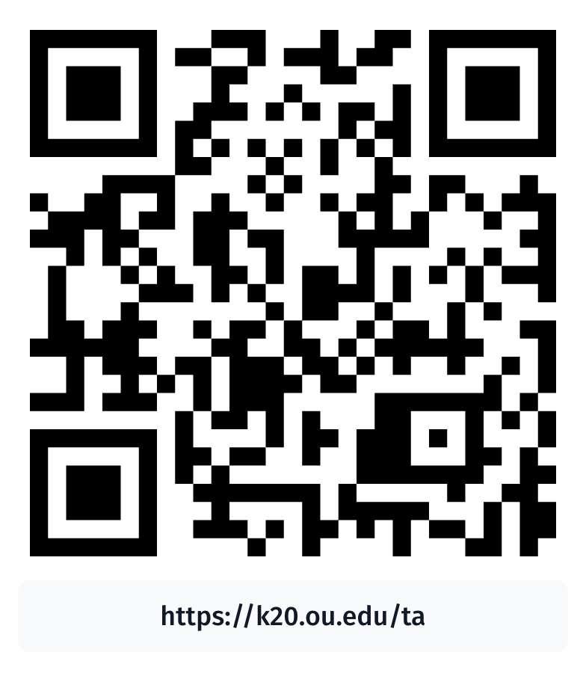
What is a Forensic Scientist?
Visit the American Academy of Forensic Sciences website.
Explore what a forensic scientist is, the expectations and practices of the career, and much more.
Notes:
American Academy of Forensic Sciences. (2025, October 10). What is a forensic science?. https://www.aafs.org/careers-forensic-science/what-forensic-science

Slide 29

Careers in Forensics
With your group, sort your cards into categories.
Use the QR code or link for each career to gather information as you sort.
Each career should have:
  Career title
  Required education level
  Years of education needed
  Salary range
Notes:
K20 Center. (n.d.). Card sort. Strategies. https://learn.k20center.ou.edu/strategy/147

Slide 30
Careers in Forensics Card Sort Answers
Career | Degree/Certification | Time Required | Salary
Biochemists & Biophysicists | Doctorate Degree | 8+ years | $74,290–$201,110
Forensic Anthropologist | Master’s Degree | 6 years | $49,050–$108,060
Analytical Chemist | Bachelor’s Degree | 4 years | $58,460–$160,830
Laboratory Technician | Tech/Vocational School | 1–2 years | $41,440–$92,040
Detectives & Criminal Investigators | Tech/Vocational School | 1 year | $55,390–$160,540

Slide 31
Career Reflection Activity
Think about the careers you explored today.
Consider the following:
  Which career most interested you?
  What is the job description for that career?
  What postsecondary options are available for that career near you?
  What different careers are you interested in? How do those relate to the skills needed for forensic science?

