Slide 2

The Case of the Vanishing Gnome
Soil Forensic Science

Slide 3
Crime Scene
The terracotta garden gnome “Terry” has vanished from her gated garden overnight. There are three suspects.
Your mission: analyze the soil evidence, identify the suspect, and crack the case of the kidnapped gnome.

Slide 4
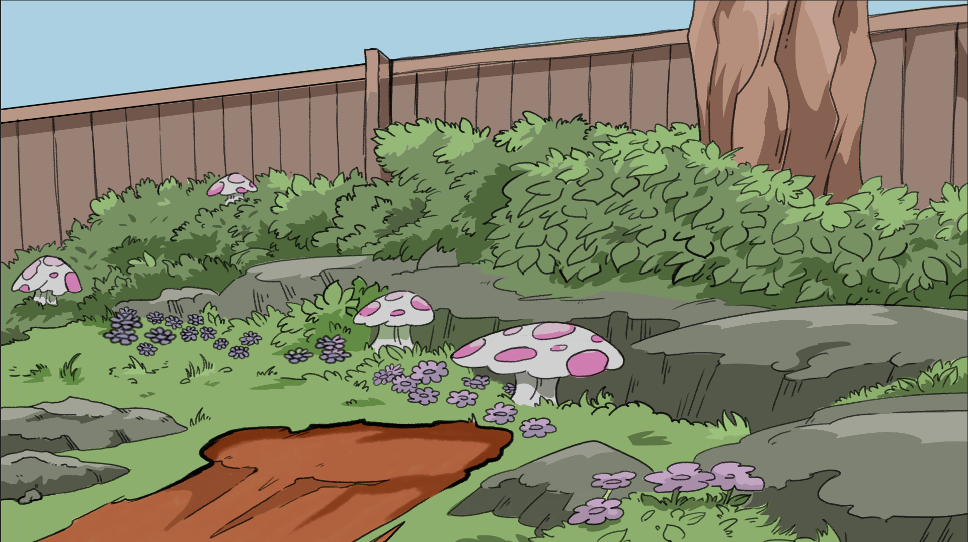
The Crime Scene

Slide 5
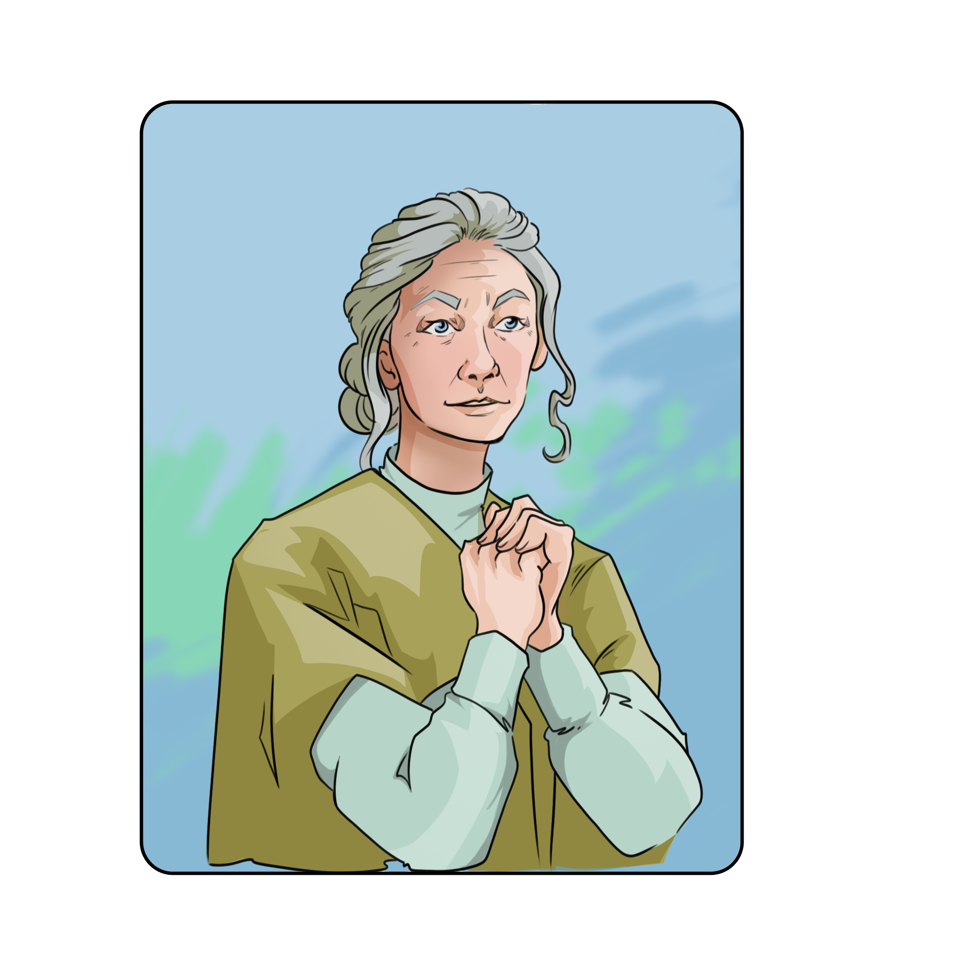


Suspects
Doreen
Hazelton
Wolfgang
Swift
Gnorman
Mann

Slide 6
Soil Forensic Science
Soil is a mixture of organic material, minerals, gasses, and water.
During a crime, organic or manufactured material can transfer from people, objects, or the environment. This is known as trace evidence.
Soil transfer is when the trace evidence is soil or earth material.

Slide 7
Testing Soil
You will do physical and chemical tests on the soil to identify the suspect.

Slide 8
Essential Question
How can soil evidence be used to link people, objects, and locations in a forensic investigation?

Slide 9
Learning Objectives
Explain why soil is considered trace evidence in forensic science.
Identify and compare physical characteristics of soil samples.
Conduct basic soil analysis techniques used by forensic scientists.
Evaluate the reliability and limitations of soil as forensic evidence.

Slide 10
Analyzing Suspect Evidence Soil
You will have three samples of soil evidence to analyze.
Each soil sample is from one of the suspects.
You will complete the following tests:
  Physical characteristics
  Sediment test
  Chemical characteristics

Slide 11
Chain of Custody
Chain of custody is the sequential paper trail that tracks the path of physical or digital evidence. It shows who has collected it, touched it, and where it is stored.
This helps to prevent tampering with evidence and helps it hold up in a court of law.
You will need to send one team member to sign out your evidence in order to protect the chain of custody.

Slide 12
Sediment Test
Collect the following materials:
Three bags of soil (one from each sample)
Vials x3
Marker
Water
Ruler
Follow the steps on your Soil Investigation Lab Guide.

Slide 13
Physical Test
Collect the following materials:
Three bags of soil (one from each sample)
Petri dishes x3
Forceps
Magnifying glass
Follow the steps on your Soil Investigation Lab Guide.

Slide 14
Chemical Test
Collect the following materials:
Test tubes with caps x3
Ruler
Distilled water
pH tester
Phosphate tester
Nitrate tester
Digital timer
Digital scale
Follow the steps on your Soil Investigation Lab Guide.

Slide 15
Chain of Custody and Decontamination
Sign back in your unused evidence.
Wipe down all tools to remove left over soil.
Return all tools and materials to the designated area for special cleaning.
Clean the surface of your lab area.

Slide 16
Analyzing Suspect Evidence
What information did you gain from the soil analysis?
How did you discover this information?
How will it help you narrow down your suspect list?

Slide 17
Analyzing Crime Scene Soil
You will have one sample of soil evidence to analyze.
This soil sample is from the crime scene.
You will complete the following tests:
  Physical characteristics
  Sediment test
  Chemical characteristics

Slide 18
Chain of Custody
You need to send one team member to sign out your evidence in order to protect the chain of custody.

Slide 19
Sediment Test
Collect the following materials:
One bag of soil from the crime scene
Vial x1
Marker
Water
Ruler
Follow the steps on your Soil Investigation Lab Guide.

Slide 20
Physical Test
Collect the following materials:
One bag of soil from the crime scene
Petri dish
Forceps
Magnifying glass
Follow the steps on your Soil Investigation Lab Guide.

Slide 21
Chemical Test
Collect the following materials:
Test tube with cap x1
Ruler
Distilled water
pH tester
Phosphate tester
Nitrate tester
Digital timer
Digital scale
Follow the steps on your Soil Investigation Lab Guide.

Slide 22
Chain of Custody and Decontamination
Sign your unused evidence back in.
Wipe down all tools to remove left over soil.
Return all tools and materials to the designated area for special cleaning.
Clean the surface of your lab area.

Slide 23
Whodunit?
Look over your data on your Soil Investigations Lab Guide.
Compare the suspect soil results to the crime scene results.
Decide who you intend to accuse of the crime.

Slide 24

Claim, Evidence, Reasoning (CER)
Complete the statement citing who you believe stole Terry from the garden.
  Suspect _____ stole Terry from the garden.
Provide 2–3 pieces of evidence from your soil analysis.
Under reasoning, explain the trace evidence, what it means, and how it applies to this case.
Notes:
K20 Center. (n.d.). Claim, evidence, reasoning (CER). Strategies. https://learn.k20center.ou.edu/strategy/156

Slide 25
Big Reveal
Doreen
Hazelton
Wolfgang
Swift
Gnorman
Mann

Slide 26
Forensic Careers Presentation
In your presentation, include the following:
Strengths and weaknesses of soil evidence/trace evidence.
One forensic career.
One career that uses soil testing or soil as evidence.
Explain how that career uses soil evidence or testing and compare it to how a crime scene investigator might use soil evidence.
Evaluate the reliability and limitations of soil as forensic evidence.

Slide 27

Notes:
Lorna Dawson on forensic soil science. (2017, January 13). YouTube. https://www.youtube.com/watch?v=EC7Mq835aYQ

Slide 28

Careers
As you listen to the presentations choose two careers you find interesting.
For each career, record the following:
  Something surprising
  Something interesting
  Something thought-provoking
Notes:
K20 Center. (n.d.). S-I-T (Surprising, Interesting, Troubling). Strategies. https://learn.k20center.ou.edu/strategy/926

