Slide 2
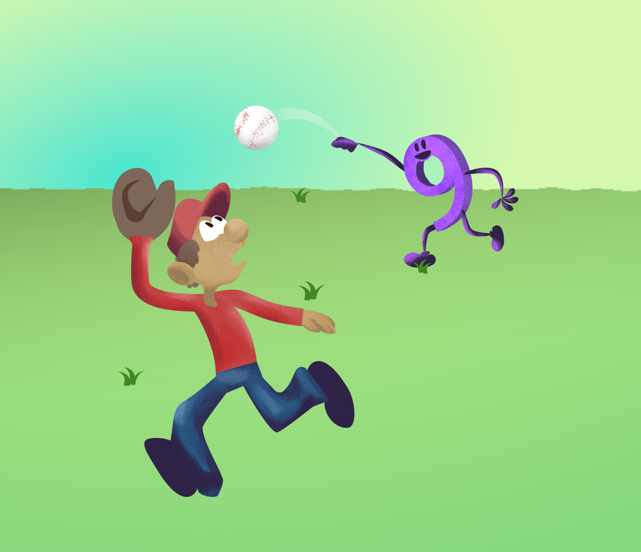
Math in Motion

Slide 3
Essential Question:
How does intentional movement in math deepen understanding, engagement, and problem-solving skills?

Slide 4
Learning Objective:
Model math concepts kinesthetically to visualize patterns and articulate reasoning.

Slide 5
Kinesthetic learning means learning by doing. It connects students to real-life ideas by letting them experience, practice, see examples, or try simulations.
-Adapted from Fleming & Mills (1992)
Notes:
Fleming, N. D., & Mills, C. (1992). Not another inventory, rather a catalyst for reflection. To Improve the Academy, 11, 137–155.

Slide 6
Model Lesson PLACEHOLDER
[add a brief description of your chosen lesson here to remind students of the content. Remember to highlight the specific part of the lesson where you think physical movement could be added.]

Slide 7

Commit and Toss
Respond in writing to a question or prompt.
(All students) Crumple their responses and toss them across the room or into a box or empty trash can.
Everyone then collects a crumpled paper, read it silently or aloud (optional).
  Try again if you got your own paper. Papers can be thrown again, traded, or passed around if this occurs.
Revise, edit, or comment upon the original statement or paragraph in a class or group discussion.
Notes:
K20 Center. (n.d.). Commit and Toss. Strategies. https://learn.k20center.ou.edu/strategy/119

Slide 8
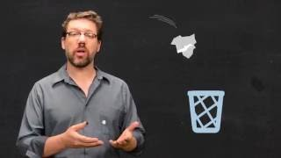
Commit and Toss
Commit and Toss - LEARN Strategy
Notes:
K20 Center. (n.d.). Commit and Toss. Strategies. https://learn.k20center.ou.edu/strategy/119
K20 Center. (2016, Aug. 3). Commit and Toss: LEARN Strategy. YouTube. https://www.youtube.com/watch?v=Jzi0N4rt4Co

Slide 9
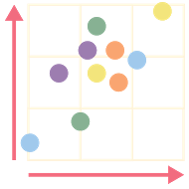
Human Scatter Graph
Designate two perpendicular walls in the classroom to be the x-axis and the y-axis.
The y-axis should be labeled with sections called A, B, C, and D.
  Leave enough room for multiple people to stand in the same area.
Label the side of the x-axis that is closest to the y-axis "low confidence" and the side that's farthest away from the y-axis "high confidence."
Notes:
K20 Center. (n.d.). Human scatter graph. Strategies. https://learn.k20center.ou.edu/strategy/172

Slide 10
Human Scatter Graph
Use a multiple choice prompt and select an answer.
Move to the location in the classroom that best matches your
response relative to the x- and y-axes.
  For example, a student who thinks that the answer is C would stand even with C on the y-axis and in the middle of the x-axis, denoting moderate confidence in the answer.
Discuss with others why you chose the spot/answer you did.
Notes:
K20 Center. (n.d.). Human scatter graph. Strategies. https://learn.k20center.ou.edu/strategy/172

Slide 11
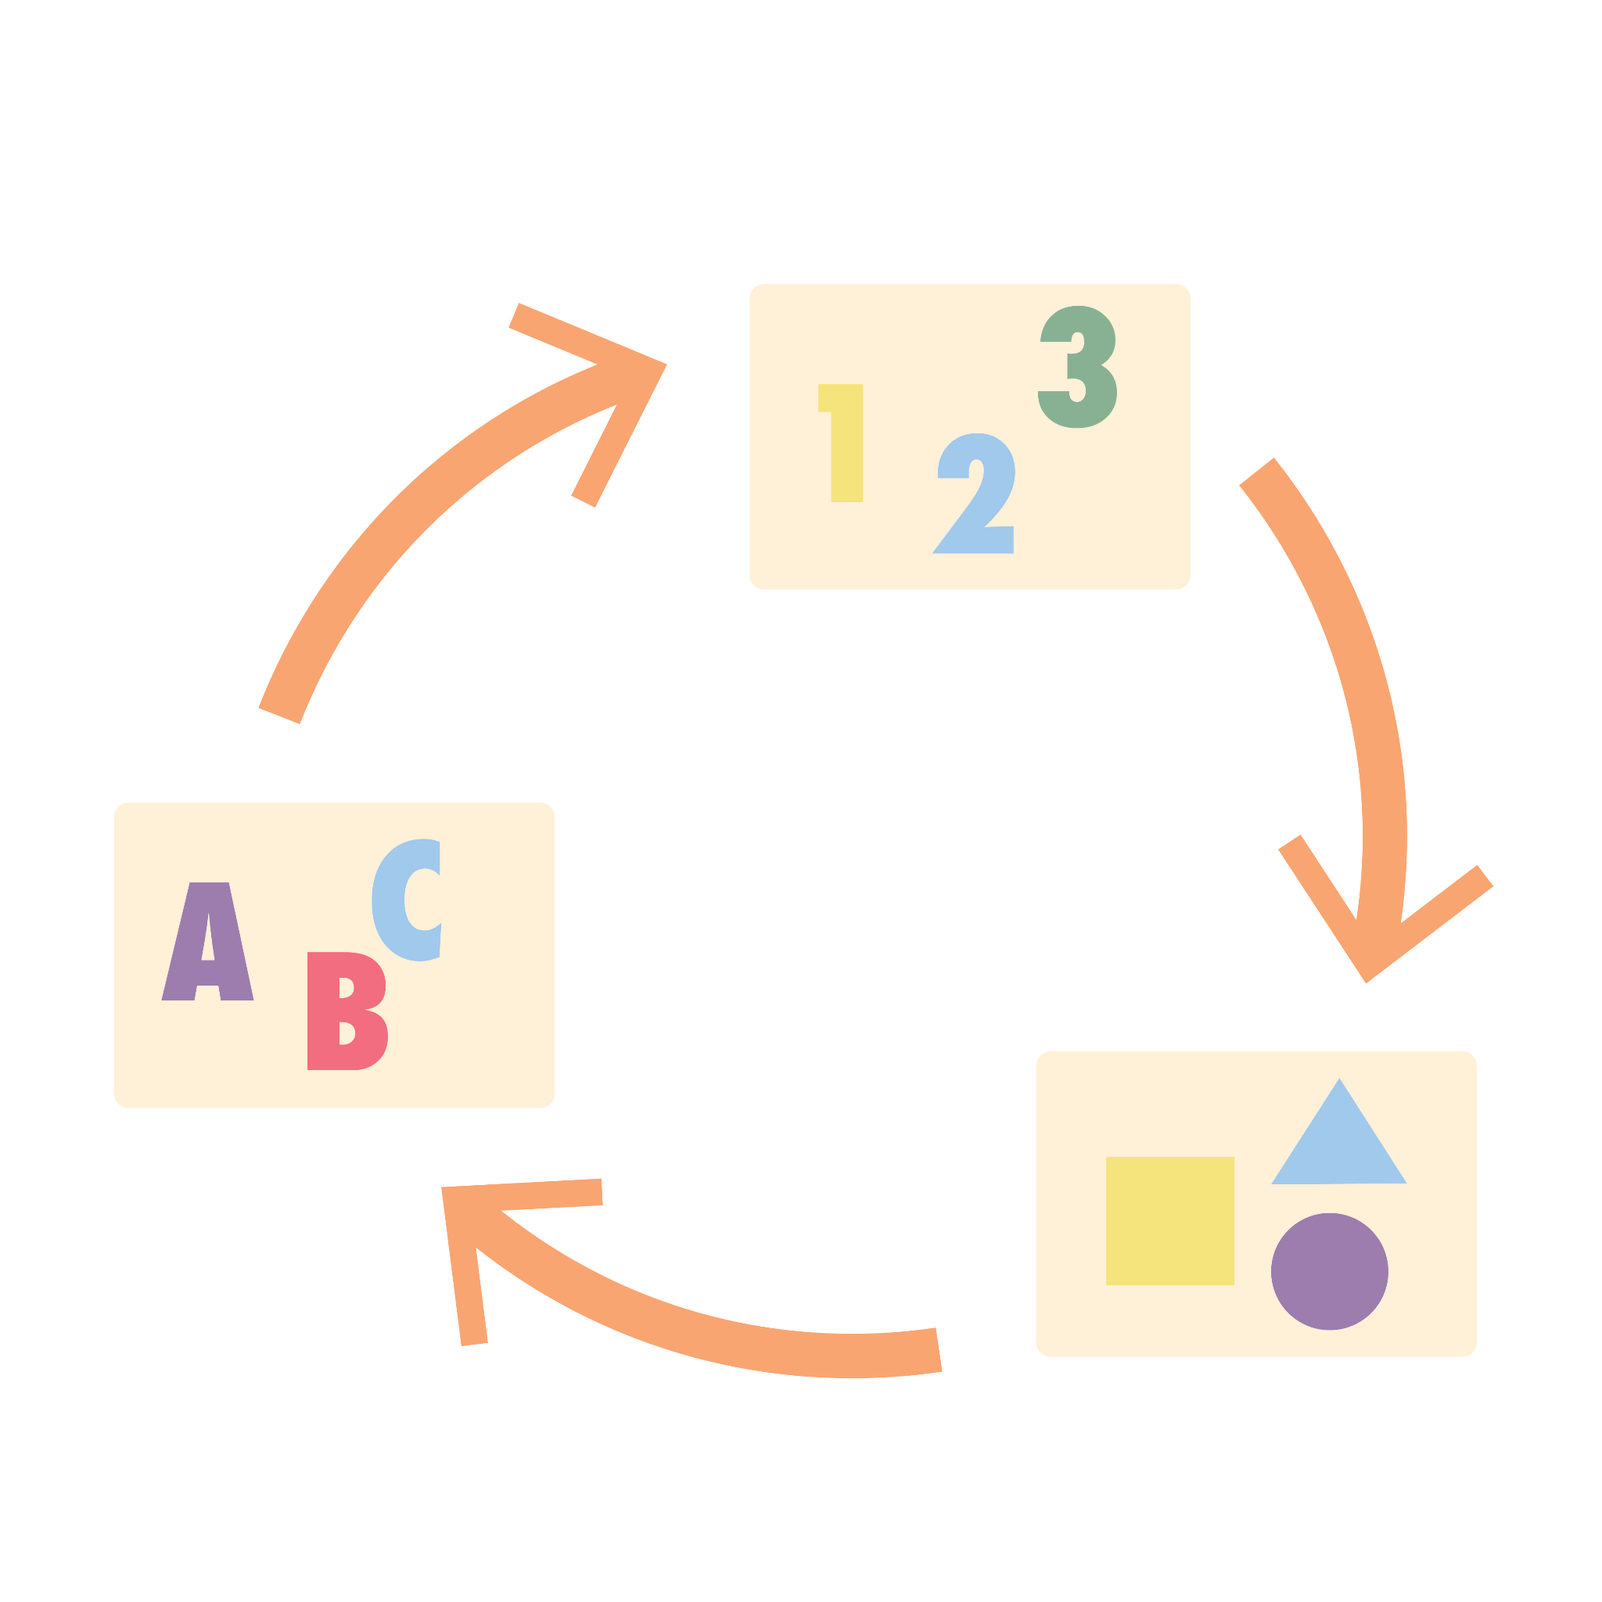
Scoot
Preparation
Create, number, and print task cards in advance. Make sure that you have a task card for everyone in the class.
  Task Cards: include the math problem or task and label each with a number.
Have a pencil and paper ready!
Place one task card on each desk in numerical order.
Note: record your answers in the appropriate place on your paper.
  Example: if a student starts at Desk 3, then instruct them to record their first answer in the box associated with Desk 3.
Notes:
K20 Center. (n.d.). Scoot. Strategies. https://learn.k20center.ou.edu/strategy/2298

Slide 12
Scoot
Activity
Start the activity by completing the task at your desk and record the answer on your sheet.
After about a minute, announce "Scoot!"
Move to the next desk and begin working on the next numbered task.
Continue until all tasks have been completed or until time is up.
Notes:
K20 Center. (n.d.). Scoot. Strategies. https://learn.k20center.ou.edu/strategy/2298

Slide 13
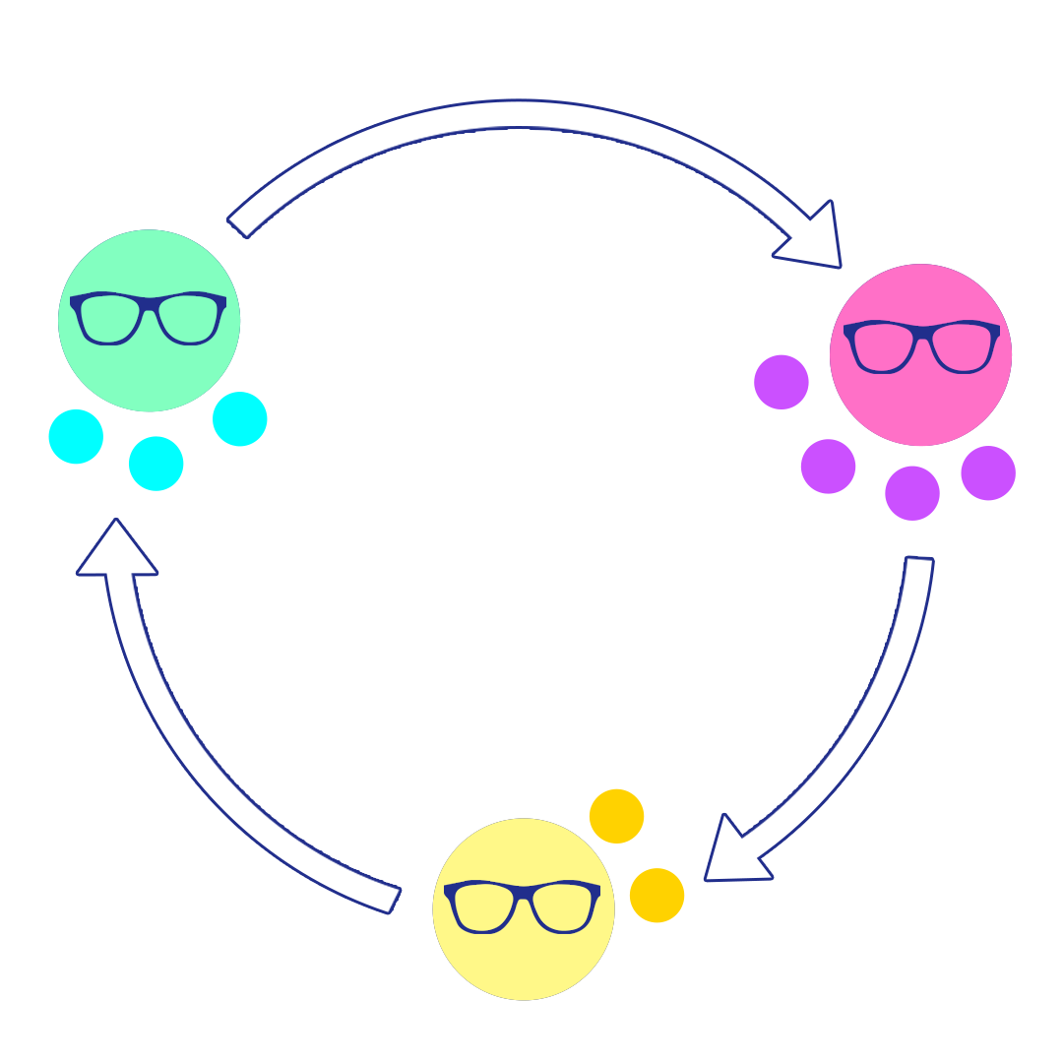
Expert Stay and Stray
Provide an open-ended task to groups of 3-5 students.
Have each group create a product for their assigned task.
  This might be a poster, forming an opinion to defend, etc.
Within each group, assign everyone a number.
Select and announce a number. The person with that number are now the experts on their assigned topics.
Notes:
K20 Center. (n.d.). Expert stay and stray. Strategies. https://learn.k20center.ou.edu/strategy/2650

Slide 14
Expert Stay and Stray
5. The expert stays while everyone else strays (moves) to the
next group.
6. The expert presents information about their topic to the new
group members.
Learners listen carefully, asking clarifying
questions, restating main ideas, and getting ready to be the next expert.
7. Select and announce a new number. The person with that
number is now the expert on what they just learned.
8. Repeat steps 5-7 as many times as necessary.
Notes:
K20 Center. (n.d.). Expert stay and stray. Strategies. https://learn.k20center.ou.edu/strategy/2650

Slide 15

Snap, Clap, Pop
Create statements that you know will apply to the lesson content. Examples:
  "If you know what a right angle looks like, stand up and make it with your arms."
  "If you know what laissez-faire means, stand up and show me with your hands."
  "If you know how heat affects the speed of molecules, stand up and demonstrate."
You can vary the statements with some calling for a physical movement, and some simply asking people to stand and call out the answer.
Notes:
K20 Center. (n.d.). Snap, clap, pop. Strategies. https://learn.k20center.ou.edu/strategy/190

Slide 16

Three Stray, One Stays
Create a discussion prompt or topic.
  For example, "Homework: Should students have to do it?"
Get into a group of four. Each group will choose a subtopic.
  For example, subtopics might include "pros," "cons," "what the research says," "time constraints," "family conflicts," etc.
  Discuss and take brief notes over your assigned subtopic. Come to a group answer.
Choose a group representative.
  This person will explain your group’s ideas to other students as they move around the room.
Notes:
K20 Center. (n.d.). Three stray, one stays. Strategies. https://learn.k20center.ou.edu/strategy/85

Slide 17
Three Stray, One Stays
Travel to other groups.
Those group members who are not the group representative will go to different groups.
Avoid going to the same group as your teammates.
Learn from other groups. Take notes, ask questions, and
prepare to share with your original group later.
Return to your original group and share what you have learned.
Put all your ideas together and share it with the class.
Notes:
K20 Center. (n.d.). Three stray, one stays. Strategies. https://learn.k20center.ou.edu/strategy/85

Slide 18

Appointment Clocks
Use a handout featuring a simply drawn analog clock with no hands, or draw one yourself.
Walk around and find 4 different partners. Schedule each partner at one time (12:00, 3:00, 6:00, or 9:00) and write each other’s names at that time.
Take time to think about the provided prompt or problem.
Call out a time to have everyone immediately move to their corresponding "appointment" and discuss their thoughts on the prompt in pairs. Together, each pair should decide on one response.
Repeat Step 4 until you have met with all of your appointments.
Notes:
K20 Center. (n.d.). Appointment Clocks. Strategies. https://learn.k20center.ou.edu/strategy/124

Slide 19
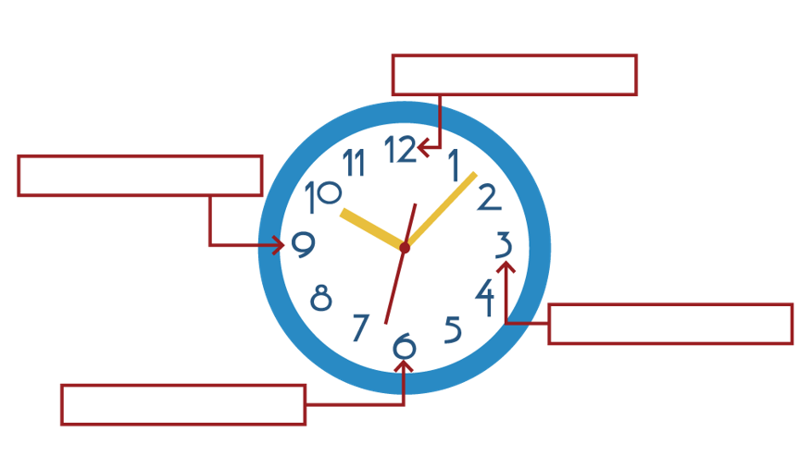
Appointment Clocks
Notes:
K20 Center. (n.d.). Appointment Clocks. Strategies. https://learn.k20center.ou.edu/strategy/124

Slide 20
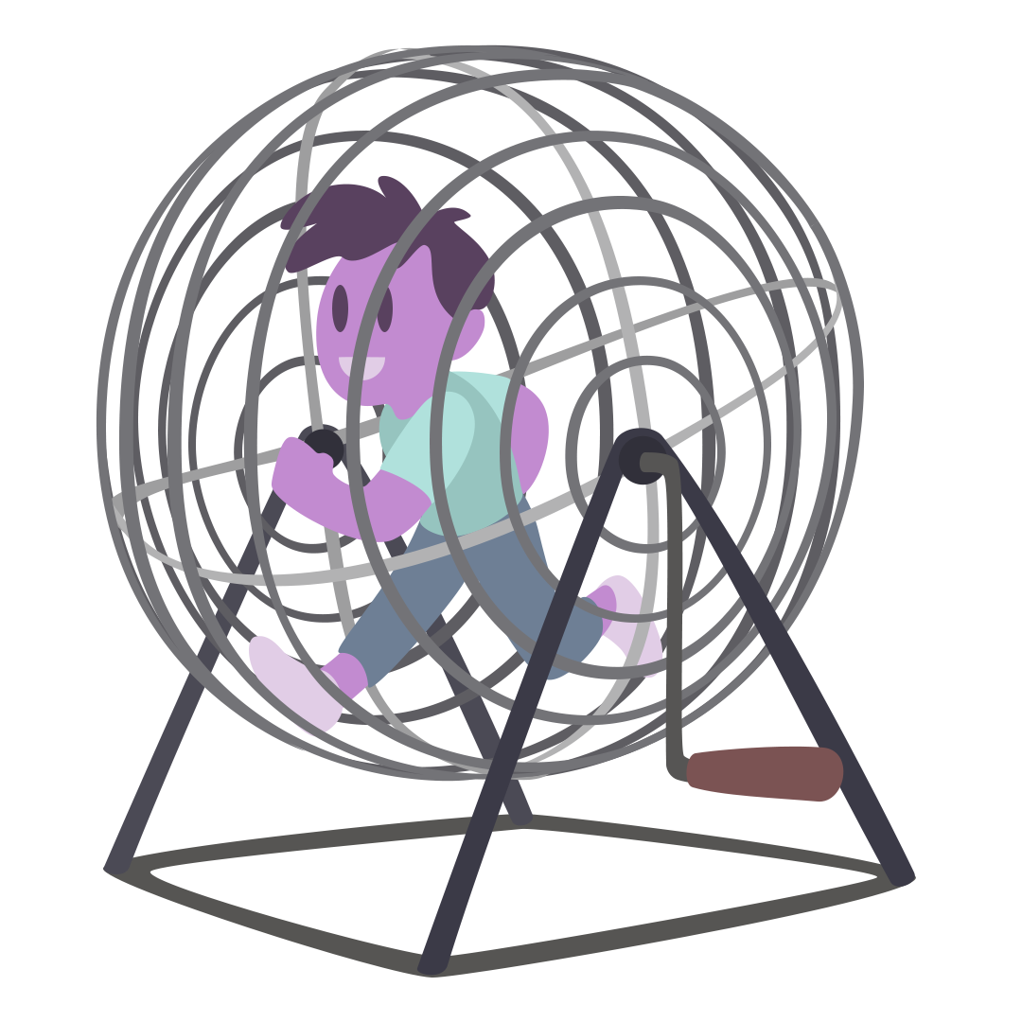
Human Bingo
Preparation
Use the provided template, or create your own Bingo card. Make at least three different versions.
  Sample Math prompts:
    “Solved a two-step equation.”
    “Can explain slope.”
    Can show a different strategy to solve the problem.”
When you are ready to begin the activity, distribute the bingo cards to everyone and get a writing utensil.
Notes:
K20 Center. (n.d.). Human Bingo. Strategies. https://learn.k20center.ou.edu/strategy/3888

Slide 21
Human Bingo
Activity
Walk around the room and find someone who matches the description in one square. When they have located someone, have that person write their name on the square.
When a you have five squares in a row signed in any direction, shout, “Bingo!” The game immediately pauses.
Someone will read each square in the line along with the content and ask the person whose name appears in the square if they can verify the fact. If they all can, you win that round.
Repeat or use different Bingo victory strategies like blackout or four corners.
Notes:
K20 Center. (n.d.). Human Bingo. Strategies. https://learn.k20center.ou.edu/strategy/3888

Slide 22

Mingle
Mingle around the room. Play appropriate music as you move.
Stop the music and get into small groups.
Once you have your group, discuss a prompt.
  This can be a math question, a statement you agree or disagree with, or a question about the current lesson.
While you are discussing, try to use mathematical vocabulary and explain your reasoning.
Repeat steps 1-4 as many times as needed, with different prompts and different groups.
Notes:
K20 Center. (n.d.). Mingle. Strategies. https://learn.k20center.ou.edu/strategy/53

Slide 23

Still Pictures
Select a topic and form groups of 4–5.
Begin round one by displaying or providing an image/art/graphic related to the topic.
Discuss the image briefly within your group. Come up with a single group pose or gesture you all could do to represent the image.
Each group hold your poses. Every member in the group should hold the same pose as their group members.
Unfreeze one member from each group to explain the group’s chosen gesture. Everyone else should remain frozen.
Notes:
K20 Center. (n.d.). Still Pictures. Strategies. https://learn.k20center.ou.edu/strategy/4960

Slide 24
Still Pictures
Begin round two by displaying or providing a text related to the
topic. Allow everyone time to read through it.
This time, discuss both the image and text. Instead of coming
up with a single pose, each member in the group should come up with a unique gesture that represents both the image and the text.
Unfreeze one member from each group to explain their group
members’ gestures.
Notes:
K20 Center. (n.d.). Still Pictures. Strategies. https://learn.k20center.ou.edu/strategy/4960

Slide 25
Still Pictures
Begin round three by choreographing a group performance that summarizes your learning.
Come up with a unique gesture, a single word to say, as well as a final group phrase to say all together.
Each group should perform!
One by one, have everyone walk on stage, say their word, and freeze in their gesture.
When all are frozen, the group speaks their shared phrase in unison, then exits for the next group.
Notes:
K20 Center. (n.d.). Still Pictures. Strategies. https://learn.k20center.ou.edu/strategy/4960

Slide 26
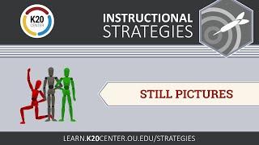
Still Pictures
Still Pictures: LEARN Instructional Strategy
Notes:
K20 Center. (n.d.). Still Pictures. Strategies. https://learn.k20center.ou.edu/strategy/4960
K20 Center. (2026, January 26). Still Pictures: LEARN Instructional Strategy. YouTube. https://www.youtube.com/watch?v=4jC6LiesgmQ

Slide 27

ABC Graffiti
Get into small groups and come up with a topic.
Each group get one different colored marker and your own poster paper that shows the alphabet in two columns (one letter per row in each column) while providing room for writing.
Write down words/phrases for as many letters on your poster as you can in the time provided using your prior knowledge of the topic.
Call time. Groups rotate to the next poster, taking their marker with them. Pick up where the last group left off in trying to fill out the poster.
Notes:
K20 Center. (n.d.). ABC graffiti. Strategies. https://learn.k20center.ou.edu/strategy/96

Slide 28
ABC Graffiti
Call time. Groups rotate again. This time, use an
outside resource to generate new words/phrases for the remaining letters. Also add to letters that were previously used.
Call time. Groups rotate to their original poster to construct a
summary statement that synthesizes the poster's information.
Share out your summary statements with the class.
Notes:
K20 Center. (n.d.). ABC graffiti. Strategies. https://learn.k20center.ou.edu/strategy/96

Slide 29
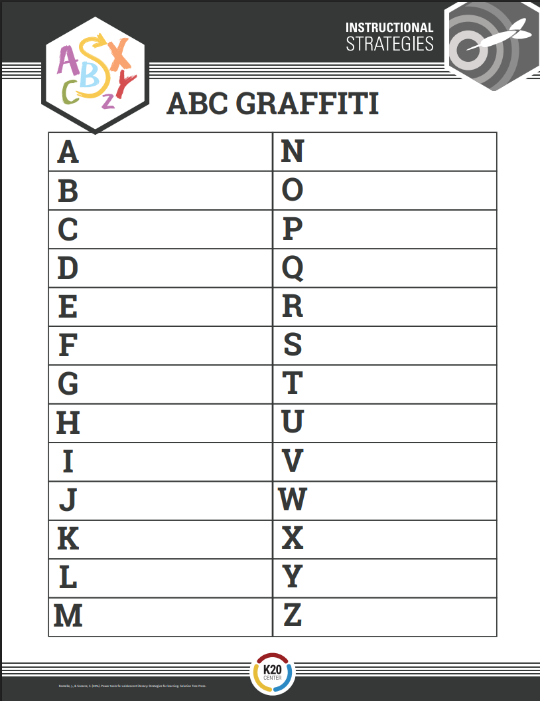
ABC Graffiti
Notes:
K20 Center. (n.d.). ABC graffiti. Strategies. https://learn.k20center.ou.edu/strategy/96

Slide 30
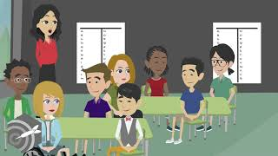
ABC Graffiti
ABC Graffiti - LEARN Strategies
Notes:
K20 Center. (n.d.). ABC graffiti. Strategies. https://learn.k20center.ou.edu/strategy/96
K20 Center. (2020, May 20). ABC Graffiti: LEARN Strategies. YouTube. https://www.youtube.com/watch?v=s3rIwa0kX7s

Slide 31
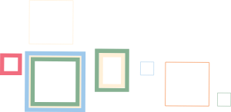
Gallery Walk
Choose a topic or a question to answer and get into a small group.
Create a presentation over your topic (e.g. poster, flyer, etc .).
Post your presentation around the room.
  Optional: Have a group member remain with the presentation to present the group's work.
As a group, circulate around the room, stopping at each presentation long enough to learn from and evaluate it.
Leave at least two questions or comments on sticky notes.
Once you’ve seen everything, return to your original presentation to checkout the feedback left for you.
Notes:
K20 Center. (n.d.). Gallery walk/carousel. Strategies. https://learn.k20center.ou.edu/strategy/118

Slide 32

Gallery Walk
Gallery Walk - LEARN Strategy
Notes:
K20 Center. (n.d.). Gallery walk/carousel. Strategies. https://learn.k20center.ou.edu/strategy/118
K20 Center. (2016, Aug. 3). Gallery Walk: LEARN Strategy. YouTube.https://www.youtube.com/watch?v=dPLk_aVhYwg

Slide 33

Strategy Harvest
Prompt: Choose 1 of the provided movement strategies you want to use within the lesson and try it out!
Using the handout, record the strategy you chose for solving the problem as well as the pros and cons.
Find a partner and record their strategy in the second row.
Repeat Step 2 with a new partner.
Return to your seat and fill in the pro/con columns for each of your partner’s strategies.
Then, complete the final reflective question about improving your strategy.
Notes:
K20 Center. (n.d.). Strategy harvest. Strategies. https://learn.k20center.ou.edu/strategy/135

Slide 34

SCORE
Reflect on the following:
Strategy: What did you try today and how long were you engaged?
Celebration: What good things came from trying the physical movement strategy?
Obstacles: Identify any challenges you faced?
Refinement: What would you do differently?
Extra Information: What other thoughts, feelings, or details do you think are important about the lesson today?
Notes:
K20 Center. (n.d.). SCORE Reflection. Strategies. https://learn.k20center.ou.edu/strategy/3694

