Slide 2
Funding Your Future
10th-Grade Pre-Campus Visit

Slide 3
Essential Question
How can Oklahoma’s Promise support my postsecondary goals?

Slide 4
Learning Objective
Examine the eligibility requirements for the Oklahoma’s Promise scholarship.

Slide 5

Tell Me Everything
What are ways you can pay for postsecondary education (PSE)?
Write everything you know about ways to pay for PSE on your paper.
Notes:
K20 Center. (n.d.). Tell me everything. Strategies. https://learn.k20center.ou.edu/strategy/107

Slide 6

Financial Aid Options
Pell Grant
money from the federal government based on need; this money does not need to be repaid

Slide 7
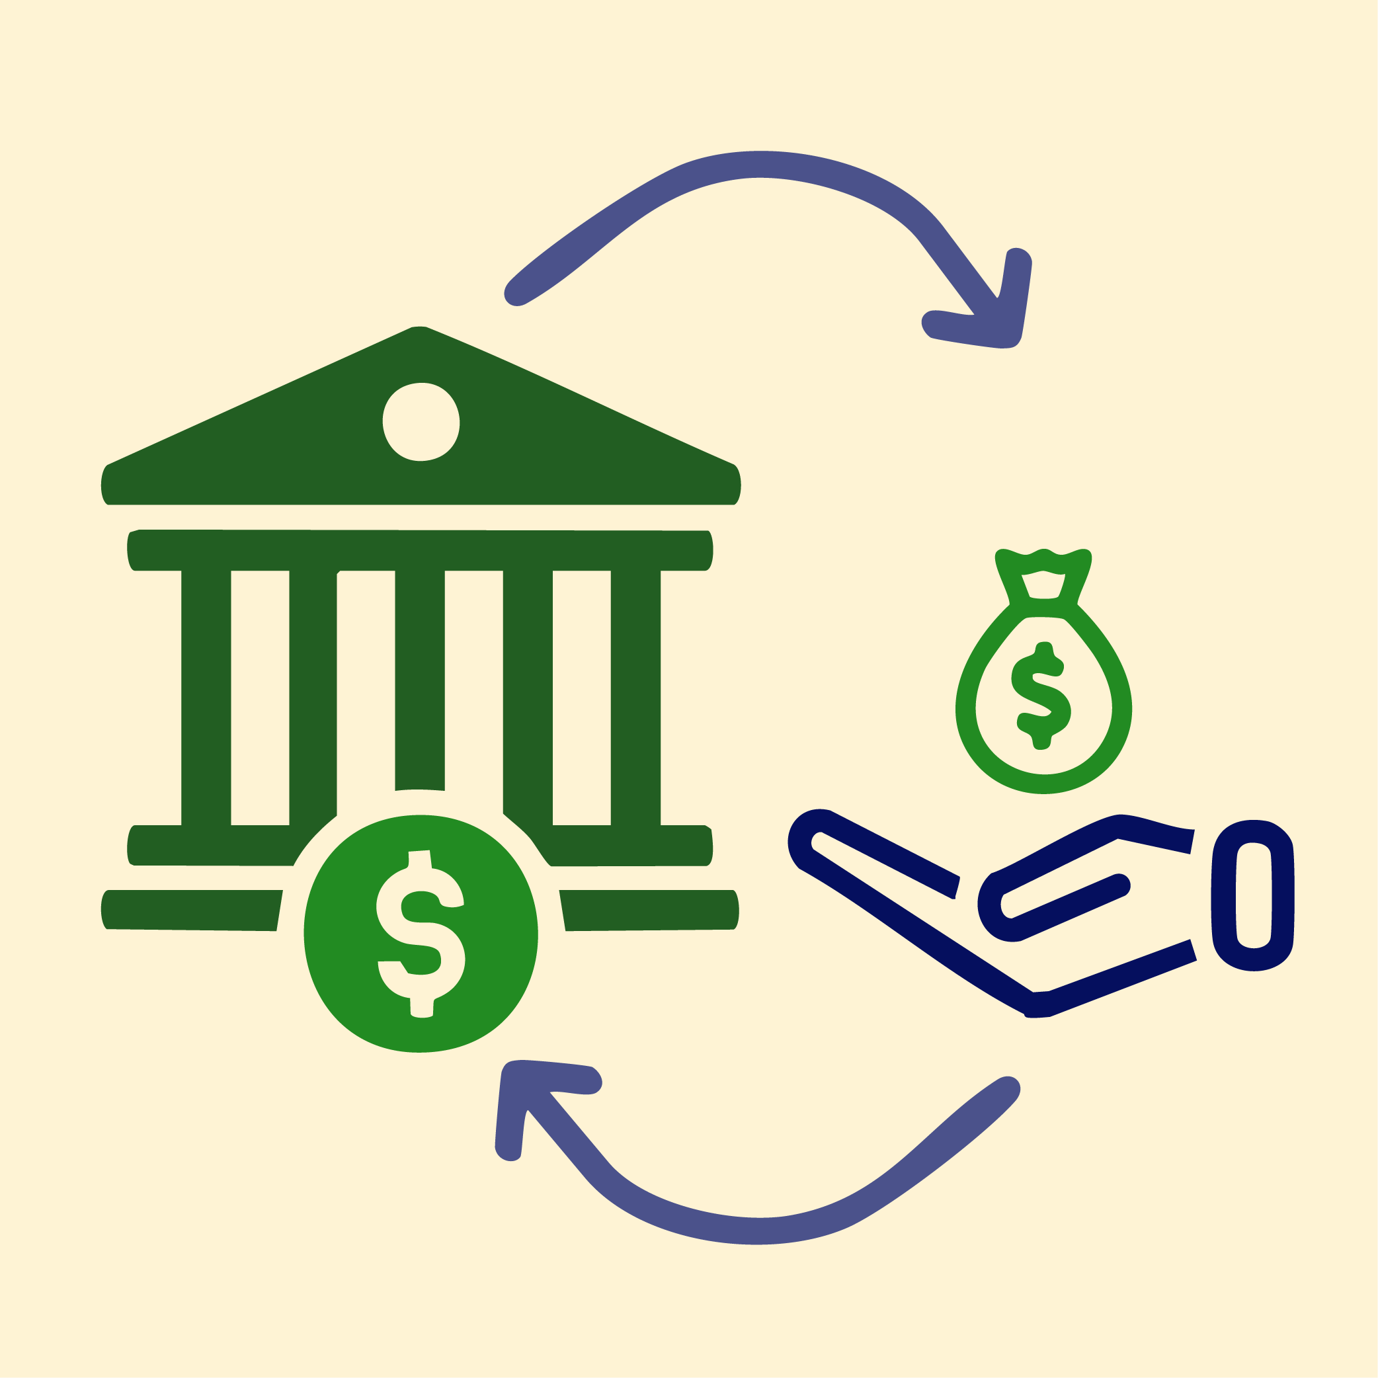
Financial Aid Options
Pell Grant
Loan
money from the federal government based on need; this money does not need to be repaid
money borrowed from the federal government or from private sources; this money must be repaid with interest

Slide 8

Financial Aid Options
Pell Grant
Loan
Scholar-ships
money from the federal government based on need; this money does not need to be repaid
money borrowed from the federal government or from private sources; this money must be repaid with interest
money awarded
for good grades, talents, or achievements; this money does not need to be repaid

Slide 9
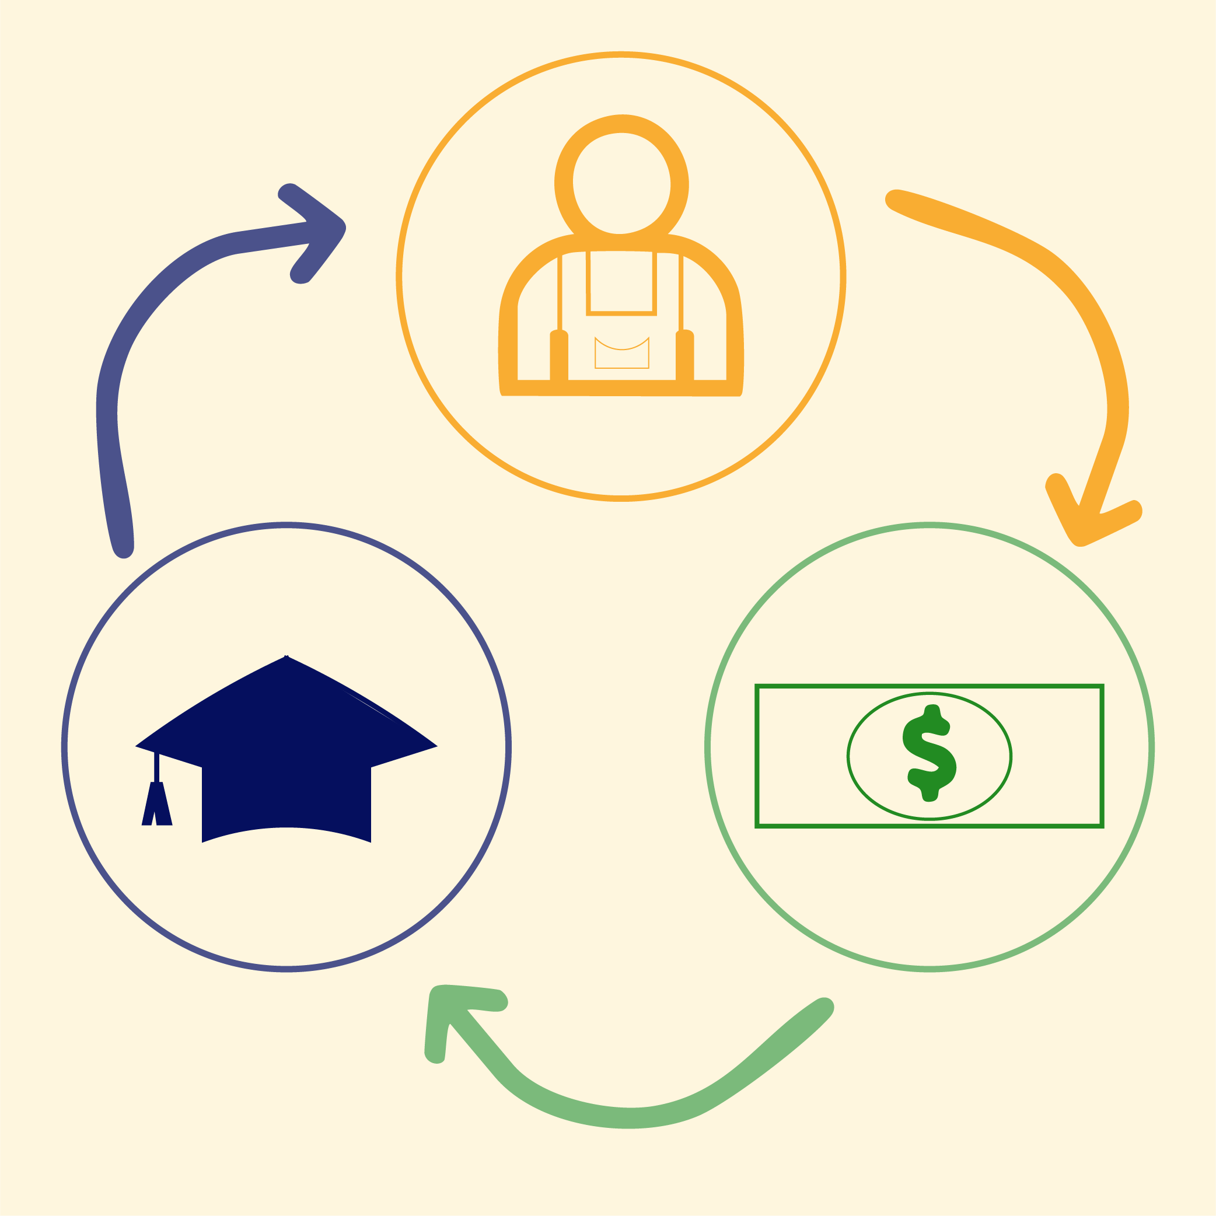
Financial Aid Options
Work
Study
a program that
lets qualifying students earn money through part-time jobs, often on-campus, while in school

Slide 10

Financial Aid Options
Work
Study
Oklahoma’s Promise
a program that
lets qualifying students earn money through part-time jobs, often on-campus, while in school
money from the state government to cover tuition that is awarded based on need, academic requirements, and residency; this money does not need to be repaid

Slide 11

Financial Aid Options
Work
Study
Oklahoma’s Promise
FAFSA
a program that
lets qualifying students earn money through part-time jobs, often on-campus, while in school
money from the state government to cover tuition that is awarded based on need, academic requirements, and residency; this money does not need to be repaid
the free form you complete
to apply for financial aid

Slide 12

Oklahoma’s Promise: Infographic
As you read through the infographic,
  Underline anything you find important.
  Put a question mark next to anything you have a question about.

Slide 13
Oklahoma’s Promise: Discussion
What is Oklahoma’s Promise?
What can you use the money for?

Slide 14
Oklahoma’s Promise: Discussion
What are the eligibility requirements?

Slide 15
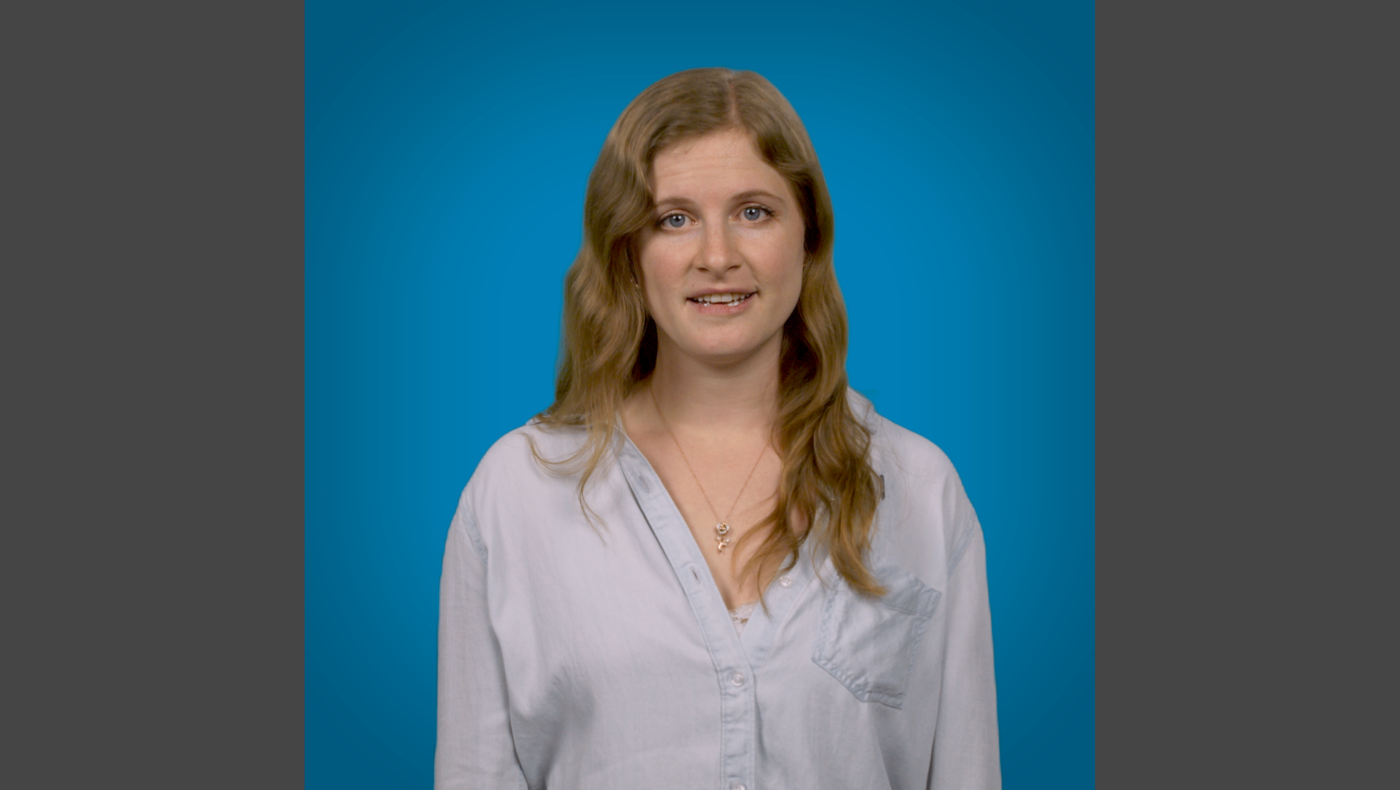
Staying Eligible for Oklahoma’s Promise
Notes:
K20 Center. (2026, May 5). Staying eligible for Oklahoma's promise [Video]. YouTube. https://www.youtube.com/watch?v=NT52h5Ji--Y

Slide 16
Staying Eligible: Discussion
True or False:
Oklahoma’s Promise reviews academic and financial information while you are attending high school and while you are attending a postsecondary institution (PSI).

Slide 17
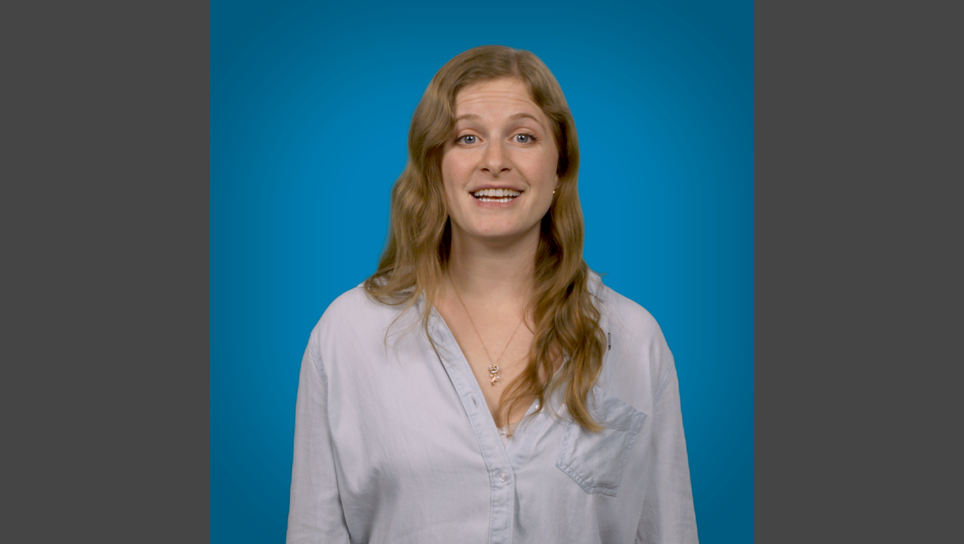
How to Apply for Oklahoma’s Promise
Notes:
K20 Center. (2026, May 5). How to apply for Oklahoma's promise [Video]. YouTube. https://www.youtube.com/watch?v=U7qGOFxZaFM

Slide 18
How to Apply: Discussion
True or False:
You must apply online.
You must start college the first August after graduation.

Slide 19

Fiction in the Facts
On the following slides, you will
read 3 statements:
  2 statements are true; 1 is false
Determine which statement you believe to be the false statement.
Notes:
K20 Center. (n.d.). Fiction in the facts. Strategies. https://learn.k20center.ou.edu/strategy/60

Slide 20
Fiction in the Facts
Read each of the following statements and decide which one is false.
Oklahoma’s Promise pays for tuition, which is the only cost of going to college.
Oklahoma’s Promise pays for tuition, which is a large percentage of the costs of going to college.
Oklahoma’s Promise pays for tuition for five years of my postsecondary undergraduate education.
Notes:
K20 Center. (n.d.). Fiction in the facts. Strategies. https://learn.k20center.ou.edu/strategy/60

Slide 21
Fiction in the Facts
It does pay for tuition, but that is not the only expense of going to college.
Oklahoma’s Promise pays for tuition, which is the only cost of going to college.
Oklahoma’s Promise pays for tuition, which is a large percentage of the costs of going to college.
Oklahoma’s Promise pays for tuition for five years of my postsecondary undergraduate education.
Notes:
K20 Center. (n.d.). Fiction in the facts. Strategies. https://learn.k20center.ou.edu/strategy/60

Slide 22
Fiction in the Facts
Read each of the following statements and decide which one is false.
I need to complete the Free Application for Federal Student Aid (FAFSA) each year to see if I am financially eligible for Oklahoma’s Promise.
I need to live in Oklahoma to be eligible for Oklahoma’s Promise.
I do not need to live in Oklahoma to be eligible for Oklahoma’s Promise.
Notes:
K20 Center. (n.d.). Fiction in the facts. Strategies. https://learn.k20center.ou.edu/strategy/60

Slide 23
Fiction in the Facts
Oklahoma’s Promise is funded by the state, so you must be an Oklahoma resident.
I need to complete the Free Application for Federal Student Aid (FAFSA) each year to see if I am financially eligible for Oklahoma’s Promise.
I need to live in Oklahoma to be eligible for Oklahoma’s Promise.
I do not need to live in Oklahoma to be eligible
for Oklahoma’s Promise.
Notes:
K20 Center. (n.d.). Fiction in the facts. Strategies. https://learn.k20center.ou.edu/strategy/60

Slide 24
Fiction in the Facts
Read each of the following statements and decide which one is false.
There are requirements for Oklahoma’s Promise that I already meet, so I am automatically enrolled and do not need to take any action at this time.
There are academic requirements for Oklahoma’s Promise that I need to start thinking about now.
There are financial requirements for Oklahoma’s Promise that I need to talk to my parent/guardian about soon.
Notes:
K20 Center. (n.d.). Fiction in the facts. Strategies. https://learn.k20center.ou.edu/strategy/60

Slide 25
Fiction in the Facts
You are not automatically enrolled, even if you meet the academic and financial requirements.
There are requirements for Oklahoma’s Promise that I already meet, so I am automatically enrolled and do not need to take any action at this time.
There are academic requirements for Oklahoma’s Promise that I need to start thinking about now.
There are financial requirements for Oklahoma’s Promise that I need to talk to my parent/guardian about soon.
Notes:
K20 Center. (n.d.). Fiction in the facts. Strategies. https://learn.k20center.ou.edu/strategy/60

Slide 26
Check out OKPromise.org!

