Slide 2

What’s Your Snap?
Effective Communication Skills for Academic and Campus Success

Slide 3
Essential Question
How does seeing a message through the receiver's eyes change the way you communicate with the different people you rely on in school and on campus?

Slide 4
Learning Objectives
Discuss the importance of respectful, audience-appropriate communication with instructors.
Explain strategies for communicating with instructors via email or in person.
Evaluate messages from the receiver's perspective and apply effective communication strategies accordingly.

Slide 5
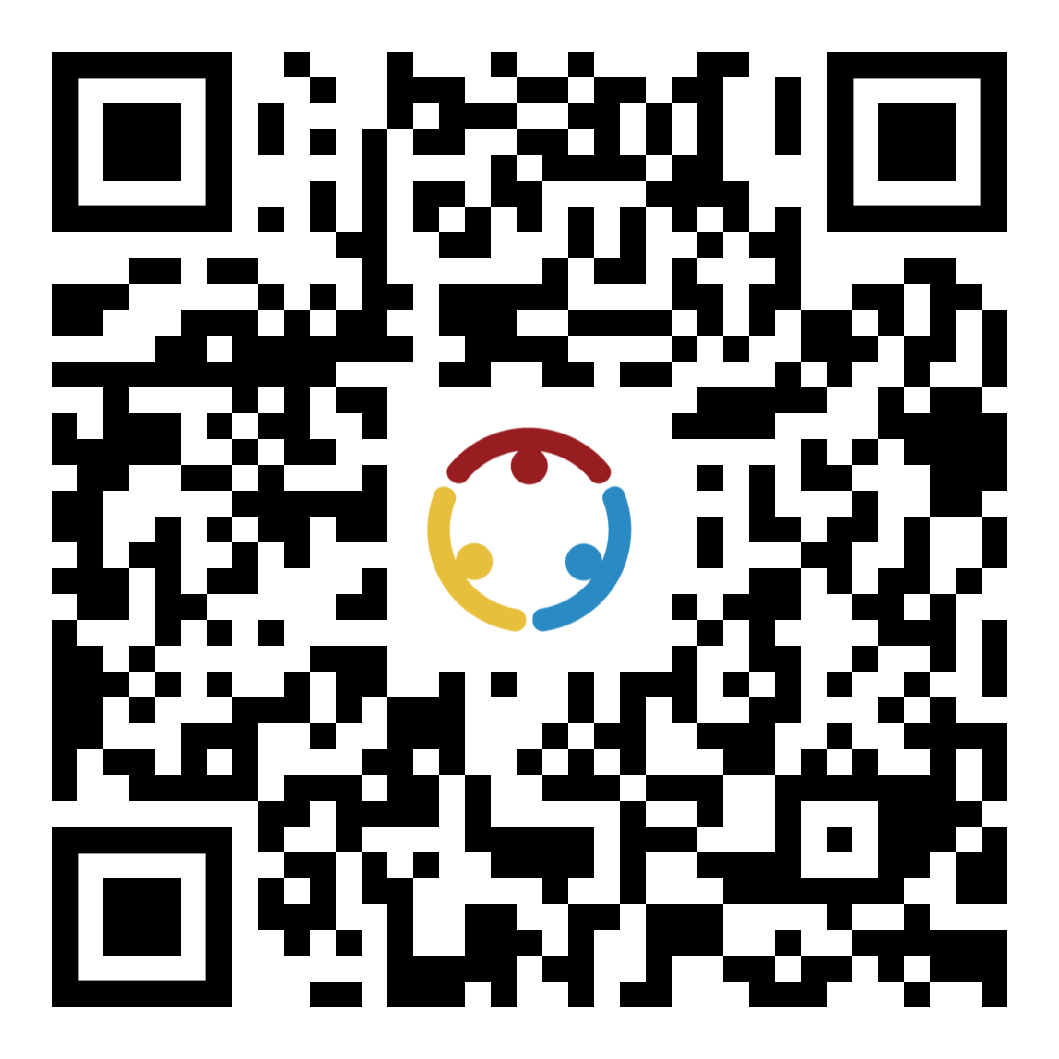
A Rough Day!
Imagine that you woke up and headed to your car to get to class. You have a flat tire.
  Use the Menti to send a message to your professor explaining why you will be late.
          Menti.com
          Code: #### ####
Notes:
Paste your own QR code in the space provided.
K20 Center. (n.d.). Mentimeter. Tech Tools. https://learn.k20center.ou.edu/tech-tool/645

Slide 6

A Rough Day!
Imagine that you woke up and headed to your car to get to class. You have a flat tire.
Write your message on a piece of paper. When ready, crumple your response and toss it as your leader indicates.

Slide 7
Discussion
What do you notice that’s similar in the texts? What is different?
How would you communicate about this situation with someone you’re close to?
How might your communication change when speaking with someone whose personality is very different from yours?

Slide 8

Inbox Disaster
Read the email and mark up anything that stands out to you or anything you might want to change.
Notes:
K20 Center. (2021). 10-Minute Timer. YouTube. https://www.youtube.com/playlist?list=PL-aUhEQeaZXLMF3fItNDxiuSkEr0pq0c2

Slide 9
Inbox Disaster
Imagine that you are the instructor reading the email you are provided.
What do you notice?
Does it bring up any emotion?

Slide 10
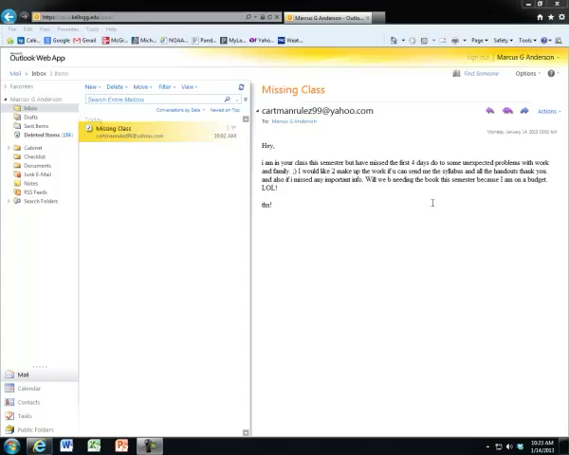
Bad Email Reply
What Not to Say to Your Professor
Notes:
Anderson, M. G. [mrandersonmath]. (n.d.). Bad email reply: What not to say to your professor... [Video]. YouTube. https://www.youtube.com/watch?v=zSNc8F9tqzY

Slide 11
Email Win
Use the “Anatomy of an Email” handout to rewrite the “Inbox Disaster” that you read at the beginning of the session.
Put yourself in the place of the recipient. What would you want to see in an email?
Notes:
K20 Center. (2021). 10-Minute Timer. YouTube. https://youtu.be/9gy-1Z2Sa-c?si=mZT8we776f2Oew46

Slide 12
Discussion
What did you make sure to include?
Did seeing emails through the eyes of the instructor help you draft your email?

Slide 13
Roommate Trouble
Imagine that you are having issues with your roommate. Reach out to your resident advisor (RA).
  Use the Menti to send a message to your RA. professor.
          Menti.com
          Code: #### ####
Notes:
Paste your own QR code in the space provided.
K20 Center. (n.d.). Mentimeter. Tech Tools. https://learn.k20center.ou.edu/tech-tool/645

Slide 14
Roommate Trouble
Imagine that you are having issues with your roommate. Reach out to your resident advisor (RA).
Write your response on a piece of paper. When ready, crumple your response and toss it as your leader indicates.

Slide 15

Significant Takeaways
What was the most significant takeaway you gained today about communicating with your instructor?
How can you use your takeaway with other situations?
  Examples:
    Joining an organization
    Talking to your advisor

