Slide 2

Money Talks
Helping Your College Student Build Smart Financial Habits

Slide 3
Essential Question
How can I support my college student with financial literacy?

Slide 4
Learning Objective
Identify practical strategies to support your student’s financial literacy development

Slide 5

Question Formulation Technique
Write as many questions as you can about the images on the following slide.
You will have five minutes to write.

Slide 6



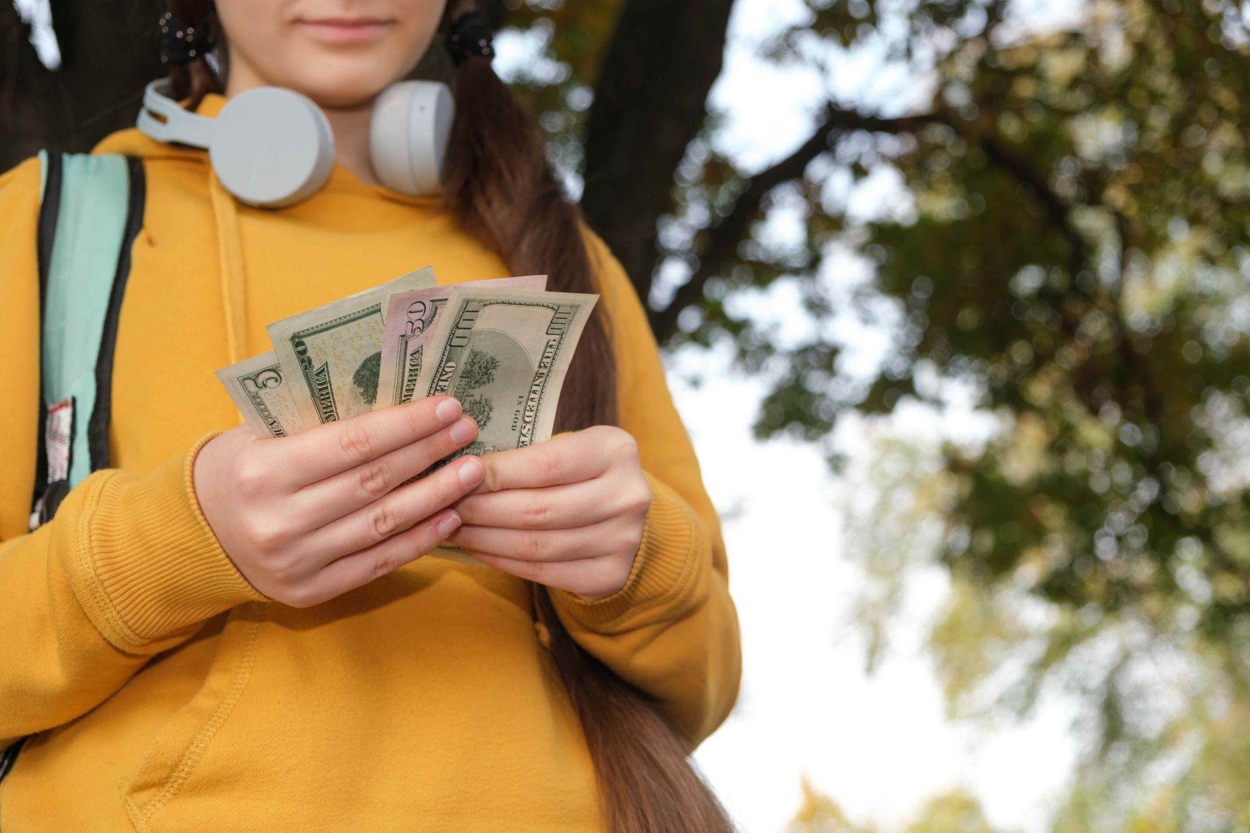
Question Formulation Technique
Notes:
K20 Center. (2021). Five Minute Timer. YouTube. https://www.youtube.com/watch?v=EVS_yYQoLJg
Adobe Stock. (n.d.). Smiling student woman wearing backpack holding notebook. stock.adobe.com
K20 Center. (2021). Five Minute Timer. YouTube. https://youtu.be/EVS_yYQoLJg?si=4VHb4BWfyxBSvfqU0
Lukash, Z. (n.d.). A teenage girl in headphones counts dollar bills, pocket money [Photograph]. Adobe Stock. https://stock.adobe.com/images/a-teenage-girl-in-headphones-counts-dollar-bills-pocket-money/472809865
motortion. (n.d.). Boy holding lot of cash receiving first salary, thinking about new purchase [Photograph]. Adobe Stock. https://stock.adobe.com/jp/images/boy-holding-lot-of-cash-receiving-first-salary-thinking-about-new-purchase/270849169

Slide 7
Mind Your Budget Game
Login to k20.ou.edu/games
  Play Mind Your Budget
    Make a budget every month
    Pay bills, save $, buy furniture, have fun
      Goal: Save $1,000 over 3 months.
Can you do it?
Notes:
K20 Center. (2026). Mind your own business [Online game]. https://games.k20center.ou.edu/play/myob/June2026

Slide 8
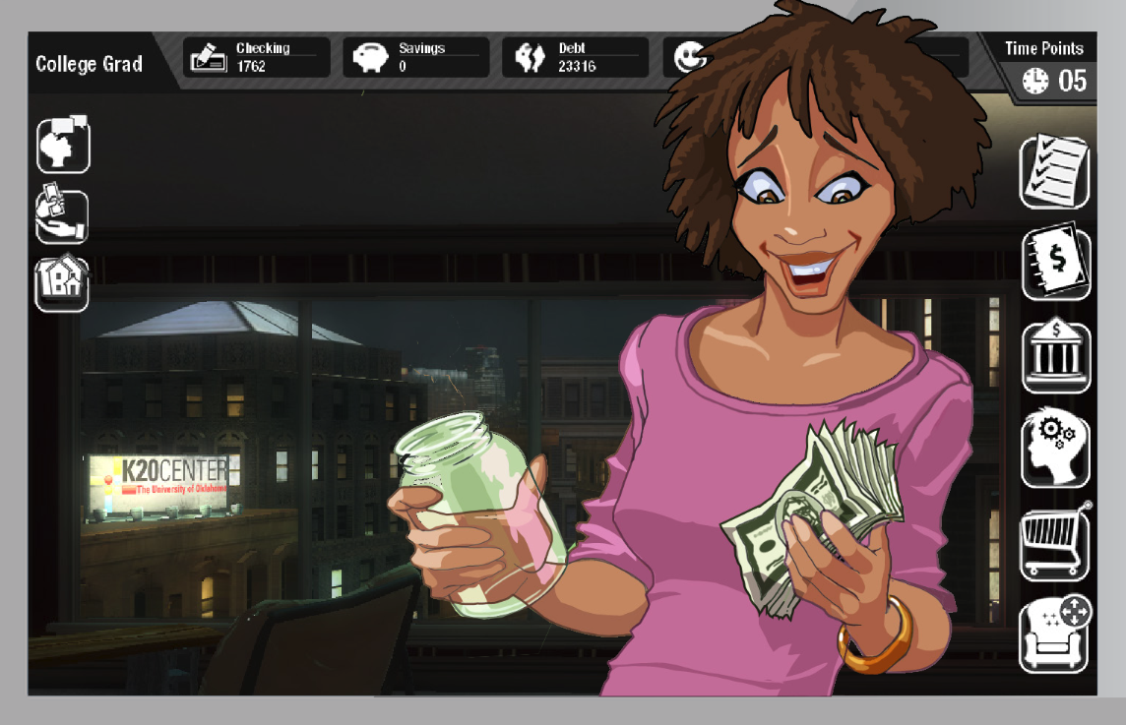
Mind Your Budget Game - S-I-T
What was
SURPRISING, INTERESTING, and TROUBLING
  for you as an adult?
  for your child as an adult college student?
Notes:
Allow participants to play MYOB for about 20 minutes, then move on to

Slide 9
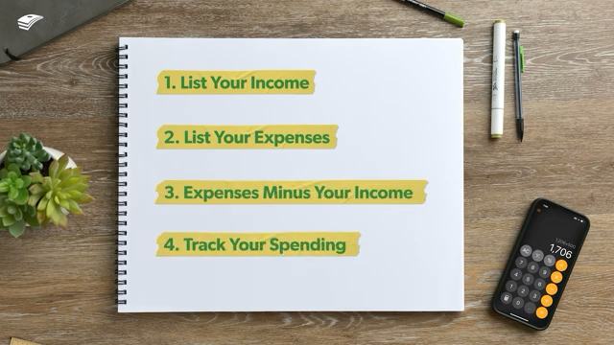
How to Budget in College
Notes:
EveryDollar. (2025). How to budget in college (four easy steps) [Video]. YouTube. https://www.youtube.com/watch?v=QnBkc-CfaHU

Slide 10

College Student Financial Literacy
Read the College Student Financial Literacy handout
  CUS and Discuss
    Circle - What your college student doesn’t know
    Underline - What your child already knows
    ⭐ Star - Something you both can do
Notes:
Examples of things families and students can do together:
Creating a simple budget
Reviewing a bank statement together
Discussing credit card use and expectations
Setting a savings goal
Set up a mock monthly budget using expected college expenses
Walk through a real or sample bank statement
Compare two financial aid offers (if applicable)
Create a shared financial checklist for the semester

Slide 11
College Student Discounts
Identify two discounts that your student could use on these websites, or another resource that could help.
StudentBeans.com/us | Unidays | Other resources
h | g
Notes:
https://www.studentbeans.com/us
https://www.myunidays.com/US/en-US

Slide 12
Question Formulation Technique
Return to your Questions
  Can you answer them?
  Which do you still need help with?
    Who can you reach out to for this help?

Slide 13
Question Formulation Technique
Notes:
K20 Center. (2021). Five Minute Timer. YouTube. https://www.youtube.com/watch?v=EVS_yYQoLJg
Adobe Stock. (n.d.). Smiling student woman wearing backpack holding notebook. stock.adobe.com
K20 Center. (2021). Five Minute Timer. YouTube. https://youtu.be/EVS_yYQoLJg?si=4VHb4BWfyxBSvfqU0
Lukash, Z. (n.d.). A teenage girl in headphones counts dollar bills, pocket money [Photograph]. Adobe Stock. https://stock.adobe.com/images/a-teenage-girl-in-headphones-counts-dollar-bills-pocket-money/472809865
motortion. (n.d.). Boy holding lot of cash receiving first salary, thinking about new purchase [Photograph]. Adobe Stock. https://stock.adobe.com/jp/images/boy-holding-lot-of-cash-receiving-first-salary-thinking-about-new-purchase/270849169

