Slide 2
Welcome!
We will begin shortly!
Getting to Know Google Classroom for Families

Slide 3
Getting to Know Google Classroom for Families
Notes:
Introductions

Slide 4
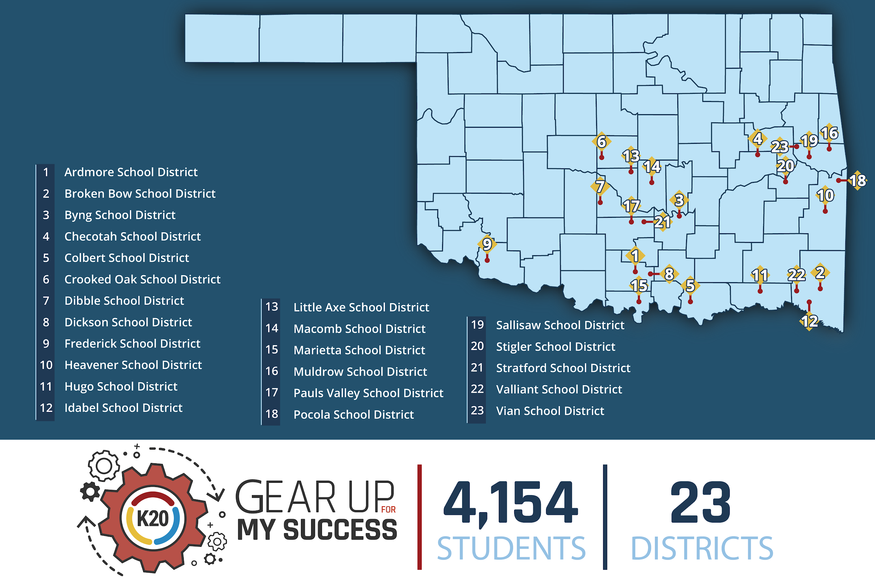
Notes:
GEAR UP is a nation-wide U.S. Department of Education competitive grant program whose ultimate goal is to increase the number of low-income students who are prepared for a post-secondary education and to help those students be successful in their transition from high school to college. We are a cohort model that starts with students in the 6th and 7th grades and follows them through their first year of college. Our cohort students are now 8th and 9th graders. We take a holistic approach to preparing students for a post-secondary education based on proven, research based practices. We work with school leadership, parents, teachers and students through a variety of projects and events, like this one. And even in the classroom.

Slide 5
GEAR UP Grant Goals:
Increase cohort academic performance and preparation for postsecondary education.
Increase high school graduation and postsecondary education participation.
Increase student educational expectations and student and family knowledge of postsecondary education options, preparation, and financing.
Notes:
If you are unfamiliar with K20 GEAR UP for MY SUCCESS, let’s share with you some of the goals our grant focuses on when working with our cohort schools and students.
First, we hope to increase cohort academic performance and preparation for post-secondary education.
Secondly, we want all cohort schools to increase high school graduation rates and post-secondary education participation.
Lastly, it is important to increase student educational expectations and student and family knowledge of postsecondary education options, preparation, and financing.

Slide 6
Objectives:
The K20 GEAR UP Google Classroom for Families presentation engages parents to become better informed about Google education software so they have the necessary skills to forge the parent-school-community partnerships essential to improving academic achievement for students.
Notes:
Today our objective will be showcasing tools that focus on Google Classroom and G Suite.
The K20 GEAR UP Google Classroom for Families presentation engages parents to become better informed about Google education software so they have the necessary skills to forge the parent-school-community partnerships essential to improving academic achievement for students.

Slide 7
Session Goals:
Participants will analyze and identify parental engagement and involvement within a virtual platform.
Participants will engage in numerous features of Google Classroom and learn how they can support their students in a virtual environment.
Notes:
We hope that this session will be informative. The goals for this session you will have the opportunity to analyze and identify parental engagement and involvement within a virtual platform.
Secondly, you will have the opportunity to engage in numerous features of Google Classroom and how they can support their students in a virtual environment.

Slide 8
Essential Question
[Insert QR Code here]
What are some of the current experiences you have had with virtual, blended, or face-to-face learning in a virtual setting?
[insert tiny url here]
Notes:
Welcome everyone, our first activity includes taking a moment to reflect on your experiences with in-class, blended, or remote learning. To complete this activity we will be utilizing Google Forms.
Please use the tiny URL or you may use our electronic device, such as a phone to scan the QR code with your camera. This will take you to our Google form.
Show Google Form
For some questions, you will choose the image that best represents how you are feeling, additional questions will include you providing (review the questions)
a short answer that best reflects how you are feeling. Once complete, click the submit button. At this time, I will give you a few moments to respond.
Transition: Let’s take a look at some of your responses!
(Show responses and discuss)

Slide 9
Topics for today’s session:
Assignment stream and features
Student “Upcoming” list
Accessing Google Calendar view and features
How to submit an assignment
How to upload an assignment
Receiving Student Progress Reports (daily or weekly)
Notes:
Now that we have reflected on the varying experiences you and your students have encountered so far this year. Let's explore and take a deeper look into some of the features of Google Classroom and G Suite.
Today will be looking at Student “upcoming” list, Google Calendar, Assignment Stream and Features, How to submit and upload assignments, and last but not least, how you as a family member can request access to student progress reports from Google Classroom.

Slide 10
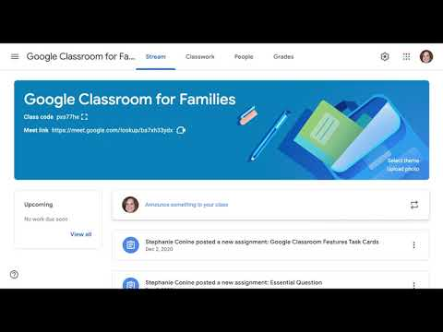
Stream Page Features
Notes:
https://youtu.be/gj-bhtNS8qM

Slide 11
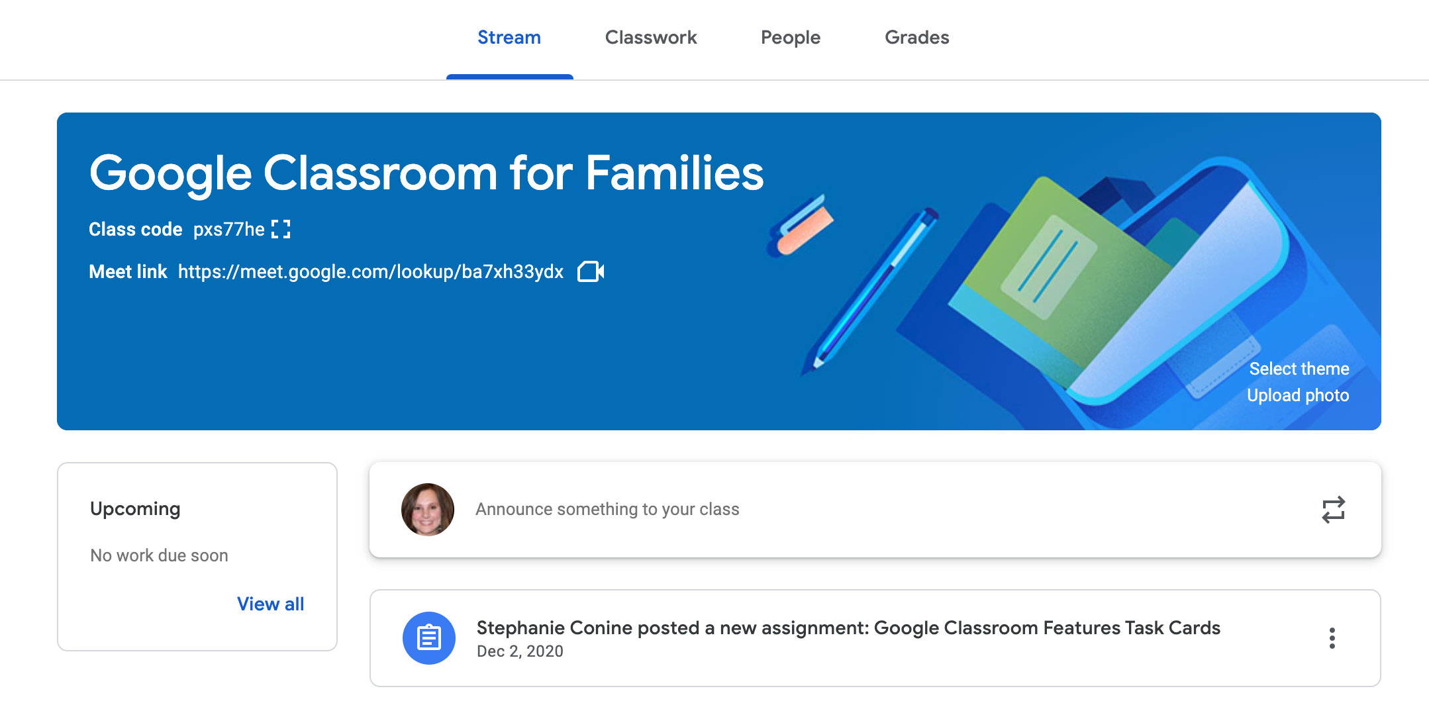
Google Classroom for Families|Stream Page Features
With your student, access Google Classroom and select one of your student’s classes (class card)
At the top of the page, select “Stream”
The Stream is the social hub of Google Classroom. This is where announcements can be made by the teacher. Students, if enabled, are able to share resources or ask questions. Any assignments created on the
Classwork tab are announced on
the Stream.
Additional features on this page
include “Upcoming” work due
dates and Google Meet links
for your student to access virtual
meetings with their instructor
and class meetings.
Notes:
All of the information from the video is also available on the task cards.

Slide 12
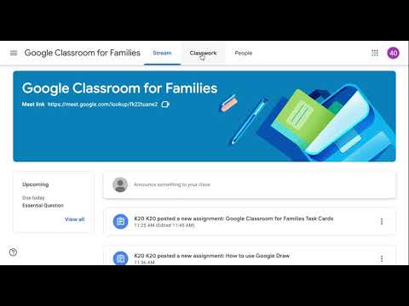
Upcoming and Google Calendar
Notes:
https://youtu.be/fb5mjprr9PM

Slide 13
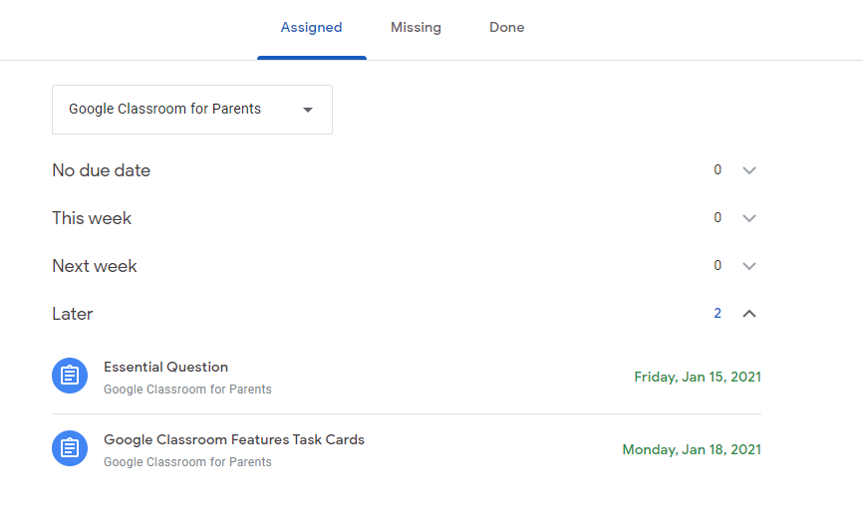
Google Classroom for Families |Student “Upcoming”
Locate the “Upcoming” box on the left hand side of the Google Stream Classroom Page. (fig. 1)
You will directed to a new page. (fig.2)
Work will be listed as follows:
No Due Date, This Week, Next
Week, and Later.
Fig. 1
Fig. 2
Notes:
Task card for previous video

Slide 14
Google Classroom for Families |Student Google Calendar
Select “Classwork” at the top of the Google Classroom page.
You will be directed to another page.
At the top of the page, select “Google Calendar.”
You will be directed to the calendar.
At the top of the page, you may change the setting to display by day, week, month, or year.
Select the “Week” drop down menu and select “Month”
This will display all upcoming assignments for all classes utilizing Google Classroom.
Notes:
Task card for previous video

Slide 15
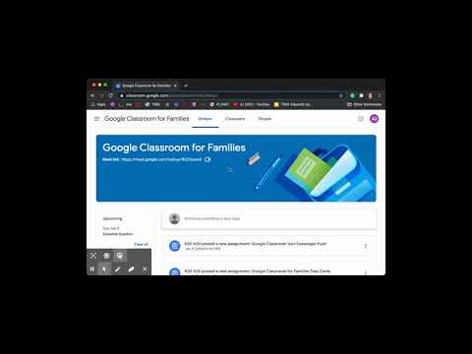
Student Work Submission
Notes:
https://youtu.be/tBtyqGWxL3M

Slide 16
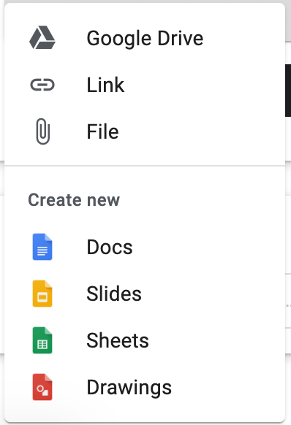
Google Classroom for Families|Student work submission
Submitting Teacher-Assigned Documents:
At the top of the page, select “Classwork”
Select the assignment topic and click “View Assignment.”
On the right-hand side of your screen, locate “Your work” and select
A new window will open, prompting you to “Turn in your work?”
Select “Turn in” at the bottom right to complete your submission.
Upload, Add or Create Work for submission:
Follow steps 1-3 noted above.
Select
A new window will open, select the location of your file
Choose your file
On the right hand side of your screen, locate and select “Your work”
A new window will open, prompting you to “Turn in your work?”
Select “Turn in” at the bottom right to complete your submission.
Notes:
Task card for previous video

Slide 17
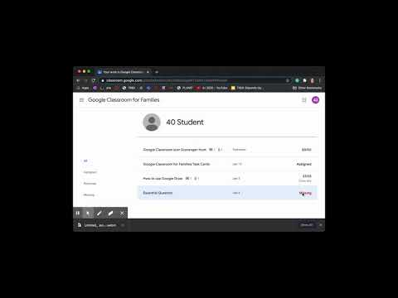
Student Grades
Notes:
https://youtu.be/_E7iqeMdBgQ

Slide 18
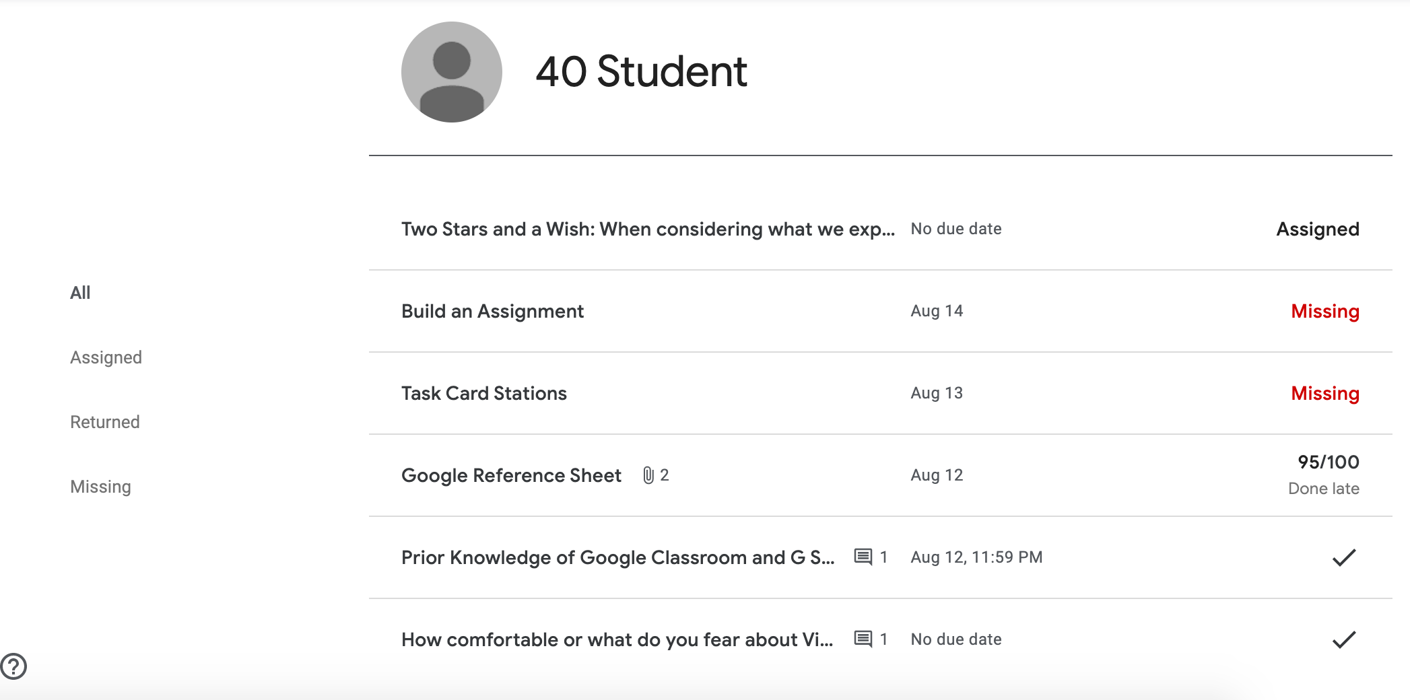
Google Classroom for Families |Student Grades
Select “Classwork” at the top of the Google Classroom page.
Select “View your work” at the top of the classwork page
Individual Student Work Page: this shows the students a list of all their assignments and the status of each assignment. Students can click on any assignment row to expand and open the assignment. They can also use the filters on the left-hand side to see which assignments they are missing.
Note: Zero scores do not count as missing.
Notes:
Task card for previous video

Slide 19
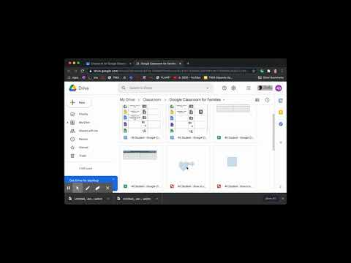
Class Drive Folder
Notes:
https://youtu.be/eW8ji5uI72k

Slide 20
Google Classroom for Families |Class Drive Folder
Select “Classwork” at the top of the Google Classroom Stream page.
Select “Class Drive Folder” in the upper right-hand corner of the Classwork page.
Work your student creates in the Classroom saves to your student’s class Drive folder.
In Drive, you can view, organize, and create files and folders.
You can open your class Drive on web or mobile versions of Classroom.
Note: If a student unenrolls from a class, work they turned in remains in their class Drive.
Notes:
Task card for previous video

Slide 21
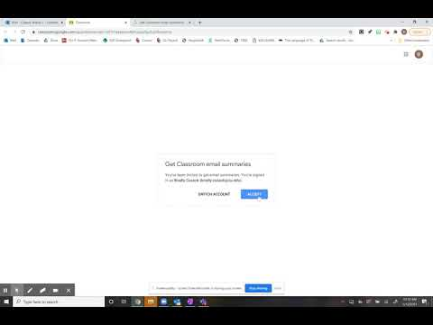
Notes:
https://youtu.be/oVXToBcEkUw

Slide 22
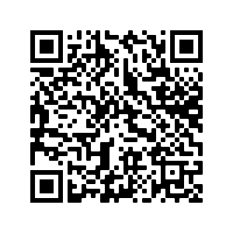
Gaining Access
How to request an invite and schedule notifications.
Form Letter - Example
https://tinyurl.com/GClassLetter

Slide 23
Two Stars and a Wish
Let’s take a moment to reflect on some of the information we have learned today.
[Insert QR Code here]
[insert tiny url here]

Slide 24
What questions do you still have?
Notes:
(images from Peggy_Marco at pixabay.com)

Slide 25
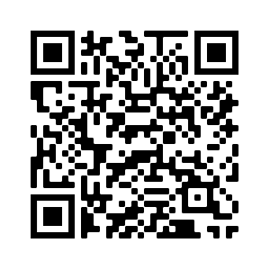
Survey
To help us measure the impact we are having at our GEAR UP partner schools, please use this link and let us know who you are. It should take about 1 minute. Thank you.
https://tinyurl.com/GC21Survey
Notes:
(images from Peggy_Marco at pixabay.com)

