Slide 2

Lotería Instructions
The caller will draw one card at a time and announce the name of the image on it. If the caller describes an image that you see on your board, place a marker over that image.
The winning patterns are any four images in a row. Winning patterns include the following:
  Row: A horizontal line of four images
  Column: A vertical line of four images
  Diagonal: A diagonal line of four images
If you see four images in a row, in any of the patterns mentioned above, shout out “GEAR UP!” to notify the caller you may have a winning pattern on your board.
The caller will look over your board and confirm that you have a winning pattern.
If you have not yet found a winning pattern, keep the markers on your board. The game will continue until 10 winners are declared.

Slide 3

1
1
2
2
3
3
4
4
Notes:
Family Feud Template
Introduction Slide – The Countdown!
Genially Link: https://view.genially.com/668c54cbfdbf10001483b824/interactive-content-family-feud-life-family-overview

Slide 4



Slide 5




TOP 10 BENEFITS
Be Prepared for Success in a Technology-Driven World
1
6
Earn More than $1 Million in Your Lifetime
7
Connect with Peers and Mentors
Understand the World Better
2
Increase Your Job Options
8
3
Make a Difference in Your Community
4
Live Longer and Healthier
Be Happier in Your Job
9
More Likely to be Employed
More Satisfying Family Life
5
10
Notes:
1. Earn more than $1 million in your lifetime 2. Connect with peers and mentors 3. Increase your job options 4. Be happier in your job 5. More likely to be employed 6. Be prepared for success in technology-driven world 7. Understand the world better 8. Make a difference in your community 9. Live longer and healthier 10. More satisfying family life

Slide 6
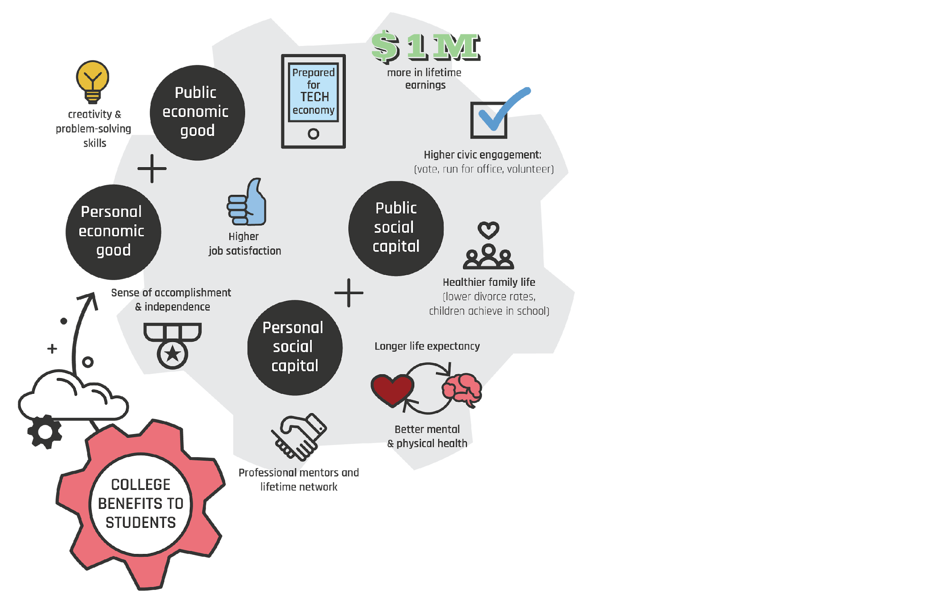
College Benefits to Students
Beneficios Universitarios para Estudiantes
Sutton, H. (2017). Learn to articulate the value of college beyond dollar signs. Recruiting & Retaining Adult Learners, 19(7), 6-7.

Slide 7
GEAR UP for LIFE Family Overview
GEAR UP for LIFE Resumen Familiar

Slide 8
What is GEAR UP?
Partnership between OU’s K20 Center and 22 school districts in Oklahoma
Helps students in the graduating classes of 2029 and 2030 prepare for postsecondary education (PSE)
Postsecondary education = Any education past high school including two-year and four-year colleges, career tech centers, military, and apprenticeships
Colaboración entre el Centro K20 de la OU y 22 distritos escolares en Oklahoma
Ayuda a los estudiantes de las clases que se graduarán en 2029 y 2030 a prepararse para la educación postsecundaria (PSE)
Educación Postsecundaria = Cualquier educación después de la preparatoria, incluyendo universidades de dos y cuatro años, centros de carreras técnicas, el ejército y aprendizajes

Slide 9
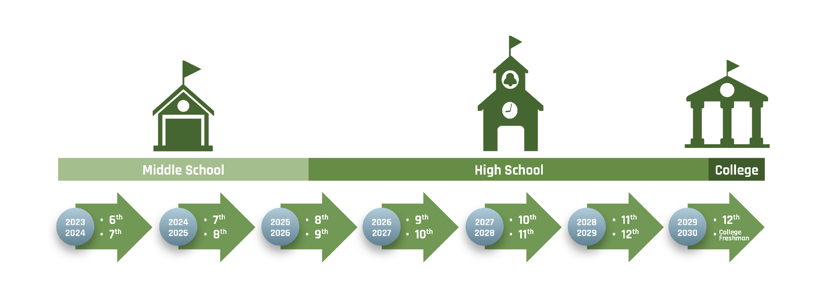
GEAR UP Model:
Gaining Early Awareness and Readiness for Undergraduate Programs
Concienciación y Preparación Temprana para Programas Universitarios

Slide 10
GEAR UP Goals
Increase students’ engagement in learning
Increase academic readiness for postsecondary education
Increase high school graduation rates and postsecondary enrollment rates
Increase students’ and parents’ knowledge of postsecondary options and financial aid
Aumentar el interés de los estudiantes por el aprendizaje
Aumentar la preparación academica para la educación postsecundaria
Aumentar las tasas de graduación de la preparatoria y de matriculación en estudios postsecundarios
Aumentar el conocimiento de los estudiantes y sus padres sobre las opciones postsecundarias y la ayuda financiera

Slide 11
Activities Offered by GEAR UP
Students
Campus visits to colleges and other PSE options
Career exploration
Mentoring opportunities
Families
Family events sharing PSE and financial aid options
Family Leadership Academy
Estudiantes
Visitas a universidades y otras opciones de educación postsecundaria
Exploración de carreras
Oportunidades de tutoría
Familias
Eventos familiars para compartir opciones de educación postsecundaria y ayuda financiera
Academia de Liderazgo Familiar

Slide 12
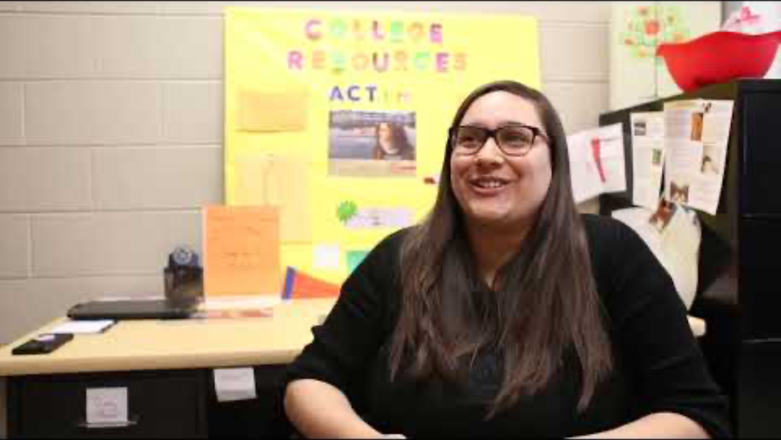
GEAR UP Overview
Notes:
K20 Center. (n.d.). GEAR UP overview. [Video]. https://www.youtube.com/watch?v=MaDO99ncRrk

Slide 13
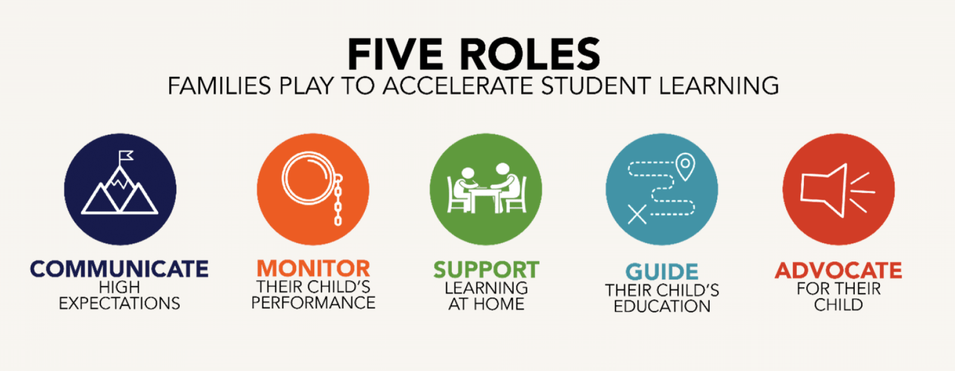

How can you accelerate your child’s learning about PSE?
Notes:
Real family engagement. (2024, April 9). Flamboyan. https://flamboyanfoundation.org/real/#:~:text=At%20Flamboyan%2C%20we%20have%20seen,5)%20advocate%20for%20their%20needs.

Slide 14

I Used To Think…But Now I Know
Using your “I Used to Think…But Now I Know” handout, respond to the following prompt:
“I used to think postsecondary education was…, but now I know it is…”
Usando el folleto “Solía pensar… Pero Ahora Sé”, respondan a la siguiente pregunta:
“Solía pensar que la educación postsecundaria era…, pero ahora sé que es…”
Notes:
K20 Center. (n.d.). I used to think…but now I know. Strategies. https://learn.k20center.ou.edu/strategy/137

