Slide 2
Leaning Plants
Plant Adaptations, Growth, and Tropisms
Pictures and Lesson by Delia Gietzen

Slide 3
Photo Time Lapse: March 12 – April 30
Look carefully at photographs in the next seven slides.
What do you notice?
What do you wonder?
Write your observations on your I Notice, I Wonder Guide.

Slide 4
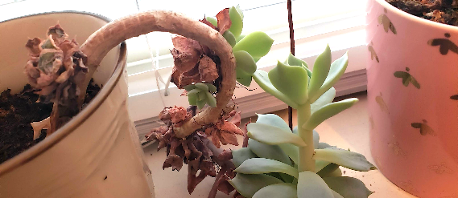
Week 1: March 12 - What do you notice about the plant?

Slide 5
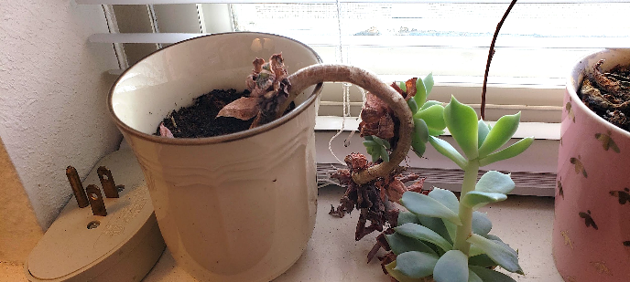
Week 2: March 20 - What is different? What is the same?

Slide 6
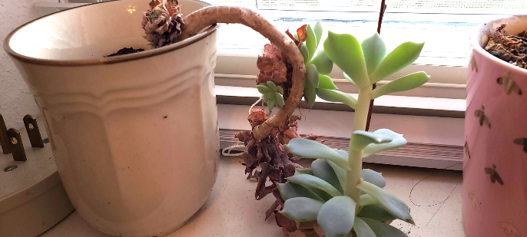
Week 3: March 28 - What’s different? What’s the same?
Notes:
There is no photo slide available for Week 4. Skip to next slide, titled Week5

Slide 7
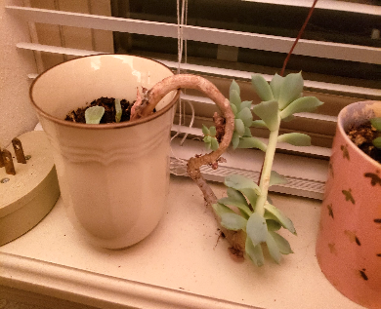
Week 5: April 11 What’s different?
Week 5 ½: April 14
What’s the same?
Notes:
Note: Week 4 skipped (Spring Break)

Slide 8
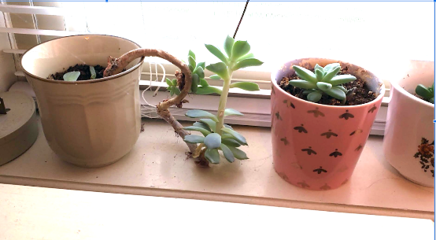
Week 6: April 23 What’s different? What’s the same?

Slide 9
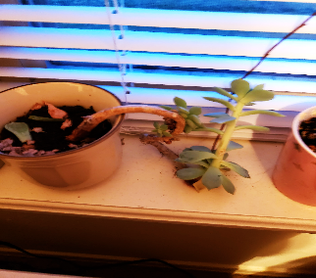
Week 7: April 30 What’s different? What’s the same?

Slide 10
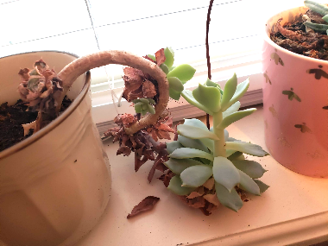
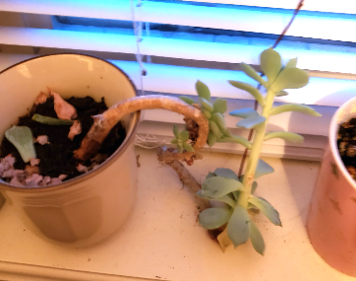
Week 7: April 30
Week 1: March 12

