Slide 2
Inertia Makerspace
Newton’s First Law of Motion

Slide 3
Essential Question:
How do the properties of inertia affect us?

Slide 4
Objectives:
By the end of this lesson, we will be able to:
apply Newton’s First Law of Motion to real-life examples;
communicate our understanding of inertia using models; and
summarize why the motion of objects change.

Slide 5
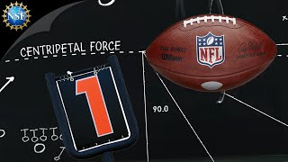
Kickoff
Can you think of sports or hobbies that involve forces?
Turn to your elbow partner and share your lists.
Newton’s First Law of Motion
Notes:
National Science Foundation. (2015 January). Newton's First Law of Motion - Science of NFL Football [video]. YouTube. https://www.youtube.com/watch?v=08BFCZJDn9w
K20 Center. (n.d.). Bell ringers and exit tickets. Strategies. https://learn.k20center.ou.edu/strategy/125

Slide 6
I Can’t Believe I’m Doing This…
Write each group member name above their column.
Each student gets 10 tries in 60 seconds.
Group members record each other’s data & calculate a group average of successful bottle flips.
Post your group’s data on the board (see next slide).
Minute To Win It - Stick the Landing
Notes:
Nonis, D. (April 2013). Minute To Win It - Stick The Landing [video]. YouTube. https://www.youtube.com/watch?v=5t4NYJbERZ0

Slide 7
Calculating Group Averages
Let’s calculate a Sample group average!
5 + 7 + 3 = 15
15 landed flips ÷ 3 group members = 5
5 would be this group’s average. If this were your group, you would add a bar representing 5 landed flips to the class’s graph.
# of flips landed
Sam | Susan | Jerry
5 | 7 | 3

Slide 8
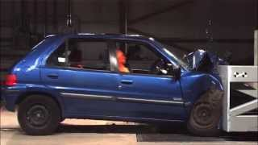
Inertia Kills
Forces and Motion
Notes:
Pumpkin Interactive. (July 2015). Forces and Motion The Physics of Car Crashes (preview) [video]. YouTube. https://www.youtube.com/watch?v=wV2UTkkQ0Fg

Slide 9
The Science of Bottle Flipping
Newton’s First Law of Motion—an object at rest or an object in motion will stay that way unless acted upon by an unbalanced force.
inertia—a property of matter to remain unchanged unless acted upon by some outside force.
force—the strength or energy produced as a result of physical movement or action.
motion—a change in position over time.
gravity—a natural, invisible force of attraction between any 2 objects.
mass—the amount of matter in an object. Greater the mass of an object, the greater its inertia

Slide 10
Makerspace Inertia Day
Each group will research, create, write up, and perform an inertia demonstration using only items from our makerspace.
By end of class today, submit a completed rubric/handout of your group demo for approval.
If time allows, practice your demo.
Notes:
Before they start researching, the rubric should be handed out and explained.

Slide 11
Demo Day
Your group has 10 minutes to gather items from our makerspace and practice.
Each group has 1 chance to perform their demo live.
Remember to follow the guidelines from the rubric.

Slide 12
Exit Ticket
Summarize your favorite inertia demo.
Include these words in your summary: gravity, force, motion, and inertia.
Hand in your Exit Ticket as you leave.
Notes:
K20 Center. (n.d.). Bell ringers and exit tickets. Strategies. https://learn.k20center.ou.edu/strategy/125

