Slide 1
It’s OPTIC-al
On your paper, write OPTIC down the left side.
O- Write observations about the visuals you see.
P- List the parts, or details, you notice.
T- Assess the title.
How does it relate?
If there is no title, give it one.
I- Determine the interrelationships of the visuals.
How do they work together?
C- Come to a conclusion about the image.

Slide 2
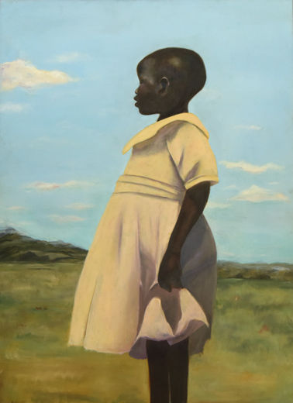
On your paper, write OPTIC down the left side.
O- Write observations about the visuals you see.
P- List the parts, or details, you notice.
T- Assess the title.
How does it relate?
If there is no title, give it one.
I- Determine the interrelationships of the visuals.
How do they work together?
C- Come to a conclusion about the image.
Uganda by Cliffanie Forrester
Notes:
Uganda
Cliffannie Forrester
Age 17, Grade 12
High School of Art & Design, Manhattan
Art Teacher: Maria Jimenez
Oil on canvas

Slide 3
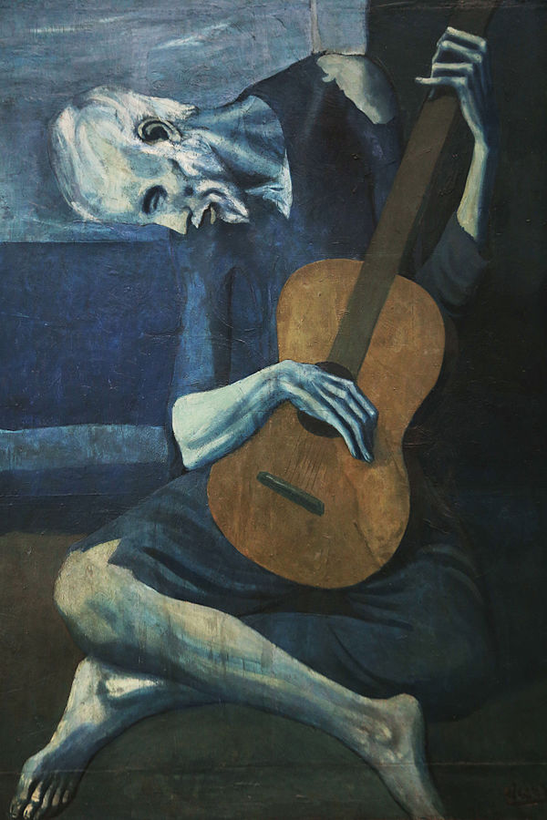
On your paper, write OPTIC down the left side.
O- Write observations about the visuals you see.
P- List the parts, or details, you notice.
T- Assess the title.
How does it relate?
If there is no title, give it one.
I- Determine the interrelationships of the visuals.
How do they work together?
C- Come to a conclusion about the image.
The Old Guitarist by Pablo Picasso.
Notes:
The Old Guitarist
Artist Pablo Picasso
Year 1903–04
Medium Oil on panel
Dimensions 122.9 cm × 82.6 cm (48.4 in × 32.5 in)
Location Art Institute of Chicago

Slide 4
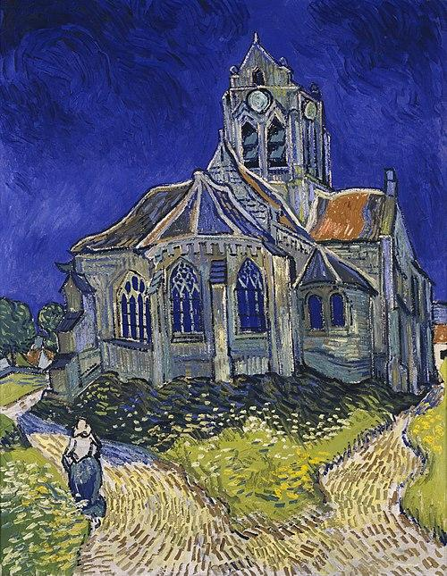
On your paper, write OPTIC down the left side.
O- Write observations about the visuals you see.
P- List the parts, or details, you notice.
T- Assess the title.
How does it relate?
If there is no title, give it one.
I- Determine the interrelationships of the visuals.
How do they work together?
C- Come to a conclusion about the image.
The Church at Auvers by Vincent Van Gogh
Notes:
The Church at Auvers
Artist Vincent van Gogh
Year 1890
Catalogue
F789JH2006
Medium Oil on canvas
Dimensions 74 cm × 94 cm (37 in × 29.1 in)
Location Musée d'Orsay, Paris

Slide 5
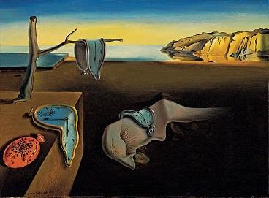
On your paper, write OPTIC down the left side.
O- Write observations about the visuals you see.
P- List the parts, or details, you notice.
T- Assess the title.
How does it relate?
If there is no title, give it one.
I- Determine the interrelationships of the visuals.
How do they work together?
C- Come to a conclusion
about the image.
The Persistence of Memory by Salvador Dalí
Notes:
The Persistence of Memory
Artist Salvador Dalí
Year 1931
Medium Oil on canvas
Dimensions 24 cm × 33 cm (9.5 in × 13 in)
Location Museum of Modern Art, New York City

Slide 6
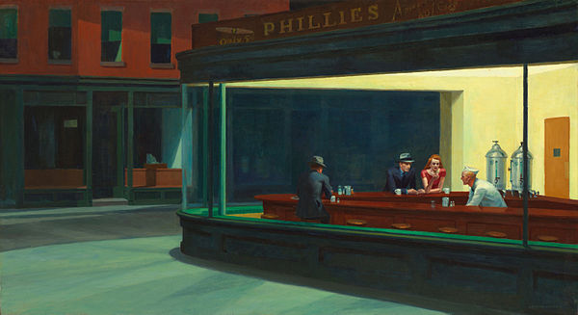
On your paper, write OPTIC down the left side.
O- Write observations about the visuals you see.
P- List the parts, or details, you notice.
T- Assess the title.
How does it relate?
If there is no title, give it one.
I- Determine the interrelationships of the visuals.
How do they work together?
C- Come to a conclusion
about the image.
Nighthawks by Edward Hopper
Notes:
Hopper, E. (1942). Nighthawks [Online image]. https://en.wikipedia.org/wiki/Nighthawks_(painting)
Nighthawks
Artist Edward Hopper
Year 1942
Medium oil paint, canvas
Movement American realism
Dimensions 84.1 cm (33.1 in) × 152.4 cm (60.0 in)
Location Art Institute of Chicago, United States

