Slide 2
Being Mindful of Sadness in “The Scarlet Ibis”
Theme and Characterization

Slide 3
Essential Question
How does a character’s state of mind affect their development and the development of the theme in a text?

Slide 4
Lesson Objectives
Analyze the development of character and theme in a text.

Slide 5
Quick Write
How do you deal with uncertain times?
Notes:
K20 Center. (2021, September 21). K20 Center 3 minute timer [Video]. YouTube. https://www.youtube.com/watch?v=iISP02KPau0

Slide 6
What is Mental Health Counseling?
Notes:
NYU Steinhardt (2014, Oct 2). What is mental health counseling? [Video]. YouTube. https://www.youtube.com/watch?v=UpsQX4nxZUI

Slide 7
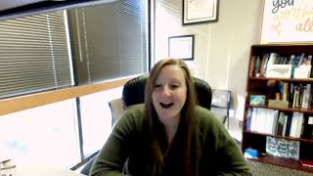
What is Social Work?
Notes:
K20 Center. (2021, March 12). K20 ICAP - Licensed Professional Counselor - Are We Okay? [Video]. YouTube. https://www.youtube.com/watch?v=BN10mvJYoTA&list=PL-aUhEQeaZXLg0yYwLKeUT2Ud1sC0inzo&index=44

Slide 8
It’s OPTIC-al
O – Write observations about the visuals you see.
P – List the parts, or details, you notice.
T – Assess the title.
How does it relate?
If there is no title, give it one.
I – Determine the interrelationships of the visuals.
How do they work together?
C – Come to a conclusion about the image.

Slide 9
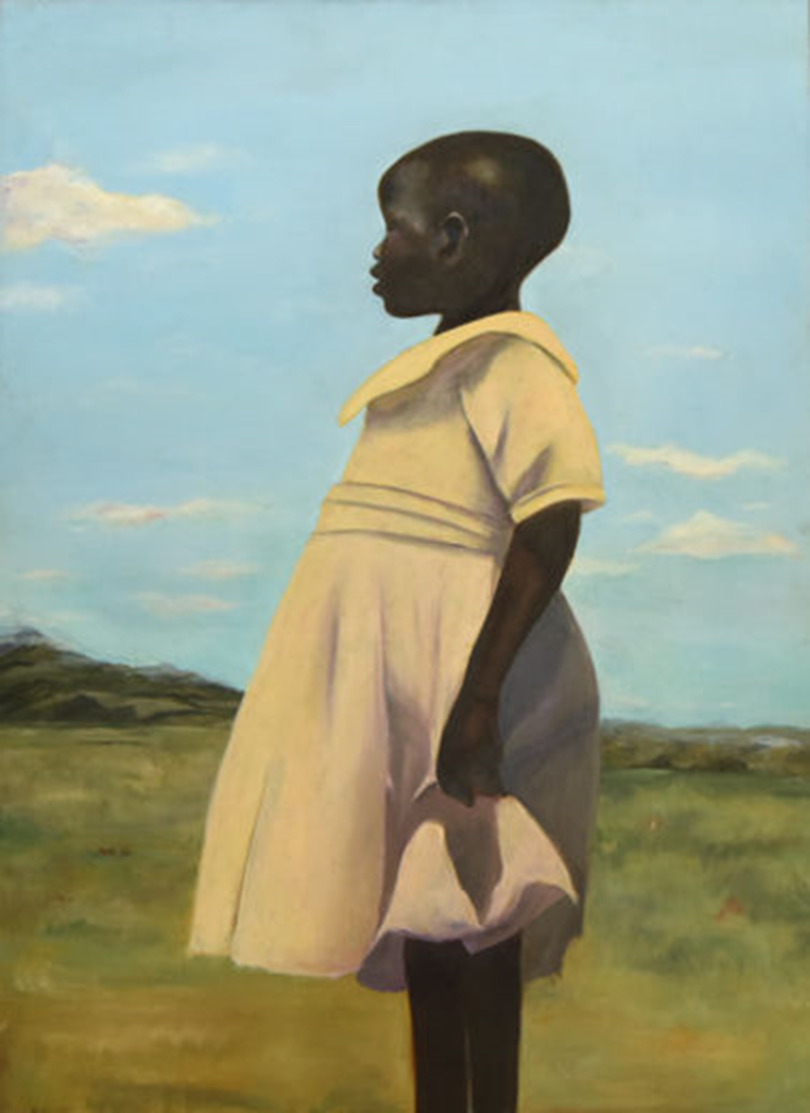
Uganda by Cliffanie Forrester
Notes:
Forrester, C. (2015). Uganda [Painting]. The Metropolitan Museum of Art, New York, NY.

Slide 10
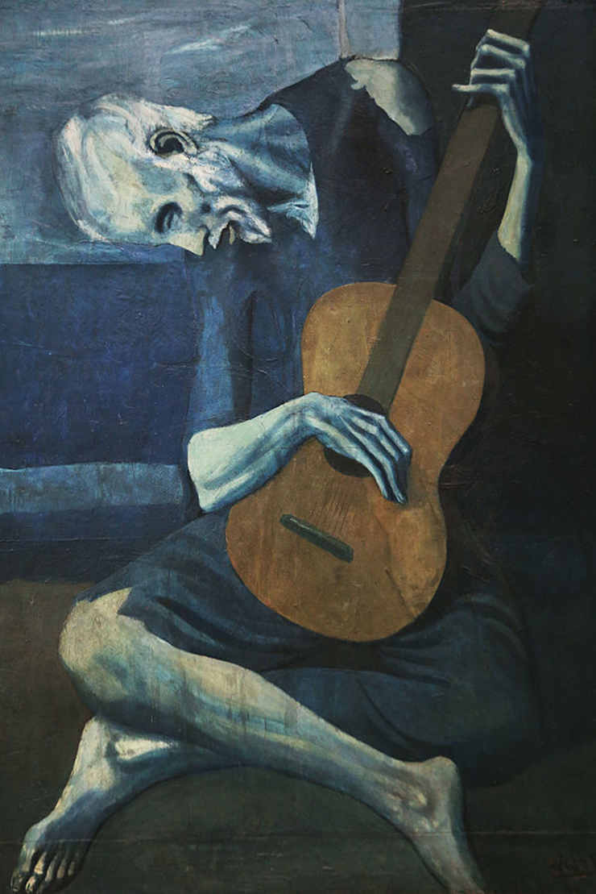
The Old Guitarist by Pablo Picasso
Notes:
Picasso, P. (1903–1904). The old guitarist [Painting]. Art Institute of Chicago, Chicago, IL

Slide 11
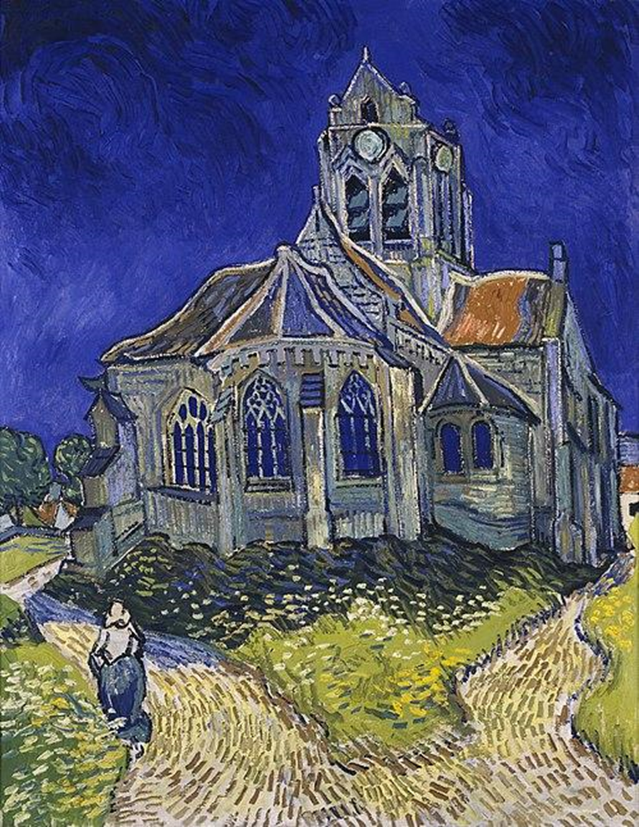
The Church at Auvers by Vincent Van Gogh
Notes:
Van Gogh, V. (1890). The church at Auvers [Painting]. Musée d'Orsay, Paris, France.

Slide 12
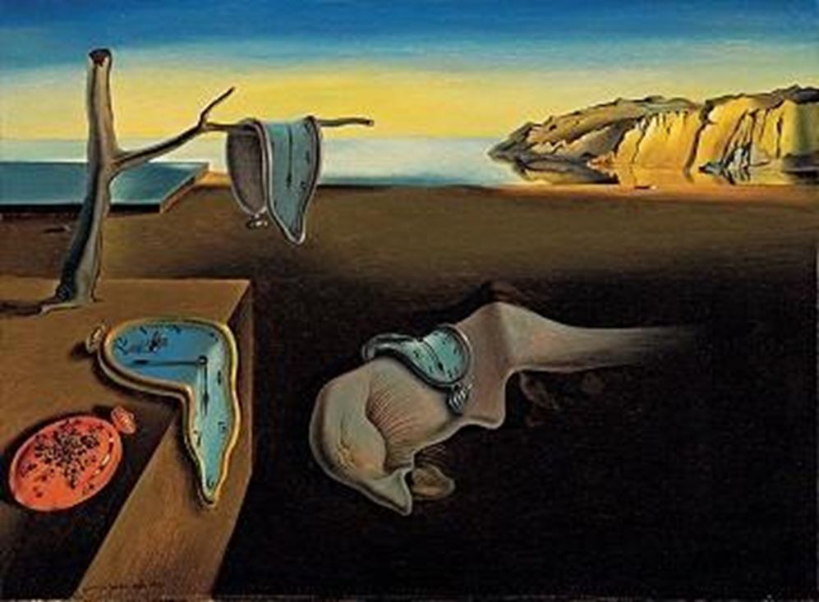
The Persistence of Memory by Salvador Dalí
Notes:
Dalí, S. (1931). The persistence of memory [Painting]. Museum of Modern Art, New York, NY.

Slide 13
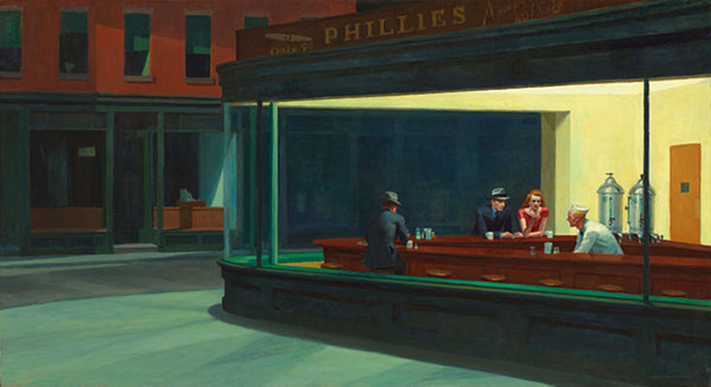
Nighthawks by Edward Hopper
Notes:
Hopper, E. (1942). Nighthawks [Painting]. Art Institute of Chicago, Chicago, IL. https://www.artic.edu/artworks/111628/nighthawks

Slide 14
“The Scarlet Ibis” by James Hurst
As you read, think about the main character’s emotional state throughout the story:
How do you know what he is feeling throughout?
How do his emotions change throughout?
What do his emotions tell us about the theme(s) in the story?

Slide 15
Text Analysis Chart
In response to the following questions, complete the Text Analysis Chart noting quotes from the text, character’s mood or state of mind, and your reaction to it.
How do you know what he is feeling throughout?
How do his emotions change throughout?
What do his emotions tell us about the theme(s) in the story?

Slide 16
Text Analysis Chart Discussion
How does the author develop the character of Brother in the text?
How are we, the audience, supposed to feel about Brother?

Slide 17
What it Says, Why it Matters Chart
Complete the What it Says, Why it Matters Chart noting quotes from the article “11 Self-Care Tips for Teens and Young Adults” by Gene Beresin and the video “Self-Care in High School.” Explain why it matters in connection to “The Scarlet Ibis.”
Notes:
MGHClayCenter. (2019, May 5). Self-care in high school [Video]. YouTube. https://www.youtube.com/watch?v=gEHPTjMv4F0

Slide 18
Two-Voice Poem – Conversation with Brother
Create a poster where Brother has a conversation with someone else who provides him with insight or ways to process his sadness.
Mom
Dad
Aunt Nicey
Friend
Counselor

Slide 19
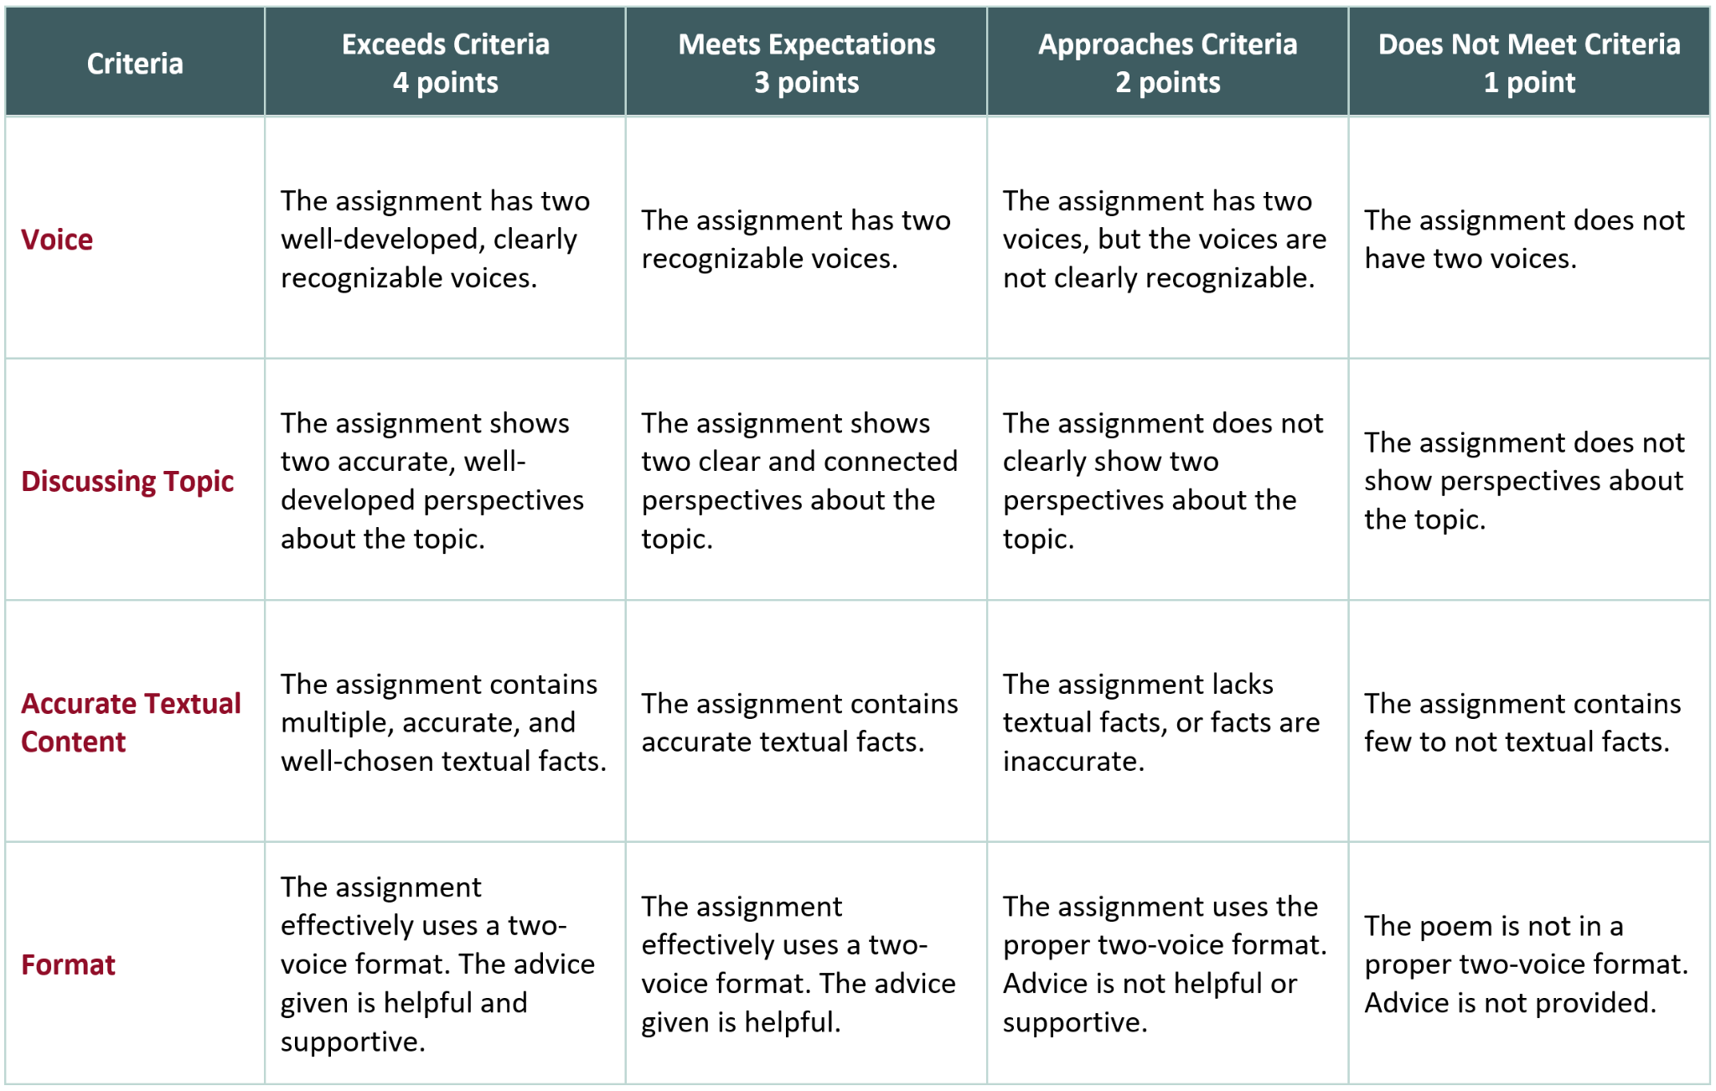
Conversation with Brother Rubric

