Slide 2
Being Mindful of Sadness
in “The Scarlet Ibis”
Theme and Characterization

Slide 3
Essential Question
How does a character’s state of mind affect their development and the development of the theme in a text?

Slide 4
Learning Objective
Analyze the development of character and theme in a text.

Slide 5
How do you deal with uncertain times?
Respond to the prompt above. Write for the full 3 minutes.
Notes:
K20 Center. (2021, September 21). K20 Center 3 minute timer [Video]. YouTube. https://www.youtube.com/watch?v=iISP02KPau0

Slide 6
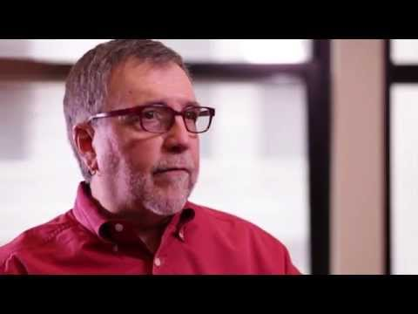
What is Mental Health Counseling?
Notes:
NYU Steinhardt (2014, Oct 2). What is mental health counseling? [Video]. YouTube. https://www.youtube.com/watch?v=UpsQX4nxZUI

Slide 7
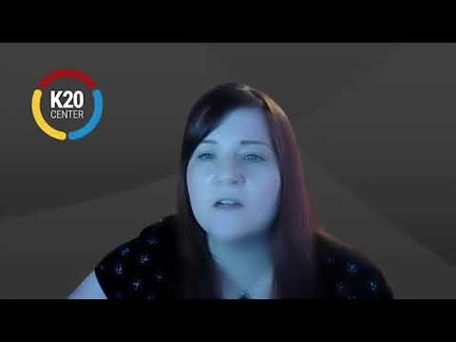
What is Social Work?
Notes:
K20 Center. (2021, January 8). Social Worker - Jessica Schonlau - Zoom Into Your Career [Video]. YouTube. https://www.youtube.com/watch?v=iD9roYUbBGw&feature=youtu.be

Slide 8
It’s OPTIC-al
On your paper, write OPTIC down the left side.
O- Write observations about the visuals you see.
P- List the parts, or details, you notice.
T- Assess the title.
How does it relate?
If there is no title, give it one.
I- Determine the interrelationships of the visuals.
How do they work together?
C- Come to a conclusion about the image.

Slide 9
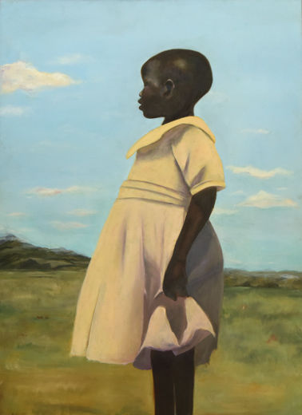
O- Write observations about the visuals you see.
P- List the parts, or details, you notice.
T- Assess the title.
How does it relate?
If there is no title, give it one.
I- Determine the interrelationships of the visuals.
How do they work together?
C- Come to a conclusion about the image.
Uganda by Cliffanie Forrester
Notes:
Forrester, C. (2016). Uganda [Online image]. P.S. Art 2016: Student Artworks. The Metropolitan Museum of Art. https://www.metmuseum.org/exhibitions/listings/2016/ps-art-2016/works-of-art
Uganda
Cliffannie Forrester
Age 17, Grade 12
High School of Art & Design, Manhattan
Art Teacher: Maria Jimenez
Oil on canvas

Slide 10
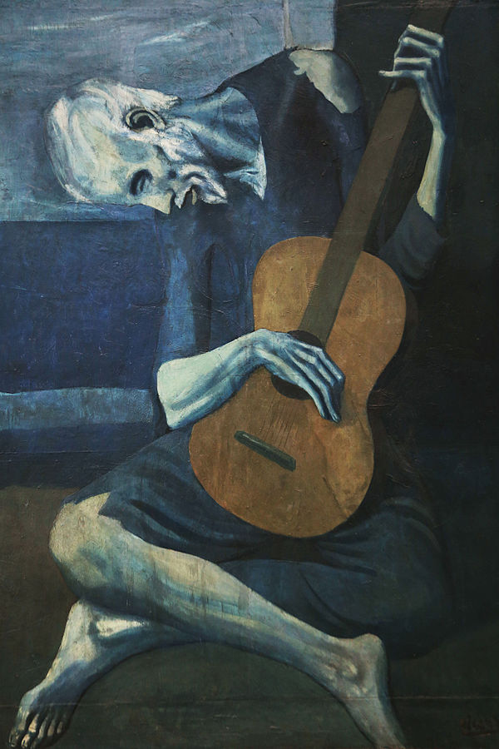
O- Write observations about the visuals you see.
P- List the parts, or details, you notice.
T- Assess the title.
How does it relate?
If there is no title, give it one.
I- Determine the interrelationships of the visuals.
How do they work together?
C- Come to a conclusion about the image.
The Old Guitarist by Pablo Picasso
Notes:
Picasso, P. (1904). The old guitarist [Online image]. https://en.wikipedia.org/wiki/The_Old_Guitarist
The Old Guitarist
Artist Pablo Picasso
Year 1903–04
Medium Oil on panel
Dimensions 122.9 cm × 82.6 cm (48.4 in × 32.5 in)
Location Art Institute of Chicago

Slide 11
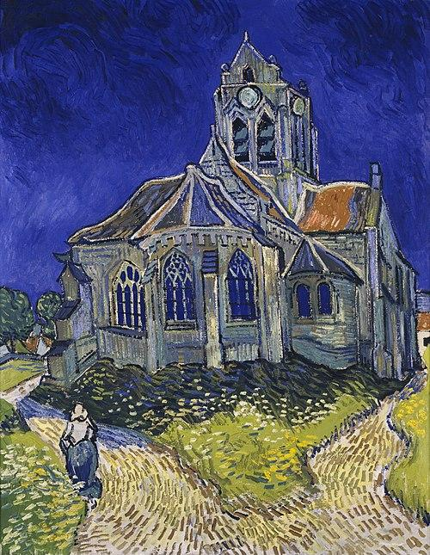
O- Write observations about the visuals you see.
P- List the parts, or details, you notice.
T- Assess the title.
How does it relate?
If there is no title, give it one.
I- Determine the interrelationships of the visuals.
How do they work together?
C- Come to a conclusion about the image.
The Church at Auvers by Vincent Van Gogh
Notes:
Van Gogh, V. (1890). The church at Auvers [Online image]. Visual Arts. https://en.wikipedia.org/wiki/Visual_arts
The Church at Auvers
Artist Vincent van Gogh
Year 1890
Catalogue
F789JH2006
Medium Oil on canvas
Dimensions 74 cm × 94 cm (37 in × 29.1 in)
Location Musée d'Orsay, Paris

Slide 12
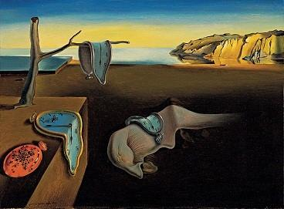
O- Write observations about the visuals you see.
P- List the parts, or details, you notice.
T- Assess the title.
How does it relate?
If there is no title, give it one.
I- Determine the interrelationships of the visuals.
How do they work together?
C- Come to a conclusion about the image.
The Persistence of Memory by Salvador Dalí
Notes:
Dali, S. (1931). The persistence of memory [Online image]. https://en.wikipedia.org/wiki/The_Persistence_of_Memory
The Persistence of Memory
Artist Salvador Dalí
Year 1931
Medium Oil on canvas
Dimensions 24 cm × 33 cm (9.5 in × 13 in)
Location Museum of Modern Art, New York City

Slide 13
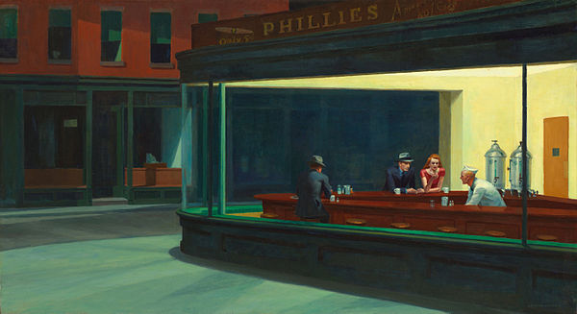
O- Write observations about the visuals you see.
P- List the parts, or details, you notice.
T- Assess the title.
How does it relate?
If there is no title, give it one.
I- Determine the interrelationships of the visuals.
How do they work together?
C- Come to a conclusion about the image.
Nighthawks by Edward Hopper
Notes:
Hopper, E. (1942). Nighthawks [Online image]. https://en.wikipedia.org/wiki/Nighthawks_(painting)
Nighthawks
Artist Edward Hopper
Year 1942
Medium oil paint, canvas
Movement American realism
Dimensions 84.1 cm (33.1 in) × 152.4 cm (60.0 in)
Location Art Institute of Chicago, United States

Slide 14
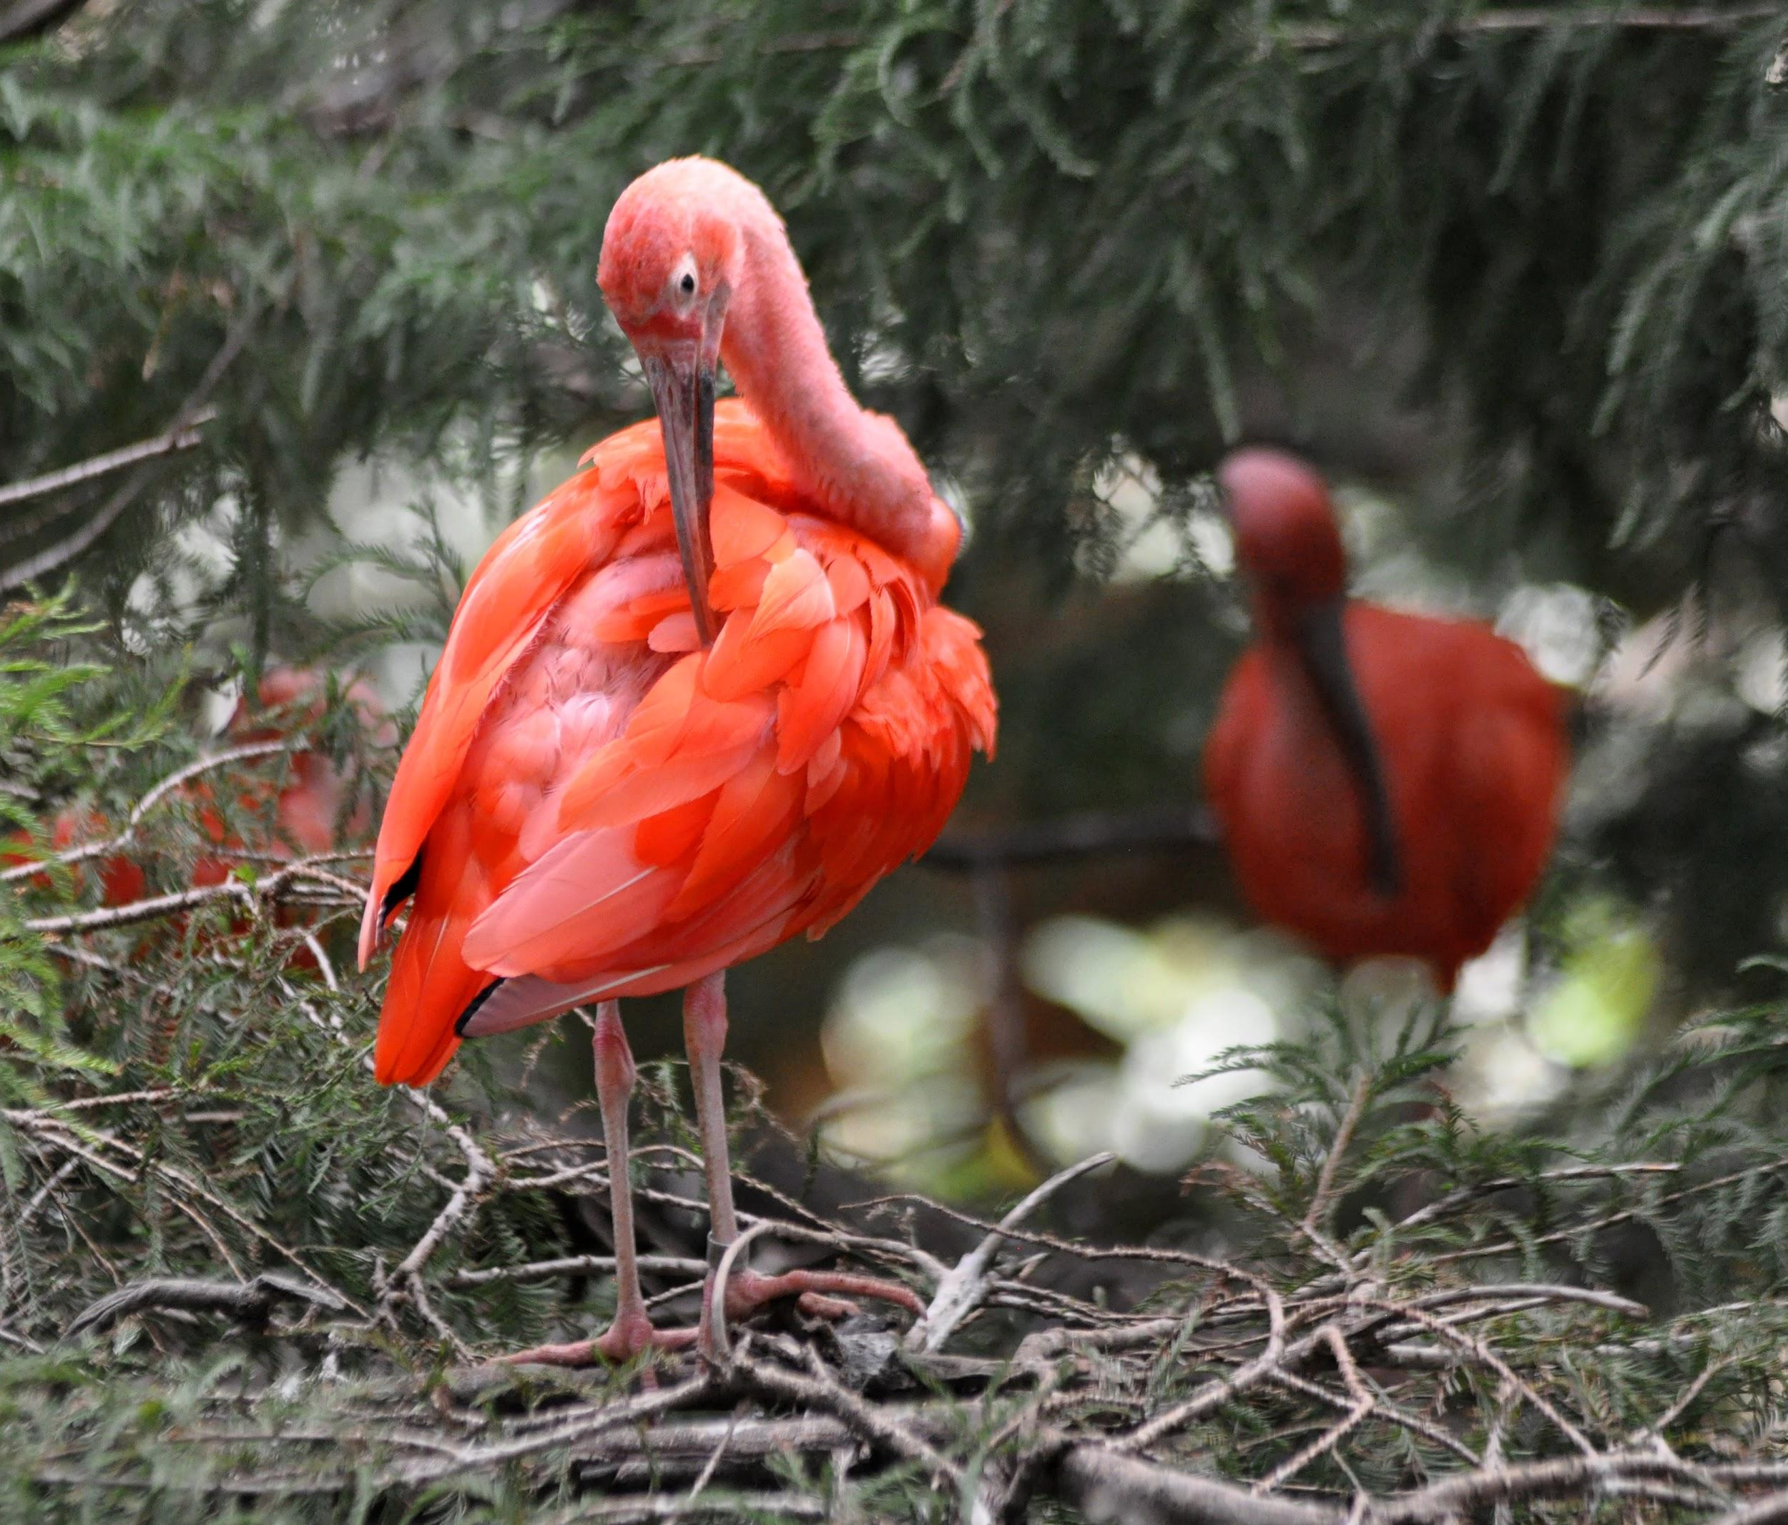
Read “The Scarlet Ibis” by James Hurst
As you read, think about the main character’s emotional state throughout the story.
How do you know what he is feeling throughout the story?
How do his emotions change throughout the story?
What do his emotions tell us about the theme(s) in the story?
Notes:
Hurst, J. (July 1960). The scarlet ibis. ActivelyLearn. https://read.activelylearn.com/#teacher/reader/authoring/preview/816689/notes
Milne, P. (2011, June 28). Scarlet ibis [Photograph]. Flickr. https://www.flickr.com/photos/48307594@N00/6037953333

Slide 15
After Reading “The Scarlet Ibis”
Complete the Text Analysis Chart
Discussion
How does the author develop the character of Brother in the text?
How are we, the audience, supposed to feel about Brother?
What the Text Says | Character’s Mood/ State of Mind | Reaction this Creates in the Reader

Slide 16
11 Self-Care Tips
Says/Matters Chart
Making Connections to “The Scarlet Ibis”
What do the video and text say?
Include these in the chart on the “Says” side.
Why does this matter?
Include why you chose these on the “Matter” side.
Explain connections you made.
What the Text Says (copy and paste the direct quote from the article here) | Why it Matters/ Connection to “The Scarlet Ibis”

Slide 17
11 Self-Care Tips
Notes:
Bereson, G. (May 5, 2019). 11 self care tips for teens and young adults. The Clay Center for Young Healthy Minds. https://www.mghclaycenter.org/parenting-concerns/11-self-care-tips-for-teens-and-young-adults/

Slide 18
Processing Sadness
Option 1
Option 2
Create a poster where Brother has a conversation with someone else who provides him with some insights or ways to process his sadness. Some choices are:
Counselor
Mom
Dad
Aunt Nicey
Friend
Create a poster providing specific tips for someone in class to use who may be having a difficult time processing their own feelings.
Then, choose a character from the story and write a paragraph explaining how that character would change or add to the poster.

Slide 19
Brother Processes His Sadness: Two Voices
Create a poster where Brother has a conversation with someone else who provides him with some insights or ways to process his sadness.
Counselor
Mom
Dad
Aunt Nicey
Friend

Slide 20
Processing Emotions
Create a poster providing specific tips to use for someone who may be having a difficult time processing their feelings.
Choose a character from “The Scarlet Ibis” and write a paragraph discussing how that character might change or add to your poster.

