Slide 2
How EGG-ceptional Are We?
Evolution: Embryonic Development

Slide 3
Essential Question
How do we decide what to believe about evolutionary claims?

Slide 4
Lesson Objectives
Students will be able to:
Compare and contrast organisms using DNA and appearance at various stages of development.
Analyze embryology as evidence for evolution.

Slide 5
I Notice, I Wonder
On your paper, make two columns.
Label the right column “I Notice,” and the left column “I Wonder.”
As you listen to the book An Egg Is Quiet by Dianna Aston, write down any observations you notice and anything the book makes you wonder about.
Notes:
Sunshine lemonade. (2016). An egg is quiet [Video of book read-aloud]. YouTube. https://www.youtube.com/watch?v=KgVaNbrCayU
K20 Center. (n.d.). I notice, I wonder. Strategies. https://learn.k20center.ou.edu/strategy/180

Slide 6
What Did You Observe?
Pair up and share your observations with each other.
While listening and discussing with your partner, think about if what they are sharing reinforces your observations or helps you learn something new.

Slide 7
Card Sort
Set A
Group what you think is similar together.
Write on a sticky note why you grouped things together (category headings).
Rotate through to see other groupings.
Set B
Combine these with the embryos from set A.
Group what you think is similar.
Notes:
K20 Center. (n.d.). Card sort. Strategies. https://learn.k20center.ou.edu/strategy/147

Slide 8
Gallery Walk
Take out as many sticky notes as you have categories.
On each sticky note, write down why your group chose to group specific cards together for each category. These will become category headings.
Post your sticky notes together in one area in the classroom.
Stay in your groups and rotate together to read the other groups’ ideas.
Take time to decide if your group should revise your original categories.
Notes:
K20 Center. (n.d.). Gallery walk/carousel. Strategies. https://learn.k20center.ou.edu/strategy/118

Slide 9
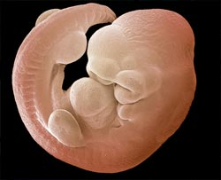
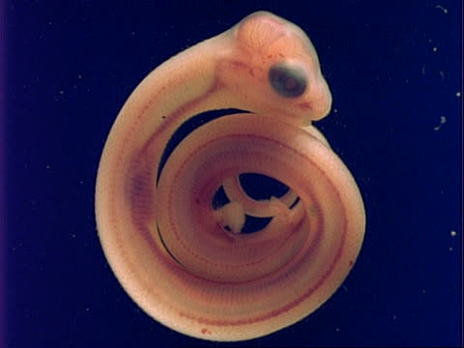
Card Sort Answers
Mouse
Snake
Notes:
K20 Center. (n.d.). Card sort. Strategies. https://learn.k20center.ou.edu/strategy/147

Slide 10
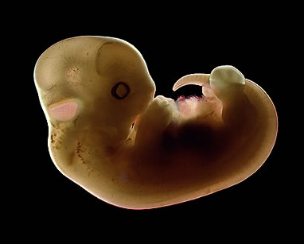
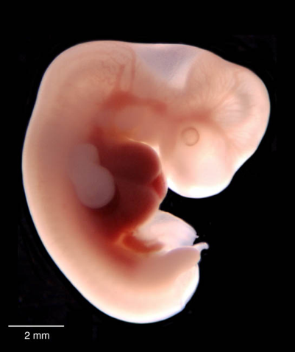
Card Sort Answers
Cat
Human
Notes:
K20 Center. (n.d.). Card sort. Strategies. https://learn.k20center.ou.edu/strategy/147

Slide 11
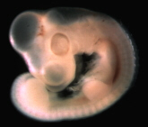
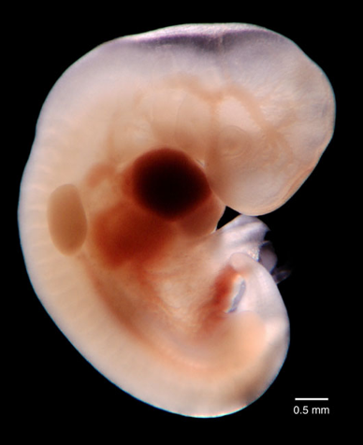
Card Sort Answers
Chicken
Elephant
Notes:
K20 Center. (n.d.). Card sort. Strategies. https://learn.k20center.ou.edu/strategy/147

Slide 12
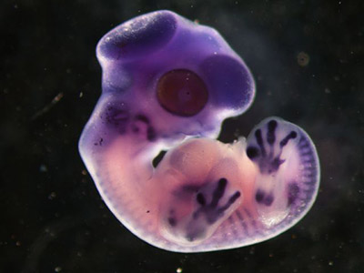
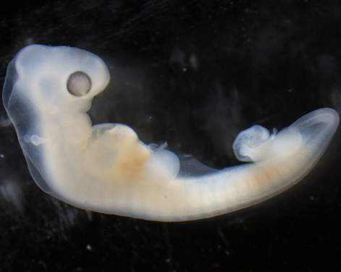
Card Sort Answers
Finch (Bird)
Turtle
Notes:
K20 Center. (n.d.). Card sort. Strategies. https://learn.k20center.ou.edu/strategy/147

Slide 13
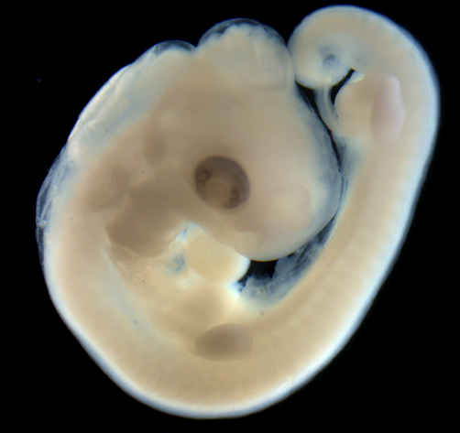
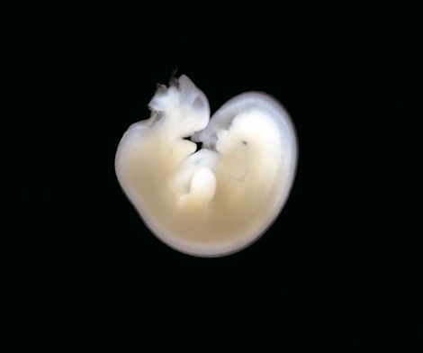
Card Sort Answers
Alligator
Horse
Notes:
K20 Center. (n.d.). Card sort. Strategies. https://learn.k20center.ou.edu/strategy/147

Slide 14
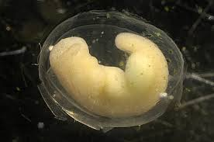
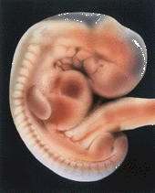
Card Sort Answers
Salamander
Rabbit
Notes:
K20 Center. (n.d.). Card sort. Strategies. https://learn.k20center.ou.edu/strategy/147

Slide 15
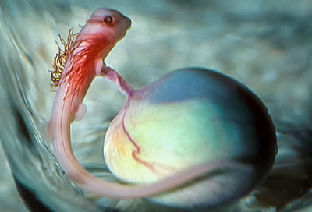
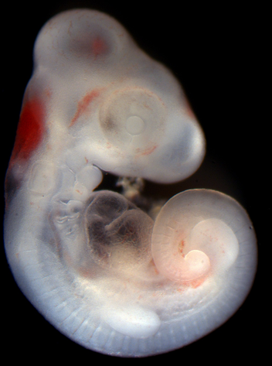
Card Sort Answers
Shark
Lizard
Notes:
K20 Center. (n.d.). Card sort. Strategies. https://learn.k20center.ou.edu/strategy/147

Slide 16
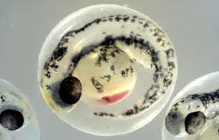
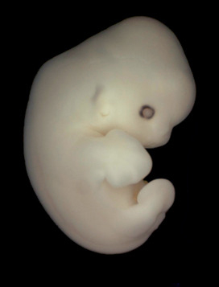
Card Sort Answers
Fish
Bat
Notes:
K20 Center. (n.d.). Card sort. Strategies. https://learn.k20center.ou.edu/strategy/147

Slide 17
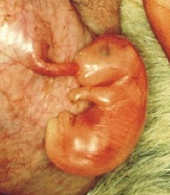
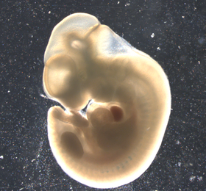
Card Sort Answers
Kangaroo
Chimpanzee
Notes:
K20 Center. (n.d.). Card sort. Strategies. https://learn.k20center.ou.edu/strategy/147

Slide 18
Card Sort
You have 2 sets of development cards:
Separate the two sets.
Put each set in the correct order.
Notes:
K20 Center. (n.d.). Card sort. Strategies. https://learn.k20center.ou.edu/strategy/147

Slide 19
Inverted Pyramid
Answer the Analysis questions.
Share your answers with a partner and combine your answers into shared statements.
Join another set of partners (creating a group of 4) share and combine your statements.
Share as a class.
Notes:
K20 Center. (n.d.). Inverted pyramid. Strategies. https://learn.k20center.ou.edu/strategy/173

Slide 20
Introduction
All vertebrate (has a spine) animals start out as embryos.
All these embryos go through the same stages, but some go through them faster or slower, and bigger or smaller.
These stages are called the Carnegie stages, because they were first to systematically document the stages
Detailed features in each stage can be found at: https://virtualhumanembryo.lsuhsc.edu/HEIRLOOM/Stage_Descriptions/Stages_intro.html

Slide 21
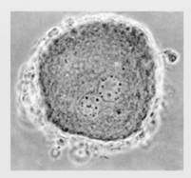
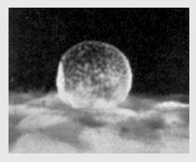
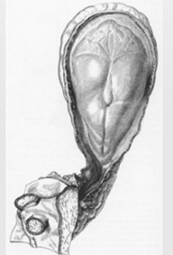
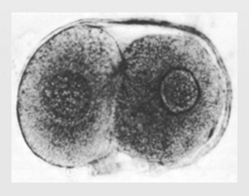
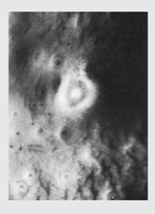
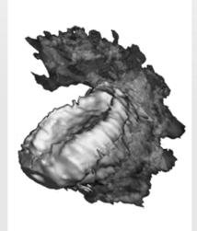
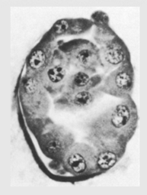
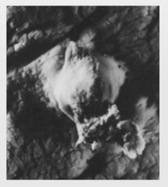
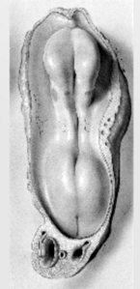
Stage 1-9
Most of these stages are just groups of cells, until stage 8, when the gastro-digestive tract is formed.
In stage 9, neural folds (the beginning of the brain) starts to form.

Slide 22
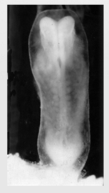
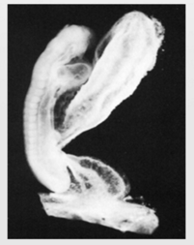
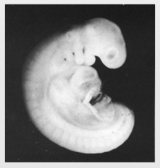
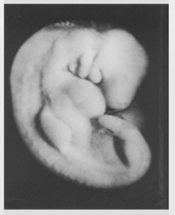
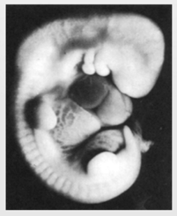
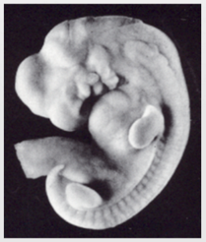
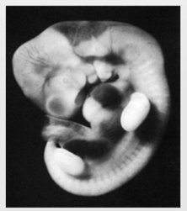
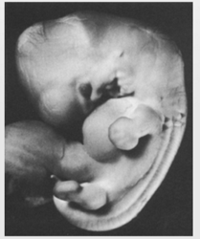
Stages 10-17
Simple structures are starting to form:
neural tube (the beginning of the spine) in stage 10;
optical sacs (the beginning of eyes) in stage 11;
limb buds in stages 15 and 16;
olfactory bulb (the beginning of the nose) in stage 17.

Slide 23
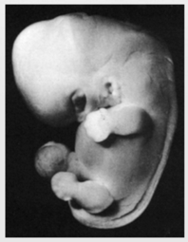
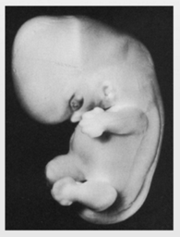
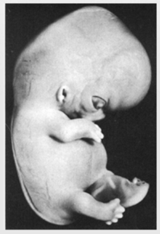
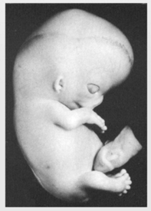
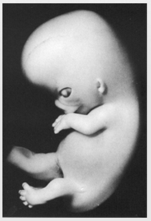
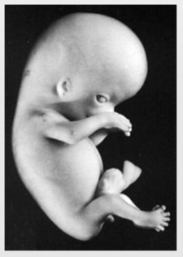
Stages 18-23
More specific features start to form:
Head features (eyelids and tip of nose) in stage 18;
Fingers and toes start to form in stage 20;
Bones start to harden in stage 22;
95% of adult features are present in stage 23.

Slide 24
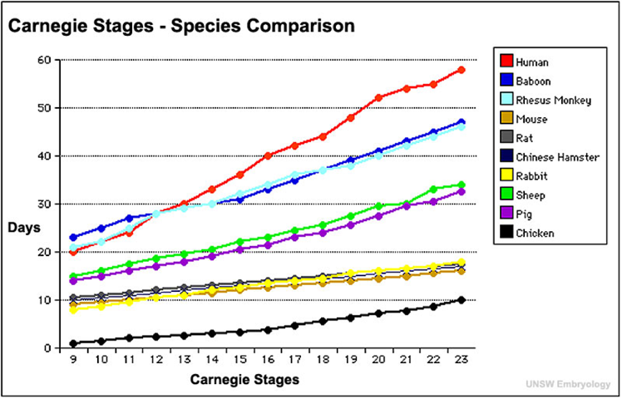
Animal Embryo Development Graph
Use the graph to complete the data table and answer the analysis questions.

Slide 25
I Used To Think…But Now I Know
On your handout, fill in the columns:
What you used to think about embryos and fetal development.
What you now know about embryos and fetal development.
Turn in the half sheet as your exit ticket.
Notes:
K20 Center. (n.d.). I used to think…but now I know. Strategies. https://learn.k20center.ou.edu/strategy/137

