Slide 2
How EGG-ceptional Are We?
Life Science: Evolution/Embryonic Development

Slide 3
Essential Question
How do we decide what to believe about evolutionary claims?

Slide 4
Lesson Objectives
Students will be able to:
Compare and contrast organisms using DNA and appearance at various stages of development.
Analyze embryology as an evidence for evolution.

Slide 5
An Egg is Quiet By Dianna Aston
Option 1: Read the book An Egg is Quiet.
Option 2: Watch An Egg Is Quiet Read Aloud video.
Aston, D. (2014). An Egg Is Quiet. Mankato, MN: Amicus.
Notes:
Video link: https://www.youtube.com/watch?v=rtX9yf62BXU
If you have a copy of An Egg is Quiet by Dianna Aston, read it to the students. If you do not have access to the book, show students the read aloud on youtube. While you read, Students will use the I Notice/I Wonder strategy to write down observations, important details, and questions they think about as the teacher reads.
Afterwards, allow students to look back through the book if they need to revisit it. In pairs, have students share what they've written and revisit the book (or copies of pages of the book) to either reinforce the observations they made or to revise them. Also use this time for students to discuss the questions they wrote and see if rereading the book answers the questions or if further investigation is needed.

Slide 6
Card Sort
Set A
Group what you think is similar together.
Write on a sticky note why you grouped things together (category headings).
Rotate through to see other groupings.
Set B
Combine these with the embryos from set A.
Group what you think is similar.
Notes:
Pass out a set of 'Set A' Card Sort embryo cards (these are the ones with letters at the bottom) from the document titled Student Version Embryo Cards to groups of two or three students. Prompt the students to group together the embryos that are similar. There are no duplicates, so each is a unique animal, but possible categories could be mammals, reptiles, amphibians, etc. Some students will think these are similar animals, but in different developmental stages. Try to leave it open-ended and leave the prompt as 'group what you think is similar together' if possible. When students are done, have them do a modified Gallery Walk, where students write why their group decided the card groupings on "Post-it" Notes as category headings. The groups then rotate and read the other groups' ideas. When a full rotation through has happened, give time for students to decide if they want to change their original groupings or not.
Teacher Note: This is a very difficult task, which is the point. Let them struggle. A teacher and PowerPoint key is included, but that's for when the task is over and it's time to debrief. These moments of disequilibrium are the gateway towards opening the mind to other thinking.
Taking the idea further, pass out a set of 'Set B' Card Sort embryo cards (these are the ones with numbers at the bottom) from the same document, so that both Set A and Set B are together, to each group. Give the prompt again to create groups. Students will probably understand that the idea is to pair the embryo with the developed animal, but try not to give it away.

Slide 7
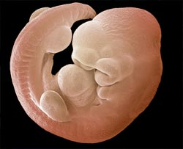
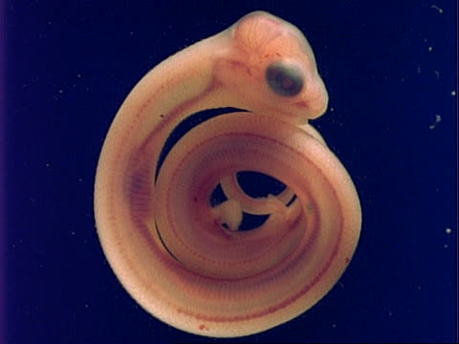
Card Sort Answers
Mouse
Snake
Notes:
The answers to what embryo is what animal is included not only as a teacher key but also in the PowerPoint (slide 6-14) to show the students when they've struggled enough. At some point reveal the answers, but try to let the struggle happen as long as possible without leaving the students too frustrated.

Slide 8
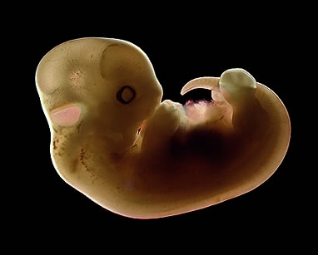
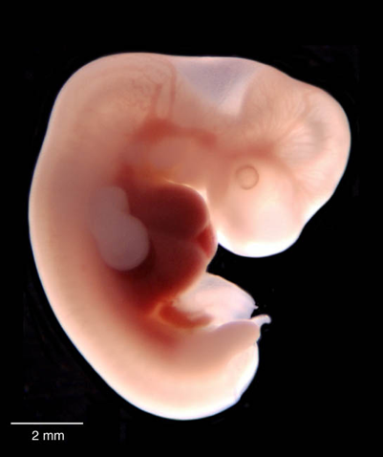
Card Sort Answers
Cat
Human

Slide 9
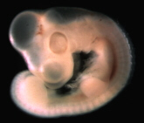
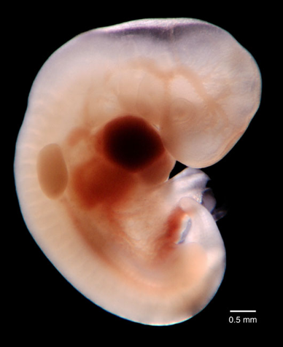
Card Sort Answers
Chicken
Elephant

Slide 10
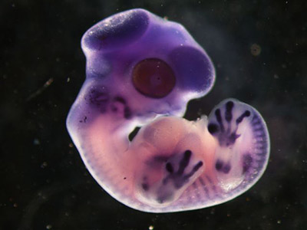
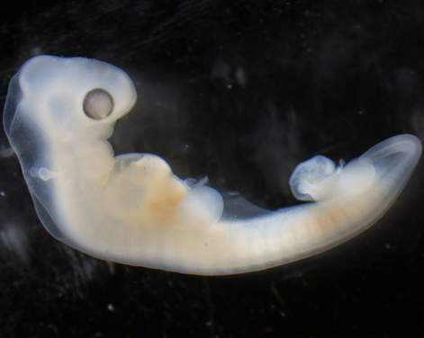
Card Sort Answers
Finch (Bird)
Turtle

Slide 11
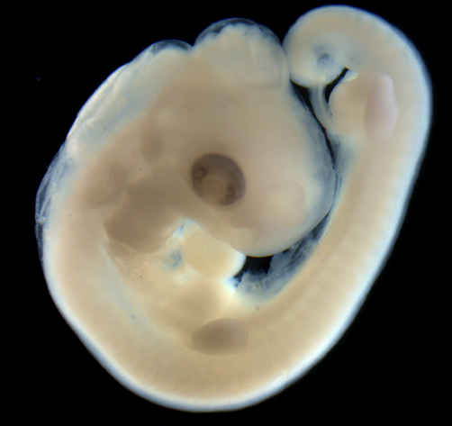
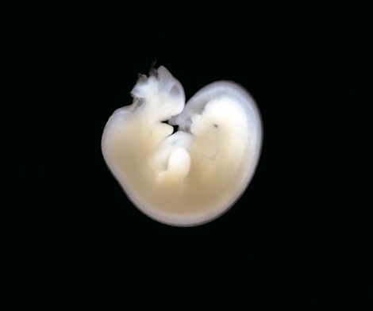
Card Sort Answers
Alligator
Horse

Slide 12
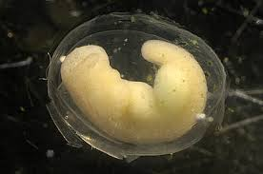
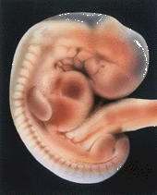
Card Sort Answers
Salamander
Rabbit

Slide 13
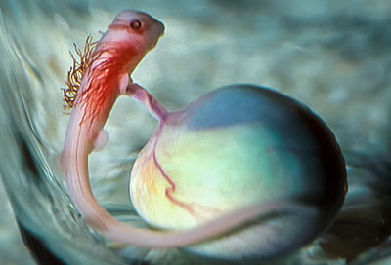
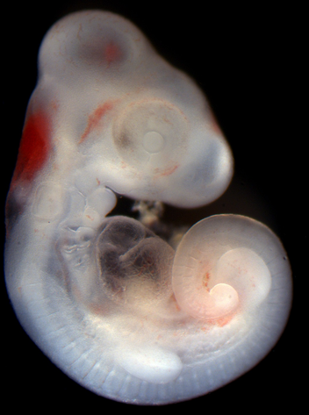
Card Sort Answers
Shark
Lizard

Slide 14
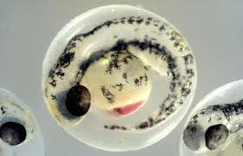
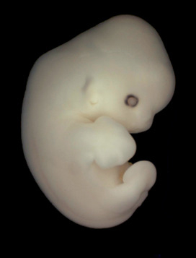
Card Sort Answers
Fish
Bat

Slide 15
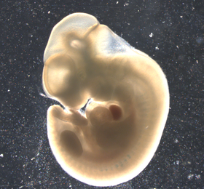
Card Sort Answers
Kangaroo
Chimpanzee

Slide 16
Card Sort
Inverted Pyramid
You have 2 sets of development cards:
Separate the two sets.
Put each set in the correct order.
Answer the Analysis questions.
Share your answers with a partner and combine your answers into shared statements.
Join another set of partners (creating a group of 4) share and combine your statements.
Share as a class.
Notes:
Pass out the Card Sort cards titled 'Explain Card Sort' with a few stages of a chicken embryo and a mouse embryo. Either display the prompt or verbally share the prompt "There are two sets. Separate the two sets, then put each set in order." Allow the students to work on this in pairs, then have each pair find another.
Once students think they have completed the prompt, distribute the analysis questions document. Using the strategy Inverted Pyramid, have students share their answers with partners, creating a shared answer that represents both of their answers. Then, partners join together to make a group of four, sharing again, this time with a focus on the statements generated. Once the groups of four construct a shared statement, each group shares their statements with the whole class, with the teacher writing them on the board for everyone to see. From here, explain to the students how all organisms develop in the same stages, called Carnegie Stages, but they go through those stages at different rates, different sizes, and that the organ shapes will be different for different animals, but the stages are all the same.

Slide 17
Introduction
All vertebrate (has a spine) animals start out as embryos.
All these embryos go through the same stages, but some go through them faster or slower, and bigger or smaller.
These stages are called the Carnegie stages, because they were first to systematically document the stages
Detailed features in each stage can be found at: http://virtualhumanembryo.lsuhsc.edu/HEIRLOOM/Stages/Stages_intro.html
Notes:
In the PowerPoint, there is a very simplified breakdown of the Carnegie Stages (slide 16-19). Using it is optional, but no matter what is used there needs to be an emphasis on the sameness of the Carnegie Stage progression, but how (especially the later stages) the physical appearance of each organism may look different within the stages.

Slide 18
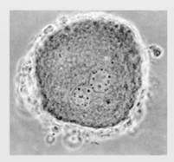
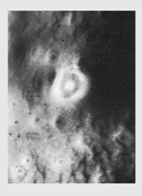
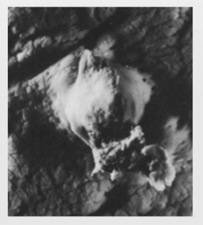
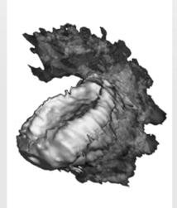
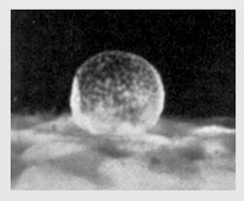
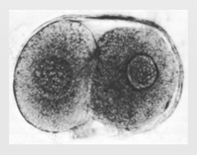
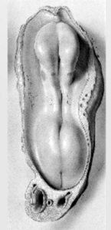
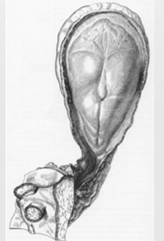
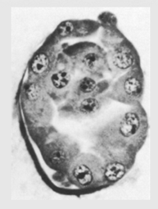
Stage 1-9
Most of these stages are just groups of cells, until stage 8, when the gastro-digestive tract is formed.
In stage 9, neural folds (the beginning of the brain) starts to form.

Slide 19
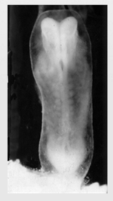
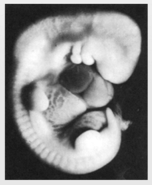
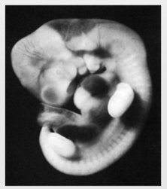
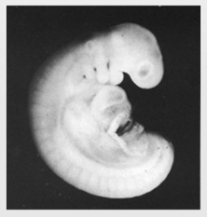
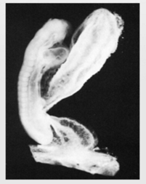
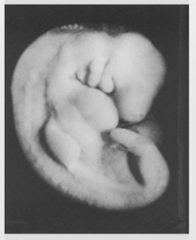
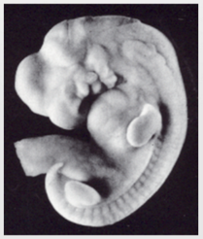
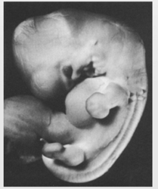
Stages 10-17
Simple structures are starting to form:
neural tube (the beginning of the spine) in stage 10;
optical sacs (the beginning of eyes) in stage 11;
limb buds in stages 15 and 16;
olfactory bulb (the beginning of the nose) in stage 17.

Slide 20
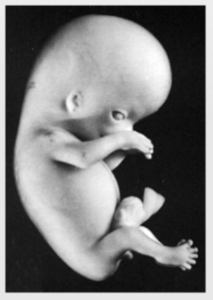
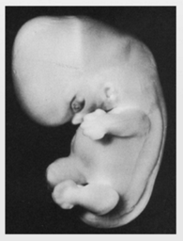
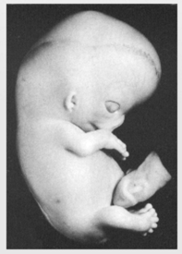
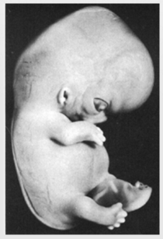
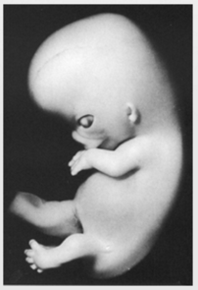
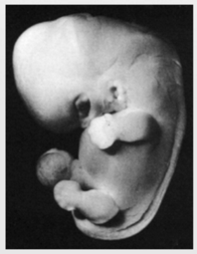
Stages 18-23
More specific features start to form:
Head features (eyelids and tip of nose) in stage 18;
Fingers and toes start to form in stage 20;
Bones start to harden in stage 22;
95% of adult features are present in stage 23.

Slide 21
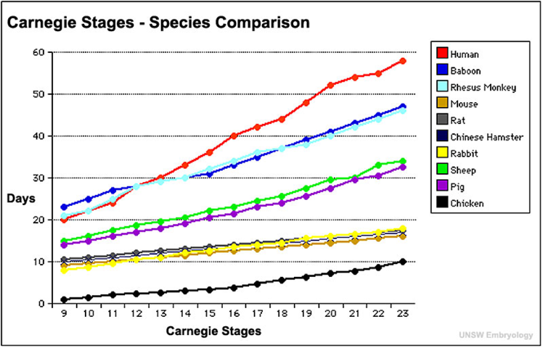
Animal Embryo Development Graph
Use the graph to complete the data table and answer the analysis questions.
Notes:
Distribute the Animal Embryo Development Graph document to each student. Have them construct the chart and answer the questions. Allow them to use this data to support their products in the Evaluate section.

Slide 22
I Used To Think…But Now I Know
On the half sheet, fill in the columns:
What you used to think about embryos and fetal development.
What you now know about embryos and fetal development.
Turn in the half sheet as your exit ticket.
Notes:
Pass out a half sheet of the two-column I Used to Think... But Now I Know document to each student. Give about 5 minutes for students to reflect upon what was presented to them and record what they used to think about embryos and fetal development compared to what they now know. Have students share their responses with a partner, then turn their responses in as an Exit Ticket.

