Slide 2
How EGG-ceptional Are We?
Biology
EVOLUTION/EMBRYONIC DEVELOPMENT

Slide 3
Essential Question
How do we decide what to believe about
evolutionary claims?

Slide 4
Lesson Objectives
Students will be able to:
Compare and contrast organisms using DNA and appearance at various stages of development.
Analyze embryology as an evidence for evolution.

Slide 5
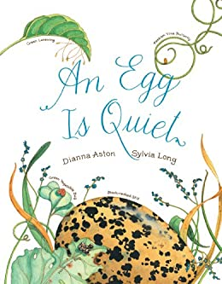
An Egg is Quiet
By Dianna Aston
Option 1: Read the book An Egg is Quiet.
Option 2: Watch An Egg Is Quiet Read Aloud video.
Aston, D. (2014). An Egg Is Quiet. Mankato, MN: Amicus.
Notes:
Video link: https://www.youtube.com/watch?v=rtX9yf62BXU
If you have a copy of An Egg is Quiet by Dianna Aston, read it to the students. If you do not have access to the book, show students the read aloud on youtube. While you read, Students will use the I Notice/I Wonder strategy to write down observations, important details, and questions they think about as the teacher reads.
Afterwards, allow students to look back through the book if they need to revisit it. In pairs, have students share what they've written and revisit the book (or copies of pages of the book) to either reinforce the observations they made or to revise them. Also use this time for students to discuss the questions they wrote and see if rereading the book answers the questions or if further investigation is needed.

Slide 6
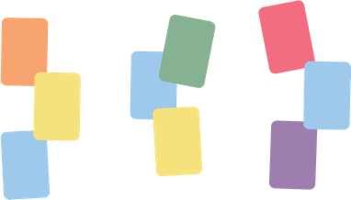
Card Sort
Set A
Group what you think is similar together.
Write on a sticky note why you grouped things together (category headings).
Rotate through to see other groupings.
Set B
Combine these with the embryos from set A.
Group what you think is similar.
Notes:
Pass out a set of 'Set A' Card Sort embryo cards (these are the ones with letters at the bottom) from the document titled Student Version Embryo Cards to groups of two or three students. Prompt the students to group together the embryos that are similar. There are no duplicates, so each is a unique animal, but possible categories could be mammals, reptiles, amphibians, etc. Some students will think these are similar animals, but in different developmental stages. Try to leave it open-ended and leave the prompt as 'group what you think is similar together' if possible. When students are done, have them do a modified Gallery Walk, where students write why their group decided the card groupings on "Post-it" Notes as category headings. The groups then rotate and read the other groups' ideas. When a full rotation through has happened, give time for students to decide if they want to change their original groupings or not.
Teacher Note: This is a very difficult task, which is the point. Let them struggle. A teacher and PowerPoint key is included, but that's for when the task is over and it's time to debrief. These moments of disequilibrium are the gateway towards opening the mind to other thinking.
Taking the idea further, pass out a set of 'Set B' Card Sort embryo cards (these are the ones with numbers at the bottom) from the same document, so that both Set A and Set B are together, to each group. Give the prompt again to create groups. Students will probably understand that the idea is to pair the embryo with the developed animal, but try not to give it away.

Slide 7
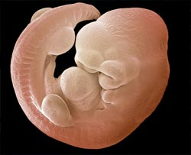
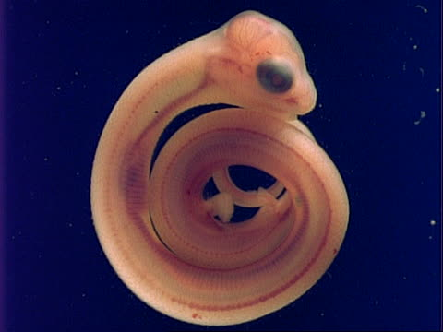
Card Sort Answers
Mouse
Snake
Notes:
The answers to what embryo is what animal is included not only as a teacher key but also in the PowerPoint (slide 6-14) to show the students when they've struggled enough. At some point reveal the answers, but try to let the struggle happen as long as possible without leaving the students too frustrated.

Slide 8
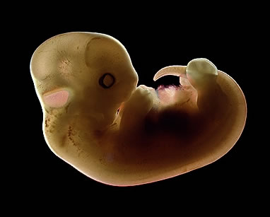
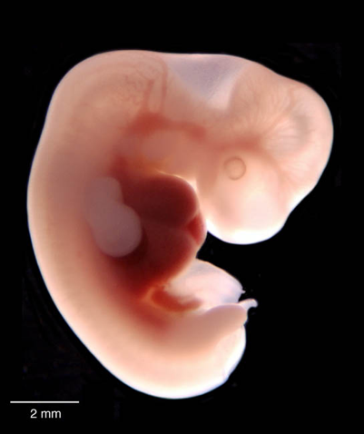
Card Sort Answers
Cat
Human

Slide 9
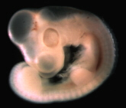
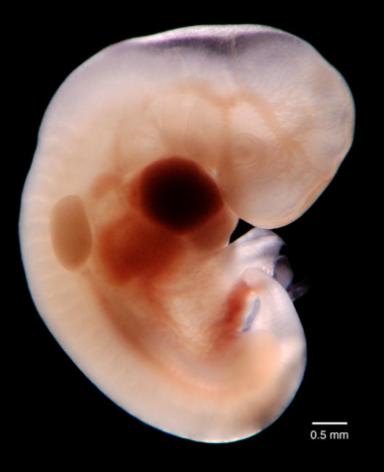
Card Sort Answers
Chicken
Elephant

Slide 10
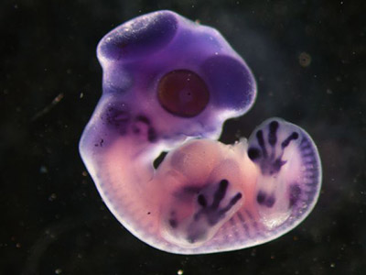
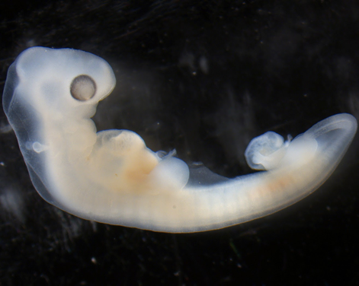
Card Sort Answers
Finch (Bird)
Turtle

Slide 11
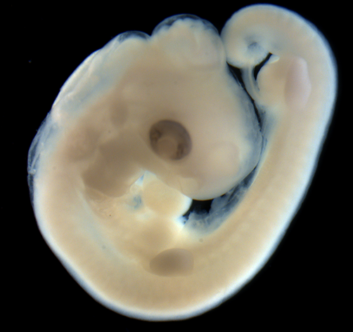
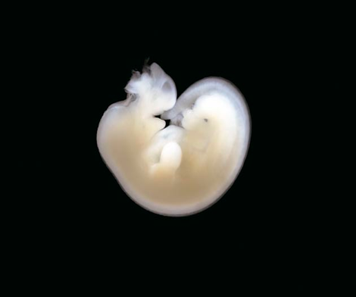
Card Sort Answers
Alligator
Horse

Slide 12
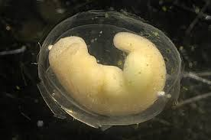
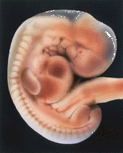
Card Sort Answers
Salamander
Rabbit

Slide 13
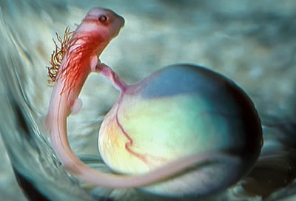
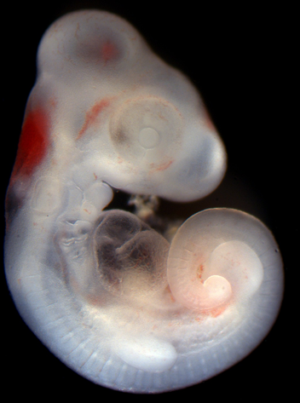
Card Sort Answers
Shark
Lizard

Slide 14
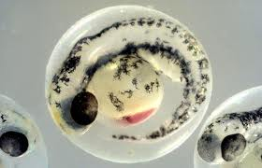
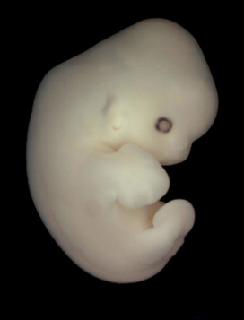
Card Sort Answers
Fish
Bat

Slide 15
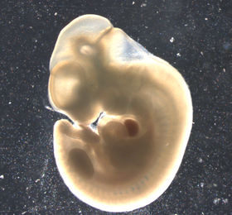
Card Sort Answers
Kangaroo
Chimpanzee

Slide 16

Claim Cards
Each person in your group…
Has a claim card and reads their claim.
Based on the card sort, supports or refutes each claim
Notes:
Pass out slides 2-5 of the "Embryo Claim Cards" to each group of four. Students will use the Claim Cards strategy, so give each student a claim. Taking turns in their groups, they read their claim and either support the claim or refute it based on the evidence from their Card Sorts in Explore. Responses are then shared with the whole group.

Slide 17
Claim #1 Analyzed
Animals start as pre-formed, microscopic versions of themselves, and just grow bigger. That is, a mouse embryo would look like a tiny mouse that would grow into a bigger mouse before being born.
This is called the Preformation Theory, or Preformationism.
Was popular in the 16th and 17th centuries until microscopes were utilized.
A reproduction of a drawing from 1695 of a tiny person inside a sperm, which is what preformationism believed was true

Slide 18
Claim #2 Analyzed
The more general parts of animals appear earlier in the embryo than the more special parts. From the most general forms the less general are developed, and so on, until finally the most special arises.
This is the first half of Von Baer’s Laws of Embryology, which was first introduced in 1828.
In this picture, the earliest (or youngest) embryo are at the left. The left embryo is the most basic. As the embryo develops, the chicken become more specialized.

Slide 19
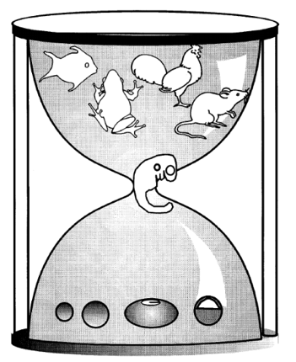
Claim #3 Analyzed
An embryo will go through all the different evolutionary kinds of animals within its history before ending as the final animal (for example, a gorilla embryo would start like a parasite embryo, then like a fish embryo, then
like an amphibian embryo, then finally
be most like a gorilla embryo).
This is called the Recapitalization Theory,
first introduced by Haeckel in 1868. It says
that all animals go through every previous
evolutionary version while an embryo.
Even though, as we’ve explored, most
embryos are very similar and go through a
very similar progression, in 1997 a
detailed study was published showing
that the physical similarities aren’t because
of past versions, since similar looking embryo
structures turn into very different organs.
The old idea that all embryos started out exactly the same with all animals, then change into different animals as they develop

Slide 20
Claim #4 Analyzed
Every embryo of all species, instead of passing through the other species, rather becomes separated from them as the embryo develops.
This is the second half of Von Baer’s Laws of Embryology.
Just as embryos develop from basic to complex, they don’t develop complex parts of other species, just complex parts for just their species.
The earliest embryos on top and the later versions at the bottom. The early embryos are very similar, but as they develop they each develop specific characteristics, not developing all characteristics then losing some.

Slide 21
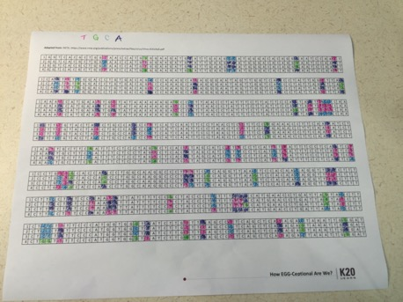
DNA Comparison
Using colored pens or markers, look through the nucleotide sequence.
Reference the questions on the back of the handout for inspiration on how to “process” the sequence.
Notes:
Pass out the DNA Comparison worksheet to students. Offer colored pens or markers and prompt the students to look through and 'process' the data with a partner. There are questions on the back that can provide inspiration for the students but allow students to explore the nucleotide sequences on their own. A picture of an example is included in the Extend section.

Slide 22
BLAST Lab
This is a partial inquiry lab, so there will be times that you have to think of next steps on your own an execute them.
BLAST is a database for genome comparison; this is a practical resource and not an education resource.
What does this mean for you? What will you have to keep in mind?
Notes:
The Blast lab is investigation 3 prescribed by the AP Biology Lab Manual. A friendly tip: this lab generally starts off rough but gets better. As the facilitator, you should try out the complete lab before students to better troubleshoot for them.

Slide 23
BLAST Lab – Pre-lab
This is not the most intuitive lab.
None of the pre-lab questions or online activities are specifically assigned, but read through them and gauge your comfort with what is being talked about.
You can always go back and try things; the intensity of this lab increases rapidly, and you may want to loop back to reorient yourself.

Slide 24
BLAST Lab - Procedures
You are making a hypothesis of where this fossil belongs in the phylogenic tree.
Follow the steps in your lab handout for comparing genomes *Read the steps carefully and execute them exactly*
Remember: BLAST offers similarity of genome only. Remind yourself what that means and what it doesn’t mean.

Slide 25
BLAST Lab – Your Procedures
The previous investigation was to help you get familiar with BLAST and how to interpret.
The ‘Example Procedure’ is just that: an example.
You need to construct similar procedures with a gene of your choice.
Your goal is to answer the questions for consideration on the last page using your BLAST analysis as the evidence.
Remember: BLAST offers similarity of genome only. Remind yourself what that means and what it doesn’t mean.

Slide 26
Free Response Question
This is a long question – pace yourself at 22 minutes to answer.
10 points are available for this question.
Remember: bolded verbs are important, and all must be addressed. They give clues of where points will be most weighted.
This is a moderate difficulty question. You can do this! Shake off jitters when you need to, keep trying.
Notes:
Individually, have students answer the free response question (AP Evolution FRQ Evaluate) in the attachments. Only give them 22 minutes to answer the question. Technically, more time can be given if generosity is needed, but students at least need to be informed of when 22 minutes have passed, because that is the pacing guidelines set by College Board. A key is provided in the attachment, along with scoring guidelines (do NOT give students the key until after the question is given, and it is highly recommended to not let it leave your classroom).

Slide 27
