Slide 2
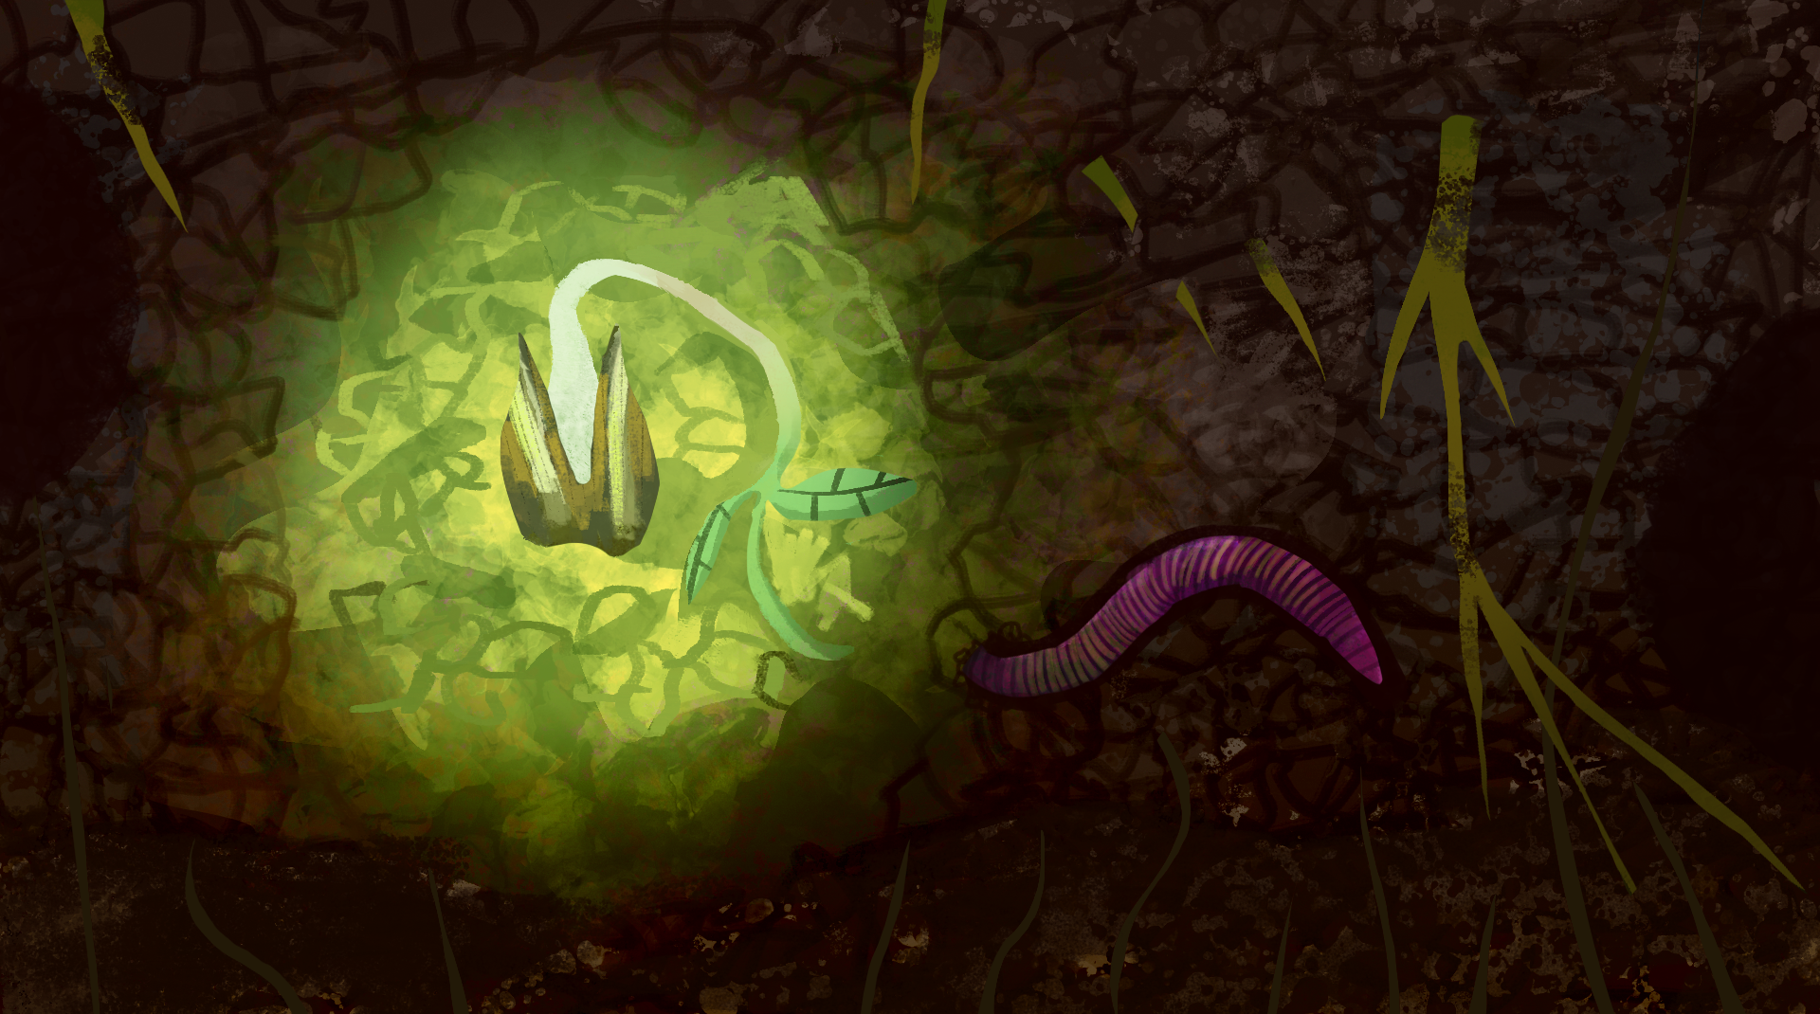
How Does Your Garden Grow?
Conservation, Ecosystems, and Soil Health

Slide 3
Essential Question
Why should we care about soil health?

Slide 4
Learning Objective
Construct an evidence-based scientific explanation for how soil health factors influence the growth of organisms.

Slide 5
Photo Deconstruction
Examine the four photos on the next slide and consider:
What do you observe in each photo?
What are some causes of the things you observed?
What do the healthy plants have that the unhealthy plants do not have?
Notes:
K20 Center. (n.d.). Photo or picture deconstruction. Strategies. https://learn.k20center.ou.edu/strategy/140

Slide 6
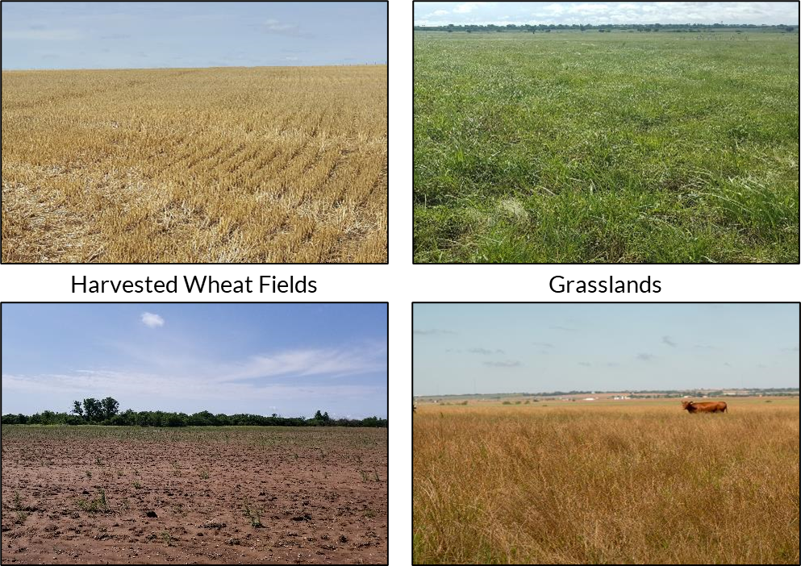
What do you notice? What is the cause?
Notes:
Shaffery, H. (2018). [Photograph series of harvested wheat fields and grasslands]. Grazinglands Research Laboratory.

Slide 7
Summarize the images.
Notes:
Shaffery, H. (2018). [Photograph series of harvested wheat fields and grasslands]. Grazinglands Research Laboratory.

Slide 8
Assessing Soil Chemistry
Lab Investigation

Slide 9
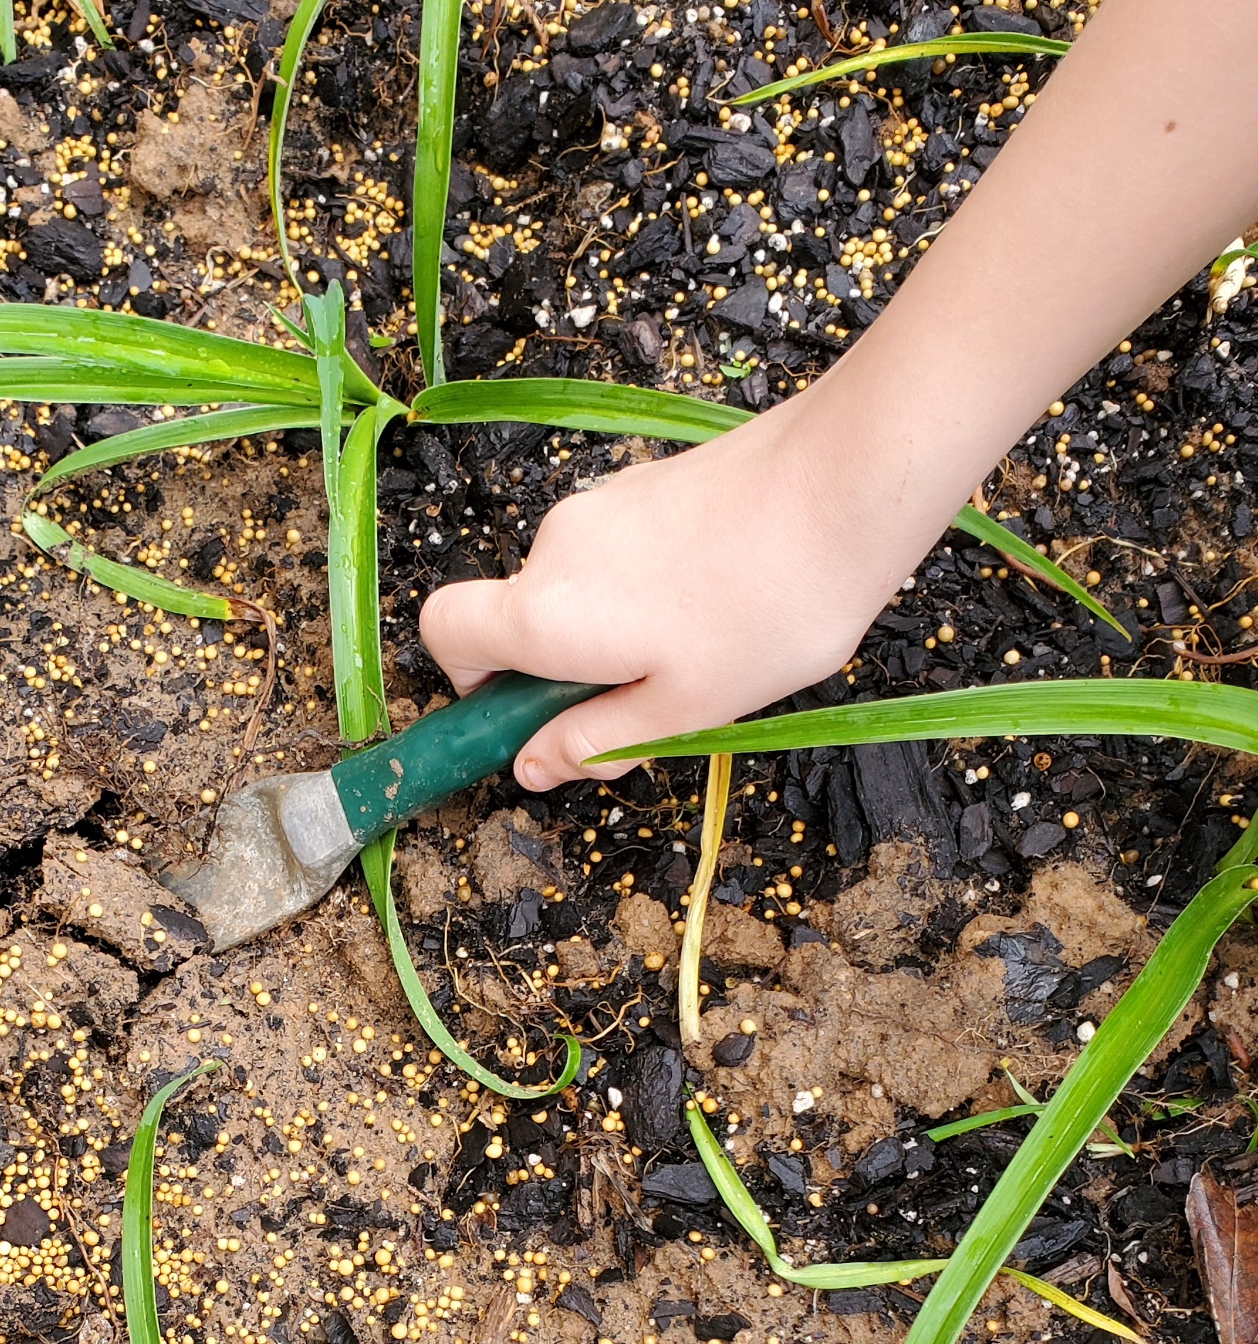
Soil Chemistry Investigation: Preparing the sample
Add 100 mg of soil and 200 mL of water to your beaker.
Stir the solution to blend the soil and water.
Use a different stirring utensil for each soil sample.
Let the soil and water mixture sit overnight.
Notes:
Shaffery, H. (2018). [Photograph of a hand digging in soil]. Grazinglands Research Laboratory.

Slide 10
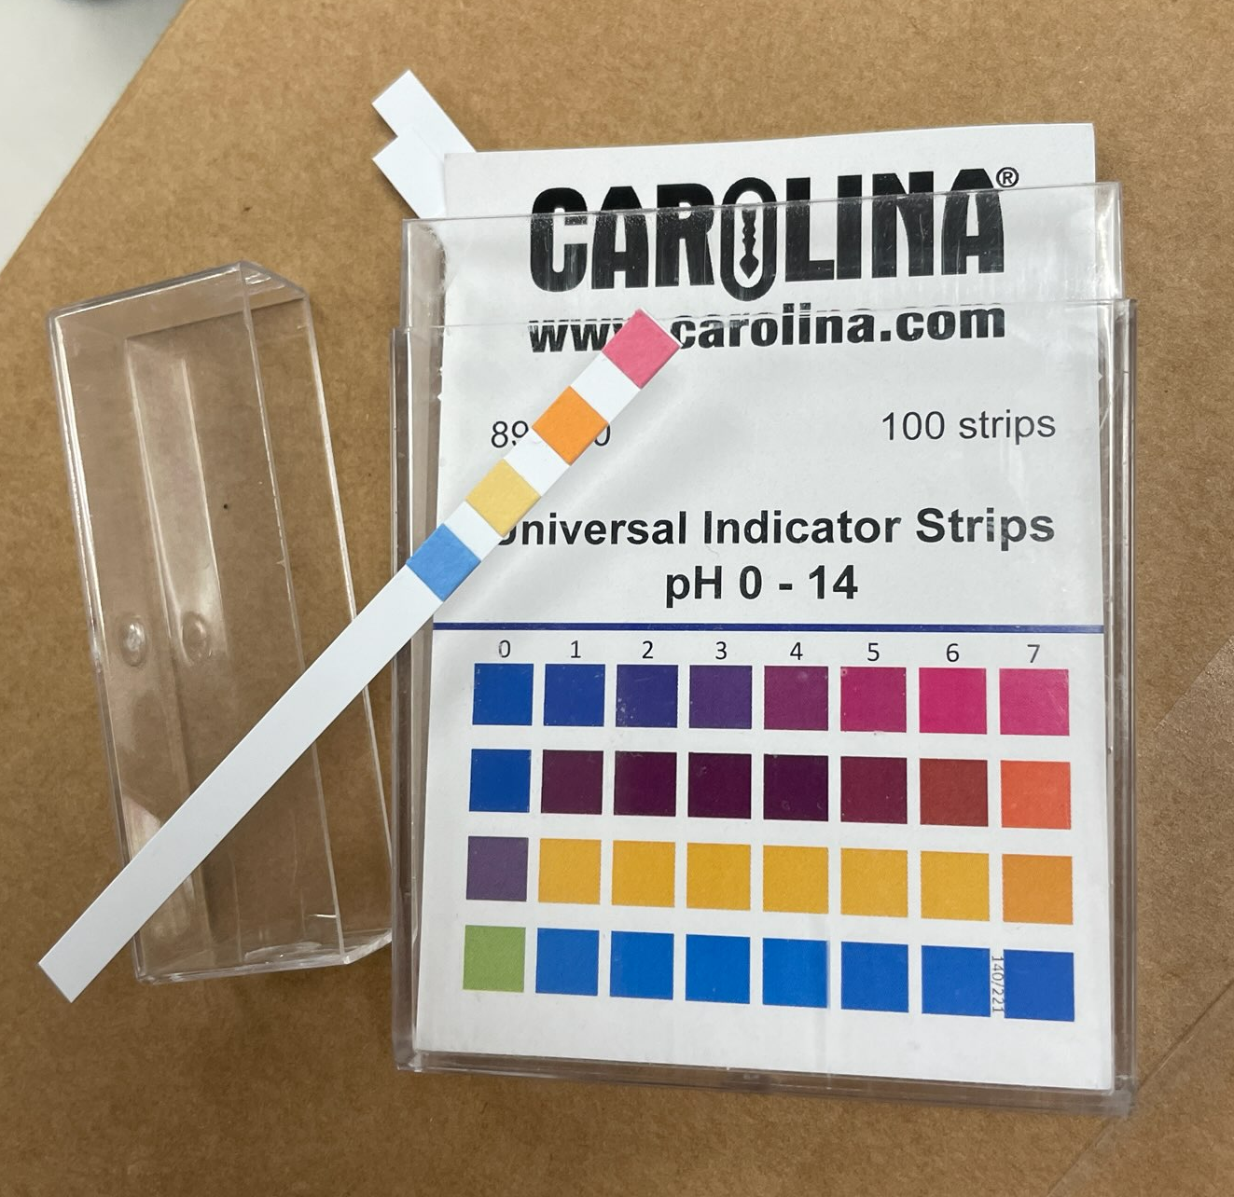
Soil Chemistry Investigation: Recording the data
Record each soil sample type in your data table.
Dip each test strip into the sample solution.
Do not touch the sample with your fingers.
Do not put more than ½ the pH strip in the sample.
Wait for 50–60 seconds.
Compare the colors of your strip to the color chart.
Record the measurement in your table.
Repeat for each sample.
Notes:
Powell, D. (2024). pH strips [Photograph].

Slide 11
Soil Chemistry Clean-Up
Wipe down your table.
Throw away garbage and gloves.
Notes:
Powell, D. (2024). pH strips [Photograph].

Slide 12
Investigating Soil and Soil Health
Online Research

Slide 13
Soil and Soil Health Research
Navigate to this website: https://bit.ly/4ebB8yX
Visit each resource to learn more about soil and soil health.
Record facts from the resources in the first three boxes of your Window Notes handout.
Put each fact under one of the headings labeled Soil Properties, Soil Health, or Soil Chemistry.
Ask for help if you don’t know how to categorize a fact.
Leave the Nutrient Cycles box empty.
Notes:
K20 Center. (n.d.). Wakelet. Tech Tool. https://learn.k20center.ou.edu/tech-tool/2180
K20 Center. (n.d.). Window notes. Strategies. https://learn.k20center.ou.edu/strategy/189

Slide 14
Discussion

Slide 15
Soil and Soil Health Research
What is soil?
How do we describe soil?
How do we know if soil is healthy?
What are the benefits of having healthy soil?
What soil management practices or strategies can improve soil health?
Notes:
K20 Center. (n.d.). Anchor charts. Strategies. https://learn.k20center.ou.edu/strategy/2364

Slide 16
Breakout Rooms

Slide 17
Breakout!
Visit bit.ly/gardengrowbreakout
Use information about nutrient cycles to find codes.
Enter the codes into the form at the bottom of the page.
Read the articles, analyze images, and collaborate to find codes.
Record facts you learn from the activity under the Nutrient Cycles box on your handout.
Soil Properties | Soil Health
Soil Chemistry | Nutrient Cycles
Notes:
K20 Center. (n.d.). How does your garden grow breakout. https://sites.google.com/ou.edu/gardengrowbreakout/home

Slide 18
Three Sticky Notes
Word
On one sticky note, summarize what you learned during the breakout activity using a single word.
Notes:
K20 Center. (n.d.). Three sticky notes. Strategies. https://learn.k20center.ou.edu/strategy/153

Slide 19
Nutrient Cycles
Phrase
On another sticky note, summarize what you learned during the breakout activity using a short phrase (less than ten words).
Notes:
K20 Center. (n.d.). Three sticky notes. Strategies. https://learn.k20center.ou.edu/strategy/153

Slide 20
Discussion
Share out your words and phrases.
Add any new information to your Window Notes.

Slide 21
Soil Health
Sentence
On another sticky note, use one sentence to describe how nutrient cycles, soil health, and soil management practices relate to each other.
Notes:
K20 Center. (n.d.). Three sticky notes. Strategies. https://learn.k20center.ou.edu/strategy/153

Slide 22
Soil Health and Plant Growth
In your groups, write a question that tests one of the following:
What soil conditions (e.g., pH, N) will give plants the perfect amount of resources for growth.
OR
How a soil management strategy affects plant growth.

Slide 23
Investigation
Notes:
Teacher’s Note: Add instructions to this slide based on the guidelines you choose for the class investigation. Provide instructions for the type of research, if any, students must conduct.

Slide 24
Growing Plants
Materials
Plastic cups
Soil
Seeds
Tray for cups
Container for water
Set-Up Steps
Punch holes in the bottom of the plastic cups for water to drain out.
Fill each cup with soil.
Plant seeds in each cup.
Create a schedule for watering and lighting.
Notes:
Shaffery, H. (2018). Growing cups [Photograph]. Grazinglands Research Laboratory.

Slide 25
Collecting Data
How will you know there are differences between your plants?
What will you measure?
How will you measure it?
How will you make sure you take pictures the same way every day?
How will you know which conditions were “best” for your plants?

Slide 26
Investigation Presentation
Soil Conditions
Soil Management
Include:
How soil health and nutrient cycles affect plant growth.
How your soil management and nutrient cycles work together to make soil healthier.
Include:
How soil health and nutrient cycles affect plant growth.
How soil would gain or develop the resources to meet plant needs.

Slide 27
Investigation Presentations
Develop a presentation about your investigation.
Notes:
Teacher’s Note: Add any material- or classroom-specific instructions for presentations to this slide.

