Slide 2
How Does Your Garden Grow?
Conservation, Ecosystems, and Soil Health

Slide 3
Essential Question
Why should we care about soil health?

Slide 4
LEARNING OBJECTIVE
Construct an evidence-based argument that explains how an increase in human population affects our consumption of natural resources and impacts soil health.
Notes:
MS-ESS3-4 (8th grade)
DCI: Human Impacts on Earth Systems:
Typically, as human populations and per-capita consumption of natural resources increase, so do the negative impacts on Earth unless the activities and technologies involved are engineered otherwise.
SEP: Engaging in argument from evidence
Construct an oral and written argument supported by empirical evidence and scientific reasoning to support or refute an explanation or a model for a phenomenon.
CCC: Cause and Effect
Cause and effect relationships may be used to predict phenomena in natural or designed systems.

Slide 5
Photo/Picture Deconstruction
After examining the four photographs on the next slide, reflect on the following:
What do you observe in each of the photographs?
What are potential causes for what you have identified?
What do you think the healthy plants have that the unhealthy plants do not?
Notes:
K20 LEARN (https://learn.k20center.ou.edu/strategy/140

Slide 6
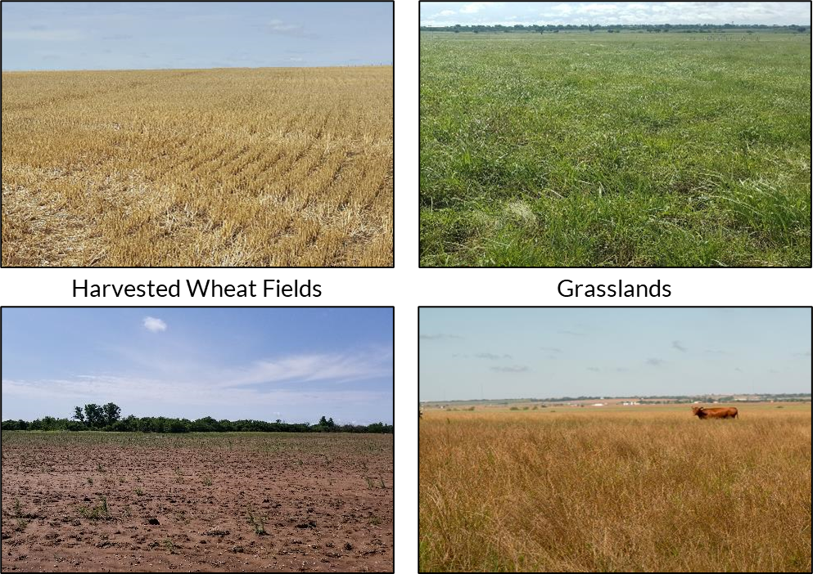
What do you notice? What is the cause?
Notes:
Show the students the series of pictures of soil and plants in different soil health conditions (healthy harvested field, bare field, plants growing in healthy and unhealthy soil). Have students do a photo deconstruction reflecting on what they observed in each photo, the potential causes for differences they notice, and what the healthy plants might have that the unhealthy plants do not.
If students do not make a connection between soil and healthy plants, guide part of the conversation toward what the plants are growing in (i.e., soil). While plants do not require soil to grow, in these cases soil is where the plants are taking in many necessary nutrients.
Photo Deconstruction: https://learn.k20center.ou.edu/strategy/d9908066f654727934df7bf4f5065b32
Photos: Heather Shaffery

Slide 7
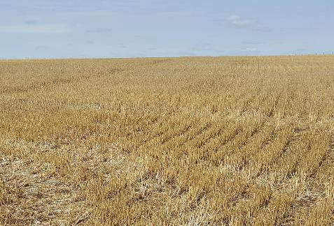
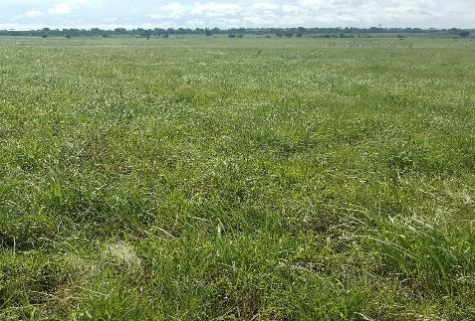
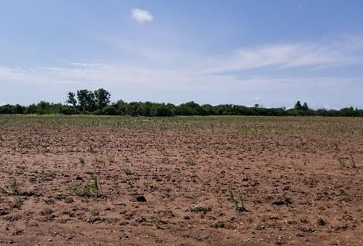
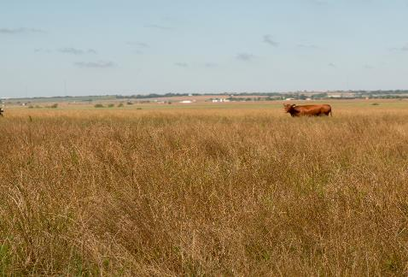
Summarize in one sentence what you think you know about these images.
Harvested Wheat Fields
Grasslands
Notes:
After the discussion, ask students to summarize what they think they know about the images in one sentence. Effective sentences should summarize the big takeaway each student gets from the conversation.

Slide 8
ASSESSING SOIL CHEMISTRY
Lab Investigation
Notes:
Now that the students have a sense that soil may be important to plant health, they will test the soil types to determine the level of the nutrients present. Have students analyze each soil sample, making sure to record the data for the most common soil chemistry tests: soil pH; and Nitrogen, Phosphorus, and Potassium levels.
Soil Samples
Have students collect soil samples from possible garden sites around campus. You may have students collect soil from multiple sites to use as a comparison. Students may even bring soil sample from home to test.
Preparing the Soil Samples: All of the tests require a soil solution which is best to prepare at least a day before to get better results due to the nutrients leaching into the water.
Have the students create a soil solution by adding 100 mg of soil and 200 mL of water to a beaker or other container.
Now have the students use the stirring rod or sticks to blend the mixture.
Ensure that students clean the stirring rod thoroughly or use a different stirring utensil for each soil sample.
Testing the Soil Samples
Provide each group with a copy of the “Soil Investigation Handout.”
Prep Note: Edit the table to include the soil types the class has collected and any additional soil chemistry variables you may be testing.
Based on the specific directions for the soil test kit/materials you have purchased, review the procedure for soil testing with your students.
Prep Note: If you are using test strips that require a color comparison, it might be necessary to filter the water sample before collecting data. This is particularly true for nitrogen test strips. Depending on how murky the soil makes the water, it is usually clean enough after 2-3 rounds of filtering through a double or triple layer of coffee filters.
Safety Note: If your kit requires the use of chemicals, be sure to check the SDS in advance for safety and disposal procedures.
Have students document their process and results by taking photos using in-class technology (e.g., Chromebooks, tablets, digital cameras) or their phone’s camera.

Slide 9
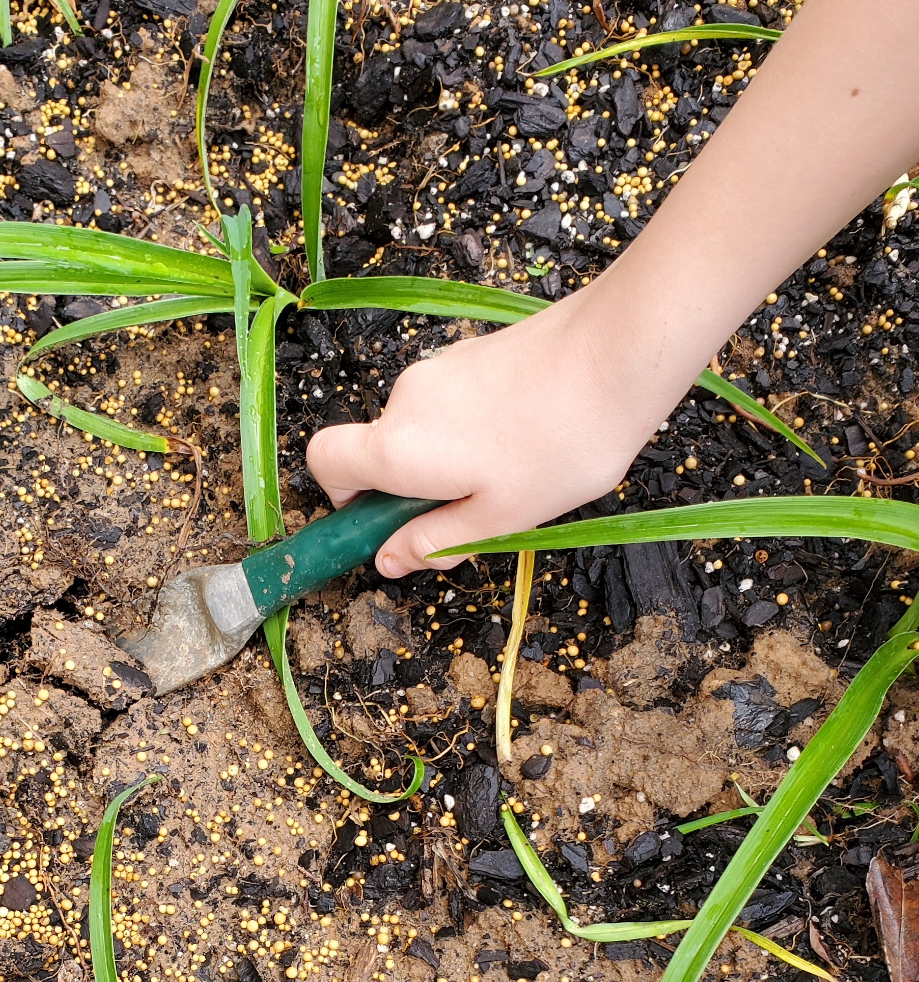
Soil Chemistry Investigation: Preparing the sample
Add 100 mg of soil to 200 ml of water to your breaker.
Stir the solution to blend the soil and water.
Use a different stirring utensil for each soil sample.
Let the soil and water mixture sit overnight.
Notes:
Source: Photograph by K20 Center.

Slide 10
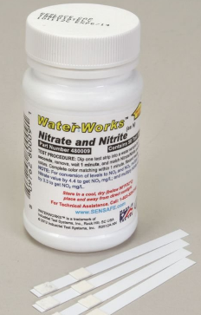
Soil Chemistry Investigation: Recording the data
Record the soil water sample type in your data table.
Dip each test strip into the sample solution.
Do not touch the sample with your fingers or put more than ½ the pH strip in the sample.
Wait for 50-60 seconds.
Compare the color of your strip/pads on the strip to the color chart as soon as time is up.
Record the measurement in your table.
Repeat for the next sample.

Slide 11
Soil Chemistry Clean-Up
Wipe up any messes on your table.
Throw away garbage and gloves.
Notes:
Clean-Up
Have students clean up any soil and water messes and wash up surfaces as necessary.
Unless the testing materials have specific disposal instructions, trash and soil water can be disposed off in the regular trash and sink.
If any chemicals were added to the water samples, do not pour them down the drain without consulting their SDS sheets for disposal procedures.
To avoid clogs, do not pour any water that still has soil/sediment in it down drains.
Gloves should be removed by turning them inside out. (See a demonstration here if you are unfamiliar with the technique.) Goggles should be wiped clean/disinfected before being put away.

Slide 12
INVESTIGATING SOIL AND SOIL HEALTH
Online Research

Slide 13
Soil and Soil Health Research
Use the Explore Resources to conduct your research.
Notes:
Provide students a copy of “Explore Resources” handout, on paper or digitally.
Note: Several of the sources are YouTube videos which may require headphones or physical distance to avoid disturbing other working groups.

Slide 14
Soil and Soil Health Research
Soil Properties | Soil Health
Soil Chemistry | Nutrient Cycles Don’t write anything here yet!
Record what you learn in the first three boxes of your Window Notes sheet
Put the information under the correct headings.
If you aren’t sure where it belongs, be sure to ask!
Leave the Nutrient Cycles box empty.

Slide 15
Soil and Soil Health Research
What is soil?
How do we describe it?
How do we know if soil is healthy?
What are the benefits of having healthy soil?
What soil management practices or strategies can improve soil health?
Notes:
Create an anchor chart summarizing student findings for each of the three boxes they have filled in on their Window Notes.
These example questions can be used to help facilitate class discussion.
This is not a comprehensive list and the order of the questions doesn’t matter.
Add other relevant questions as necessary to scaffold students’ summaries.
Note: The purpose of this discussion is just to summarize the class’s research. Higher order questions should be saved for the Explain discussions when students are synthesizing information.

Slide 16
Anchor Chart
Create an anchor chart for each of the four windows in the Window Chart.
Include information on Soil Properties, Soil Health, and Soil Chemistry.
Leave the window on Nutrient Cycles until later.

Slide 17
Breakout!
Soil Properties | Soil Health
Soil Chemistry | Nutrient Cycles
bit.ly/gardengrowbreakout
Notes:
LINK: How Does Your Garden Grow Breakout (google.com)
The breakout should be completed collaboratively.
Students should summarize the information in the Nutrient Cycles Window Note box and add any new information to the other boxes as necessary.

Slide 18
Three Sticky Notes
Word
Phrase
Sentence

Slide 19
Nutrient Cycles
Word
Phrase
On a sticky note, summarize what you learned in the breakout using a single word.
On a sticky note, summarize what you learned in the breakout using a short phrase (less than 10 words).
Word
Phrase
Notes:
In their breakout groups, ask students to summarize what they learned from the breakout into a word and a phrase. Groups should attempt to create a single word and phrase.
If they can’t narrow it down to a single example, ask that they limit their responses to one sticky per person (e.g., a group of 3 could have up to 3 words and up to 3 phrases.)
Repeat the discussion process you used in the Explore debrief to develop a final anchor chart for Nutrient Cycles.
Ask students to share out their Words and Phrases at the beginning of the discussion.
If necessary, add any new information students discovered to the other three charts as well.

Slide 20
Soil Health
Sentence
You could write about how:
Nutrient cycles contribute to healthy soil;
Unhealthy soil might disrupt nutrient cycles;
Soil management practices can strengthen natural nutrient cycles;
Soil management practices can affect soil health.
One a sticky note, in 1 sentence describe a way nutrient cycles, soil health, and soil management practices relate to each other.
Sentence
Notes:
Now that students have familiarity with all the relevant content, they need to connect the pieces to develop a conceptual understanding.
Rather than just telling students what the connections are, help them synthesize the conceptual pieces for themselves.
As part of this process, ask students individually to write a single summary sentence over their learning up to this point on a sticky note. Their sentence should emphasize the connections among the information they've gathered during the Explore and Explain activities and discussions.
Instructional Note: The sticky-note summaries students have completed are the steps in a strategy called Three Post-It Notes. While they are typically written all at the same time, this lesson is scaffolds them to support the complexity of the synthesis students are doing.
Instructional Note: There are other ways to direct students' knowledge construction, but they should at least work out the connections provided on the slide.
Three Post-It Notes: https://learn.k20center.ou.edu/strategy/d9908066f654727934df7bf4f506d92f

Slide 21
Concept Card Mapping
Create either hand-drawn or digital concept maps.
If making hand-drawn maps, use physical card that is glued down.
Draw lines or paste string on hand-drawn maps to show connections among ideas.
As a whole class, you might consider using string to physically connect concepts found on the four anchor charts.
Notes:
K20 Center. (n.d.). Concept card mapping. Strategy. https://learn.k20center.ou.edu/strategy/d9908066f654727934df7bf4f505c351
Create Your Mind Maps Online - On Any Device | MindMeister
Cmap Cloud (ihmc.us)

Slide 22
Metaphorical Thinking
Create your own metaphors to explain the connections you are making.
Notes:
K20 Center (n.d.). Metaphorical thinking. Strategy. https://learn.k20center.ou.edu/strategy/d9908066f654727934df7bf4f5068fc

Slide 23
Cognitive Comics
Use three-paneled frame to express your understanding of the connections between soil and its impact on the growing cycle.
You may be asked to display your comic strip for a gallery walk or a brief presentation to the whole class.
Notes:
K20 Center. (n.d.). Cognitive comics. Strategy. https://learn.k20center.ou.edu/strategy/fe96d3de46cfdc1f385aab7e7500a422

Slide 24
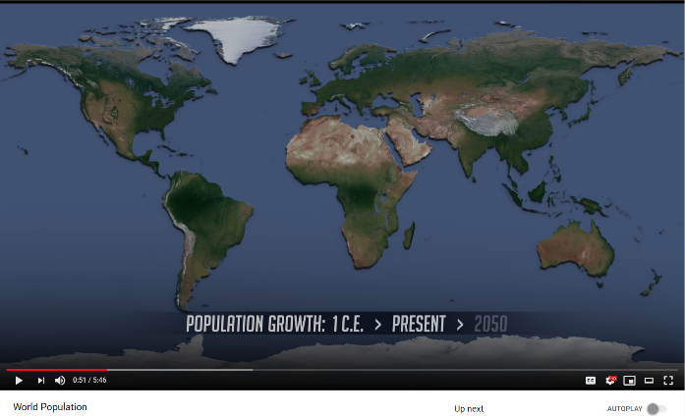
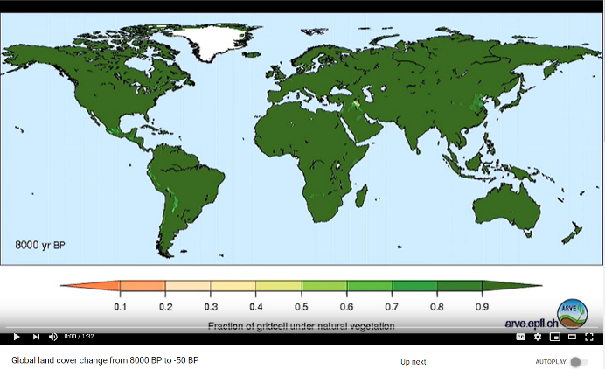
World Population and Land Use
World Population Change
Land Cover Change
Notes:
MS-ESS3-4 (8th grade)
Show students the World Population video (population simulation begins at 0:44) followed by the Global Land Cover Change video.
Ask them to explain how the two videos relate to one another
"As population increases, we use up more natural land."
Global Land Cover Change: https://www.youtube.com/watch?v=gBTlIaf12-4
World Population: https://youtu.be/khFjdmp9sZk?t=44

Slide 25
H-Chart Comparison
Take notes on the first video on the left side of the H-Chart.
Take notes on the second video on the right side of the H-Chart.
Show the relationships between the two videos on the middle bar of the H-Chart.
Be prepared to share out your conclusions in a whole class discussion.
Notes:
https://learn.k20center.ou.edu/strategy/132

Slide 26
Threats to Soil Health
Brainstorm in small groups an answer to the following question: In what ways could increased population size and land use impact soil health?
Pick a threat to research from your own notes or from a list that is provided to you.
Analyze the threat using the Threat Research handout.
Notes:
MS-ESS3-4 (8th grade)
Have students brainstorm some ways increased population size and land use might impact soil health.
Students should choose a potential threat to soil health from either their list, a list you provide to them, or through their own independent research.
Have students research the threat and answer three questions:
How does the threat damage soil health?
What causes the threat?
How can the threat be avoided, mitigated, or eliminated?

Slide 27
Threats to Soil Health
Research your threat online.
Record information that helps answer the following questions:
How does the threat damage soil health?
What causes the threat?
How can the threat be avoided, mitigated, or eliminated?
Mitigate:
to make less severe or serious
Notes:
MS-ESS3-4 (8th grade)
Give students time to research their threat of choice in order to answer the following questions:
How does the threat damage soil health?
What causes the threat?
How can the threat be avoided, mitigated, or eliminated?

Slide 28
Public Service Announcement (PSA)
“A PSA (Public Service Announcement) is a short informational clip that is meant to raise the audience’s awareness about an important issue.”
Characteristics of an effective PSA:
Short and clear
Stay on topic
Supported by factual evidence
Meant to encourage audience sympathy
Notes:
MS-ESS3-4 (8th grade)
Source: –Media Commons @ Penn State University
Community Tool Box (https://ctb.ku.edu/en/table-of-contents/participation/promoting-interest/public-service-announcements/main) recommends a series of steps for producing a PSA. It is very long, but one key suggestion is to limit the word count of a PSA to 20-25 words for every 10 seconds of video.
How To
How to Make a PSA: https://youtu.be/eywBa0xfQFw
Examples (1:00 or less)
(Student Made) PSA on Water Consumption: https://youtu.be/94Ve2vctL9c
Let Her Learn: https://youtu.be/9FKUNLrMXic
Bully Bystanders: https://youtu.be/L7b2AC9R460
Cyberbullying: https://youtu.be/2dlKgIieK_0
Don’t Text and Drive: https://youtu.be/eywBa0xfQFw
Cyberbullying (If you wouldn't say it in person): https://youtu.be/zRUFvQ_25eg
G.I. Joe - Teamwork: https://youtu.be/lR9OY8Nh1NM
Don’t Almost Give: https://youtu.be/PiYYpEmiq24
Stranger Danger (80s): https://youtu.be/9mEQmrw6JpA
MR. T Anti Drug (80s): https://youtu.be/FJiTxtcW-is

Slide 29
PSA About Soil Health: What’s the Point
Tell the audience:
About dangers to soil health cause by your threat
Advocate for the benefits of improved soil health by (a) preventing the threat OR by (b) emphasizing the consequences of not protecting the soil from the threat
Include a synthesis of what you have learned throughout the lesson.
Notes:
MS-ESS3-4 (8th grade)
As a final presentation, ask students to create a Public Service Announcement about the dangers posed to soil health.
They may choose to create their PSA from a stance advocating for the benefits of improved soil health or highlighting the threat of not protecting the soil from their particular threat.
A Two-Minute Documentary or similar format would be appropriate for this activity.
The PSAs should synthesize what students have learned throughout the lesson about soil.
Two-Minute Documentary: https://learn.k20center.ou.edu/strategy/d9908066f654727934df7bf4f

Slide 30
PSA About Soil Health: Support Your Claims
Support your PSA with:
evidence and science concepts from your research
information recorded in your Window Notes
Include:
Characteristics of healthy soil
Cause of your chosen threat
Effects of your chosen threat
Ways the threat can be avoided, mitigated, or eliminated
Notes:
MS-ESS3-4 (8th grade)
Students should address
what characterizes healthy soil and
the ways in which their threat damages soil health,
what causes the threat to occur,
ways the threat can be avoided, mitigated, or eliminated

Slide 31
Public Service Announcement: Soil Health
Use this time to develop your Public Service Announcement about soil health.
Notes:
MS-ESS3-4 (8th grade)

