Slide 2
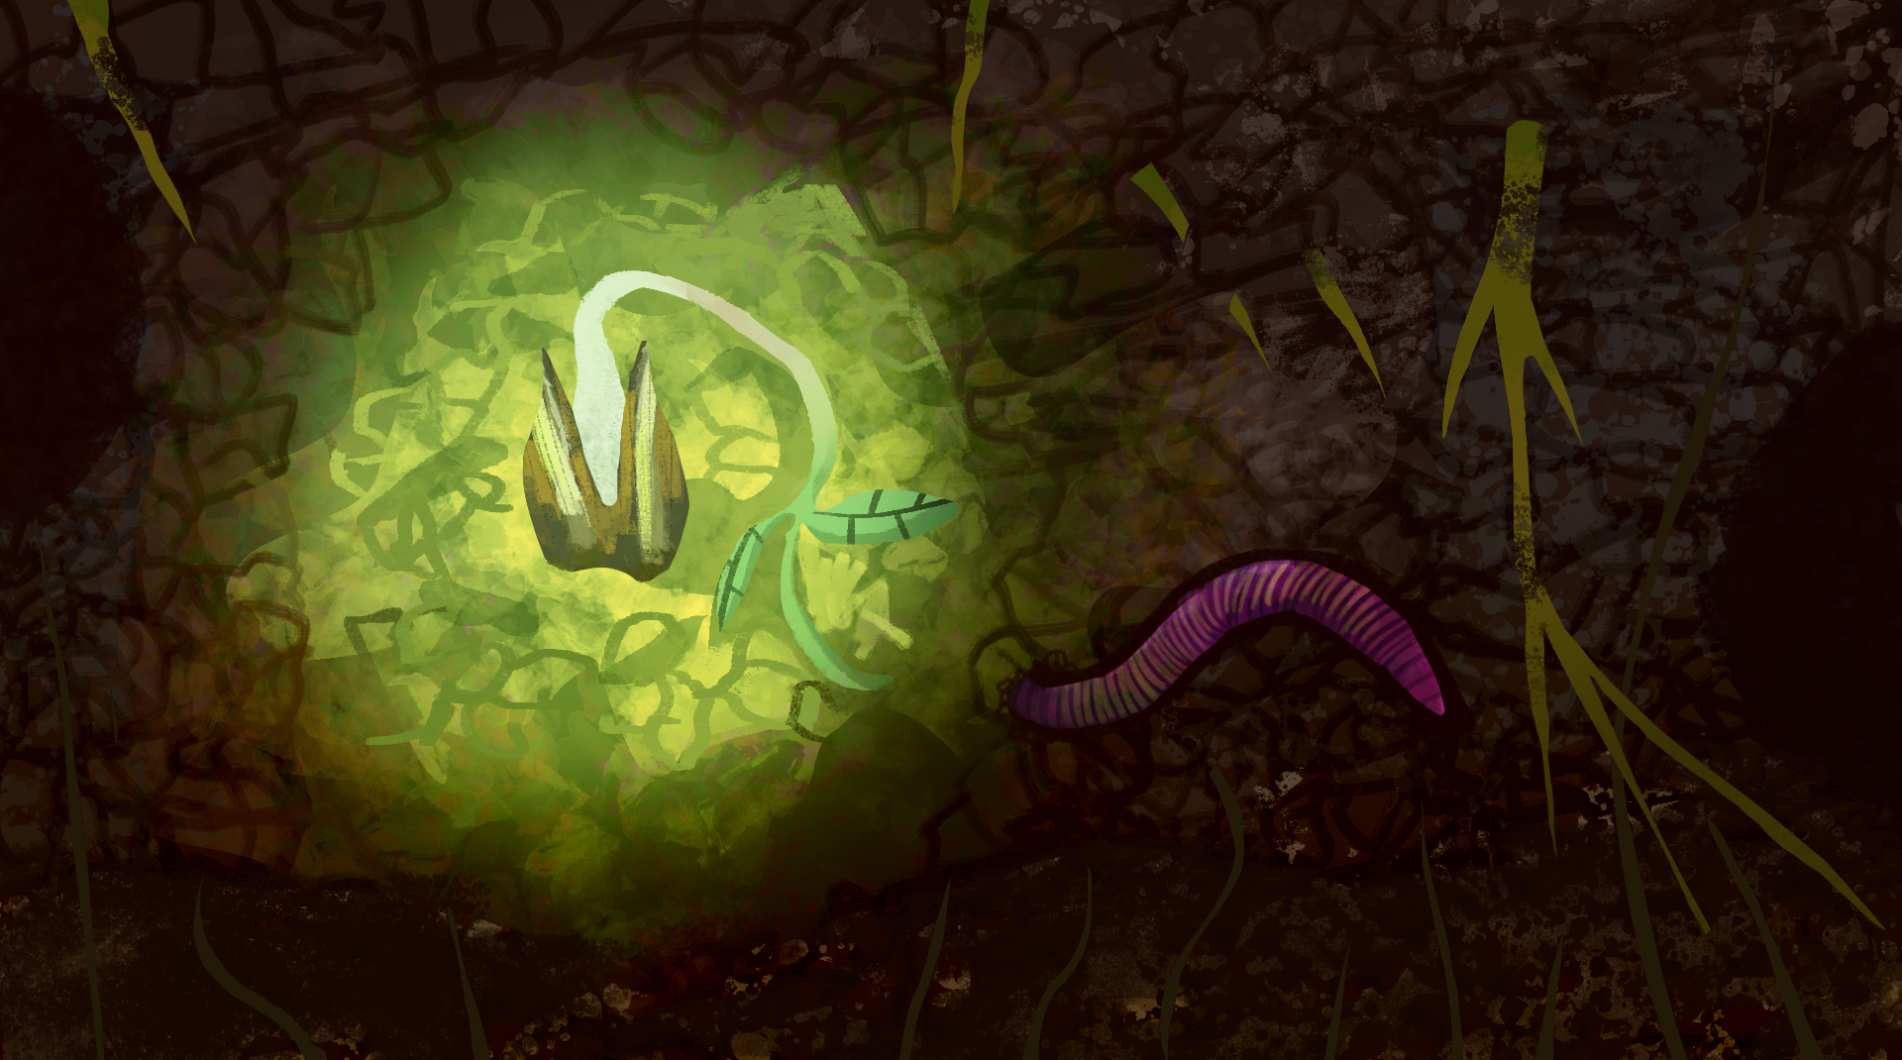
How Does Your Garden Grow?
Conservation, Ecosystems, and Soil Health

Slide 3
Essential Question
Why should we care about soil health?

Slide 4
Learning Objective
Construct an evidence-based argument that explains how an increase in human population affects the consumption of natural resources and impacts soil health.

Slide 5

Photo Deconstruction
Examine the four photos on the next slide and consider:
What do you observe in each photo?
What are some causes of the things you observed?
What do the healthy plants have that the unhealthy plants do not have?
Notes:
K20 Center. (n.d.). Photo or picture deconstruction. Strategies. https://learn.k20center.ou.edu/strategy/140

Slide 6
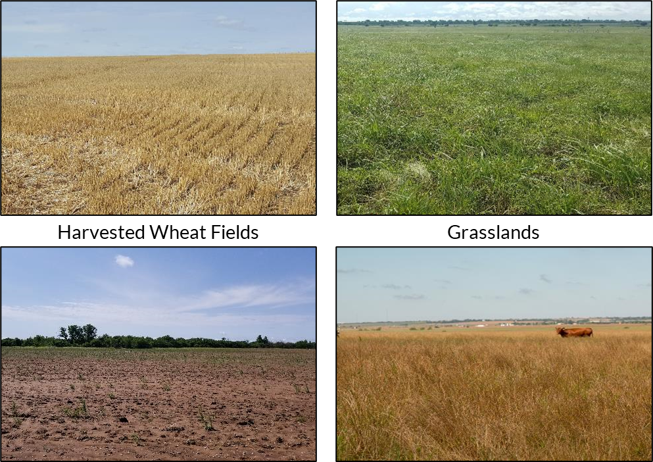
What do you notice? What is the cause?
Notes:
Shaffery, Heather. (2018). [Photograph series of harvested wheat fields and grasslands]. Grazinglands Research Laboratory.

Slide 7
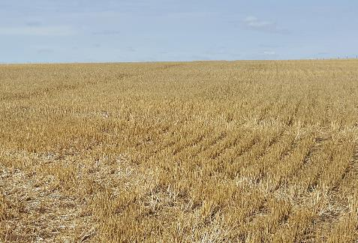
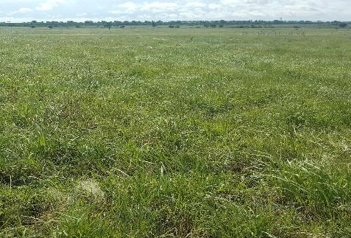
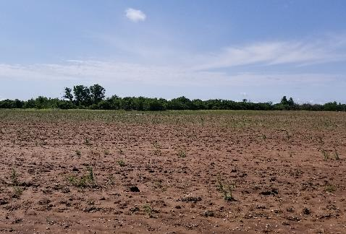
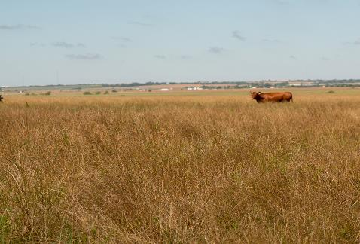
Summarize the images.
Harvested Wheat Fields
Grasslands
Notes:
Shaffery, Heather. (2018). [Photograph series of harvested wheat fields and grasslands]. Grazinglands Research Laboratory.

Slide 8
Assessing Soil Chemistry
Lab Investigation

Slide 9
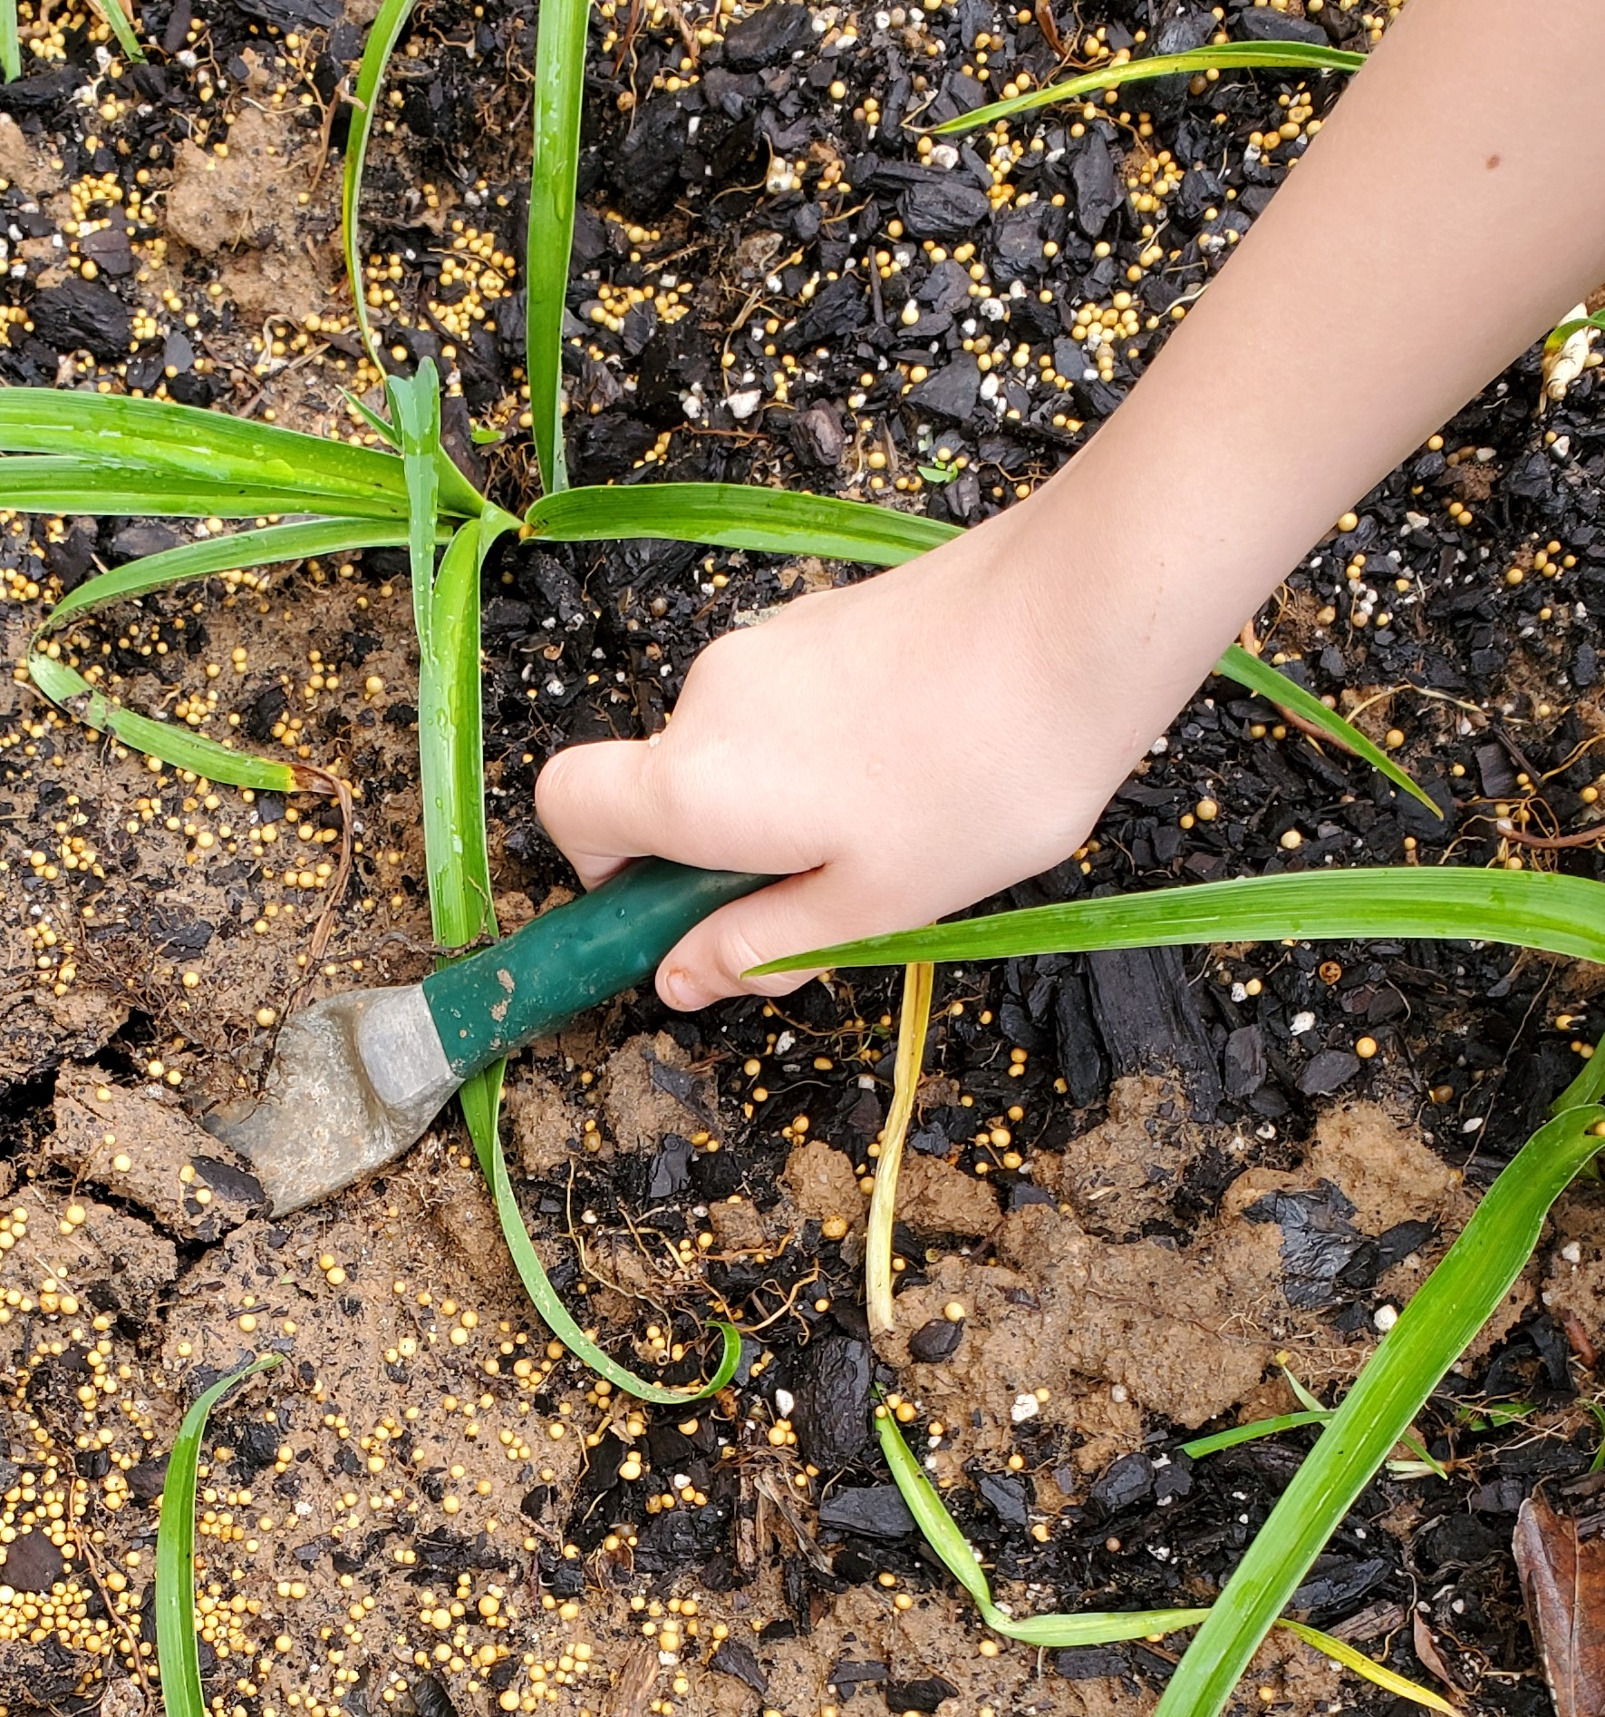
Soil Chemistry Investigation: Preparing the Sample
Add 100 mg of soil and 200 mL of water to your breaker.
Stir the solution to blend the soil and water.
  Use a different stirring utensil for each soil sample.
Let the soil and water mixture sit overnight.
Notes:
Shaffery, Heather. (2018). [Photograph of a hand digging in soil]. Grazinglands Research Laboratory.

Slide 10
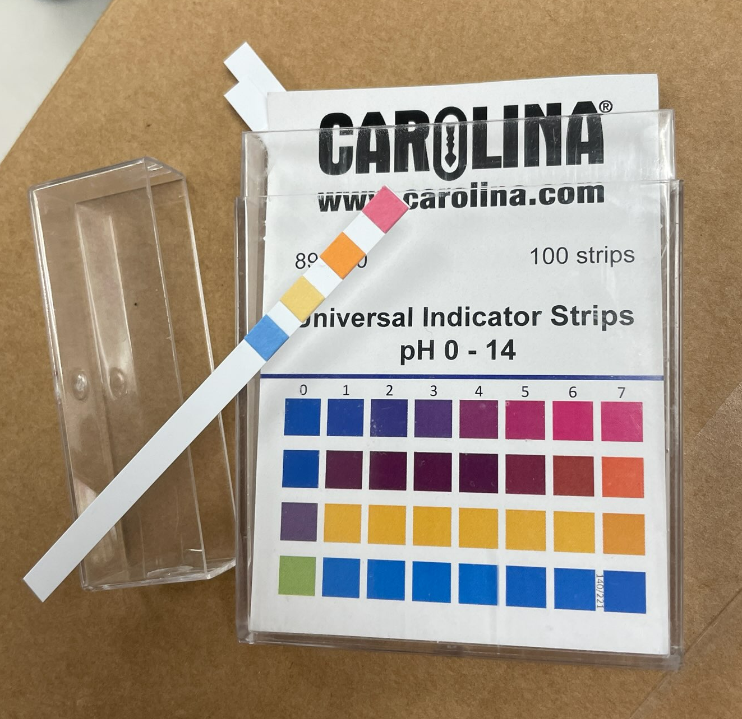
Soil Chemistry Investigation: Recording the data
Record each soil sample type in your data table.
Dip each test strip into the sample solution.
  Do not touch the sample with your fingers.
  Do not put more than ½ the pH strip in the sample.
Wait for 50–60 seconds.
Compare the colors of your strip to the color chart.
Record the measurement in your table.
Repeat for each sample.
Notes:
Powell, David. (2024). pH strips [Photograph].

Slide 11
Soil Chemistry Clean-Up
Wipe down your table.
Throw away garbage and gloves.
Notes:
Powell, David. (2024). pH strips [Photograph].

Slide 12
Investigating Soil and Soil Health
Online Research

Slide 13

Soil and Soil Health Research
Navigate to this website: https://bit.ly/4ebB8yX
Visit each resource to learn more about soil and soil health.
Record facts from the resources in the first three boxes of your Window Notes handout.
  Put each fact under one of the headings labeled Soil Properties, Soil Health, or Soil Chemistry.
  Ask for help if you don’t know how to categorize a fact.
Leave the Nutrient Cycles box empty.
Notes:
K20 Center. (n.d.). Window notes. Strategies. https://learn.k20center.ou.edu/strategy/189
K20 Center. (n.d.). Wakelet. Tech Tool. https://learn.k20center.ou.edu/tech-tool/2180

Slide 14
Discussion

Slide 15

Soil and Soil Health Research
What is soil?
How do we describe soil?
How do we know if soil is healthy?
What are the benefits of having healthy soil?
Which soil management practices or strategies can improve soil health?
Notes:
K20 Center. (n.d.). Anchor charts. Strategies. https://learn.k20center.ou.edu/strategy/2364

Slide 16
Breakout Rooms

Slide 17

Breakout!
Visit bit.ly/gardengrowbreakout
Use information about nutrient cycles to find codes.
Enter the codes into the form at the bottom of the page.
Read the articles, analyze images, and collaborate to find codes.
Record facts you learn from the activity under the Nutrient Cycles box on your handout.
Soil Properties | Soil Health
Soil Chemistry | Nutrient Cycles
Notes:
K20 Center. (n.d.). How does your garden grow breakout. https://sites.google.com/ou.edu/gardengrowbreakout/home

Slide 18

Three Sticky Notes
Word
On one sticky note, summarize what you learned during the breakout activity using a single word.
Notes:
K20 Center. (n.d.). Three sticky notes. Strategies. https://learn.k20center.ou.edu/strategy/153

Slide 19
Nutrient Cycles
Phrase
On another sticky note, summarize what you learned during the breakout activity using a short phrase (less than ten words).
Notes:
K20 Center. (n.d.). Three sticky notes. Strategies. https://learn.k20center.ou.edu/strategy/153

Slide 20
Discussion
Share out your words and phrases.
Add any new information to your window notes.

Slide 21
Soil Health
Sentence
On another sticky note, use one sentence to describe how nutrient cycles, soil health, and soil management practices relate to each other.
Notes:
K20 Center. (n.d.). Three sticky notes. Strategies. https://learn.k20center.ou.edu/strategy/153

Slide 22

H-Chart Comparison
Watch the video about changes in world population.
Take notes on the on the left side of the H-Chart.
Notes:
K20 Center. (n.d.). Paired texts H-chart. Strategies. https://learn.k20center.ou.edu/strategy/132

Slide 23
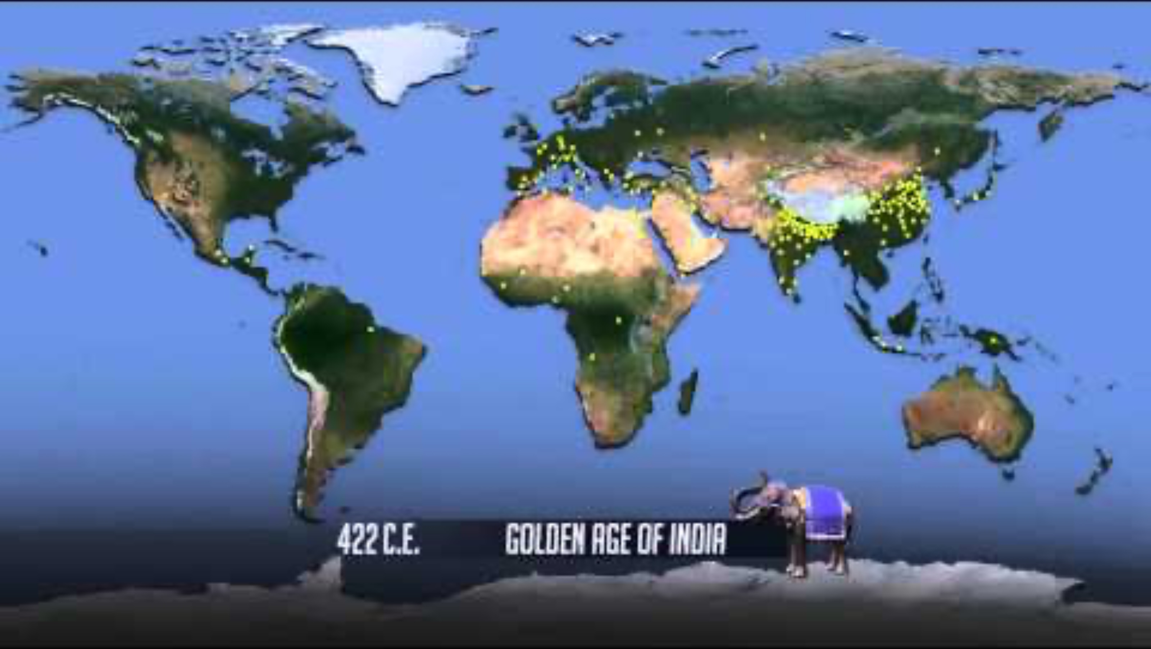
World Population Change
Notes:
Population Education. (2015, March 26). World population [Video]. YouTube. https://www.youtube.com/watch?v=khFjdmp9sZk

Slide 24
H-Chart Comparison
Watch the video about Land Cover Change.
Take notes on the on the right side of the H-Chart.
Notes:
K20 Center. (n.d.). Paired texts H-chart. Strategies. https://learn.k20center.ou.edu/strategy/132

Slide 25
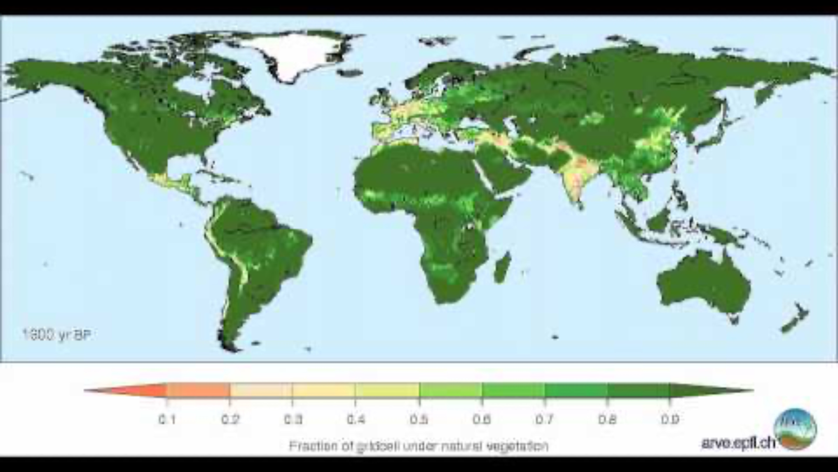
Land Cover Change
Notes:
ARVE Research Group. (2011, January 20). Global land cover change from 8000 BP to -50 BP [Video]. YouTube. https://www.youtube.com/watch?v=gBTlIaf12-4

Slide 26
H-Chart Comparison
Show the relationships between the two videos using the middle bar of the H-Chart.
Prepare to share out your conclusions with the whole class.
Notes:
K20 Center. (n.d.). Paired texts H-chart. Strategies. https://learn.k20center.ou.edu/strategy/132

Slide 27
Threats to Soil Health
In small groups, brainstorm an answer to the following question:
  In what ways could increased population size and land use impact soil health?
Choose one threat to research.
Analyze the threat using the Threat Research handout.

Slide 28
Threats to Soil Health
Research your threat online.
Record information related to the following questions:
  How does the threat damage soil health?
  What causes the threat?
  How can the threat be avoided, mitigated, or eliminated?
Mitigate:
to make less severe or serious

Slide 29
Public Service Announcement
A PSA (Public Service Announcement) is a short informational clip that is meant to raise the audience’s awareness about an important issue.
–Media Commons at Penn State University
Notes:
Penn State. (n.d.). Public service announcement. Media Commons. https://mediacommons.psu.edu/2017/02/14/public-service-announcement/

Slide 30
Public Service Announcement (PSA)
Characteristics of an effective PSA:
Short and clear
On-topic
Supported by factual evidence
Meant to encourage audience sympathy

Slide 31
PSA About Soil Health: Support Your Claims
Support your PSA with:
  Evidence and scientific concepts from your research
  Information recorded in your Window Notes
Include:
  Characteristics of healthy soil
  Cause of your chosen threat
  Effects of your chosen threat
  Ways the threat can be avoided, mitigated, or eliminated

