Slide 2
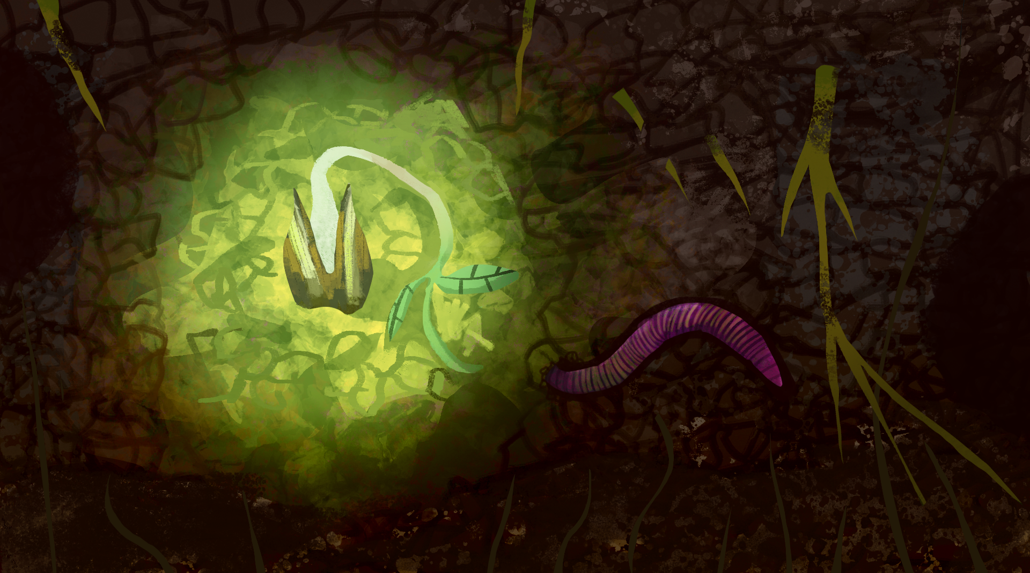
How Does Your Garden Grow?
Conservation, Ecosystems, and Soil Health

Slide 3
Essential Question
Why should we care about soil health?

Slide 4
Learning Objective
Develop a model to describe matter cycles and energy flows
among living and nonliving parts of a local ecosystem.

Slide 5
Photo Deconstruction
Examine the four photos on the next slide and consider:
What do you observe in each photo?
What are some causes of the things you observed?
What do the healthy plants have that the unhealthy plants do not have?
Notes:
K20 Center. (n.d.). Photo or picture deconstruction. Strategies. https://learn.k20center.ou.edu/strategy/140

Slide 6
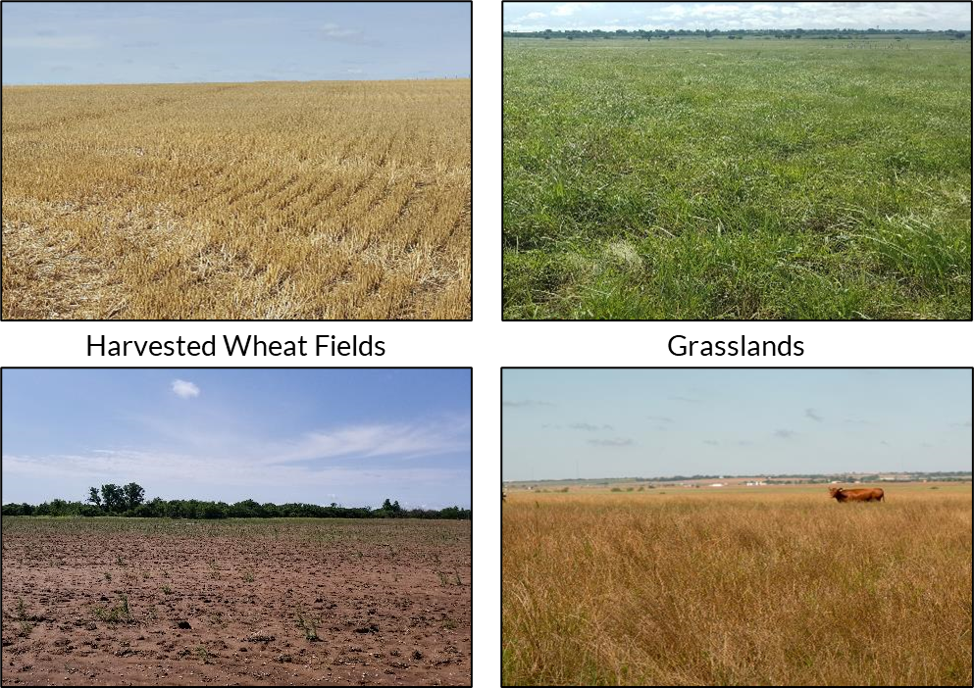
What do you notice? What is the cause?
Notes:
Shaffery, H. (2018). [Photograph series of harvested wheat fields and grasslands]. Grazinglands Research Laboratory.

Slide 7
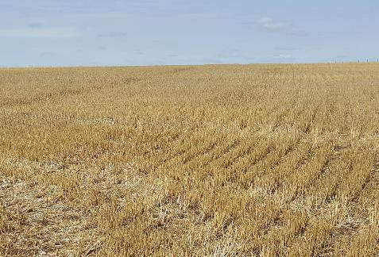
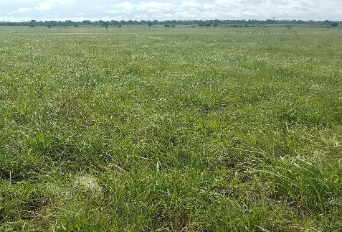
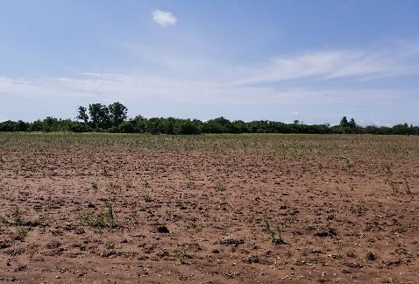
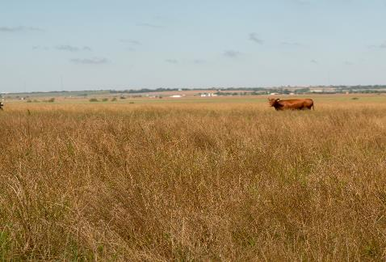
Summarize the images.
Harvested Wheat Fields
Grasslands
Notes:
Shaffery, H. (2018). [Photograph series of harvested wheat fields and grasslands]. Grazinglands Research Laboratory.

Slide 8
Assessing Soil Chemistry
Lab Investigation

Slide 9
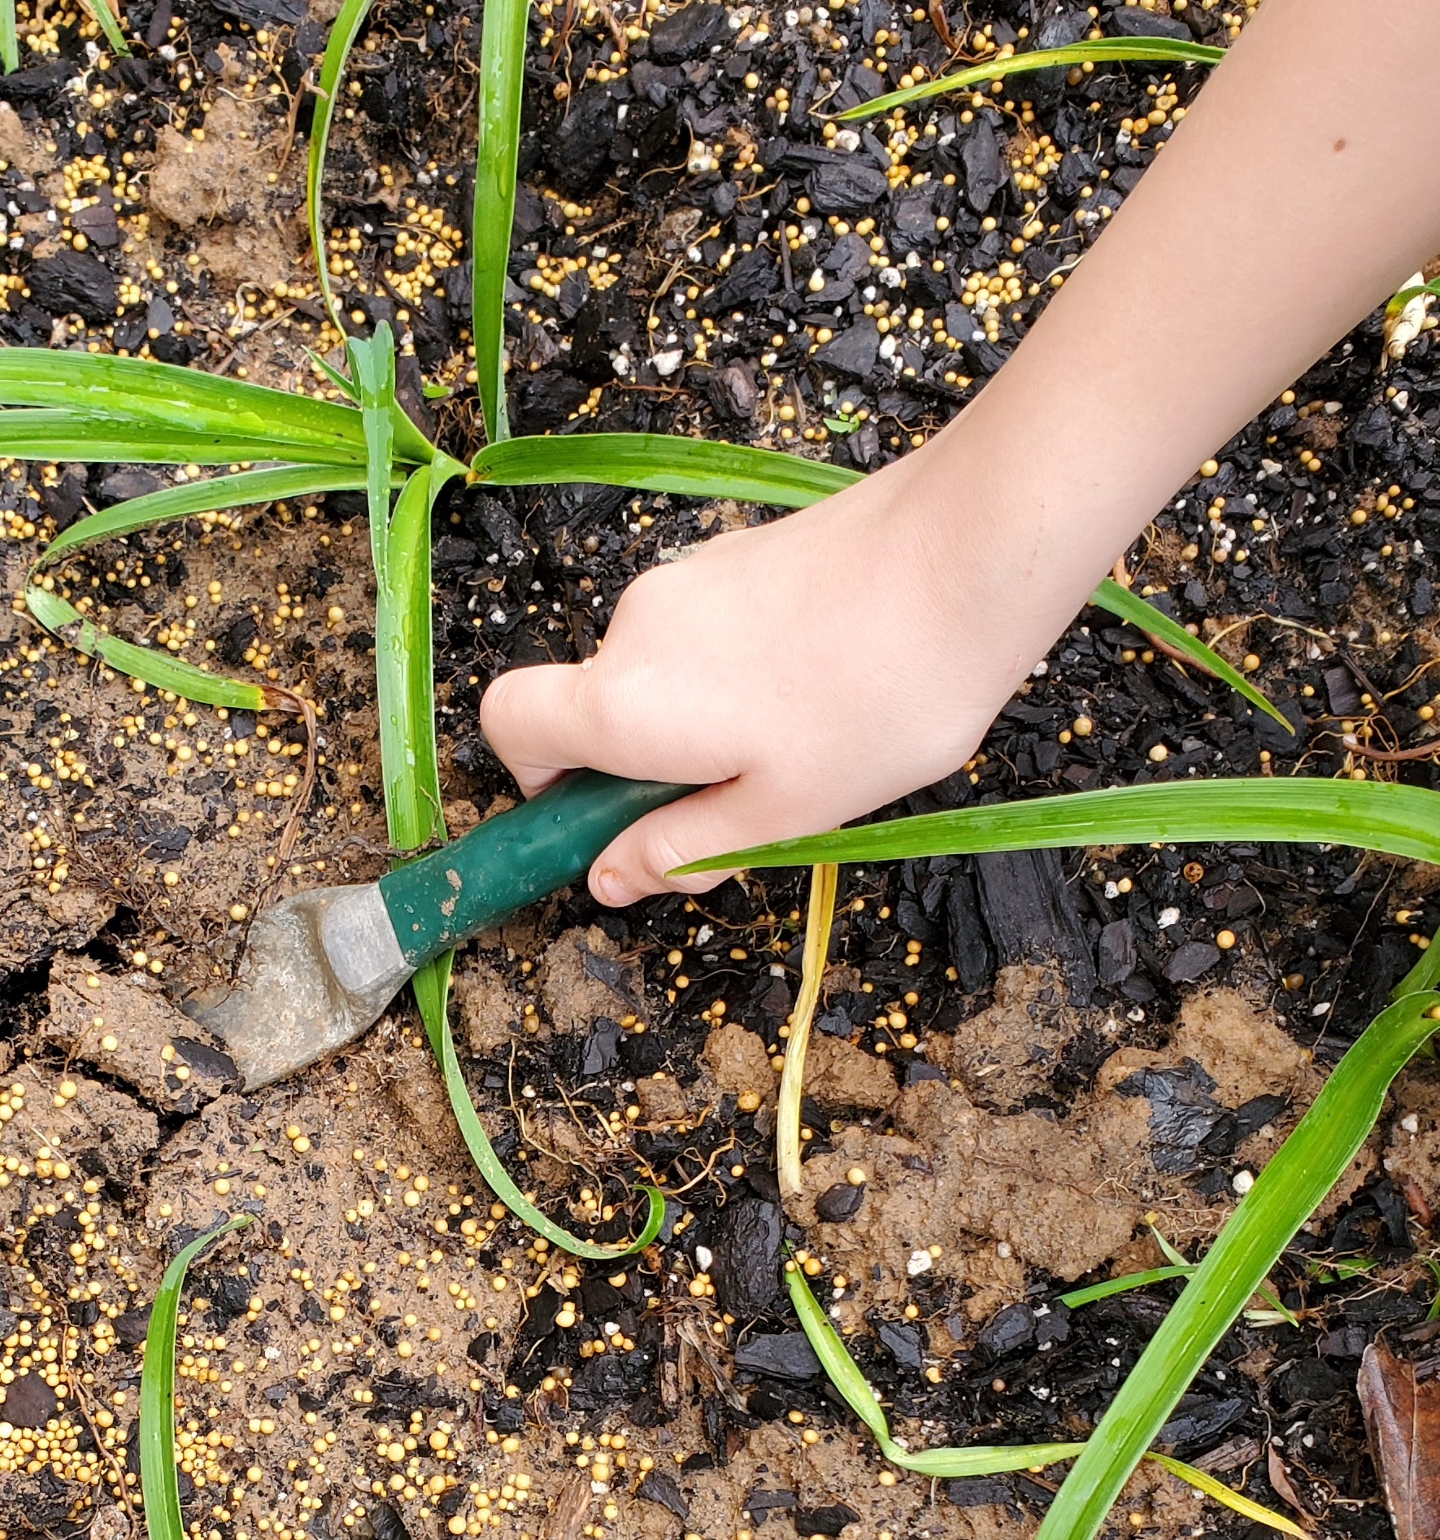
Soil Chemistry Investigation: Preparing the sample
Add 100 mg of soil and 200 mL of water to your beaker.
Stir the solution to blend the soil and water.
Use a different stirring utensil for each soil sample.
Let the soil and water mixture sit overnight.
Notes:
Shaffery, H. (2018). [Photograph of a hand digging in soil]. Grazinglands Research Laboratory.

Slide 10
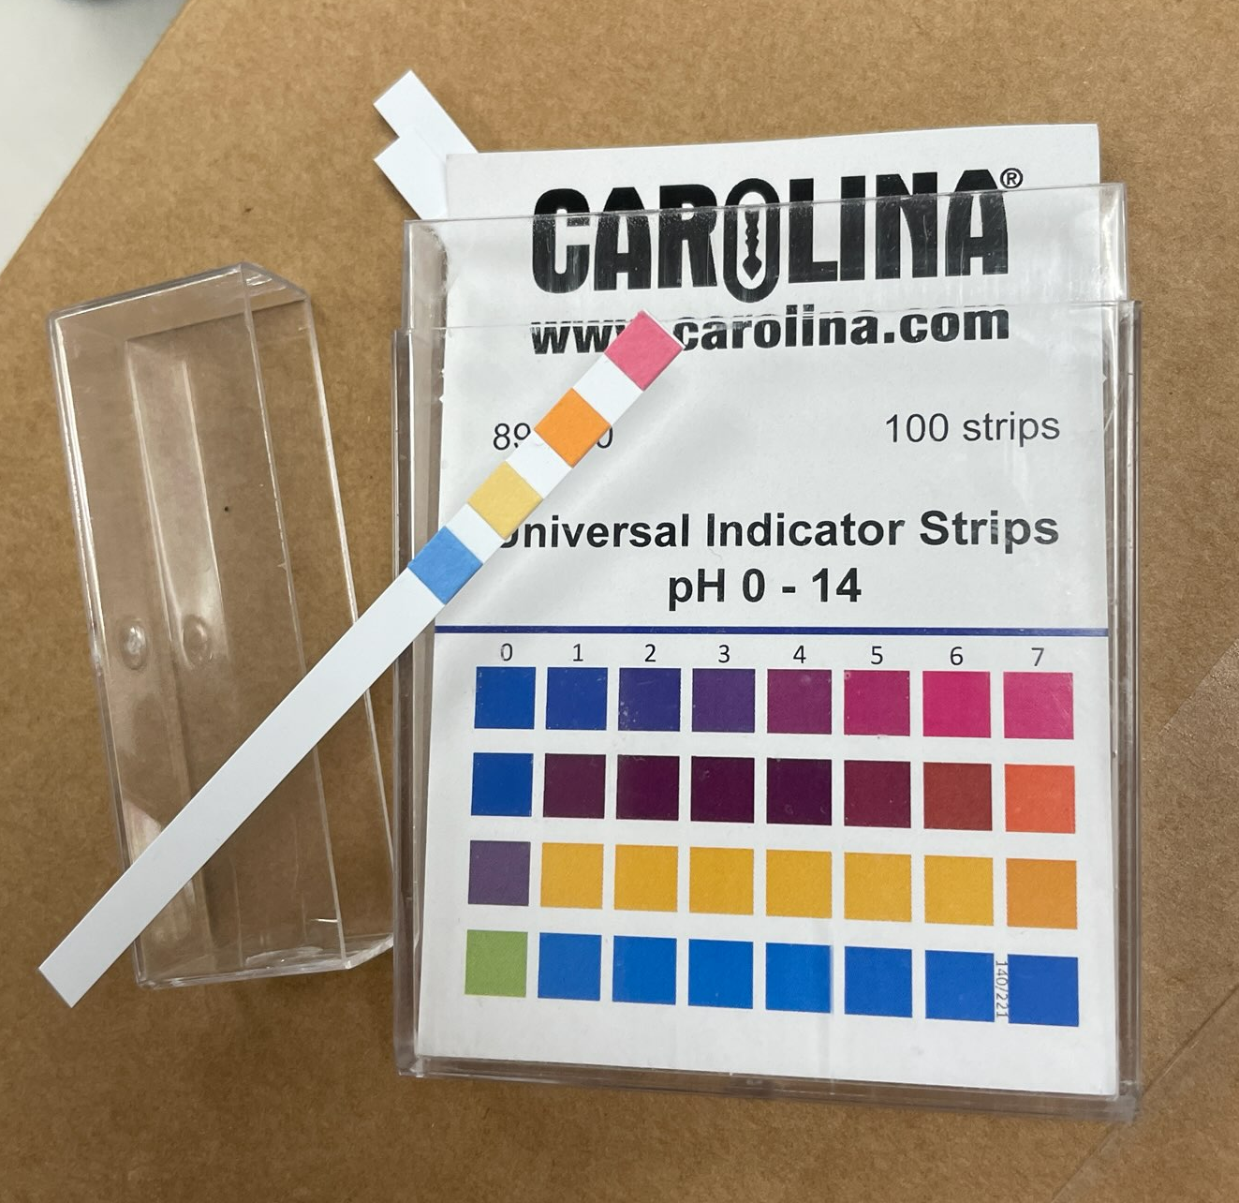
Soil Chemistry Investigation: Recording the data
Record each soil sample type in your data table.
Dip each test strip into the sample solution.
Do not touch the sample with your fingers.
Do not put more than ½ the pH strip in the sample.
Wait for 50–60 seconds.
Compare the colors of your strip to the color chart.
Record the measurement in your table.
Repeat for each sample.
Notes:
Powell, D. (2024). pH strips [Photograph].

Slide 11
Soil Chemistry Clean-Up
Wipe down your table.
Throw away garbage and gloves.
Notes:
Powell, D. (2024). pH strips [Photograph].

Slide 12
Investigating Soil and Soil Health
Online Research

Slide 13
Soil and Soil Health Research
Navigate to this website: https://bit.ly/4ebB8yX
Visit each resource to learn more about soil and soil health.
Record facts from the resources in the first three boxes of your Window Notes handout.
Put each fact under one of the headings labeled Soil Properties, Soil Health, or Soil Chemistry.
Ask for help if you don’t know how to categorize a fact.
Leave the Nutrient Cycles box empty.
Notes:
K20 Center. (n.d.). Wakelet. Tech Tool. https://learn.k20center.ou.edu/tech-tool/2180
K20 Center. (n.d.). Window notes. Strategies. https://learn.k20center.ou.edu/strategy/189

Slide 14
Discussion

Slide 15
Soil and Soil Health Research
What is soil?
How do we describe soil?
How do we know if soil is healthy?
What are the benefits of having healthy soil?
What soil management practices or strategies can improve soil health?
Notes:
K20 Center. (n.d.). Anchor charts. Strategies. https://learn.k20center.ou.edu/strategy/2364

Slide 16
Breakout Rooms

Slide 17
Breakout!
Visit bit.ly/gardengrowbreakout
Use information about nutrient cycles to find codes.
Enter the codes into the form at the bottom of the page.
Read the articles, analyze images, and collaborate to find codes.
Record facts you learn from the activity under the Nutrient Cycles box on your handout.
Soil Properties | Soil Health
Soil Chemistry | Nutrient Cycles
Notes:
K20 Center. (n.d.). How does your garden grow breakout. https://sites.google.com/ou.edu/gardengrowbreakout/home

Slide 18
Three Sticky Notes
Word
On one sticky note, summarize what you learned during the breakout activity using a single word.
Notes:
K20 Center. (n.d.). Three sticky notes. Strategies. https://learn.k20center.ou.edu/strategy/153

Slide 19
Nutrient Cycles
Phrase
On another sticky note, summarize what you learned during the breakout activity using a short phrase (less than ten words).
Notes:
K20 Center. (n.d.). Three sticky notes. Strategies. https://learn.k20center.ou.edu/strategy/153

Slide 20
Discussion
Share out your words and phrases.
Add any new information to your window notes.

Slide 21
Soil Health
Sentence
On another sticky note, use one sentence to describe how nutrient cycles, soil health, and soil management practices relate to each other.
Notes:
K20 Center. (n.d.). Three sticky notes. Strategies. https://learn.k20center.ou.edu/strategy/153

Slide 22
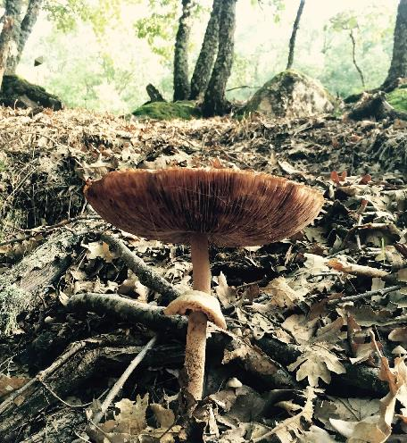
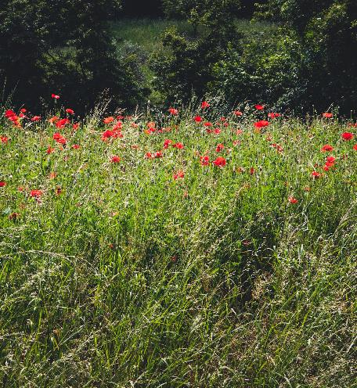
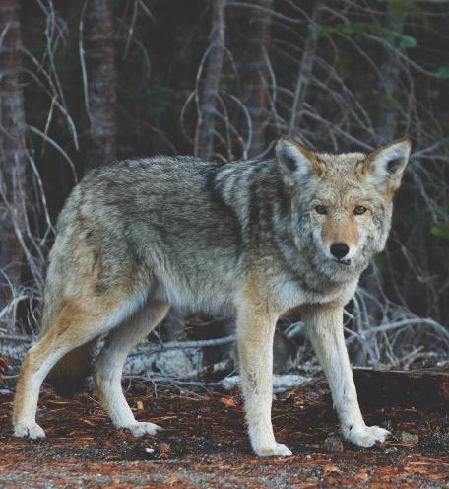
Ecosystem Functions
What are the functions of these groups in an ecosystem?
Decomposers
Producers
Consumers
Photo by Roberto Arias
Photo by Alberta Tessaro
Photo by Josh Felise
Notes:
Arias, R. (2015). Brown mushroom surrounded by dried leaves [Photograph]. Unsplash. https://unsplash.com/photos/brown-mushroom-surrounded-by-dried-leaves-ihpiRgog1vs
Felise, J. (2015). Focus photography of standing wolf near tree [Photograph]. Unsplash. https://unsplash.com/photos/focus-photography-of-standing-wolf-near-tree-mblYxasm0nk
Tessaro, A. (2019). Common poppy flower [Photograph]. Unsplash. https://unsplash.com/photos/common-poppy-flower-8Qeelw9kL4s

Slide 23
Food Webs
On your handout, create a model food web of your neighborhood or school ecosystem.
Draw arrows to show the flow of matter and energy between organisms.
Label each arrow with what causes the matter and energy to flow.

Slide 24
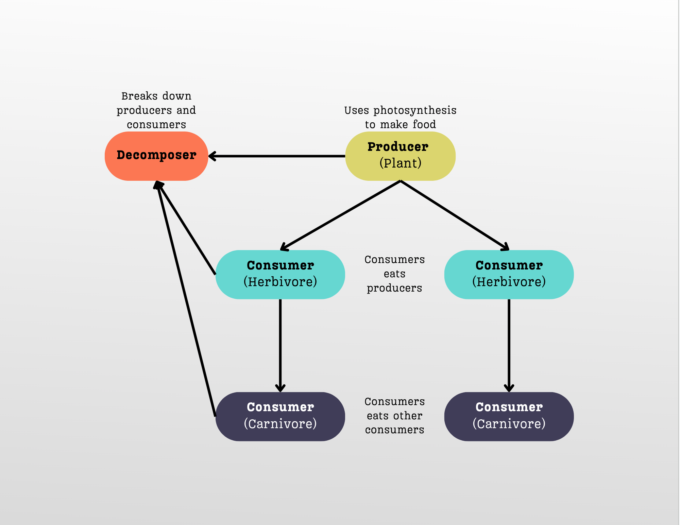
Food Web Example

Slide 25
Ecosystem Webs
Add parts of the environment to your food web.
Choose one nutrient you measured in your soil investigation.
Show how the nutrient flows in and out of the ecosystem.
Use a color that is different from the one you used to draw your energy and matter arrows.
Label the arrows with what causes the nutrient to flow in and out of the system.

Slide 26
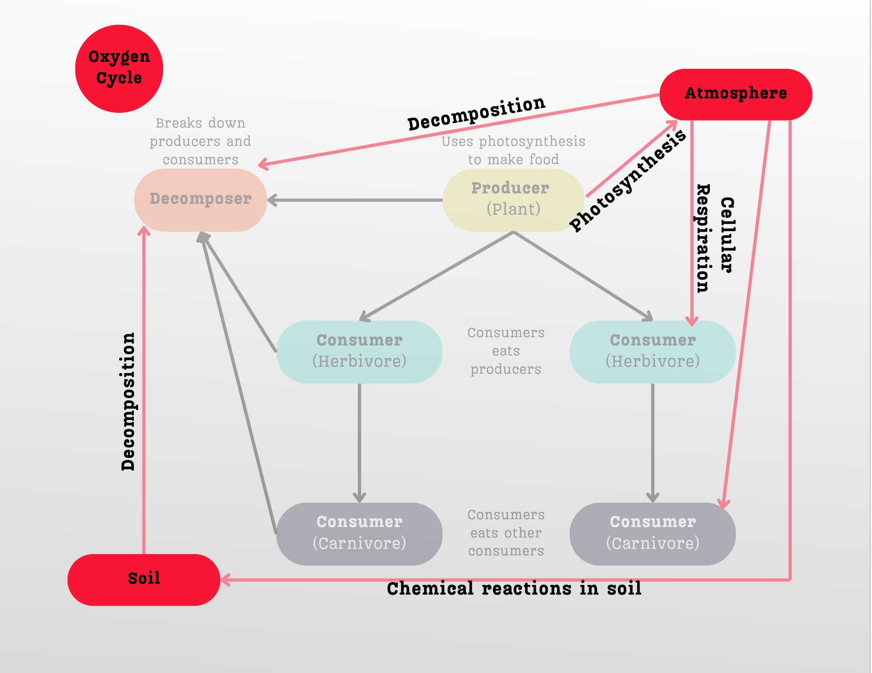
Ecosystem Web Example

