Slide 2
Doggos, Digestion, and Fossils, Oh My!
Digestion and the Fossil Record
Notes:
MS-LS1-7
MS-LS4-1
MS-LS4-2

Slide 3
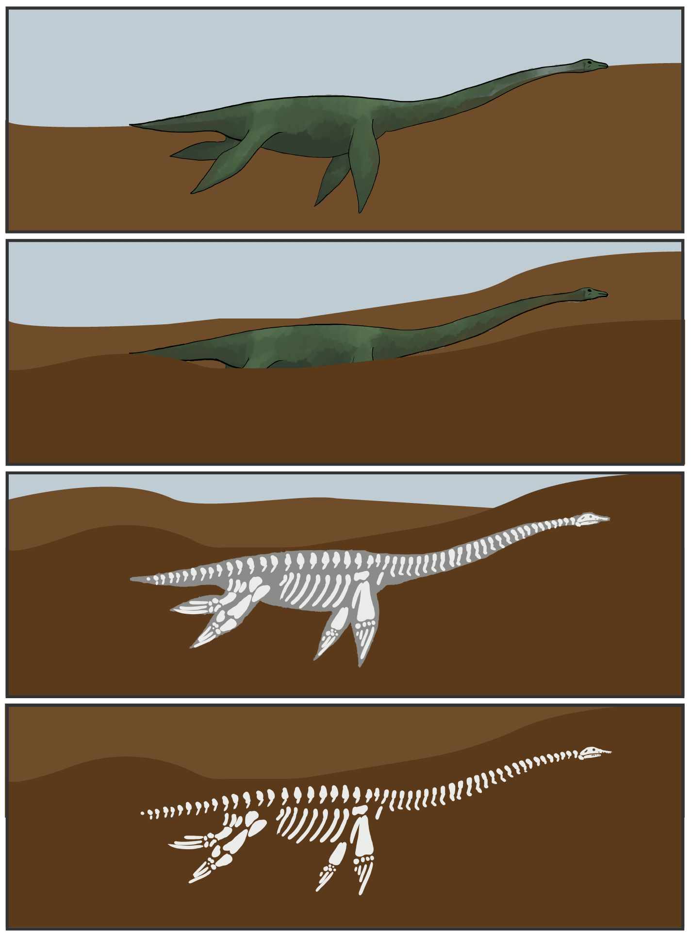
Prerequisite Knowledge: How Are Fossils Made?
An organism dies.
The organism is buried in the ground.
Soft tissues decompose, and hard structures like bone are left.
Sediment fills the space that was once occupied by soft tissue.
Notes:
If students need a brief review about fossilization, include images and description as necessary.
Instructions for hiding slides can be found on the following site: https://support.office.com/en-us/article/hide-or-show-a-slide-8313e1ec-3e20-4464-952f-387931554d69

Slide 4
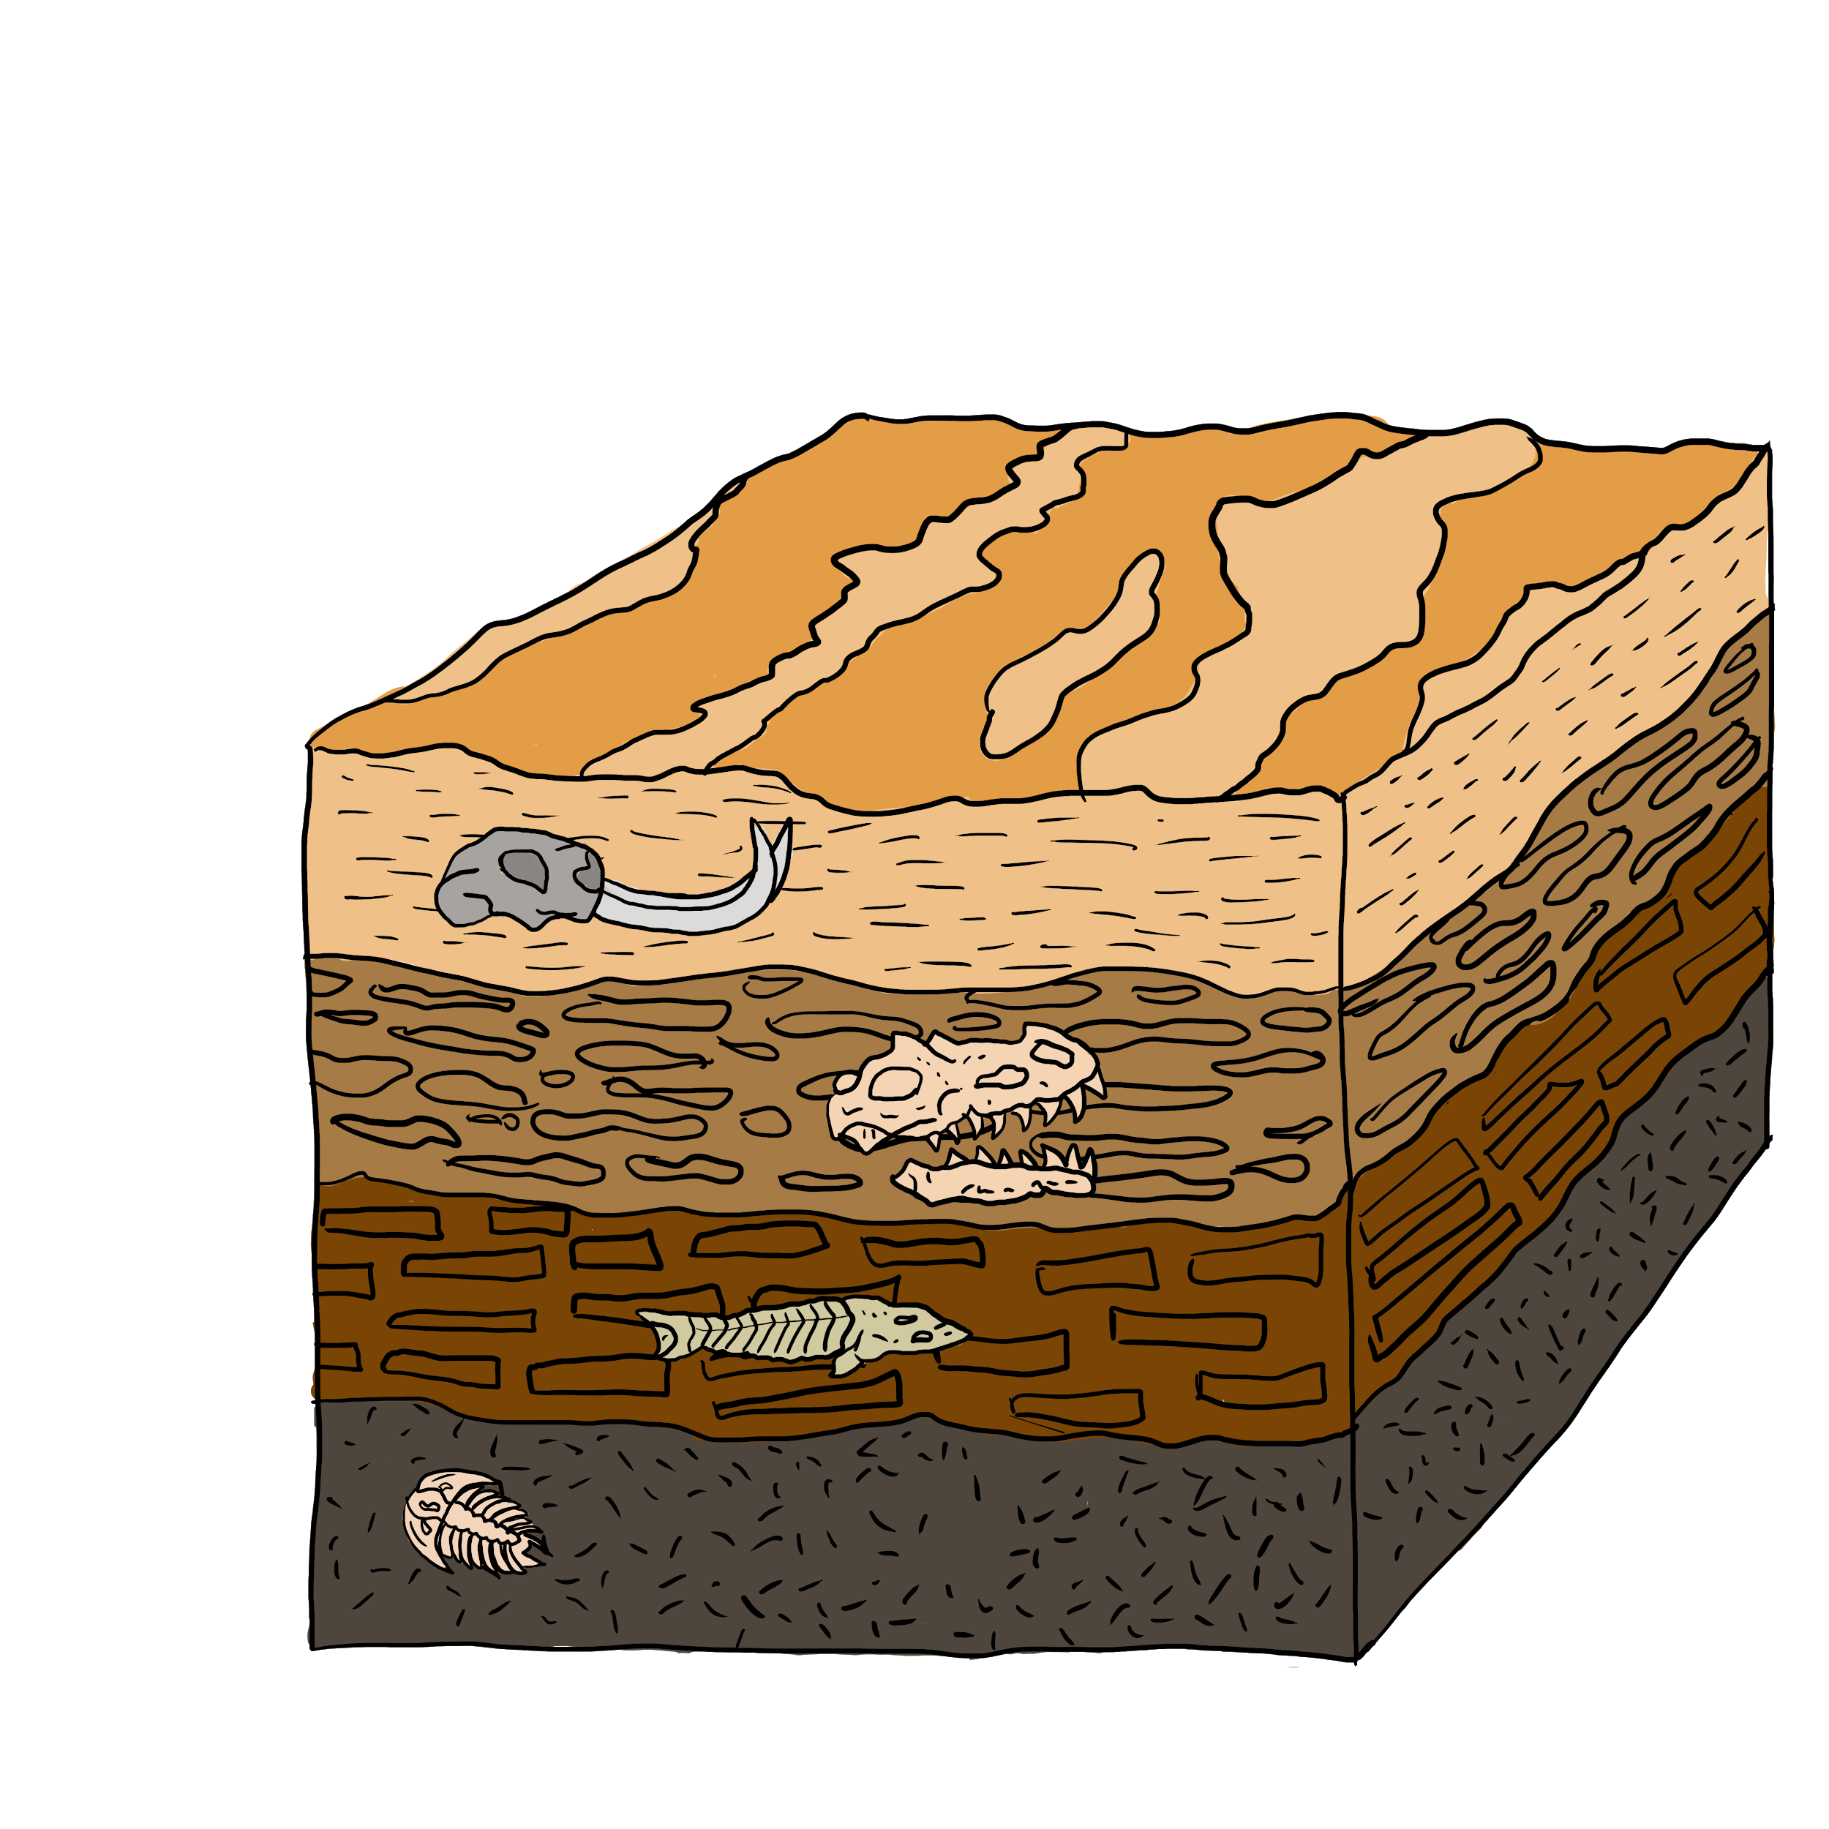
Prerequisite Knowledge: What does the fossil record reveal about the evolution of life on earth?
Fossils provide evidence of Earth’s climate in the past. The fossil record shows that groups of organisms have changed over time.
Notes:
If students need a brief review about how we use the fossil record, include images and description as necessary.
Instructions for hiding slides can be found on the following site: https://support.office.com/en-us/article/hide-or-show-a-slide-8313e1ec-3e20-4464-952f-387931554d69

Slide 5
Essential Question
How can we use fossils to learn about ancient organisms' diets and ecosystems?

Slide 6
Objectives
Students will be able to:
connect the chemical and physical process of digestion to fossil formation;
explain what coprolites can tell us about the diet of the organisms they came from;
and draw conclusions about ecosystem-level interactions.

Slide 7
Collective Brain Dump
What is poop?
Why do we poop?
Where does poop come from?
Notes:
As a formative assessment, ask students to explain what they know about poop. Use the Collective Brain Dump strategy to structure this conversation. Arrange students into small groups. Allow students to collaborate with their groups to share knowledge. When groups seem to be done sharing with one another, have each group share their knowledge with the whole class. As groups share, write list items on the board to create a whole-class product. Using the whole-class list, you can guide the lesson to address misconceptions and gaps in knowledge.

Slide 8
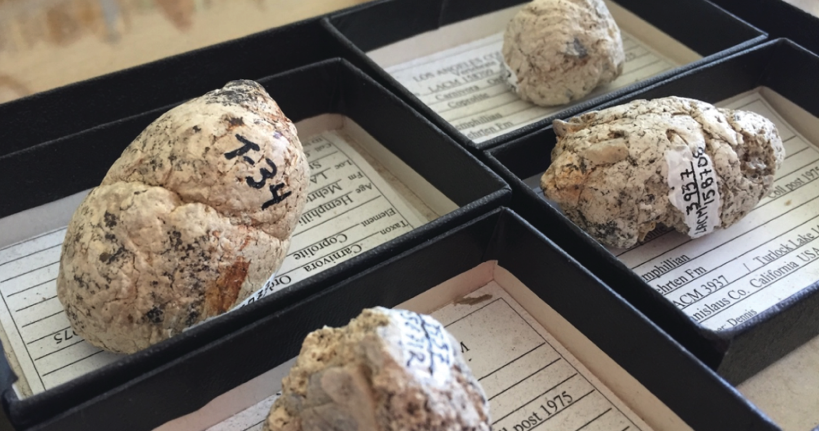
Fossilized Poop (“coprolites”)
Natural History Museum of Los Angeles County. (n.d.). [A few of the six-million-year-old coprolites (fossilized feces) of extinct bone-crushing dogs; the one on the right has visible bits of bone sticking out]. https://nhm.org/stories/proof-pooping
Notes:
Show students images of the coprolites from the Natural History Museum of LA County.
Retrieved from:
Natural History Museum of Los Angeles County. (n.d.). [A few of the six-million-year-old coprolites (fossilized feces) of extinct bone-crushing dogs; the one on the right has visible bits of bone sticking out]. https://nhm.org/stories/proof-pooping

Slide 9
Ancient Poop
Scientists were able to figure out how the dogs hunted based on these fossils.
How do you think they were able to do this?
Write an explanation then discuss with your neighbor.
Notes:
Tell students that scientists were able to figure out how the "bone-crushing" dogs' hunted based on these fossils.
Ask students to write an explanation about how it was possible for scientists to draw that conclusion (see “Student Explanations” handout). Have them discuss with an elbow partner after.
Click on the Ancient Poop link to go to Poozeum’s website to show students more picture of coprolites.
{Screenshot is of one of the articles used in the lesson. Retrieved from Fritts-Penniman, A. (2018, July 5). What can ancient dog poop reveal about an ecosystem? Massive Science. https://massivesci.com/articles/ancient-dog-fossils-bones.}

Slide 10
Modeling Digestion
Provide class-specific instructions for acquiring materials and completing the work here
Notes:
Provide students the materials and instructions for conducting the digestion model simulation. Teacher and student set-up guides are provided in the attachments.

Slide 11
Modeling Digestion
Provide class-specific instructions for how to complete the model (e.g., pacing, demo video for support, etc.)
Notes:
Group Structure Options
Have the entire class go through the activity at the same pace. Consider demonstrating each step of the process to help students successfully create the models for themselves. The YouTube video “Lesson Idea: Digestive System Experiment” provides a clear demonstration of the entire model. If necessary, it can be used to help students (or teacher) assemble and use the model. If showing the video to the entire class, consider pausing between steps to ensure students are able to recreate each part of the model.
Teacher demonstration of any portion of the model should not be used as a substitute for students doing the activity.
Have a small group of students demonstrate the model while their classmates observe.
Several model set-ups; at each station 3 students work through the model on one side of the table and 3-4 peers make observations and support from the other side.
As students explore the model, they should record observations of what they see happening at each step, including what the food materials look like before and after they enter each section.

Slide 12
Modeling Digestion
Visit each (GROUP/STATION) around the room. [Provide class-specific instructions for moving around the room here]
Record new observations about how your classmates' model waste looks different than yours.
If you see things in the waste that weren’t “digested,” try to guess what they are.
Notes:
Several groups should have "undigestible" materials in their food that all students should have a chance to observe. Ask students to Carousel around the room to observe the final products of each group's model. They should record additional observations about their peers' models and attempt to identify the content of the "waste" products.

Slide 13
Modeling Digestion
Provide class-specific instructions for clean-up here
Notes:
Despite the messy ingredients, the pie pan and plates make clean-up for the investigation easy. With rare exception, clean-up only involved the students' normal post-lab procedure of wiping down their stations with a disinfecting wipe or spray cleaner.

Slide 14
Observations of the Model
In the model...
(What did you observe in the model?)
Phase 1
Phase 2
Phase 3
Phase 4
Phase 5
Notes:
As a class, ask students to describe what happened in each step of the model.

Slide 15
Digestion Model vs. Real Digestion
In the model...
(What did you observe in the model?)
In the body...
(What happens inside each organ?)
Phase 1
Phase 2
Phase 3
Phase 4
Phase 5
Notes:
For each step, ask them to describe what part of their body the process is occurring in. (What organ does this part of the model represent? What process in digestion does this part of the model represent?) Next, ask students where they think chemical reactions are happening in the system. Have them justify their claims based on prior knowledge and what they observed in the model.
After the group discussion provide students a formal explanation of the digestive system. While it's important to cover the entire system, focus more heavily on the structures and processes students misunderstood or left out during the conversation. If they already know part of the content, a brief overview is all that is necessary for those details.

Slide 16
Digestion
Where did chemical reactions happen?
How do we know?

Slide 17
Digestion: Mouth → Stomach
Mouth
Salivary Glands (amylase)
Esophagus
Notes:
Food starts in the mouth where we chew it up with our teeth. When we swallow the food, it travels down our esophagus into the stomach.

Slide 18
Digestion: Stomach → Small Intestine
Stomach
Liver
Gallbladder (bile)
Pancreas (lipase, protease, amylase)
Small intestine
Notes:
Food in the stomach is broken down into liquid with digestive juices. Next, food travels through the small intestine – a long and windy tube. The small intestine is very important because this is where many of the nutrients are absorbed by your body and travel via your bloodstream to all the body parts (like muscles, bones, eyes, skin, etc.) that need them.
Liver produces bile, removes toxins, stores some vitamins/minerals; gallbladder stores bile
Pancreas releases enzymes to break food down and neutralize the acidity of stomach contents when they enter small intestine
Lipase, bile 🡪 breaks down fats
Protease 🡪 breaks down proteins
Amylase 🡪 breaks down starches and sugars

Slide 19
Digestion: Small Intestine → Anus
Large Intestine
Rectum
Anus
Notes:
Finally, food travels through the large intestine where water and some minerals are extracted and now that your body has taken everything it needs out of your food, the waste temporarily stored in the rectum then exits your body through the anus – like when you go to the bathroom.

Slide 20
Watch How Digestion Works
Notes:
To further reinforce digestive system details, see the following YouTube video. A camera travels through the digestive system so students can watch the process in action from inside the human body. After watching the video, consider walking students through the process one more time to ensure they understand where the chemical processes occur. Whenever possible have students answer their classmates' questions during discussion.
Doolan, Tom. The Digestive System. (2012, November 26). YouTube. http://youtu.be/_QYwscALNng

Slide 21
From Digestion to Fossilized Poop…
What types of materials are most/least likely to fossilize?
Why are coprolites rare?
When poop does fossilize, what sort of materials might be found inside?
Why?
Notes:
Once students have a complete understanding of digestive processes, return to their observations from the Explore Carousel. Ask them to describe what they were able to identify in the "waste" products of the models. Help students connect this to their understanding of how fossils form.

Slide 22
From Digestion to Fossilized Poop…
Why can't we eat our poop?
Why do some animals eat their poop?
Notes:
Additionally, interesting conversation synthesizing content can be facilitated through student-generated questions. Previous student questions have included:
Why can't we eat our poop?
Why do some animals eat their poop?

Slide 23
From Digestion to Fossilized Poop…
What conclusions could you draw about an animal based on what you might find in its poop?
Come up with as many answers as you can.
Notes:
Have students brainstorm the types of conclusions they might be able to draw about an animal based on what they might find in its poop (e.g., whole seeds would tell us that animals can't digest that food).

Slide 24
Ancient Poop
Scientists were able to figure out how the dogs hunted based on these fossils.
Based on what you know now, write a new explanation.
Notes:
Remind students that scientists figured out how the "bone-crushing" dogs hunted based on their coprolites. Ask them to revise their explanation from the Engage for how this is possible using what they now understand about digestion.
{Screenshot is of one of the articles used in the lesson. Retrieved from Fritts-Penniman, A. (2018, July 5). What can ancient dog poop reveal about an ecosystem? Massive Science. https://massivesci.com/articles/ancient-dog-fossils-bones.}

Slide 25
All About Dino Dung
Read the article given and answer the following question:
Why are bones and other materials left behind during digestion?
Notes:
Have students read about how scientists use coprolites or about the bone-crushing dog research specifically. Discuss the article(s) as a class to help students determine why bones and other materials are left behind during digestion (e.g., lack of necessary enzymes, too dense for body to break down physically, etc.).
{Screenshot is of one of the articles used in the lesson. Retrieved from https://newsela.com/read/dinosaurs-crustaceans/id/35605/}

Slide 26
Poop: What is It Good For?
Pick the coprolite evidence that helped scientists draw their conclusions.
Evidence
Some of the bones in the coprolites belonged to animals that weighed 75 lbs or more.
About 5% of the coprolites were bone fragments.
14 coprolite fossils were found in the same place.
Partially digested bone and feces with bones provide nutrients to an ecosystem in an unusual way.
The coprolites came from multiple dogs.
Conclusions
Bone-crushing dogs weighed about 50 lbs, and probably hunted in packs.
The dogs marked their territories.
The dogs ate animals much larger than them.
Ecosystems were probably disrupted when the dogs went extinct.
Notes:
Provide students with the evidence scientists found within the coprolites and the specific things they concluded about the "bone-crushing" dogs' ecosystem. Ask students to decide what evidence supports each conclusion and explain why using what they understand about digestion and fossils (see “Student Explanations” handout). Note that pieces of evidence can be used to support more than one conclusion and conclusions may be supported by more than one piece of evidence.

Slide 27
Poop: What is It Good For?
Discuss with a partner:
How does your evidence support the conclusion(s) you matched it to?
If your conclusions/evidence don’t match, discuss why not
Notes:
After students complete the task, have them compare their answers and reasoning with a partner. They should discuss why their ideas do or do not match one another using the evidence and their learning so far.
Students may generate several questions which provide an opportunity for a discussion connecting previous knowledge and the content learned during the lesson.

Slide 28
Explain how the process of digestion left bone fragments in the coprolites of "bone-crushing" dogs.
Use a digestion model as part of your explanation.
Revise your explanation for why scientists can use coprolites to understand ecosystems.
Notes:
Have students explain how the process of digestion left bone fragments in the coprolites of "bone-crushing" dogs. Either have them draw or provide a pre-printed (unlabeled) model of the digestive system for students to use as part of their explanation. In addition, students should revise their Engage/Extend explanation one more time to describe why scientists can use materials found in coprolites to understand ancient ecosystems (see “Student Explanations” handout).

Slide 29
Muddiest Point
What is your muddiest point about how we can use fossils to learn about ancient organisms' diets and ecosystems?

