Slide 2
Doggos, Digestion, and Fossils, Oh My!
Digestion and the Fossil Record
Notes:
MS-LS1-7
MS-LS4-1
MS-LS4-2

Slide 3
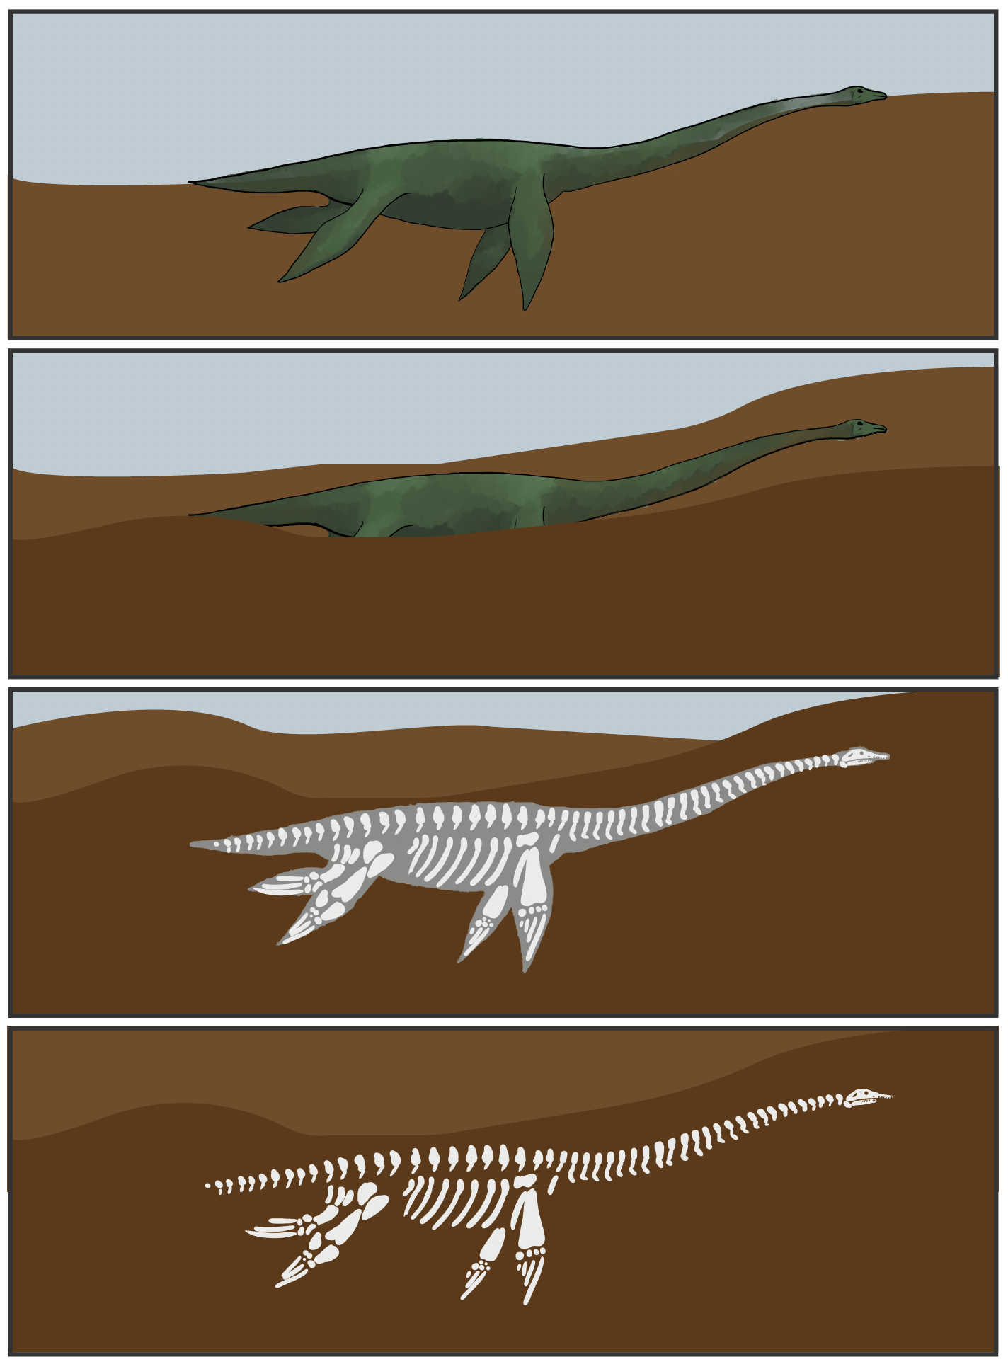
How Are Fossils Made?
An organism dies.
The organism is buried in the ground.
Soft tissues decompose, and hard structures like bone are left.
Sediment fills the space that was once occupied by soft tissue.

Slide 4
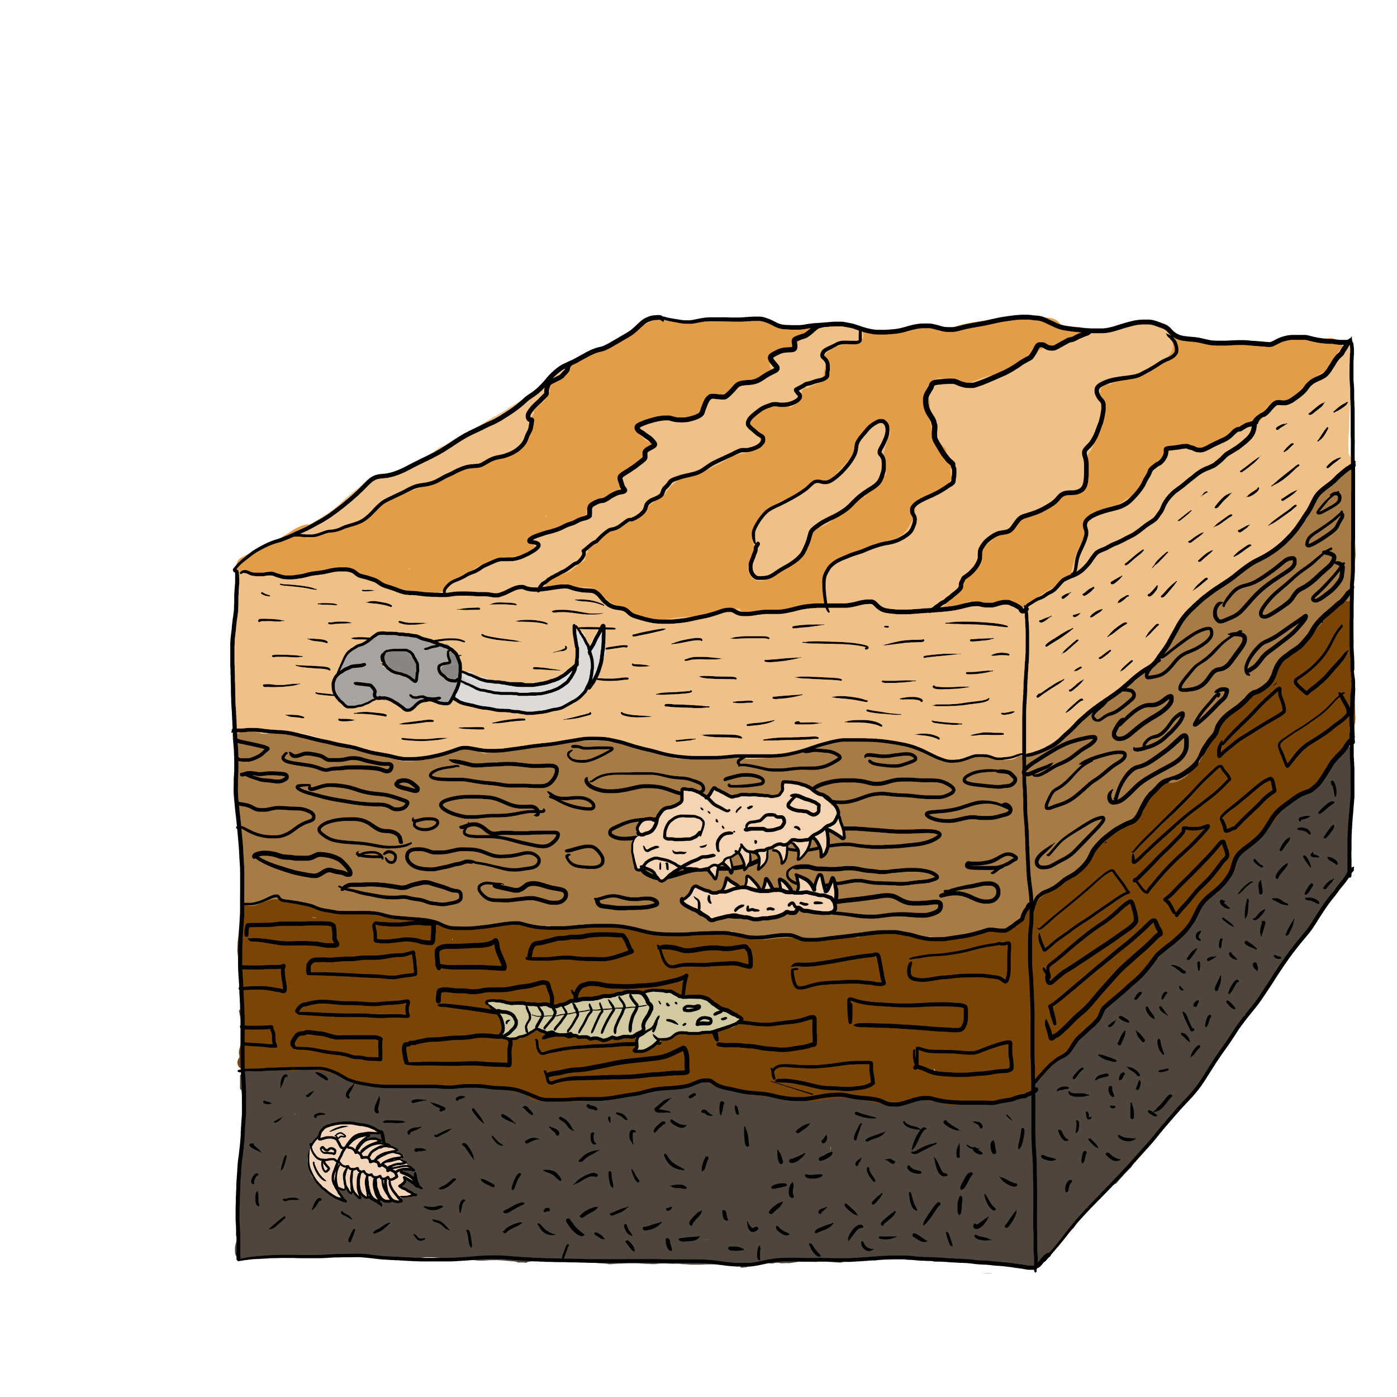
What does the fossil record reveal about the evolution of life on earth?
Fossils provide evidence of Earth’s climate in the past. The fossil record shows that groups of organisms have changed over time.

Slide 5
Essential Question
How can we use fossils to learn about ancient organisms' diets and ecosystems?

Slide 6
Lesson Objectives
Connect the chemical and physical process of digestion to fossil formation.
Explain what coprolites can tell us about the diet of the organisms they came from.
Draw conclusions about ecosystem-level interactions.

Slide 7
Collective Brain Dump
What is poop?
Why do we poop?
Where does poop come from?
Notes:
K20 Center. (n.d.). Collective brain dump. Strategies. Retrieved from https://learn.k20center.ou.edu/strategy/111

Slide 8
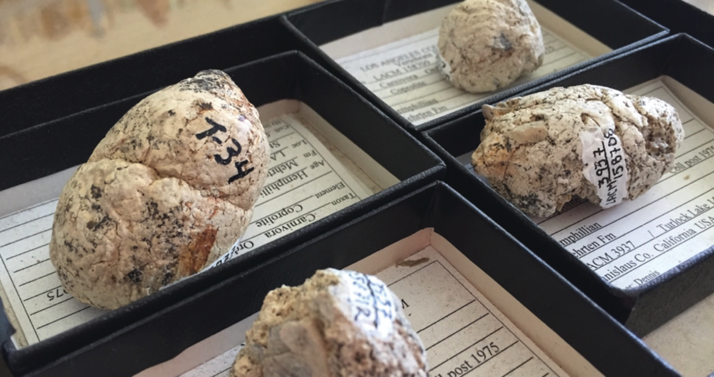
Fossilized Poop (“coprolites”)
Notes:
Natural History Museum of Los Angeles County. (n.d.). [A few of the six-million-year-old coprolites (fossilized feces) of extinct bone-crushing dogs; the one on the right has visible bits of bone sticking out]. https://nhm.org/stories/proof-pooping

Slide 9
Ancient Poop
Scientists were able to figure out how the dogs hunted based on these fossils.
How do you think they were able to do this?
Write an explanation then discuss it with your neighbor.
Notes:
Fritts-Penniman, A. What can ancient dog poop reveal about an ecosystem? (2018, July 5). Massive Science. https://massivesci.com/articles/ancient-dog-fossils-bones/
Wang, X., White, S. C., Balisi, M., Biewer, J., Sankey, J., Garber, D., & Tseng, J. First bone-cracking dog coprolites provide new insight into bone consumption in Borophagus and their unique ecological niche. (2018, May 22). eLife. https://elifesciences.org/articles/34773

Slide 10
Materials - Modeling Digestion
Provide class-specific instructions for acquiring materials and completing the work here

Slide 11
Modeling Digestion
Provide class-specific instructions for how to complete the model (e.g., pacing, demo video for support, etc.)

Slide 12
Modeling Digestion
Visit each (GROUP/STATION) around the room. [Provide class-specific instructions for moving around the room here]
Record new observations about how your classmates' model waste looks different than yours.
If you see things in the waste that weren’t “digested,” try to guess what they are.
Notes:
Several groups should have "undigestible" materials in their food that all students should have a chance to observe. Ask students to Carousel around the room to observe the final products of each group's model. They should record additional observations about their peers' models and attempt to identify the content of the "waste" products.

Slide 13
Clean Up - Modeling Digestion
Provide class-specific instructions for clean-up here

Slide 14
Observations of the Model
In the model...
(What did you observe in the model?)
Phase 1
Phase 2
Phase 3
Phase 4
Phase 5

Slide 15
Digestion Model vs. Real Digestion
In the model...
(What did you observe in the model?)
In the body...
(What happens inside each organ?)
Phase 1
Phase 2
Phase 3
Phase 4
Phase 5

Slide 16
Digestion
Where did chemical reactions happen?
How do we know?

Slide 17
Digestion: Mouth → Stomach
Mouth
Salivary Glands (amylase)
Esophagus

Slide 18
Digestion: Stomach → Small Intestine
Stomach
Liver
Gallbladder (bile)
Pancreas (lipase, protease, amylase)
Small intestine

Slide 19
Digestion: Small Intestine → Anus
Large Intestine
Rectum
Anus

Slide 20
From digestion to fossilized poop…
What types of materials are most/least likely to fossilize?
Why are coprolites rare?
When poop does fossilize, what sort of materials might be found inside?
Why?
Notes:
Once students have a complete understanding of digestive processes, return to their observations from the Explore Carousel. Ask them to describe what they were able to identify in the "waste" products of the models. Help students connect this to their understanding of how fossils form.

Slide 21
From digestion to fossilized poop…
Why can't we eat our poop?
Why do some animals eat their poop?
Notes:
Additionally, interesting conversation synthesizing content can be facilitated through student-generated questions. Previous student questions have included:
Why can't we eat our poop?
Why do some animals eat their poop?

Slide 22
From digestion to fossilized poop…
What conclusions could you draw about an animal based on what you might find in its poop?
Come up with as many answers as you can.
Notes:
Have students brainstorm the types of conclusions they might be able to draw about an animal based on what they might find in its poop (e.g., whole seeds would tell us that animals can't digest that food).

Slide 23
Ancient Poop
Scientists were able to figure out how the dogs hunted based on these fossils.
Based on what you know now, write a new explanation.
Notes:
Fritts-Penniman, A. What can ancient dog poop reveal about an ecosystem? (2018, July 5). Massive Science. https://massivesci.com/articles/ancient-dog-fossils-bones/
Wang, X., White, S. C., Balisi, M., Biewer, J., Sankey, J., Garber, D., & Tseng, J. First bone-cracking dog coprolites provide new insight into bone consumption in Borophagus and their unique ecological niche. (2018, May 22). eLife. https://elifesciences.org/articles/34773

Slide 24
All About Dino Dung
Read your section of the article with your expert group
Teach your home group about your section
As a group answer the following question:
Why are bones and other materials left behind during digestion?
Notes:
K20 Center. (n.d.). Jigsaw. Strategies. Retrieved from https://learn.k20center.ou.edu/strategy/179
{Screenshot is of one of the articles used in the lesson. Retrieved from https://newsela.com/read/dinosaurs-crustaceans/id/35605/}

Slide 25
Poop. What is it good for?
Pick the coprolite evidence that helped scientists draw their conclusions.
Conclusions
Bone-crushing dogs weighed about 50 lbs, and probably hunted in packs.
The dogs marked their territories.
The dogs ate animals much larger than them.
Ecosystems were probably disrupted when the dogs went extinct.
Evidence
Some of the bones in the coprolites belonged to animals that weighed 75 lbs or more.
About 5% of the coprolites were bone fragments.
14 coprolite fossils were found in the same place.
Partially digested bone and feces with bones provide nutrients to an ecosystem in an unusual way.
The coprolites came from multiple dogs.

Slide 26
Poop. What is it good for?
Discuss with a partner:
How does your evidence support the conclusion(s) you matched it to?
If your conclusions/evidence don’t match, discuss why not.

Slide 27
Explain how the process of digestion left bone fragments in the coprolites of "bone-crushing" dogs.
Use a digestion model as part of your explanation.
Revise your explanation for why scientists can use coprolites to understand ecosystems.

Slide 28
Muddiest Point
What is your muddiest point about how we can use fossils to learn about ancient organisms' diets and ecosystems?
Notes:
K20 Center. (n.d.). Muddiest point. Strategies. Retrieved from https://learn.k20center.ou.edu/strategy/109

