Slide 2
Phylogenetic Mana-trees
Using Genomic Data to Evaluate Evolutionary Relationships
Notes:
Engage
Students draw cladograms to predict how manatees are classified.
Explore
Students analyze protein sequence data from the UniProt online database to develop phylogenetic relationships among several organisms of their choice.
Explain
Students synthesize what they learned from the Explore investigation and discuss the value of using molecular and/or morphological data for classifying organisms and their evolutionary relationships.
Extend
Students use UniProt to construct a phylogenetic tree for manatees and compare it with their previous prediction(s), as well as recently published phylogenetic trees.
Evaluate
Using the tree comparisons from the Extend section, students provide an explanation for how genetic and morphological data serve as evidence for manatees’ evolutionary relationships.

Slide 3
Essential Questions
How do molecular data and morphological data compare when predicting phylogenetic relationships?
How are molecular and morphological data used to determine manatees’ evolutionary relationships?

Slide 4
Lesson Objectives
Use multiple lines of evidence to construct and compare phylogenetic trees.
Evaluate the pros and cons of using molecular and morphological data as evidence of common ancestry.
Notes:
Before going to the next slide, share the Student Slides with students—you may either share the Google Slides link or send students the PowerPoint file that is attached to the lesson in LEARN.
The Google Slides presentation has been the most effective way for students to collaborate on the work. Use of the PowerPoint version is not preferred, but the slides can be printed out as student handouts for use as they are or in science notebooks, if necessary.

Slide 5
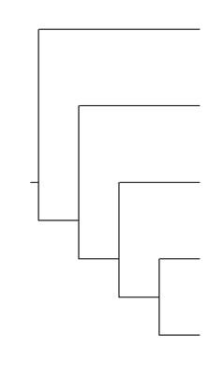
Cladogram
A
On the blank cladogram, circle and label the following:
Node
Common ancestor to all
A monophyletic group
Its sister species
Its outgroup
E
B
D
C
Notes:
Review cladogram structure as a formative assessment before beginning the actual lesson. This same slide is in the Student Slides without the answers.
The red annotations are animated to reveal the answers. Do not click through these until students have had time to work through and share their own answers with the class.
Be sure students understand that this is not the only monophyletic group, and that the sister species and outgroup will change depending on what group they select.
Students should understand that a monophyletic group contains a common ancestor and all its descendants.
Revisit this in greater detail in the Explain section if students struggle to remember the relationships illustrated in a cladogram or need more practice interpreting the models.

Slide 6
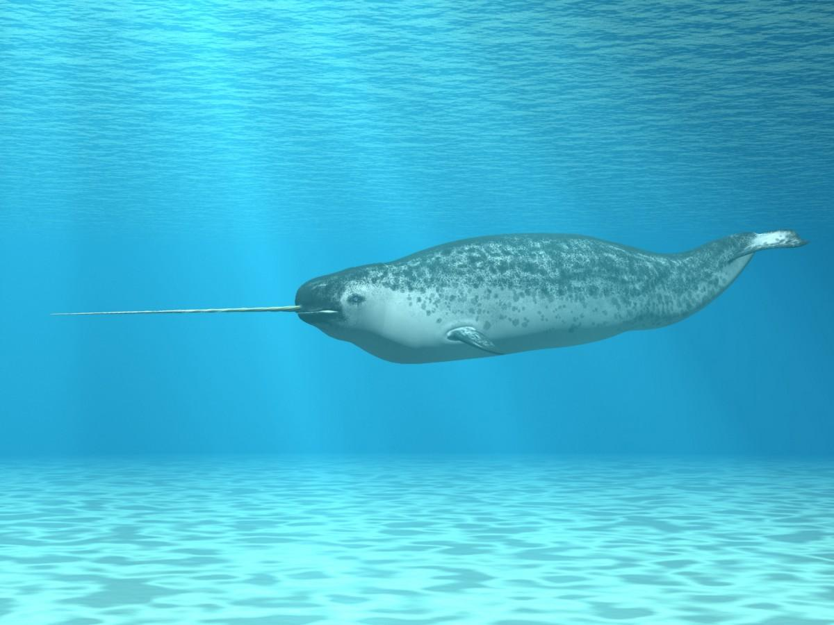
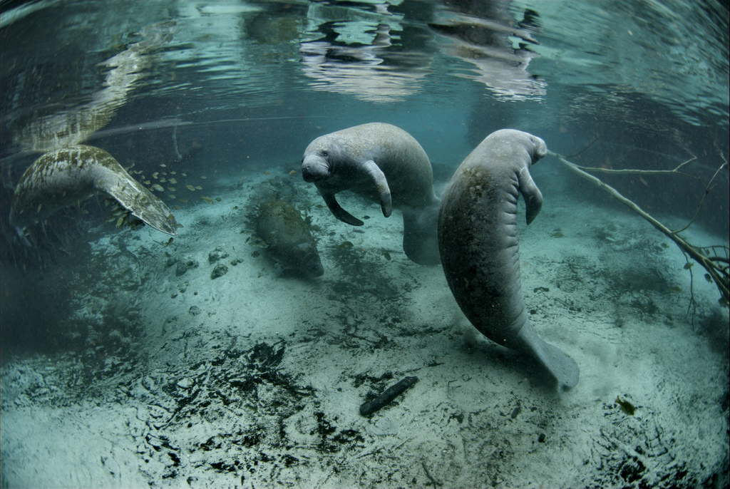
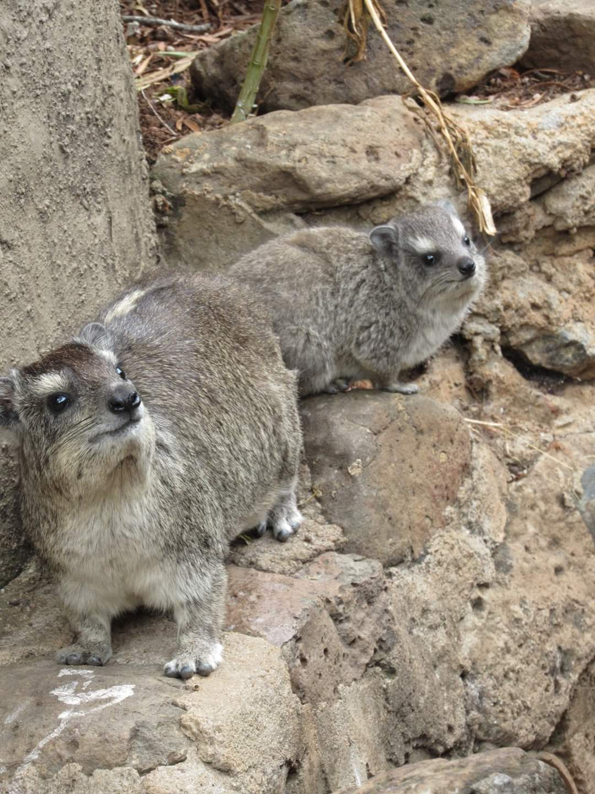
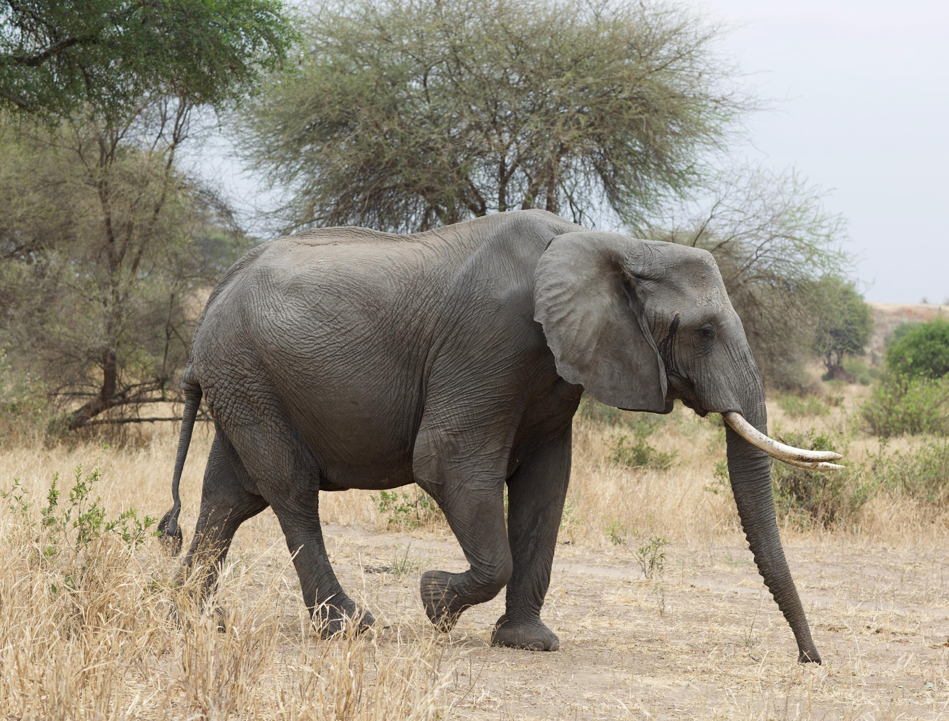
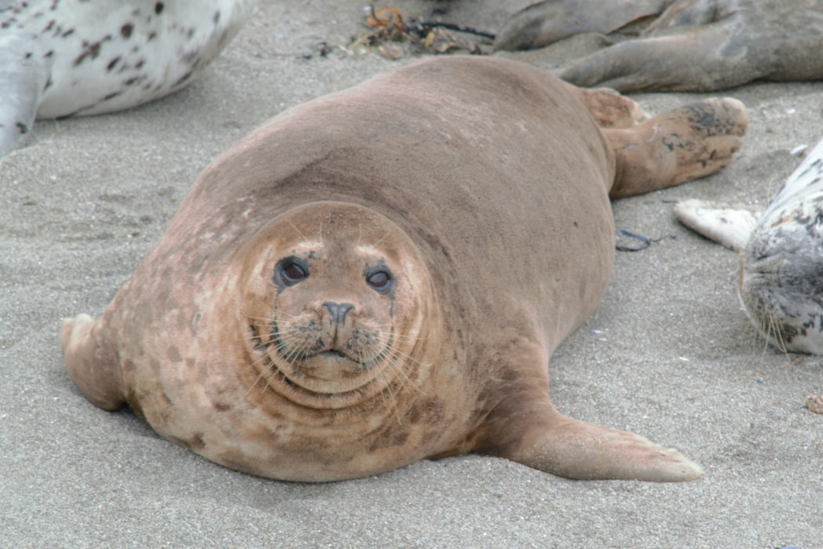
Where are manatees in the tree of life?
Narwhal
Elephant
Manatee
Seal
Hyrax
Notes:
Give students the list of organisms (manatee, seal, hyrax, narwhal, elephant) and pose the following question: If you were to classify a manatee by its morphology, which organisms would you group it with?
Image sources:
Dean, J. (2018). Friendly harbor seal [Photo]. Unsplash. https://unsplash.com/photos/xNJGO5fyOsk
Dutton, J. (2019, September 28). Elephant [Photo]. Unsplash. https://images.unsplash.com/photo-1567968110429-ac9fbc3d6e25?ixlib=rb-1.2.1&q=80&fm=jpg&crop=entropy&cs=tinysrgb&w=1080&fit=max&ixid=eyJhcHBfaWQiOjEyMDd9
Hinkel, D., & U.S. Fish and Wildlife Service. (2012, July 24). Endangered Florida manatee [Photo]. Flickr. https://www.flickr.com/photos/usfwshq/7636816484/in/photostream/
Meyer, A. (n.d.). Narwhal [Illustration]. Shutterstock. https://www.shutterstock.com/image-illustration/narwhal-31848370
Randall, T. (n.d.). Hyrax [Photo]. K20 Center.

Slide 7
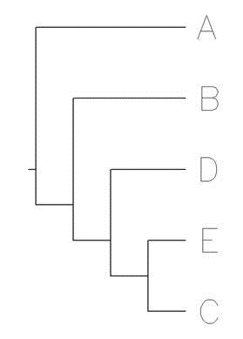
Predict How They’re Related
Draw a simple cladogram predicting how these five organisms are related.
Manatee
Seal
Hyrax
Elephant
Narwhal
Notes:
Ask students to create their own cladogram based on what they know about these organisms. Two formats are shown.
Students should be able to defend with evidence why they placed each organism where they did.
Image sources:
Dean, J. (2018). Friendly harbor seal [Photo]. Unsplash. https://unsplash.com/photos/xNJGO5fyOsk
Dutton, J. (2019, September 28). Elephant [Photo]. Unsplash. https://images.unsplash.com/photo-1567968110429-ac9fbc3d6e25?ixlib=rb-1.2.1&q=80&fm=jpg&crop=entropy&cs=tinysrgb&w=1080&fit=max&ixid=eyJhcHBfaWQiOjEyMDd9
Hinkel, D., & U.S. Fish and Wildlife Service. (2012, July 24). Endangered Florida manatee [Photo]. Flickr. https://www.flickr.com/photos/usfwshq/7636816484/in/photostream/
Meyer, A. (n.d.). Narwhal [Illustration]. Shutterstock. https://www.shutterstock.com/image-illustration/narwhal-31848370
Randall, T. (n.d.). Hyrax [Photo]. K20 Center.

Slide 8
Partner Up and Share Out
Why do your cladograms look different even though they have the same organisms?
How did you decide to place organisms where you did?
What could we do to see which cladogram is most accurate, or how could we make a more accurate one?
Notes:
This is where students will give their reasoning for placing organisms where they did. Correct answers should not be shared with students at this point, as all the questions students are answering here will be addressed later in the lesson. This can be used as a formative assessment.
K20 Center. (n.d.). Partner Speaks. Strategies. https://learn.k20center.ou.edu/strategy/62

Slide 9
UniProt Investigation: Background
Scientists worldwide use an international database called GenBank for genomic research.
  When a scientist determines the sequence of a DNA strand, they can upload that sequence data to GenBank so other scientists can use it.
If a scientist works with amino acid (protein) sequences, they can submit their data to the international UniProt database instead.
We will use UniProt to compare amino acid sequences
from the hemoglobin subunit alpha (HBA) protein.
Notes:
The Student Slides serve as the investigation “handout” for this segment of the lesson.
Before students begin the UniProt investigation, take some time to discuss the information on the slide so students have context for their work and a basic understanding of the UniProt database.
Teacher’s Note: Full Explanation
Basic Local Alignment Search Tools (BLASTs) are databases that can find regions of similarity among organisms in order to elucidate, or make clear, evolutionary relationships. These databases are collected from the tireless, dedicated work of scientists from all over the world. When a scientist uses DNA sequencing to determine the base sequence of a strand of DNA, they can submit the resulting information to an international database called GenBank, so that all the other scientists in the world can use that data for their own work. If a scientist works with amino acid (protein) sequences, they can submit their data to UniProt, an international database that offers universal access. We will practice using UniProt today because of its increased compatibility with the Chromebook OS. When we are comparing sequences, we are comparing sequences of PROTEINS, not DNA. Specifically, we will use the amino acid sequence of the Hemoglobin-alpha protein.

Slide 10
UniProt Investigation: Setup
You will need to work with three different websites:
  Uniprot.org
  Uniprot.org/align
  Google Slides presentation [provide specific details here]
You should have three different tabs or three windows open at once.
Notes:
Provide any necessary details about the Student Slides where the red text is currently. For example, if you’ve given the Student Slides a different name or have placed them in Google Classroom, now is the time to share that information with students so they can use the slides as you intend.
The Student Slides contain screenshot images from the UniProt website and align with Lesson Slide placeholders. Students can follow along with their slides as you walk through the demonstration, and the screenshots can serve as a point of reference to come back to later.

Slide 11
UniProt Investigation
As a group, pick five different organisms you would like to investigate.
For this activity, each animal must be in the same class (e.g., Mammalia, Amphibia, etc.).
Notes:
In pairs or in small groups, have students select five organisms to investigate. Each animal must be in the same class (e.g., Mammalia, Amphibia, etc.).

Slide 12
Part 1: Collecting Sequences
Notes:
Once students have selected their five animals, demonstrate how to use the UniProt database for Part 1 (see below). Annotated instructions are included in the Student Slides.
Open the Uniprot.org tab. In the SEARCH box, type the following:
[Name of organism] hemoglobin alpha
Find the entry that matches the ORGANISM and the PROTEIN NAME (hemoglobin alpha).
Click on the “Entry” code shown in blue text.
Scroll down (it might be a long way down!) until you find the FASTA button. CLICK IT!
Copy and paste the code exactly as written into the table on the next slide.

Slide 13
Organism | Copy and paste your sequence here:
Human | >sp|P69905|HBA_HUMAN Hemoglobin subunit alpha OS=Homo sapiens GN=HBA1 PE=1 SV=2 MVLSPADKTNVKAAWGKVGAHAGEYGAEALERMFLSFPTTKTYFPHFDLSHGSAQVKGHG KKVADALTNAVAHVDDMPNALSALSDLHAHKLRVDPVNFKLLSHCLLVTLAAHLPAEFTP AVHASLDKFLASVSTVLTSKYR
Lemur
Elephant
Rabbit
Dolphin
Notes:
Students should search the UniProt database for "hemoglobin subunit alpha" (HBA) sequences from their five chosen organisms. They should then copy the FASTA sequence for each organism and paste it in their data table. Make sure that students do not make any changes to a sequence once it’s pasted.

Slide 14
UniProt Sequences: Predicted Cladogram
Now that you have HBA sequences…
Predict how your five organisms are related by drawing a cladogram.
Notes:
Before moving on to the next activity, students should predict what they think the cladogram for their five organisms will look like based on the HBA sequences.

Slide 15
Part 2: Comparing Sequences
Notes:
Once again, show students how to complete the steps within the UniProt database.

Slide 16
UniProt Sequences: Similarity Data
 | Human | Lemur | Elephant | Rabbit | Dolphin
Human |  | 88.7%
Lemur
Elephant
Rabbit
Dolphin
Notes:
Once you have demonstrated the procedure, give students time to complete their comparisons and fill out the table.

Slide 17
Part 3: Analyzing Sequences
Notes:
Once again, show students how to complete the steps within the UniProt database.

Slide 18
Cladogram vs. Phylogenetic Tree
A cladogram is a model that represents possible relationships among organisms.
A phylogenetic tree represents the evolutionary relationships among organisms based on data.
So far, we’ve been using only cladograms. Now that we have real data, we will create phylogenetic trees.

Slide 19
UniProt Sequences: Predicted Tree
Based on your % similarity data, draw a phylogenetic tree predicting the relationships among the organisms.
Notes:
Based on students’ comparisons of what percent of the sequences are identical, ask students to create a phylogenetic tree predicting the organisms’ relationships.

Slide 20
Part 3: Analysis of Sequences
Using the evidence you’ve collected about your organisms, answer the following to the best of your ability:
Which two organisms seem to be most closely related? Justify your answer with evidence from your table.
  These two species would be considered ________.
Which organism seems to be the least related to all other organisms? Justify with evidence from your table.
  This organism would be considered the ______.
Notes:
Have students answer the questions.

Slide 21
Part 3: Compare Your Trees
Copy and paste your % similarity
tree from your slide 16 here:
Paste a screenshot of the tree you created in UniProt here:
Notes:
Finally, have students put all five HBA sequences into the UniProt alignment tool used in Part 2, which will generate a phylogenetic tree from the data. Students should either take a screenshot of this tree or redraw it themselves to include with their predicted tree(s).

Slide 22
Comparing Phylogenetic Trees
How well do your predicted tree and UniProt tree align?
Why aren’t they identical?
Notes:
Have student groups share out their findings from the investigation.

Slide 23
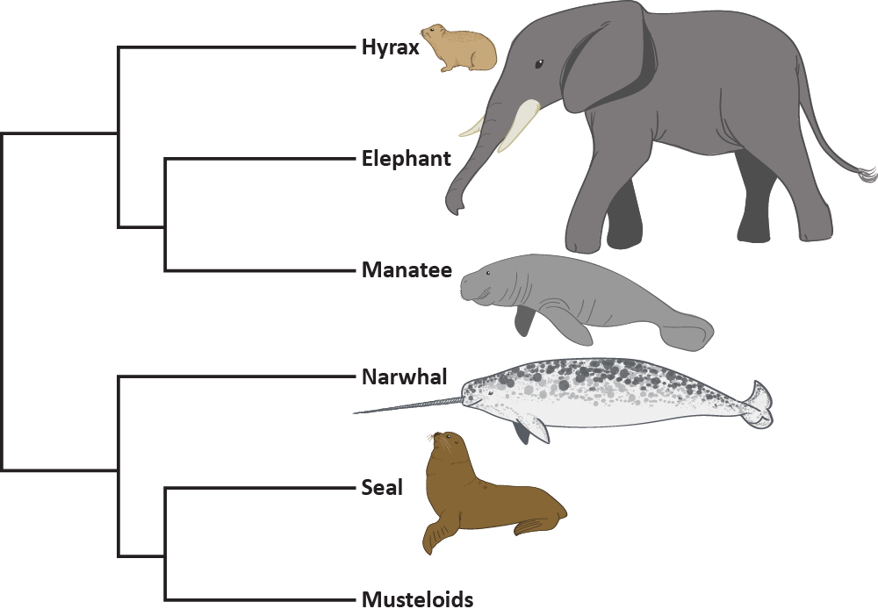
Phylogenetic Tree
Node
Common ancestor to all
A monophyletic group
Its sister species
Its outgroup
Notes:
Animation Notes
Due to the layers, this slide is not usable without displaying it with animations. The effects are complicated and easy to disrupt, so it is recommended that you do not modify any effects.
For E. the monophyletic group is circled, and the outgroup is indicated by the arrow.
Teacher’s Note:
If students lack sufficient prior knowledge about phylogenetic trees, this is an ideal place to take some time to address the elements of phylogenies and how they are used for analysis. Lean on student knowledge as much as possible. Ask them to identify and explain the information before resorting to direct lecture.
In this example, a different tree is used to give students more opportunities to apply their understanding. Additional examples of each element are identified as animated answers. The tree provided here is an unlabeled version of the manatee tree provided later in the lesson. You may also use students’ trees as an example for them to practice with.

Slide 24
Conserved Sequences
The amino acid sequence of the Hemoglobin-alpha protein is “highly conserved.”
Highly conserved sequences are found in most complex organisms, even if the sequence changes slightly.
Why do you think scientists usually prefer highly conserved proteins rather than just any protein?
Notes:
Provide students with some background knowledge of conserved sequences (HBA) and why scientists might prefer them over other molecular data for these analyses.

Slide 25
Roundabout Conversations, Part 1
How do we know which of our phylogenetic trees is most likely to be accurate?
What steps could we take to find more evidence to support the tree(s) we have constructed or to improve the accuracy of our tree(s)?
Notes:
Using the Roundabout Conversations strategy, have students answer the following questions one at a time through movement and discussion.
K20 Center. (n.d.). Roundabout Conversations. Strategies. https://learn.k20center.ou.edu/strategy/196

Slide 26
Roundabout Conversations, Part 2
Why is analyzing protein sequences a useful way to classify organisms or to determine organisms’ evolutionary relationships?
Is a tree made from molecular data (e.g., DNA or protein sequences) more or less reliable than one made from derived (i.e., morphological) characteristics? Why?
Notes:
From their conversations, students should conclude that there is value in using both morphological and molecular data, but molecular data is more reliable. Additionally, students should recognize that protein sequences are useful for classification since proteins are what give organisms their characteristics.
K20 Center. (n.d.). Roundabout Conversations. Strategies. https://learn.k20center.ou.edu/strategy/196

Slide 27
Next Steps
If you were scientists trying to improve or support your original manatee trees, what would your next step be?
Notes:
Remind students they have constructed a morphological tree for manatees' evolutionary relationships. To transition into the Extend section of the lesson, ask students what their next step would be.

Slide 28
Where are manatees in the tree of life?
Narwhal
Elephant
Manatee
Seal
Hyrax
Notes:
Ask students to return to manatees and the other four organisms from the Engage section of the lesson. For these five organisms, students should repeat the same processes from the Explore investigation to collect HBA sequences and construct a phylogenetic tree on the Student Slides.
Image sources:
Dean, J. (2018). Friendly harbor seal [Photo]. Unsplash. https://unsplash.com/photos/xNJGO5fyOsk
Dutton, J. (2019, September 28). Elephant [Photo]. Unsplash. https://images.unsplash.com/photo-1567968110429-ac9fbc3d6e25?ixlib=rb-1.2.1&q=80&fm=jpg&crop=entropy&cs=tinysrgb&w=1080&fit=max&ixid=eyJhcHBfaWQiOjEyMDd9
Hinkel, D., & U.S. Fish and Wildlife Service. (2012, July 24). Endangered Florida manatee [Photo]. Flickr. https://www.flickr.com/photos/usfwshq/7636816484/in/photostream/
Meyer, A. (n.d.). Narwhal [Illustration]. Shutterstock. https://www.shutterstock.com/image-illustration/narwhal-31848370
Randall, T. (n.d.). Hyrax [Photo]. K20 Center.

Slide 29
Copy and paste or redraw the cladogram you made using morphological characteristics.
Copy and paste or draw the phylogenetic tree you created using molecular proteins in UniProt.
Notes:
Once students have the HBA tree from UniProt, have them compare it with the cladogram they made in the Engage section using morphological characteristics. Students should identify similarities and differences between their predicted morphological cladogram and the molecular protein tree.

Slide 30
Morphological Cladogram
Published Tree
UniProt Tree
Notes:
Finally, provide students with the current manatee phylogenetic tree to compare it with the other two. The “Morphology Cladogram” and “UniProt Tree” boxes represent the content students have on their slide 25.

Slide 31
Discussion
What patterns did you notice among your three phylogenetic trees?
What did your group find interesting or surprising?
What patterns did you notice across all groups’ observations of their trees?
Notes:
Facilitate a group discussion addressing the following:
Individual groups will share out the similarities and differences they noticed among the three manatee phylogenetic trees and what they found interesting or surprising.
As a class, students will identify patterns across all groups' observations.

Slide 32
Different Trees
How is it possible for scientists to get different trees for the same organisms?
Notes:
Students will discuss the question: “How is it possible for scientists to get different trees for the same organisms (even when using the same protein as data)?”
Provide a summary of the major ideas. This should reinforce what students have just discussed, but it is also an opportunity to clarify alternative conceptions or fill gaps in students’ knowledge.

Slide 33
Where are manatees in the tree of life?
Which organisms are the closest sister species
to manatees?
Notes:
Based on these conversations, facilitate consensus-building for the class to determine manatees' closest living relative(s).

Slide 34
Phylogenetic Trees and Evolution
How does having different “mana-trees” contribute to our understanding of evolution broadly?
Notes:
Conclude the class discussion by asking students to explain why having different phylogenetic trees contributes to our understanding of evolution broadly.

Slide 35
Assess and Reflect
Identify manatees’ closest living relative(s).
Answer the following questions:
  What evidence did you use and how did you use it to determine manatees’ evolutionary relationships?
  Why do scientists use multiple lines of evidence to determine evolutionary relationships among organisms?
Include the morphological cladogram you drew
and the HBA molecular tree from UniProt.
Notes:
Each student should submit two completed phylogenetic trees: the morphological cladogram they created in the Engage section and the HBA molecular tree created in the Extend section. If the class consensus tree differs from these, ask students to explicitly identify the manatee's closest living relative(s).
In addition to submitting their trees, students should include explanations about:
what evidence they used and how they used it to determine the manatee's evolutionary relationships.
why scientists use multiple lines of evidence to determine evolutionary relationships among organisms.
Explanations might be written, oral, or completed as formal class presentations as is appropriate for a given group of students.

