Slide 2
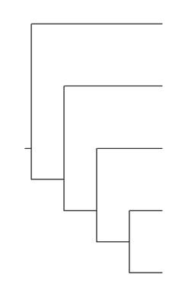
Cladogram
On the blank cladogram, circle and label the following:
Node
Common ancestor to all
A monophyletic group
Its sister species
Its outgroup

Slide 3
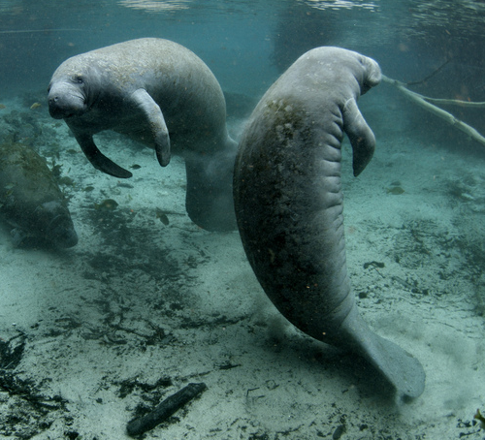
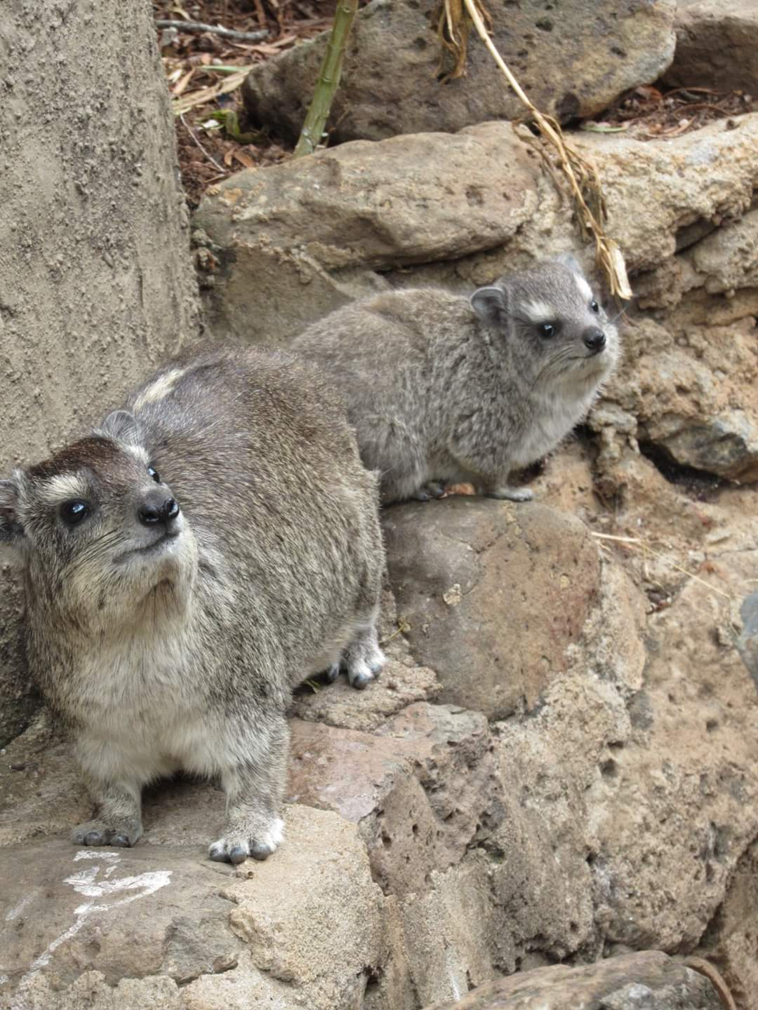
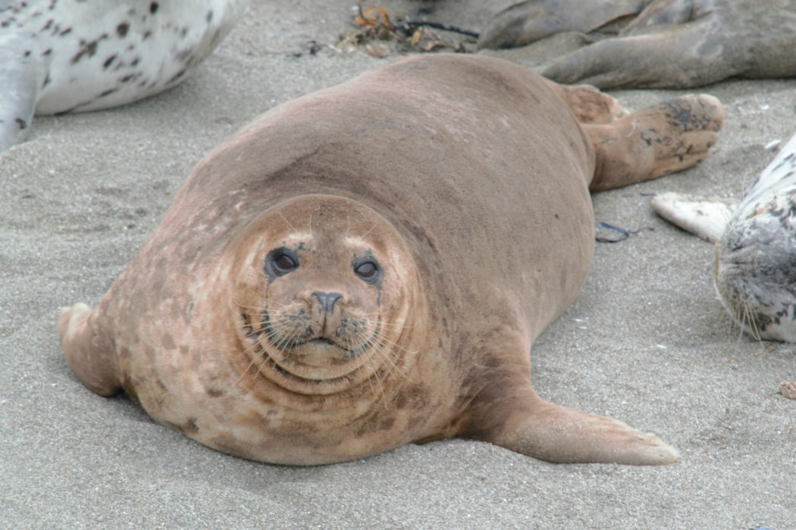
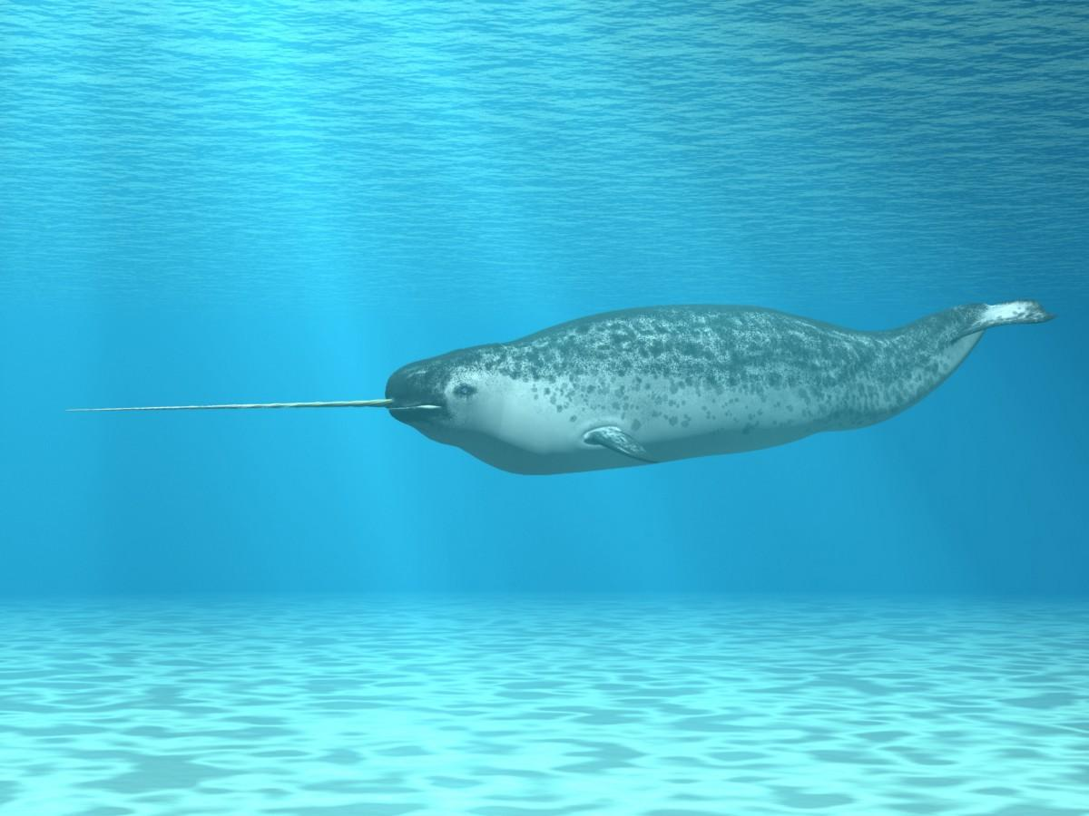
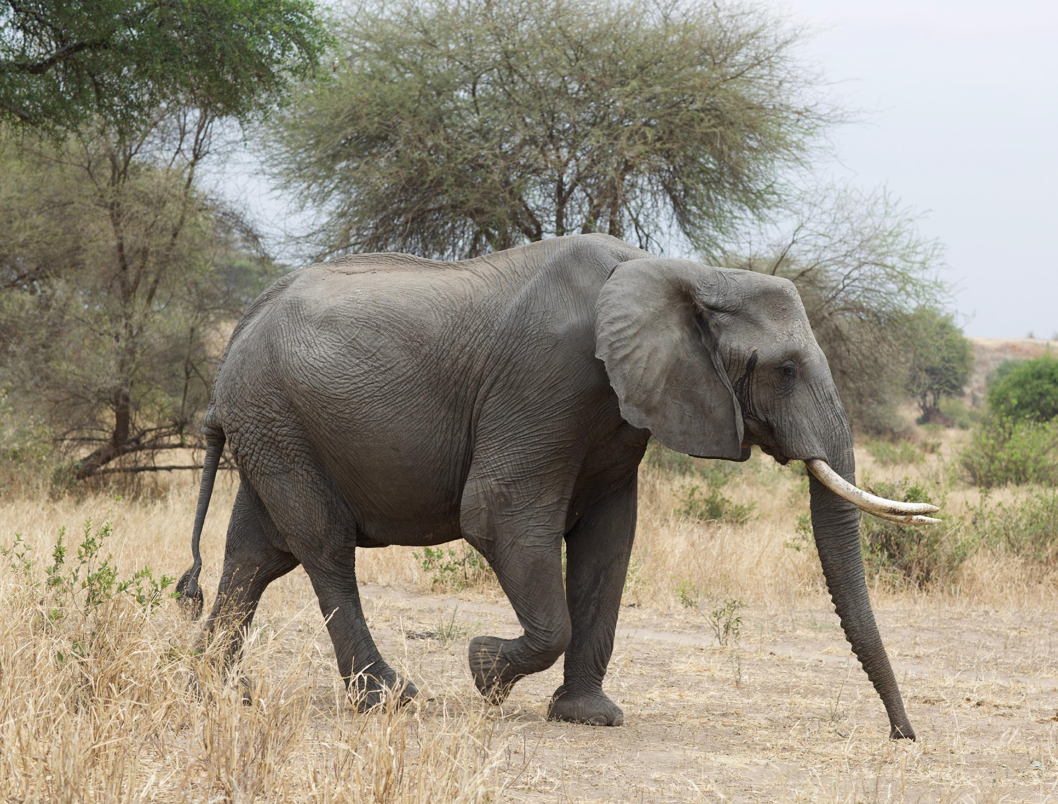
Draw a simple cladogram predicting how these five organisms are related.
Manatee
Seal
Hyrax
Elephant
Narwhal
Notes:
Create your own cladogram based on what you know about these organisms. Remember, you must be able to defend with evidence why you placed each organism where you did.
Image sources:
Dean, J. (2018). Friendly harbor seal [Photo]. Unsplash. https://unsplash.com/photos/xNJGO5fyOsk
Dutton, J. (2019, September 28). Elephant [Photo]. Unsplash. https://images.unsplash.com/photo-1567968110429-ac9fbc3d6e25?ixlib=rb-1.2.1&q=80&fm=jpg&crop=entropy&cs=tinysrgb&w=1080&fit=max&ixid=eyJhcHBfaWQiOjEyMDd9
Hinkel, D., & U.S. Fish and Wildlife Service. (2012, July 24). Endangered Florida manatee [Photo]. Flickr. https://www.flickr.com/photos/usfwshq/7636816484/in/photostream/
Meyer, A. (n.d.). Narwhal [Illustration]. Shutterstock. https://www.shutterstock.com/image-illustration/narwhal-31848370
Randall, T. (n.d.). Hyrax [Photo]. K20 Center.

Slide 4
Choose Your Own Organisms
UniProt Investigation #1

Slide 5
UniProt Investigation: Setup
Open the following websites in their own tabs or separate windows:
  Uniprot.org
  Uniprot.org/align
  Google Slides presentation
Share the Google Slides presentation with your group.

Slide 6
UniProt Investigation
As a group, choose five organisms you want to compare and fill in your blank data table on slide 9.
All five of your organisms must be in the same class.
  Example: If you pick the “green tree frog” as one of your organisms, the other four also must be amphibians.

Slide 7
Part 1: Collecting Sequences
You will need to switch back and forth between slide 8 and slide 9 to complete this part.

Slide 8

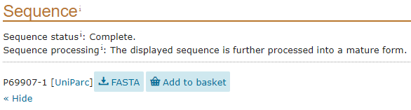

Part 1 Procedure: Collecting Sequences
1. | On Uniprot.org, type the following in the search box: [Organism] hemoglobin alpha
2. | Find the entry that matches the organism and “hemoglobin subunit alpha.”
3. | Click the “Entry” code shown in blue text.
4. | Scroll down until you find the “Sequence” section.
5. | Click the “FASTA” button.
6. | Copy and paste the code exactly as written into the table on the next slide.

Slide 9
Part 1: UniProt Sequences
Organism | Copy and paste your FASTA sequence here:
Notes:
Do not make any changes to a sequence once it’s pasted!

Slide 10
Part 1: Predict Your Tree
Draw a simple cladogram that shows how you think your five organisms are related.

Slide 11
Part 2: Comparing Sequences
You will need to switch among slide 9, slide 13, and slide 14 to complete this part.

Slide 12
Part 2: Preparation
For this portion, you mostly will use the following two tabs:
  Uniprot.org/align
  These presentation slides
You will need to compare each of your organisms to each other. Divide up the work as you see fit to ensure your group’s collaboration and efficient use of time.
For each organism pair, copy and paste their amino acid sequences into the Align comparison box on Uniprot.org/align.
  **Make sure you press ENTER after the first sequence to start a new line.**

Slide 13
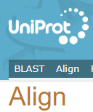
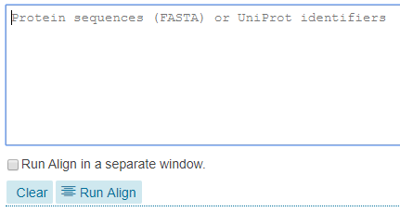
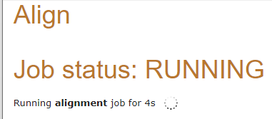
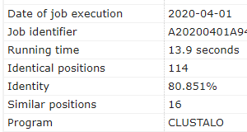
Part 2 Procedure: Comparing Sequences
1. | On Uniprot.org, click “Align” on the top toolbar.
2. | Copy one FASTA code from your sequence slide and paste it in the “Protein Sequence” box.
3. | Hit your enter key and paste a second FASTA code on the next line.
4. | Click the “Run Align” button and wait. You should see this message while you wait.
 | You should see this message while you wait.
5. | Once the alignment finishes, scroll down to the “Result information” section.
6. | Copy the percentage in the “Identity” box at the bottom of the menu and paste it in your sequence alignment table.

Slide 14
Part 2: Sequence Similarity Data
Notes:
Record the % similarity data in your table at the intersection of your two organisms. Look at the sample data table on the Lesson Slides for an example of where to type.
You and your partner/group will need to gather a total of 15 different comparisons to complete your data table.

Slide 15
Part 3: Analyzing Sequences
You will need to switch back and forth between slide 9 and slide 18 to complete this part.

Slide 16
Part 3: Predict Your Tree Now
Use your % similarity data to draw a new phylogenetic tree that shows the relationships among your five organisms.

Slide 17
Part 3: Analysis of Sequences
Using the evidence you’ve collected about your organisms, answer the following to the best of your ability:
Which two organisms seem to be most closely related? Justify your answer with evidence from your table.
  These two species would be considered ________.
Which organism seems to be the least related to all other organisms? Justify with evidence from your table.
  This organism would be considered the ______.

Slide 18
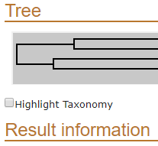
Part 3 Procedure: Analyzing Sequences
1. | On Uniprot.org, click “Align” on the top toolbar.
2. | Copy one FASTA code from your sequence slide and paste it in the “Protein Sequence” box.
3. | Hit your enter key and paste a second FASTA code on the next line. Continue until all five codes are entered.
4. | Click the “Run Align” button and wait. You should see this message while you wait.
 | You should see this message while you wait.
5. | Once the alignment finishes, scroll down to the “Tree” section. It will be right before the “Result information” section.
6. | The full tree is very long. Either take a screenshot of it to paste on the next slide or redraw a smaller version.
Notes:
The first four steps are similar to the instructions you saw in Part 2.

Slide 19
Part 3: Compare Your Trees
Copy and paste your % similarity
tree from slide 16 here:
Paste a screenshot of the tree you created in UniProt here:

Slide 20
Evolutionary Relationships of the Manatee
UniProt Investigation #2

Slide 21
Investigation 2: UniProt Sequences
Organism | Copy and paste your FASTA sequence here:
Manatee
Narwhal
Elephant
Hyrax
Seal
Notes:
Change the name of the organism to the specific species your data came from (e.g., “Harbor Seal”).
Do not make any changes to a sequence once it’s pasted!

Slide 22
Investigation 2: Comparing Sequences
1. | On Uniprot.org, click “Align” on the top toolbar.
2. | Copy one FASTA code from your sequence slide and paste it in the “Protein Sequence” box.
3. | Hit your enter key and paste a second FASTA code on the next line.
4. | Click the “Run Align” button and wait. You should see this message while you wait.
 | You should see this message while you wait.
5. | Once the alignment finishes, scroll down to the “Result information” section.
6. | Copy the percentage in the “Identity” box at the bottom of the menu and paste it in your sequence alignment table.

Slide 23
Investigation 2: Sequence Similarity Data
 | Manatee | Narwhal | Elephant | Hyrax | Seal
Manatee
Narwhal
Elephant
Hyrax
Seal
Notes:
Record the % similarity data in your table at the intersection of your two organisms. Look at the sample data table on the Lesson Slides for an example of where to type.
You and your partner/group will need to gather a total of 15 different comparisons to complete your data table.

Slide 24
Investigation 2: Analyzing Sequences
1. | On Uniprot.org, click “Align” on the top toolbar.
2. | Copy one FASTA code from your sequence slide and paste it in the “Protein Sequence” box.
3. | Hit your enter key and paste a second FASTA code on the next line. Continue until all five codes are entered.
4. | Click the “Run Align” button and wait. You should see this message while you wait.
 | You should see this message while you wait.
5. | Once the alignment finishes, scroll down to the “Tree” section. It will be right before the “Result information” section.
6. | The full tree is very long. Either take a screenshot of it to paste on the next slide or redraw a smaller version.
Notes:
The first four steps are similar to the instructions you saw in Part 2.

Slide 25
Copy and paste or redraw the cladogram you made on slide 3 using morphological characteristics:
Copy and paste or draw the phylogenetic tree you created using molecular proteins in UniProt:

