Slide 1
Getting Yourself Out There
Middle School Science

Slide 2
Learning Objectives
Use evidence to explain how the environment affects organisms.
Defend the usefulness of a bioengineering design based on data and scientific ideas.
Notes:
(OAS-S, 7th Grade) MS-LS1-5: Construct a scientific explanation based on evidence for how environmental and genetic factors influence the growth of organisms.
(NGSS) MS-ETS1-2: Evaluate competing design solutions using a systematic process to determine how well they meet the criteria and constraints of the problem.

Slide 3
I Notice, I Wonder
What do you notice about the video?
What do you wonder about it?
Notes:
Image Source: NGSS Phenomena. (2019). Phenomena for NGSS: Creating the next generation of student engagement. https://www.ngssphenomena.com/#/exploding-seeds/

Slide 4
I Notice, I Wonder
Which question should we investigate further?
Notes:
Image Source: NGSS Phenomena. (2019). Phenomena for NGSS: Creating the next generation of student engagement. https://www.ngssphenomena.com/#/exploding-seeds/

Slide 5
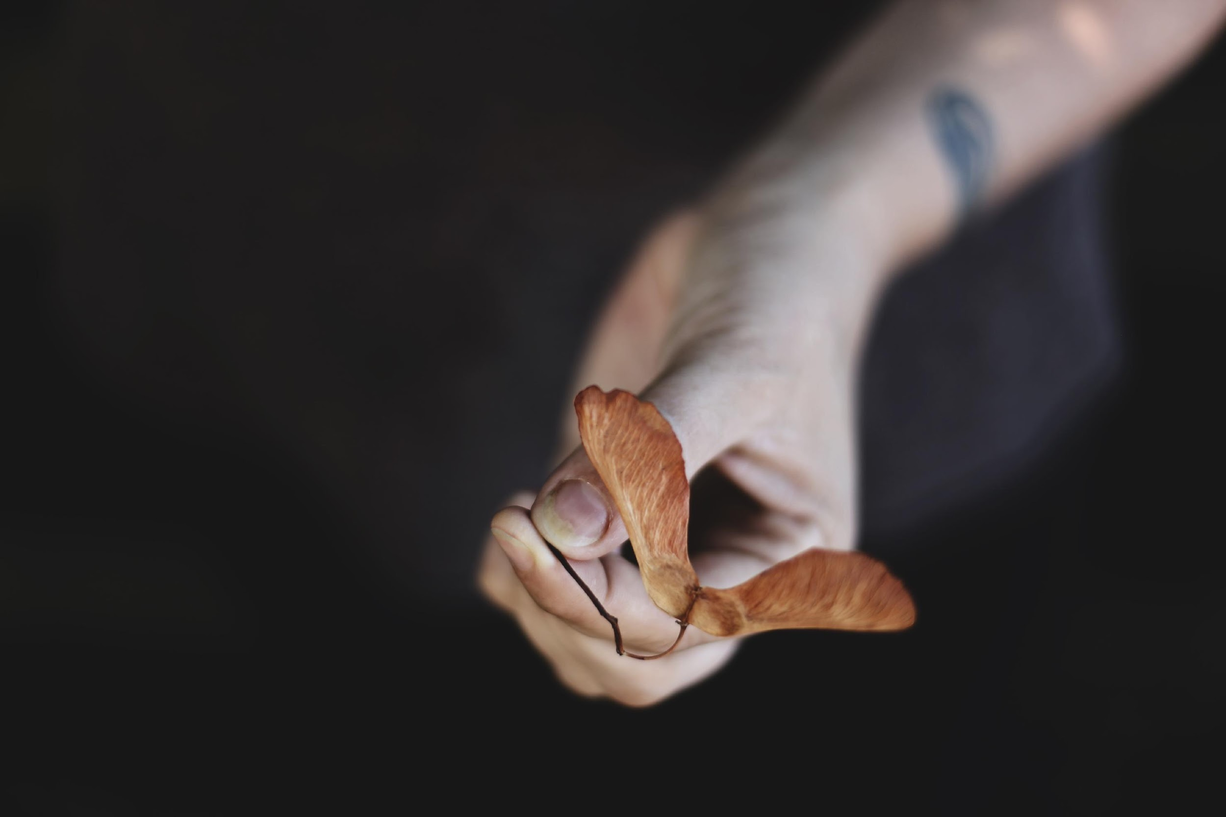
How Do Plants Reproduce?
Research the plant you were given to figure out:
Its basic characteristics.
How it reproduces.
How it passes on its genetic information.
The purpose for its external structures.
Answers to your research question.
Notes:
Image Sources:
Tang, J. (2019, April 2). Strawberry plants [Image]. Unsplash. https://unsplash.com/photos/eY2xn59BSyM
McCutcheon, S. (2018, April 27). Dandilion [Image]. Unsplash. https://unsplash.com/photos/Q1kLdAAoWTw
LeGette, M. (2019, Nov. 10). Beets and carrots [Image]. Unsplash. https://unsplash.com/photos/Xgcq-t-hCt4

Slide 6
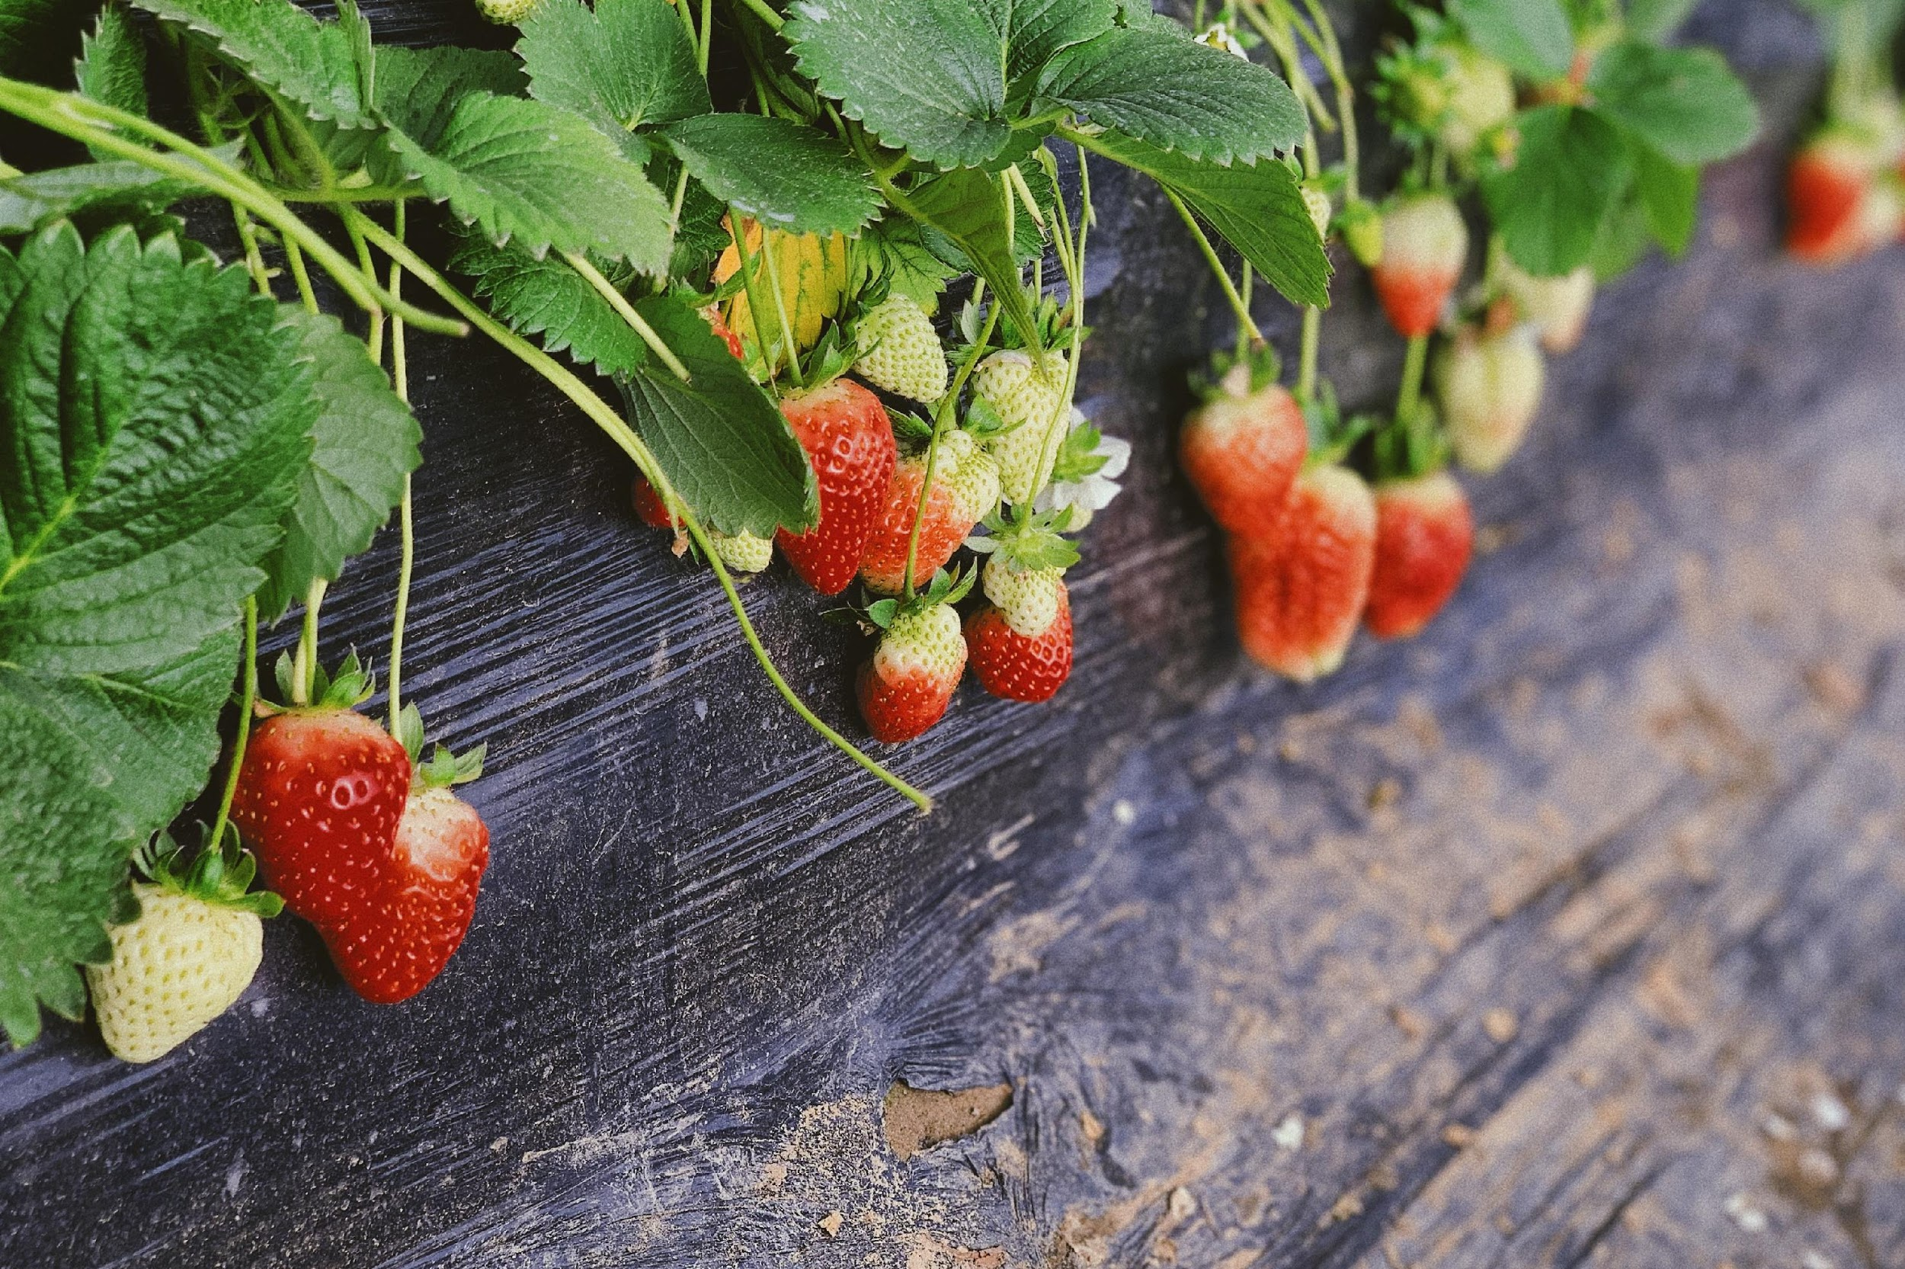
How Do Plants Reproduce?
Prepare a visual presentation to share the information that you learned about your plant.
Notes:
Feel free to customize this slide with specific guidance regarding the presentation parameters.

Slide 7
Research Discussion
What are the answers to our research questions?
Notes:
Feel free to move this slide as necessary.
Depending on the nature of the class research questions, where you choose to discuss them is flexible. It might make sense to discuss them immediately after student presentations, during the Explain section as relevant details are discovered, or near the end of the Explain section before students complete the summary activity.

Slide 8
Discussion: How Do Plants Reproduce?
Get into new groups but remember who is in your original group. You will return to it later.

Slide 9
Passing on Genetic Information
How does your plant pass on its genetic information?
How does your plant disperse seeds?
If your plant doesn't disperse seeds, how does it reproduce?

Slide 10
Patterns of Seed Dispersal
Compare asexually and sexually reproducing plants.
What patterns do you notice in how each disperses seeds?
Why might those patterns exist?

Slide 11
How Do Plants Reproduce?
Why would plants need to disperse their seeds?
What are the costs and benefits of dispersing seeds…
Near the parent plant?
Far away from the parent?

Slide 12
Strike Out!
Identifying important ideas:
Go back to your original research groups.
Write down as many important science-related ideas as you can think of that you’ve learned during your research and discussions.

Slide 13
Strike Out!
Pass your list to the next group.
Cross out one idea from the list that you think is the least important.

Slide 14
Strike Out!
You should have your original list back.
Add one idea back to your list that was crossed out.
If ideas go together, group them to make a bigger idea.

Slide 15
Strike Out!
Share your list with the class.
Can we combine any ideas?
Are these all big ideas?
Did we miss anything?

Slide 16
How Do Specialized Structures Affect a Plant’s Likelihood of Successful Reproduction?
Work with a partner to create a model plant or plant part designed to disperse seeds.
Create your plant based on what you’ve learned about actual plant structures and seed dispersal.
You will design, build, test, and refine your model plant.
Don’t start building until you get your design approved!

Slide 17
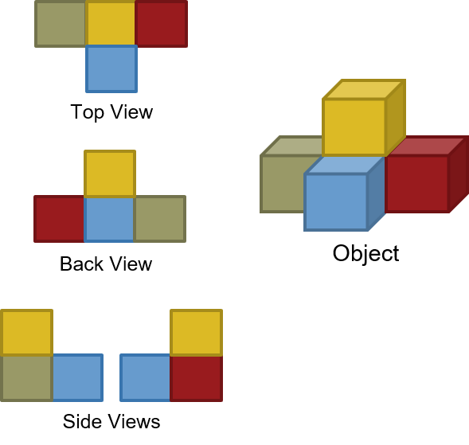
Step 1: Creating a Prototype
Create a visual model of your design.
Draw a technical diagram that shows all sides of your plant model (top, side, bottom, etc.).
Label all the parts on each view.

Slide 18
Step 1: Creating a Prototype
Write a claim about the purpose of your plant’s structures and why it will be effective.
Use the important science ideas you’ve learned to support your claim.

Slide 19
Step 2: Building and Testing
Once your design is approved, use the materials provided to build your seed dispersal device.

Slide 20
Step 2: Building and Testing
What data should we collect to figure out how effective our models are?
Hint: If these were real plants, what would you observe to determine their success?

Slide 21
Step 2: Building and Testing
Try out your seed dispersal device.
Collect data (measure and record) to determine how well it works.

Slide 22
Step 3: Evaluating the Design
Evaluate your design using your data as evidence.
What are the strengths of your design?
What are the weaknesses of your design?
Why do you think it was effective/ineffective at dispersing seeds?

Slide 23
Step 3: Evaluating the Design
Your pair’s design
Notes:
Each pair should begin by adding their own design to the bracket. They can use a nickname for the design, a short description, their names, etc.

Slide 24
Step 3: Evaluating the Design
Your pair’s design
Pair with more effective design
The other pair’s design

Slide 25
Step 3: Evaluating the Design
Your pair’s design
Pair with more effective design
The other pair’s design
Group of 4 with more effective design
Information from the other group of 4

Slide 26
Step 3: Evaluating the Design
How do the different designs compare?

Slide 27
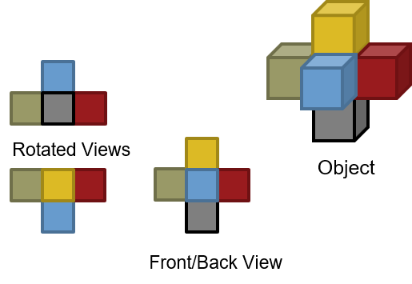
Step 4: Revising Models
Think about your data and all the conversations you’ve had.
Revise your original model.
Revise

Slide 28
Step 4: Revising Models
Revise your original claim to describe the purpose of your plant’s new structure and why it will be effective.
Use your data, reflections, and the important science ideas you’ve learned to support your claim.
Notes:
REVISING MODELS
Using evidence from their tests, their design evaluation, and the group discussion of all devices, each pair should revise their claim.

Slide 29
Artificial Seed Dispersal Pitch
A company is developing artificial plants to support reproduction of endangered species. The company wants to mimic actual seed dispersal and has asked for design ideas for structures with potential for use in this work.
You have identified two possible structures, the exploding seed pod you saw earlier and the device you designed in class. Create a sales pitch for the company to argue the merits of each.

Slide 30
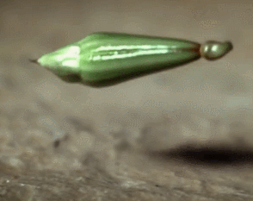
Artificial Seed Dispersal Pitch
Notes:
If needed, provide class-specific pitch format and presentation guidelines on this slide.

