Slide 2
Clear as Phytoplankton: A Tale of Four Lakes
Nutrients, Genetics, and Plant Growth

Slide 3
Essential Questions
How do genetic and environmental factors influence the growth of phytoplankton?
How does phytoplankton growth affect water clarity?

Slide 4
Lesson Objectives
Construct a scientific explanation based on evidence for how environmental and genetic factors influence the growth of organisms.
Use a model to explain the relationship between the growth of organisms and their environment.

Slide 5
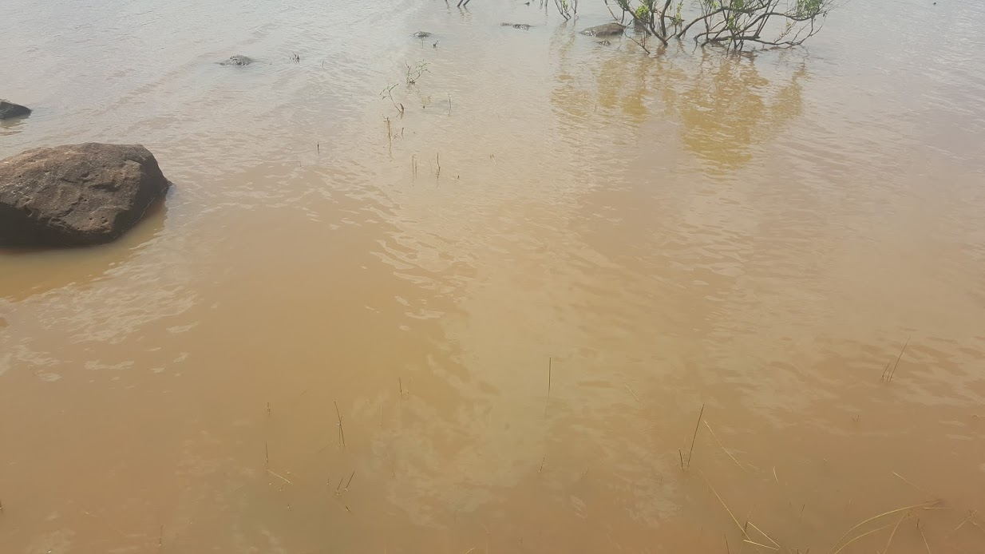
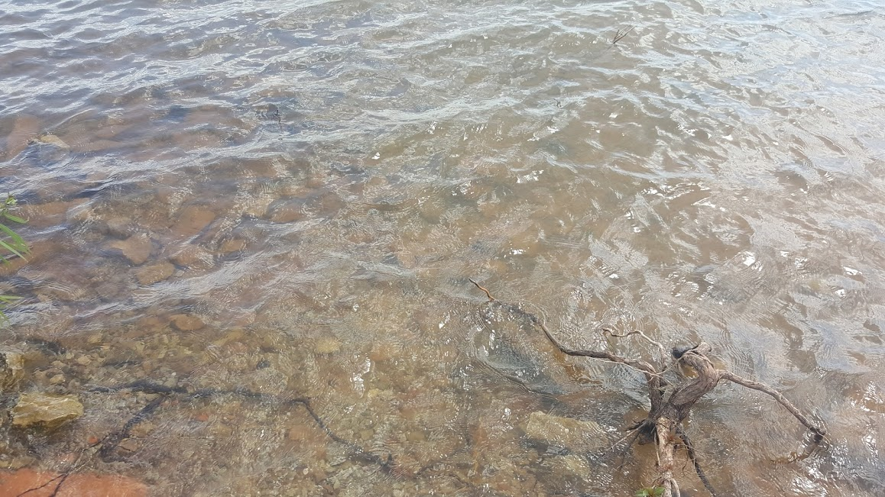
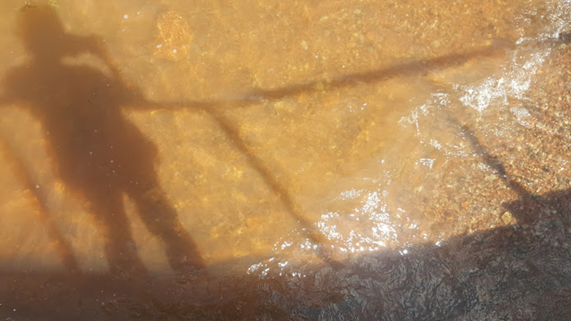
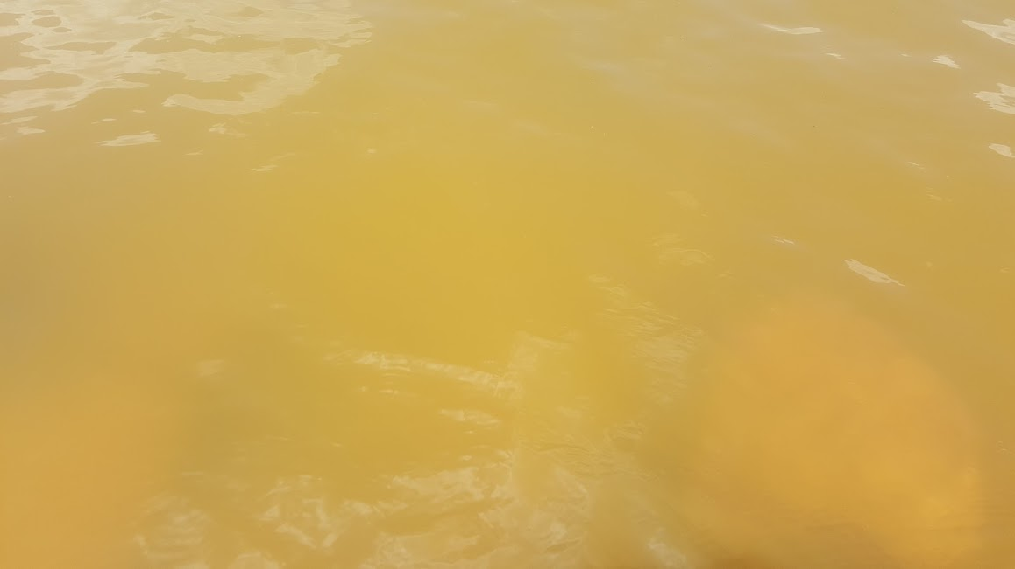
Tecumseh Lake
Shawnee Twin Lake #1
Lake Stanley Draper
Lake Thunderbird

Slide 6
Tecumseh Lake Tecumseh, OK
Notes:
K20 Center. (n.d.). I Notice, I Wonder. Strategies. https://learn.k20center.ou.edu/strategy/180

Slide 7
Shawnee Twin Lake #1 Shawnee, OK
Notes:
K20 Center. (n.d.). I Notice, I Wonder. Strategies. https://learn.k20center.ou.edu/strategy/180

Slide 8
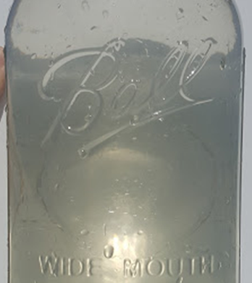
Lake Stanley Draper Oklahoma City, OK
Notes:
K20 Center. (n.d.). I Notice, I Wonder. Strategies. https://learn.k20center.ou.edu/strategy/180

Slide 9
Lake Thunderbird Norman, OK
Notes:
K20 Center. (n.d.). I Notice, I Wonder. Strategies. https://learn.k20center.ou.edu/strategy/180

Slide 10
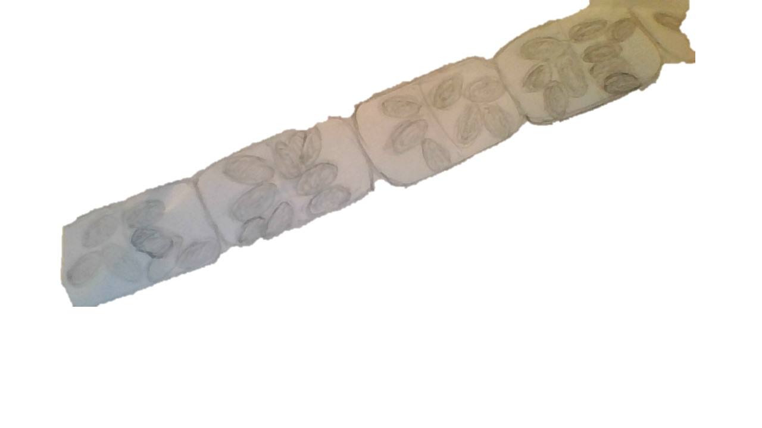
Lake Thunderbird June 3, 2016
40x
Notes:
Chlorophyll-a concentration 21 mg/m3
Secchi Depth 52 cm (Average)
Ave. Turbidity 14 NTU
Trophic State Index 61 (Hypereutrophic)

Slide 11
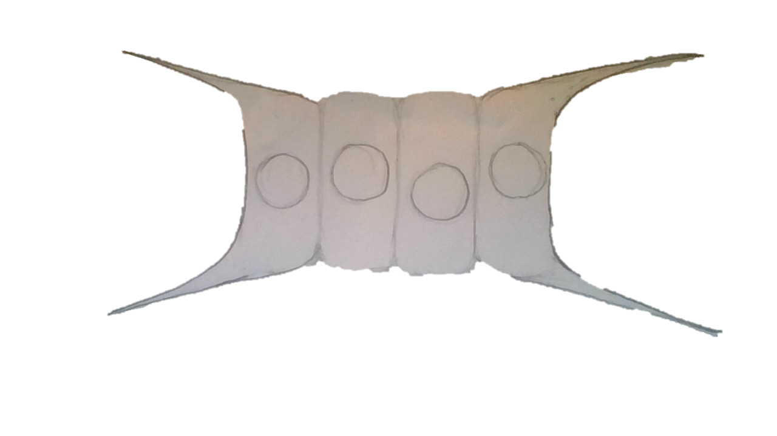
Lake Stanley Draper June 3, 2016
40x
Notes:
Chlorophyll-a concentration 2.7 mg/m3
Secchi Depth 104 cm (Excellent)
Ave. Turbidity 8 NTU
Trophic State Index 40 (Oligotrophic)

Slide 12
Shawnee Twin Lake #1 June 3, 2016
40x
Notes:
Chlorophyll-a concentration 8.93 mg/m3
Secchi Depth 74.2 cm (Good)
Ave. Turbidity 12 NTU
Trophic State Index 52 (Eutrophic)

Slide 13
Tecumseh Lake June 3, 2016
40x
Notes:
Chlorophyll-a concentration 5.5 mg/m3 (back calculated from Trophic State Index)
Secchi Depth 11 cm (Poor) [high sediment load]
Ave. Turbidity 132 NTU
Trophic State Index 49 (Mesotrophic)

Slide 14
Phytoplankton are...
... also called algae.
... tiny plants that live in water.
... too small for us to see as individual cells without using a microscope.
The collection of different species in each lake is called its phytoplankton community.

Slide 15
Water Clarity
When there are lots of phytoplankton, you can tell because the water clarity changes.
Water clarity is how far you can see through the water. This depends on how many particles are suspended in the water.

Slide 16
What helps plants grow?
Notes:
You may use this slide to record student ideas or as a placeholder for the question.

Slide 17
Phytoplankton Growth Model
Draw a model that explains what causes the differences in water clarity in the four lakes.
Use any information we’ve discussed so far.
It’s okay if you aren’t sure! Just do the best you can right now.

Slide 18
Phytoplankton Growth Investigation
How can we test the factors we think affect phytoplankton growth?

Slide 19
Investigating Phytoplankton Growth
Notes:
Edit this slide to include your class-specific instructions for grouping and investigation procedures.

Slide 20
Phytoplankton Communities
Compare your phytoplankton cards with the microscopic views of each lake.
Count the number of each type of phytoplankton found in each lake.

Slide 21
Phytoplankton Communities
Pick one of the genetic factors listed in the table on each card.
Sort the cards into at least two different groups based on the factor you picked. Record your results.
Pick a different factor and re-sort your cards. Again, record your results.
Repeat with a third factor. Record your results.

Slide 22
Phytoplankton Functional Groups
Compare your sorted lists with the groups of phytoplankton you counted in each lake.
What patterns do you notice?
What do these patterns mean?
In what kinds of environments would we find different functional groups?

Slide 23
Revised Phytoplankton Growth Model
Revise the model you drew at the beginning to better explain what causes the differences in water clarity in the four lakes.
Add new information you didn’t have before.
Correct anything you understand better now.

Slide 24
Phytoplankton Growth Investigation
What do our data tell us about the factors that affect phytoplankton growth?

Slide 25
Factor Expert Panels
Notes:
Edit this slide to include your class-specific instructions for:
Grouping students
Analyzing and graphing data
Making claims (about the investigation and phytoplankton functional groups)

Slide 26
Concept Card Mapping
Notes:
Edit this slide to include your class-specific instructions for creating the Concept Card Map.
K20 Center. (n.d.). Concept Card Mapping. Strategies. https://learn.k20center.ou.edu/strategy/123

Slide 27
Revised Phytoplankton Growth Model
Again, revise your model to better explain what causes the differences in water clarity in the four lakes.
Add new information you didn’t have before.
Correct anything you understand better now.

Slide 28
Four Lakes’ Data Reports
Make a prediction about the conditions in each of the four lakes.
Use the Venn diagram to compare the factors you included in your model with the scientific data in the four reports.
How well do your model and predictions match the scientific data?

Slide 29
Explaining Lake Water Clarity
Pick any lake except Tecumseh Lake.
Use your model to explain which factors affect phytoplankton growth.
Then, explain how phytoplankton affect the water clarity of your lake.

